Slide 1
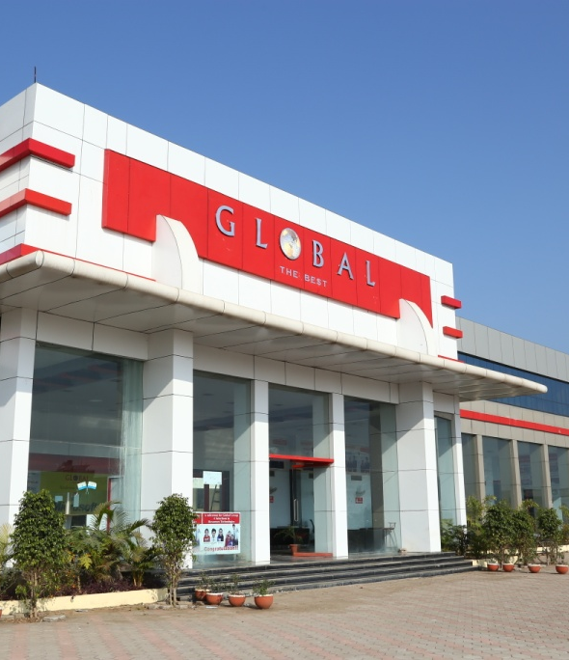
Global Nature Care Sangathan’s Group of Institutions
SMART INDIA
HACKATHON
Notes:
Line spacing + Page numbers

Slide 2

SIH 2022
Technology Bucket: Software-Mobile App Development
Category: Software
Company Name/Ministry Name: National Institute of Ocean Technology (NIOT),
Ministry of Earth Sciences (MoES)
Problem Code: GR922
Team Members: Dipanshu Mishra ( CSE 6th SEM )
Anmol Sahu ( CSE 6th SEM )
Akash Kanojiya ( CSE 6th SEM )
Isha Shrivastava ( CSE 4th SEM )
Radhika Tiwari ( CSE 4th SEM )
Amal Dubey ( CSE 4th SEM )

Slide 3
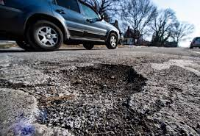
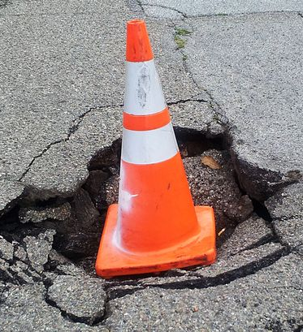
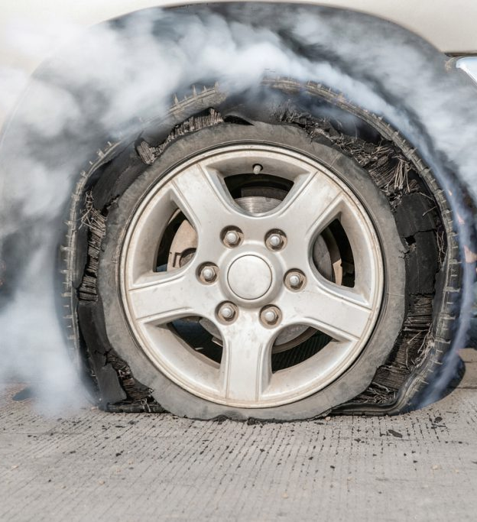
Problem Statement:
01
Uploading and updating the database of pothole on road on Maps to help people driving their vehicle when the roads are flooded.

Slide 4
Potholes are usually caused by the presence of heavy traffic and water on roads. Several studies conducted in cities such as Chandigarh and Mumbai point to the lack of a proper drainage system and weak proportioning of aggregates for road construction as major reasons for pothole.
PROBLEMS DUE TO POTHOLES:
Pothole Kills: It’s somewhat uncertain if potholes may necessarily cause death. But unfortunately, potholes are capable of causing serious to fatal accidents. Let me recount an event that happened while I was travelling on the Golf Course Extension Road, Gurgaon. The road has numerous amount of craters. A person driving over 60kmph hit the brake hard, upon seeing a crater. This led to a chain accident. All 3 of the cars involved were badly damaged all thanks to a dreaded pothole.

Slide 5
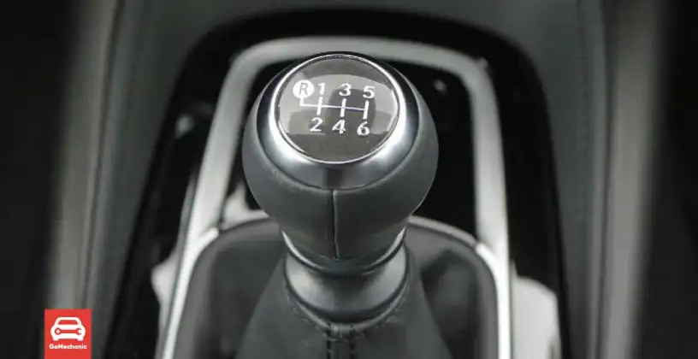
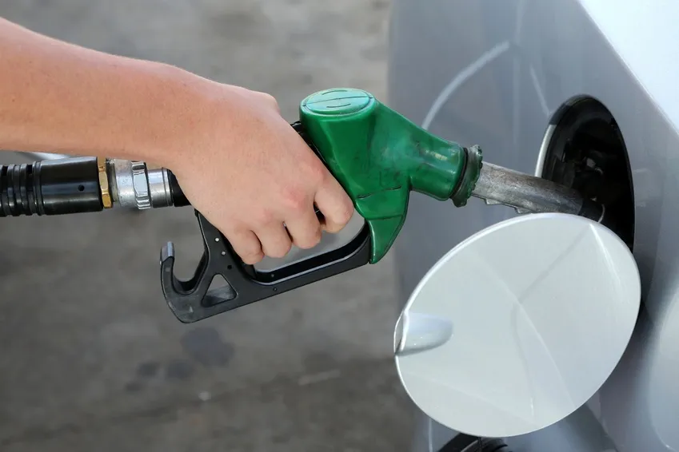
Efficiency: The Manual Transmission. Yes, potholes can make your car less efficient. We’ll explain this in a very simple way. Potholes cause traffic to move slowly. Because of this, people shift down to lower gears. Since people are driving slowly a lot of fuel becomes consumed. Again, this would not have happened if it weren’t for the potholes.

Slide 6
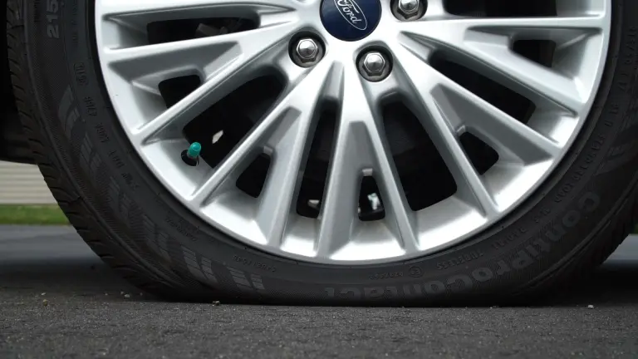
Tyres: The damage caused by driving through potholes begins at the tyres. While driving, the tyres get crushed between the road surface and the wheels of the vehicle. Because of this, the tyre experiences forces that are violent and concentrated. As a result, when your car hits a pothole, the tyre may get punctured. The sidewall of the tyre may slice, rendering the tyre irreparable. Sometimes because of all this, the internal belts that form the structure of the tyre could become torn.

Slide 7
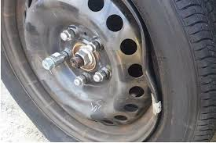
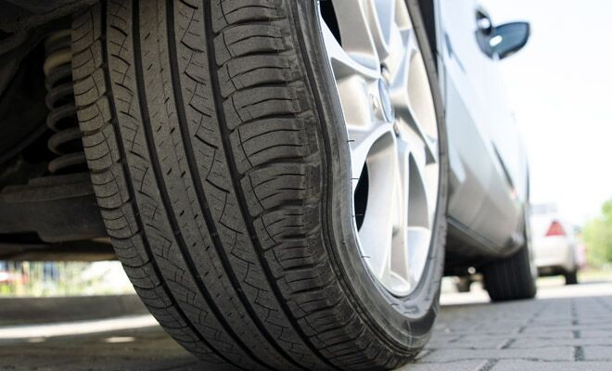
Suspension: Car suspension is designed to absorb shocks and ensure a smooth ride for the passengers. Sudden, jarring impact, because of the vehicle hitting a pothole can cause a variety of suspension problems. This includes misalignment, broken ball joints and damaged shocks or struts. A suspension that is no longer straightened can make you feel your steering being off-centred and your car pulling to one direction. The tyres may wear unevenly and this leaning of the vehicle to one side also indicates possibly broken ball joints, struts, or shockers.

Slide 8
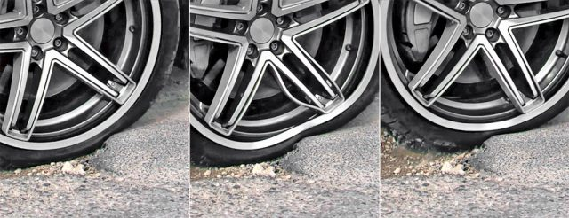
Wheels/Rims: After the tyres, the wheels take the most hit when you drive through bad roads. Possible rim damages range from bent lips, fractures/cracks to being bent out of round or out of parallel. Some of these damages may not be apparent without spinning it in place on a hoist or mounted on a tire balancer. The wheel bearing experiences the shock of the impact at the same instant as the wheel.However, a direct bearing failure as a result of hitting a pothole is extremely unlikely. But, repetitive or severe impacts can crater or flake the chromed surfaces in which the bearing’s balls or rollers run on. This can lead to premature death, excessive play, or – quite commonly – noisy operation.

Slide 9
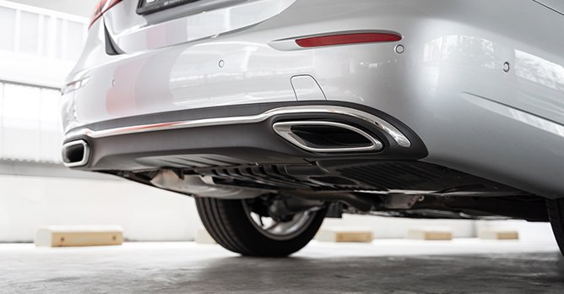
Exhaust : Exhaust pipes run along the underbody of the car. They are an easy target for the potholes lurking on the road. Deep potholes can damage the car bottom. Moreover, this can cause the car to drag and scrape the undercarriage against the road. This can potentially dent or rip a hole in the exhaust pipes, muffler or catalytic converter.If you experience weird exhaust noises or lack of power, your exhaust may have dents or holes. Cracked and perforated exhaust and catalytic converter can lead to unchecked pollutants being released into the air. Besides, a leaky pipe can get harmful fumes inside the cabin.

Slide 10

OUR IDEA:
Our idea is to create a mobile application through which the user can click pictures of the potholes on the road and upload it . Then , the data will be sent to the Administrative panel, from where the concerned authorities can fetch the data.
Also, the locations of the potholes will be visible to the user through geo-locaters for convenience in route selection.

Slide 11
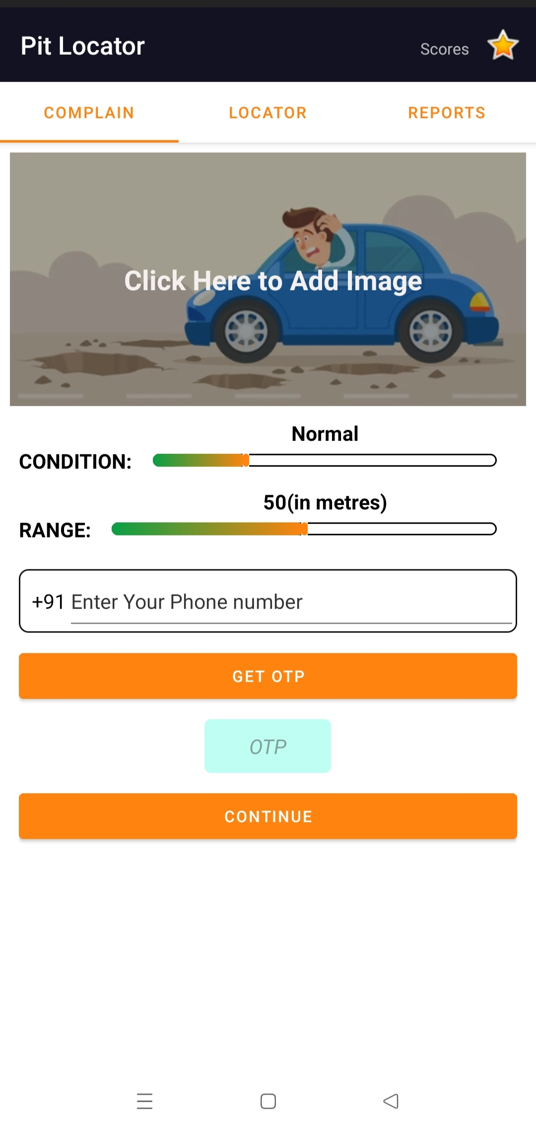
SCREENSHOT 1:

Slide 12
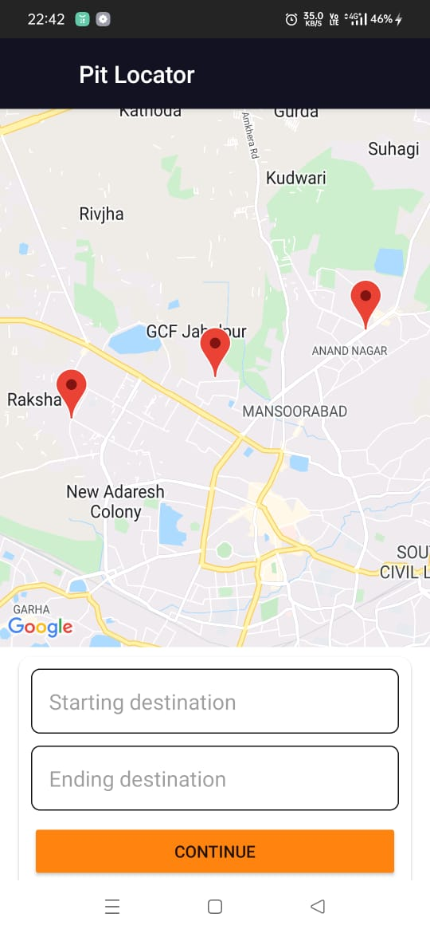
SCREENSHOT 2:

Slide 13
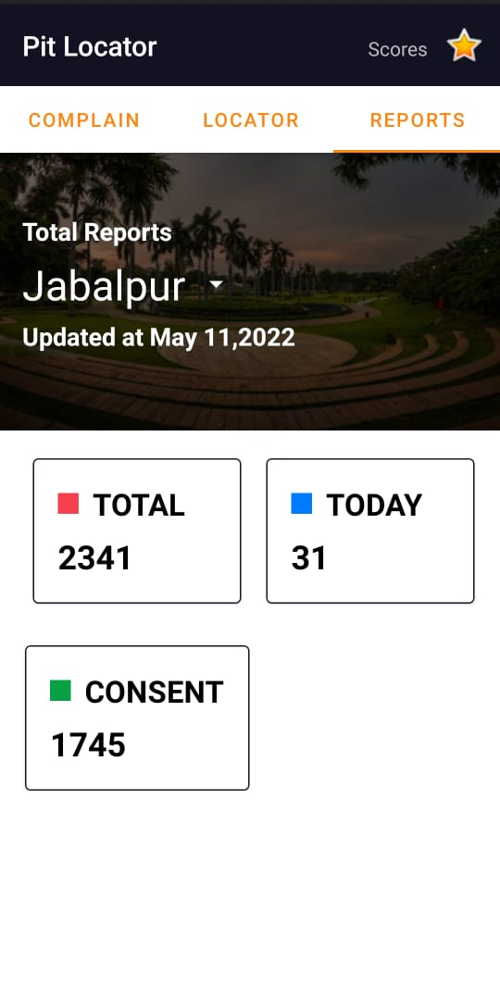
SCREENSHOT 3:

Slide 14
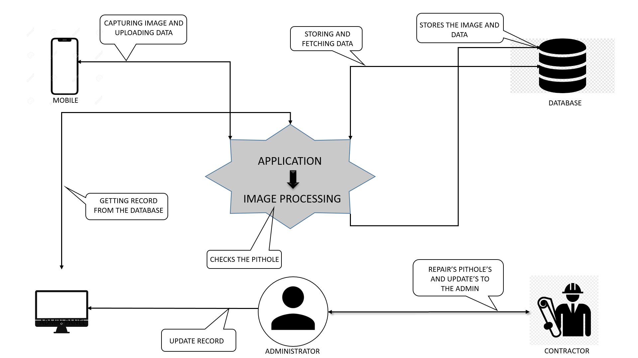
DIAGRAMATIC REPRESENATION:

Slide 15
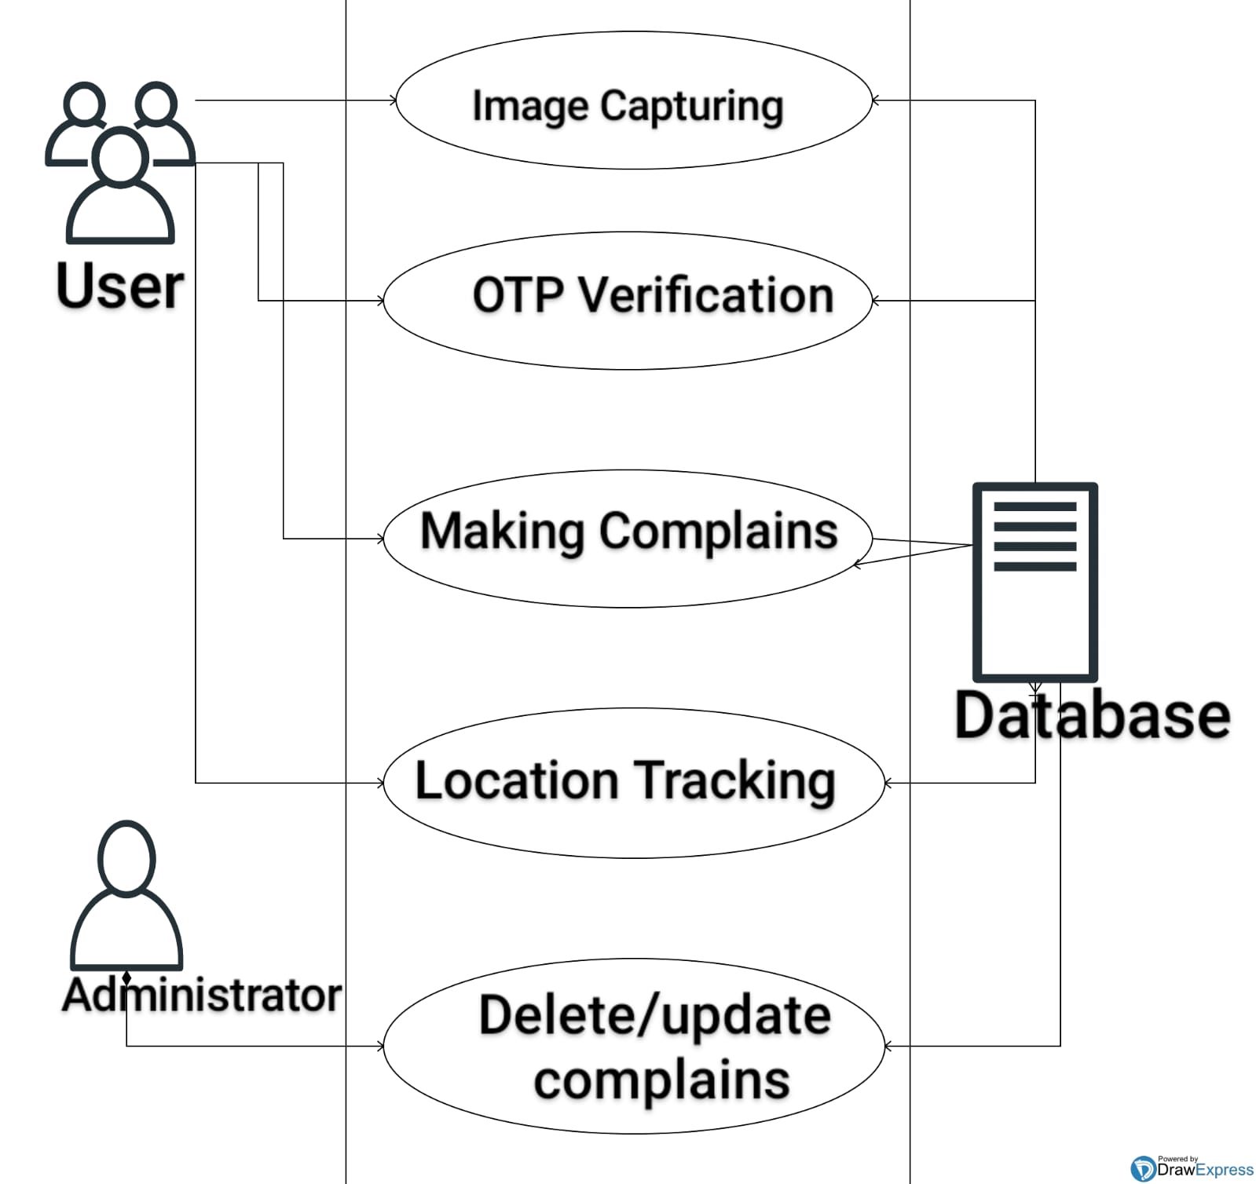
USE CASE DIAGRAM:

Slide 16
IN DETAIL: • Then our application will be launched for the users, through which users can Upload images of the affected areas of the road, and also register/write a complaint or issue, regarding the condition of the road and range of the pothole. • While uploading the images, our app will take care of the Geo-location of the images, with the help of Geo- Tagging. • Then, the images will be distributed to different city administrative officers.

Slide 17
• The additional feature in our app is that it will tell the user best possible route with pit location on map for their convenience. • There is a fragment in our app with range and condition bar for the user to describe the adversity of the pothole. • There is another fragment in our app which will record the number of complaints ward wise in a sorted manner for the government to prioritise and work on. • Administrative officer can have a look on the report and take decisions accordingly.

Slide 18
Techno Stack:
• Adobe XD: Adobe XD is the Adobe prototyping tool for user experience and interaction designers. Adobe XD features are used for creating wireframes, prototypes, and screen designs for digital products such as websites and mobile apps.
• XML: The Extensible Markup Language (XML) is a simple text-based format for representing structured information: documents, data, configuration, books, transactions, invoices, and much more. It provides a standard method to access information, making it easier for applications and devices of all kinds to use, store, transmit, and display data.
•Android Studio: is the official Integrated Development Environment (IDE) for Android app development, based on IntelliJ IDEA. It is a unified environment where you can develop for all Android devices.
•Java: can be used to create complete applications that may run on a single computer or be distributed among servers and clients in a network. It can also be used to build a small application module or applet (a simply designed, small application) for use as part of a Web page.

Slide 19
•Google Maps API: The Maps JavaScript API lets you customize maps with your own content and imagery for display on web pages and mobile devices. The Maps JavaScript API features four basic map types (roadmap, satellite, hybrid, and terrain) which you can modify using layers and styles, controls and events, and various services and libraries. •Fire database: the fire realtime database is a cloud-hosted database in which data is stored as JSON. The data is synchronised in real time to every connected client.By using a single API, the fire database provides the application with the current value of the data and updates to that data • Cloudinary image database: is an end to end image and video management solution for websites and mobile app, covering everything from image and video uploads, storage, manipulations, optimizations to delivery • Geo-Tagging: Geo-tagging is the process of encoding digital photographs with the GPS latitude and longitude location information of where the photograph was taken. The images are then incorporated into GIS mapping tools, creating a rich, multimedia representation of an incident. As you can imagine, geo-tagged photos greatly enhance situational awareness for large incidents and events.

Slide 20
DEPENDENCIES:
GPS (GLOBAL POSITIONING SYSTEM)
PERMISSION’S FROM TELECOM COMPANIES (FOR OTP AND MOBILE NUMBER REGISTRATION)
INTERNET CONNECTION, LOCATION AND CAMERA PERMISSION

Slide 21


