Slide 1

SHOPEE - Price match guarantee
Kaggle CHALLENGE
CMPE 256: Web And Big Data Mining
Instructor. Dr. Magdalini Eirinaki

Slide 2
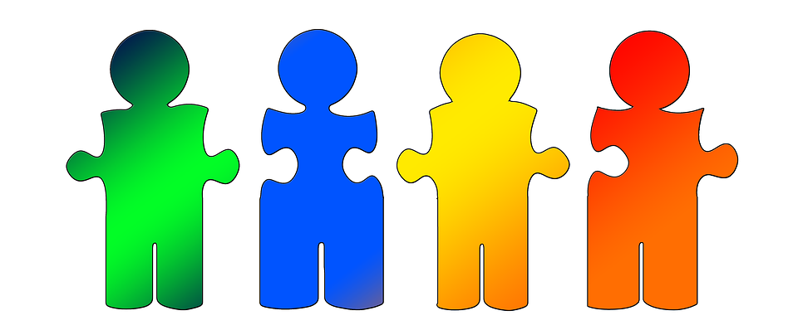

Our Team
Akash Aggarwal
Sowmya Mruthyunjaya
Sudha Vijayakumar
Thanks to the kaggle community!
Team: Recommenders-4m-SPARTAN,

Slide 3
Problem
Solution
“Similarity computation”
Using product images
Using product meta-data
Determine if two products are similar

Slide 4
Motivation
“Shopee”
Driven by the need to support more accurate product categorization, listings for customers and, also to uncover marketplace spam.
Build product recommendation systems supported by accurate product similarity matching.

Slide 5
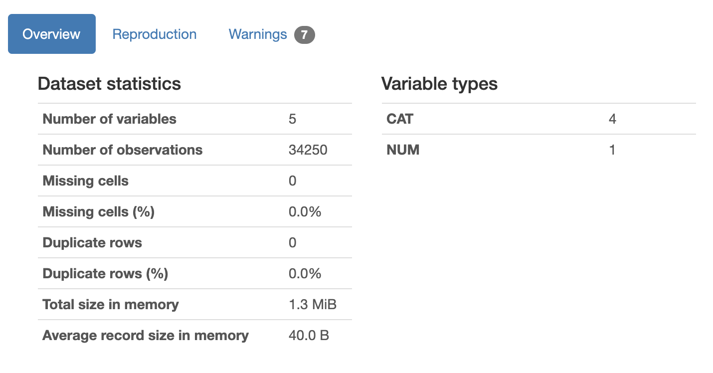
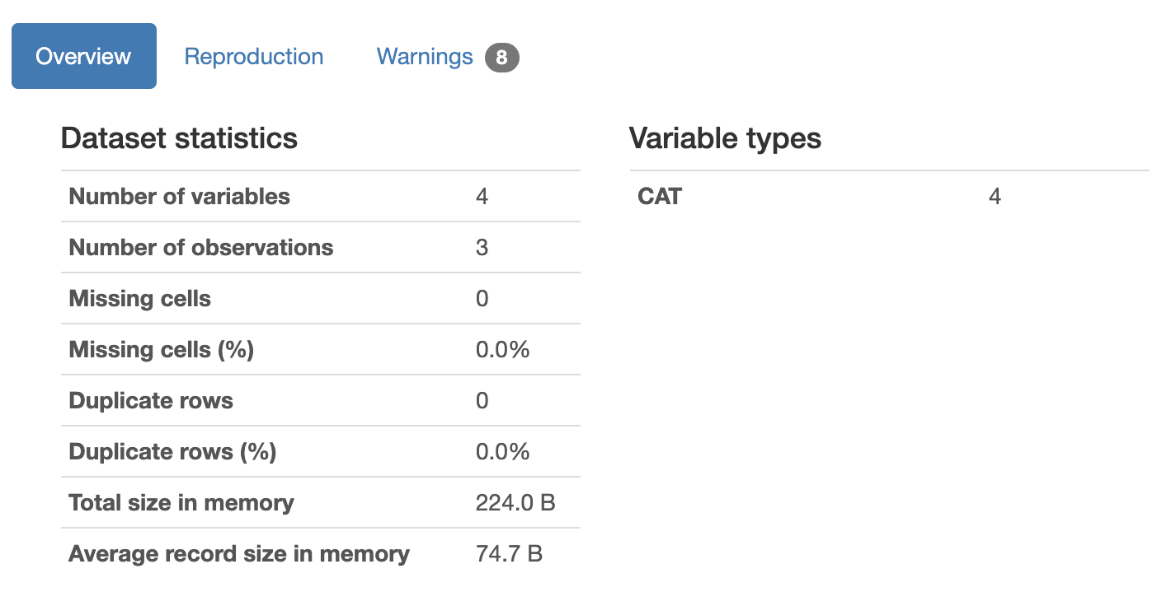

Dataset
“Total Size” 1.79 GB
TRAIN
TEST
Using ‘Pandas profiling’ GUI for EDA.

Slide 6
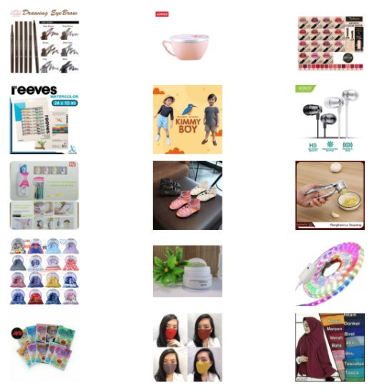
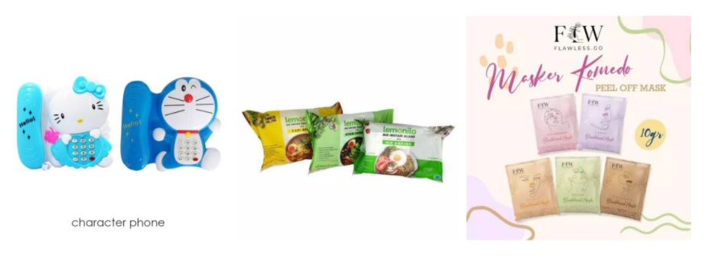
Sample train images
Sample test images
Prediction test size: 3 images
Evaluation test size: 70,000 images

Slide 7
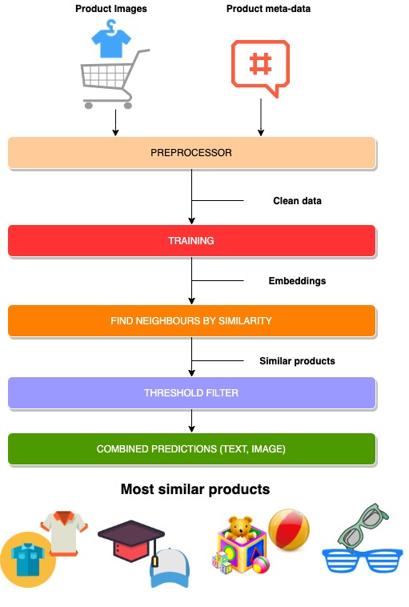
Solution Architecture
Resnet 152/ 50
Efficient net
Eca-nfnet
WHY ?
CNN backbones that have provided exemplary results on various well known image datasets.

Slide 8
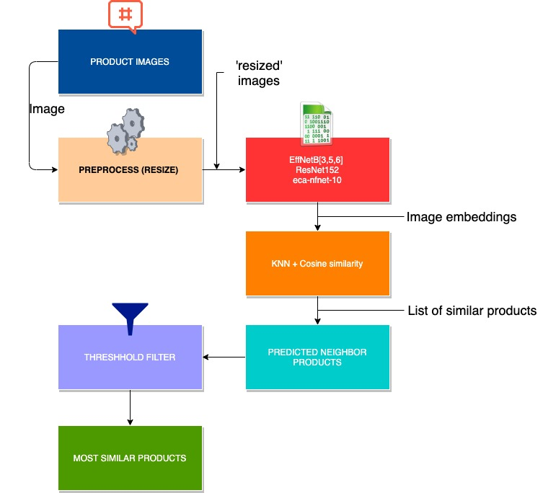
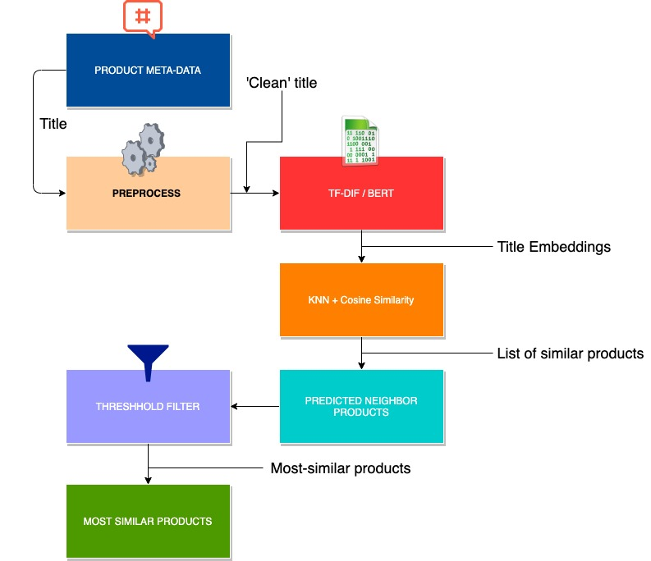
ML Pipeline
Match-by Image
Match-by meta-data

Slide 9
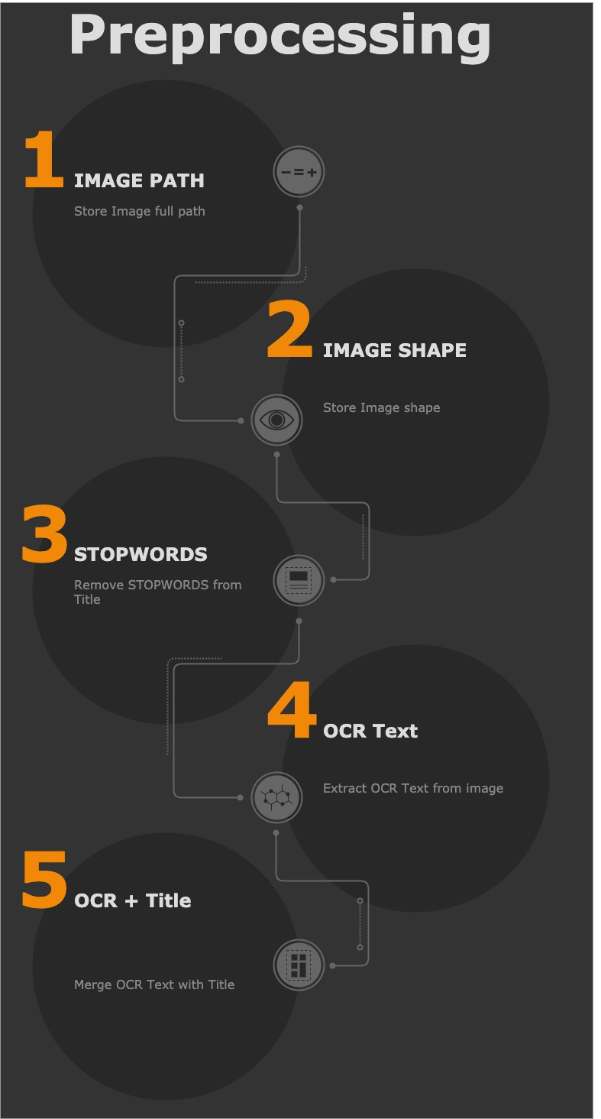
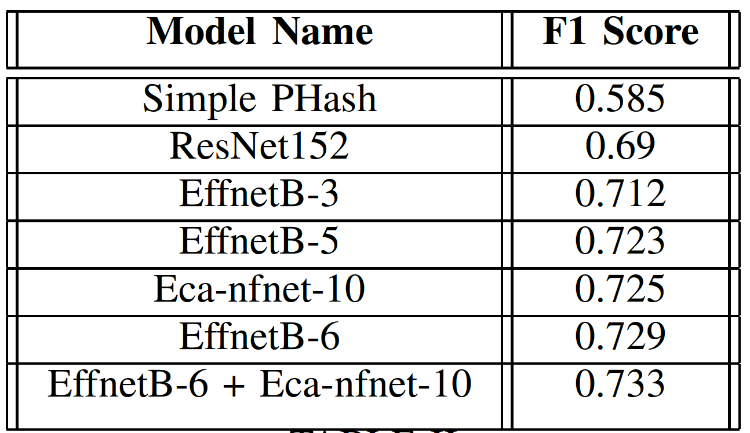
Algorithm variations

Slide 10
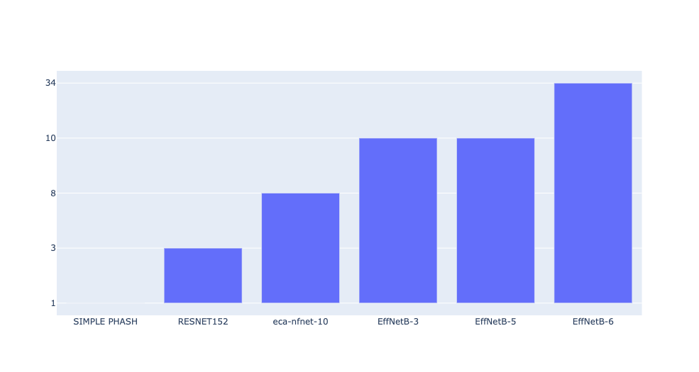
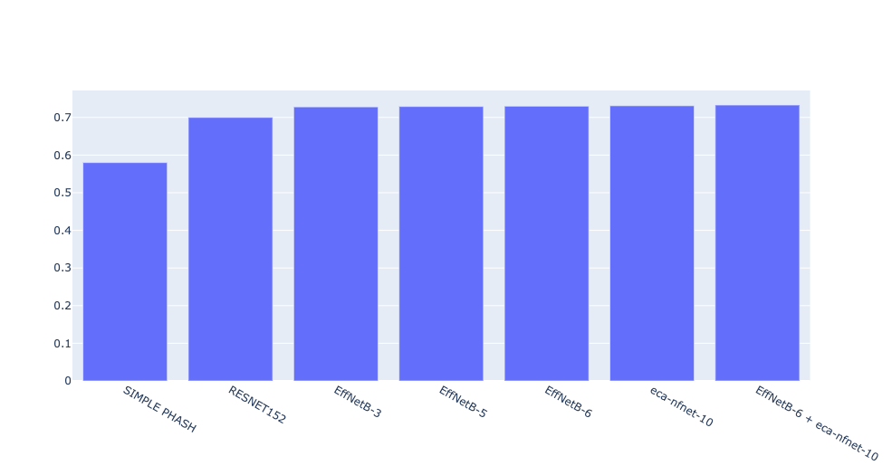
Algorithm variations & Evaluation
Time-T0-Train ~12-20 Epochs
Eca-nfnet-10
EffNetB3
EffNetB5
EffNetB6
F1 Score (Kaggle)
Resnet152
Resnet50
Linear
SVM
ML NN
ML NN

Slide 11
Ensembled Model Evaluation (EffNetB6 + ec-nfnet-10)
Total Training Time
~40 hours == 20 Epochs
Training CV Score
0.87
F1 Score
0.733
Kaggle public leaderboard
Top 12%

Slide 12
Things that worked
Things that didn’t work
“Challenges faced”
Most training on GPU broke after 10 epochs(after 10 hours approx), so in order to train for more epochs, ran training in a batch of 10 epochs by saving and continuing from previous Checkpoints.
Successfully trained shoppee dataset using different pretrained image processing models and completed predictions for the test dataset.

Slide 13


Future Scope
To try [Fastai + Annoy] (Match by image) along with BART tokenizer(match by title) to find similar products.
Can be extended for different product domains.
Build product-based recommendation systems.

