Slide 1
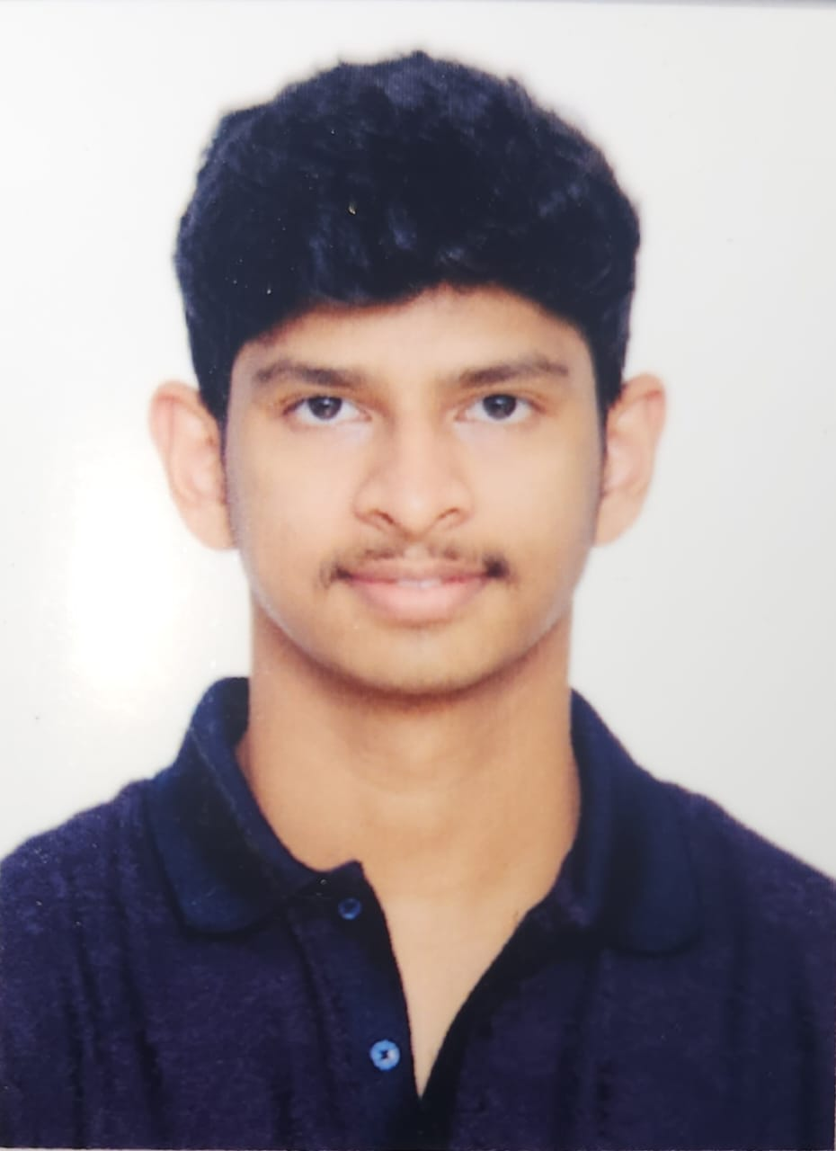
DENDUKURI SASHI VARMA
Project Engineer – GenAI | Agentic AI
Phone: 7729085361
Email: dendukuri.varma@wipro.com
LinkedIn: https://www.linkedin.com/in/sashi-varma-3196b01a8/
SUMMARY
Early‑career Data Scientist and Project Engineer with hands‑on experience building scalable GenAI, Agentic AI, and Data Analytics prototypes using Python, Vertex AI (Gemini), LangChain, and Streamlit. Strong understanding of Azure services, machine learning pipelines, data preprocessing, and prompt engineering.
TECHNICAL SKILLS
Programming: Python, Java, JavaScript
ML & AI: Data Science, TensorFlow, Scikit-learn, LLMs, Prompt Engineering, GenAI, Agentic AI
Cloud: GCP (Vertex AI)
Tools: Docker, VS Code, Streamlit, GitHub, Kubernetes
Frontend/Backend: HTML, CSS, React.js, Node.js, SQL, MongoDB
WORK EXPERIENCE
Project Engineer – DA&AI (Turbo), Wipro Limited, Chennai (2025 – Present)
Trained in Generative AI, Agentic AI, LLM development, and prototype building.
Built real‑world prototypes using Vertex AI (Gemini), LangChain, and Python.
Worked with data preprocessing, ML model evaluation, and deployment workflows.
PROJECTS:
Task Scheduler: Developed a comprehensive TODO List application to help users manage their tasks efficiently. Implemented key features such as task creation, prioritization, due dates, reminders, and search/filter functionalities. Utilized technologies including React.js, Node.js, Express.js, and MongoDB to perform CRUD Operations. Enabled seamless task categorization by

Slide 2
allowing users to group tasks into custom lists or categories, simplifying task organization and tracking.
Generative AI Chatbot : Designed and developed a Generative AI chatbot and voice chatbot to increase customer engagement and satisfaction by providing instant and accurate responses. Integrated the chatbot using Machine Learning, LLM, OpenAI, Gradio, PlayHT, and Hugging Face technologies.
Load Tender Agent : Built an autonomous Load Tender Agent that electronically tenders shipments to carriers via TMS and carrier APIs, eliminating manual load‑assignment effort. Designed real‑time monitoring logic to track tender acceptance/rejection events and instantly update TMS/ERP systems based on carrier responses. Implemented robust exception‑handling and auto‑retry workflows to resolve tender failures, ensuring uninterrupted O2C transportation execution. Integrated the agent into a multi‑agent orchestration flow, enabling seamless handoff from Booking Agent to Dispatch Confirmation Agent for end‑to‑end logistics automation.
EDUCATION
B.Tech – Computer Science, VIT Vellore (CGPA: 8.13, 2021–2025) Intermediate (MPC)- Sri Chaitanya Junior College – 95.7% (2019–2021) High School, Sri Chaitanya School – 97% (2018–2019)
CERTIFICATIONS
MERN Full Stack Development – Ethnus Consultancy (2023)
AIML Program – Smartbridge (2023).

