Slide 1
Module-1
Unit-2
Experiment Tracking, Data and Model Management

Slide 2
Contents
Feature Stores
Concept
Benefits
Role in AI applications
Feast overview

Slide 3
Feature Stores
A feature is simply an input given to a model.
A feature store is a system used to store, manage, share, and reuse the input features used by machine-learning models.
Instead of calculating these features separately every time a model is trained, they can be created once and stored for reuse.

Slide 4
Feature Stores
Why Do We Need a Feature Store?
Consider two teams developing different models.
  Team A
    Placement prediction model.
    Uses:
      CGPA
      coding score
      attendance percentage
      internship count
  Team B
    Student fail-risk prediction model.
      Also needs:
        CGPA
        attendance percentage
        assignment average
“Without a feature store, both teams independently calculate the same features”

Slide 5
Feature Stores
Why Do We Need a Feature Store?
This can create:
  duplicated work
  different formulas
  inconsistent values
  difficult maintenance
Raw Data -> Feature Engineering -> Feature Store -> Placement Model, Student Fail-Risk Model, Recommendation Model

Slide 6
Feature Stores
Feature Engineering vs Feature Store
Feature Engineering
  Creating useful information from raw data.
Feature Store
Storing and managing the created feature.

Slide 7
Feature Stores
Example:
Student attendance for the last four semesters
Offline and Online Feature Stores
Feature stores often have two uses.
Offline Features
Used mainly for:
  historical data
  model training
  batch analysis
“Student attendance for the last four semesters”

Slide 8
Feature Stores
Offline and Online Feature Stores
Feature stores often have two uses.
Online Features
Used for immediate predictions.
Example:
A fraud-detection system may need
“Number of transactions in the last 10 minutes”
Offline Store → Training
Online Store → Real-time Prediction

Slide 9
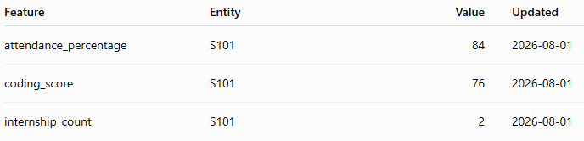
Feature Stores
What Does a Feature Store Maintain?
A feature store may maintain:
  feature name
  feature value
  data type
  entity ID
  feature definition
  source
  timestamp
  version
  owner
  description

Slide 10
Feast
Feast is an open-source feature store for machine-learning systems.
Its purpose is to make features available consistently for:
  model training
  batch prediction
  real-time prediction
Feast manages feature definitions and retrieval.
It does not train or deploy the ML model itself.

Slide 11
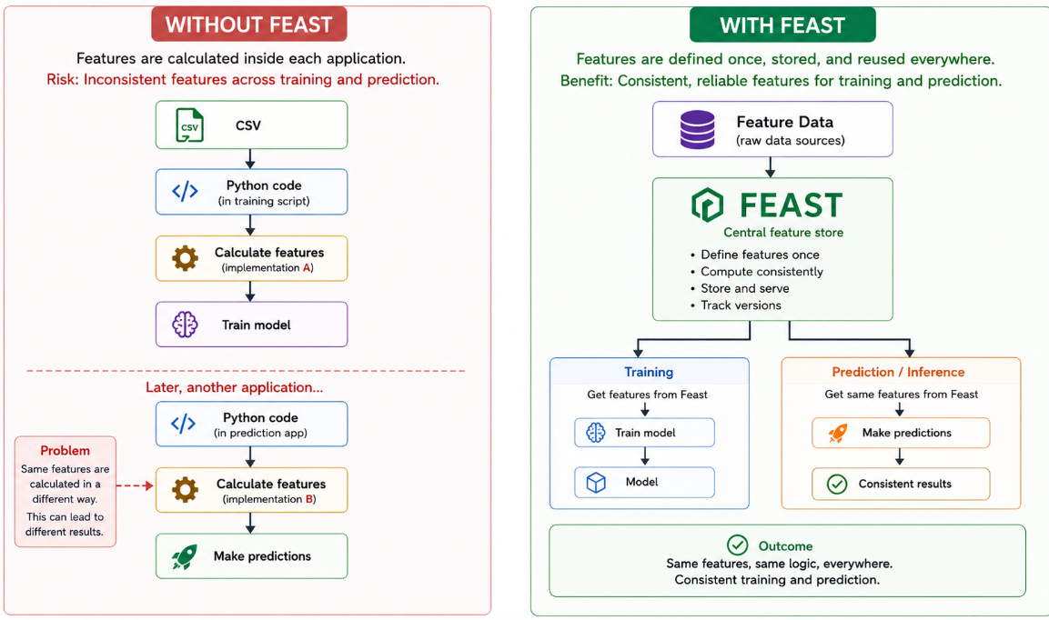
Feast

Slide 12
Feast

Slide 13
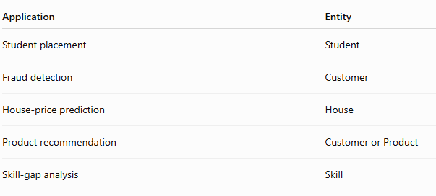
Feast
Feast Concepts
  Entity
  An entity identifies the object for which features are stored.

Slide 14
Feast
Feast Concepts
Feature
A feature is a value associated with an entity.
  For the entity “Skill”
  Skill = Docker
    Possible features:
      industry_demand = 0.72
      job_role_count = 5
      course_count = 1
      practical_coverage = 0
      project_coverage = 0

Slide 15
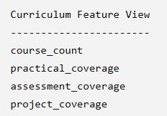
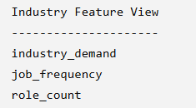
Feast
Feast Concepts
Feature View
A FeatureView logically groups related features and connects them to a data source. Feast uses feature views when building historical training datasets and when loading/retrieving online features.

Slide 16
Feast
Feast Concepts
Registry
The Feast Registry stores definitions of objects such as:
  data sources
  feature views
  feature services
It allows Feast to know what features exist and how they are organized.

Slide 17
Feast
Feast Concepts
Feature Service
A Feature Service defines a collection of features required by a particular model or model version.
Suppose our skill gap-classification model needs
  industry_demand
  role_count
  course_count
  practical_coverage
  project_coverage
These can be grouped as:
  Skill Gap Model Feature Service

Slide 18
Feast
Feast Operation
Suppose features currently exist in historical storage.
Offline Store -> Materialize -> Online Store
Materialization copies feature values needed for online serving from the offline data source into the online store.
This allows the model to access current feature values quickly.

Slide 19
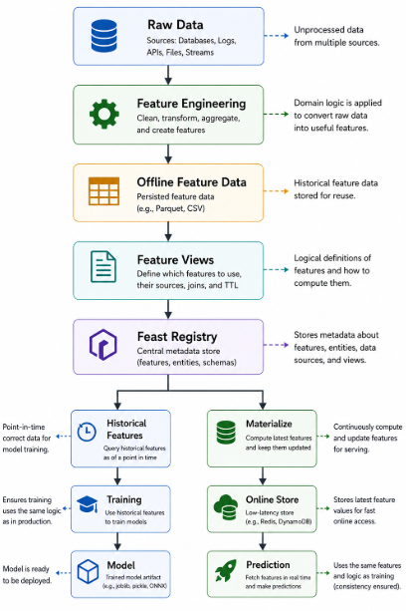
Feast
Feast Operation

Slide 20
Thank You

