Slide 1
Boston Housing Price Prediction
Akash Chandivkar

Slide 2
INTRODUCTION
Real estate agencies and people buy and sell houses all the time, people buy houses to live in or as an investment whereas real estate agencies buy it to run a business.
But the problem arises in evaluation of the cost of the property. Over-validation / Under-validation have always been the issues faced in house markets due to lack of proper detection measures.
It is also very difficult task. We know that features like size, area, location etc affect the price of the property but there are many other features also which affect the property such as inflation rates in market, age of the property etc.
In order to overcome these problems a throw analysis is done using Machine Learning (ML) which is a branch of Artificial Intelligence (AI).

Slide 3
PROJECT STATEMENT
The problem that we are going to solve here is that given a set of features that describe a house in Boston, our machine learning model must predict the house price. To train our machine learning model with Boston housing data, we will be using housing dataset.
In this dataset, each row describes a Boston town or suburb. There are 506 rows and 14 attributes (features) with a target column (PRICE).

Slide 4
DATA DESCRIPTION
The attribute description of this dataset is given below:
CRIM: This is the per capita crime rate by town
ZN: This is the proportion of residential land zoned for lots larger than 25,000 sq.ft.
INDUS: This is the proportion of non-retail business acres per town.
CHAS: This is the Charles River dummy variable (this is equal to 1 if tract bounds river; 0 otherwise)
NOX: This is the nitric oxides concentration (parts per 10 million)
RM: This is the average number of rooms per dwelling
AGE: This is the proportion of owner-occupied units built prior to 1940
DIS: This is the weighted distances to five Boston employment centers
RAD: This is the index of accessibility to radial highways
TAX: This is the full-value property-tax rate per $10,000
PTRATIO: This is the pupil-teacher ratio by town
B: This is calculated as 1000(Bk — 0.63)², where Bk is the proportion of people of African American descent by town
LSTAT: This is the percentage lower status of the population
PRICE: This is the median value of owner-occupied homes in $1000s

Slide 5
MODEL SELECTION
There are various models available under regression analysis but for this paper four regression models are used which are Linear Regression, Random Forest, XGBoost and Support Vector Machine on the Boston house dataset.
After implementation of these models we measure the accuracy by splitting the dataset into two parts which are training dataset and test dataset. We use 70% of the dataset as training data and 30% is used as test data.
The fitting of our models is done using the training dataset and evaluation of the model is done in test dataset.

Slide 6
ALGORITHMS USED
LOGISTIC REGRESSION
RANDOM FOREST
XGBOOST
SUPPORT VECTOR MACHINE

Slide 7
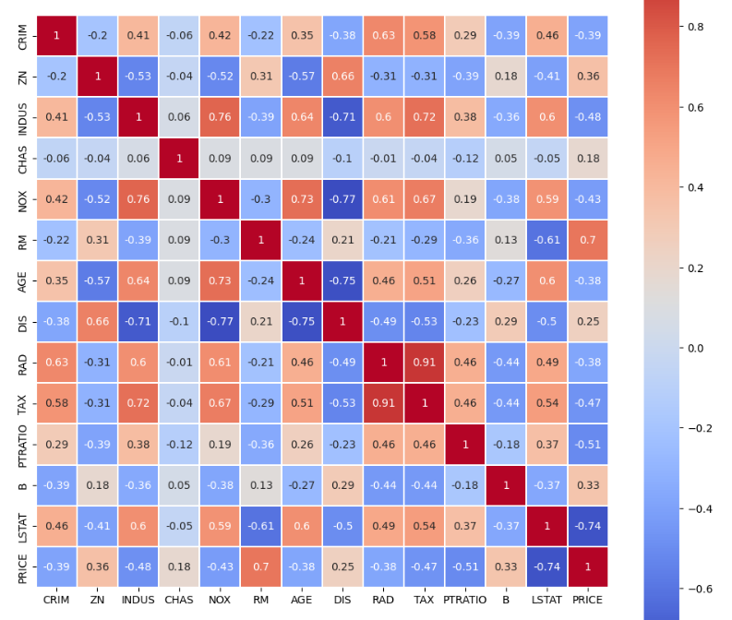
HEATMAP
This Figure gives us an insight into how parameters are correlated with each other.
From heat map it is observed that
the attributes “TAX” and “RAD”
are highly correlated.

Slide 8
MODEL EVALUATION
𝑅^2 : It is a measure of the linear relationship between X and Y. It is interpreted as the proportion of the variance in the dependent variable that is predictable from the independent variable.
Adjusted 𝑅^2 :The adjusted R-squared compares the explanatory power of regression models that contain different numbers of predictors.
MAE : It is the mean of the absolute value of the errors. It measures the difference between two continuous variables, here actual and predicted values of y.
MSE: The mean square error (MSE) is just like the MAE, but squares the difference before summing them all instead of using the absolute value.
RMSE: The mean square error (MSE) is just like the MAE, but squares the difference before summing them all instead of using the absolute value.

Slide 9
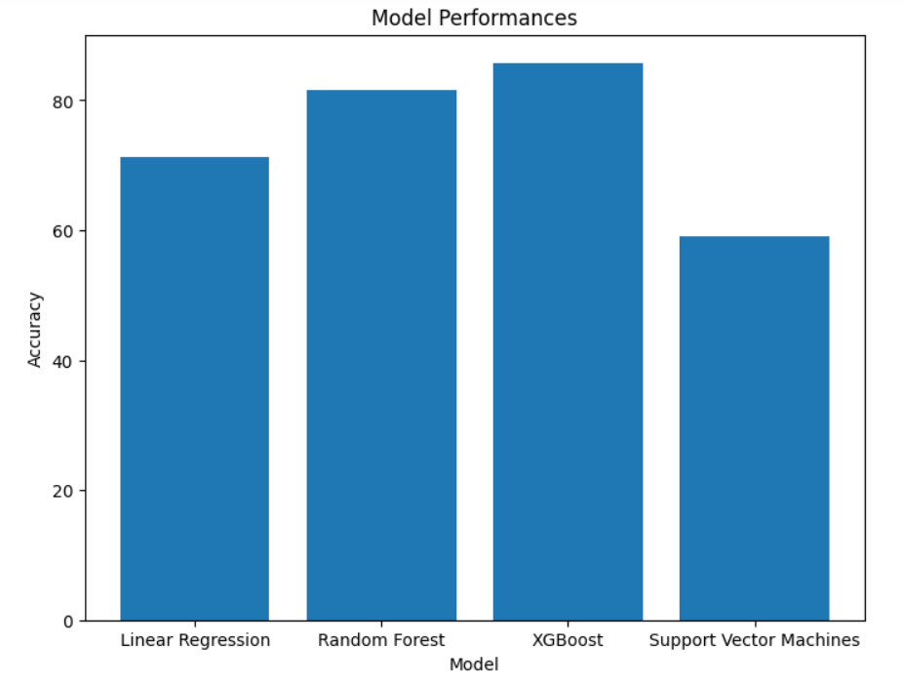
RESULTS
Comparing the R^2 Score of all the models by plotting histogram and finding the best model out of all.
From the plot, we can say that XGBoost has the highest R^2 Score.
Hence XGBoost Regression works the best for this dataset.

Slide 10
CONCLUSION
The main purpose of this project is to help people who are facing these issues to predict the house price in future years.
In this project an intelligent system is made using the Regressor models which are Simple Linear Regression, Random Forest, XGBoost and SVM on the Boston House Dataset to predict the house price.
In this paper it is observed that using the Boston house dataset, and implementing various data preprocessing techniques which are needed on the dataset and then splitting the dataset into 70-30, 70% for training and 30% for testing, XGBoost Regression performs the best with R^2 score of 0.98.
This may change if we use different dataset or different pre-processing approaches but in this case this is the results that we get.

