Slide 1
A Student Information System
that refuses to lie
Every claim in this talk is a measurement, or it is not in the talk.
Sujith · UCS3513 System Design Laboratory
github.com/sujith0613/sis-system-design
10 minutes · live demo

Slide 2
THE POINT
Everyone demos the happy path.
Ours demos the failure path.
Redis. MongoDB. Rate limits. Every project in this room has that diagram.
This one can prove it — so it can also show you what happens when it breaks.
Orbit SIS · system design · 22 October 2026
02 / 09

Slide 3
THE STARTING POSITION
Three claims, and how each one dies
Each of these is true of a prototype that never has to fail in public.
“Rate limited”
“Sharded”
“Cached”
Two replicas.
Two counters.
Double the limit.
One process.
One dictionary.
hash(key) % 3.
Cache and truth share
a lifetime, so
neither is real.
We deleted all three. No flag, no fallback: if a store is down, the system refuses to answer.
Orbit SIS · system design · 22 October 2026
03 / 09

Slide 4
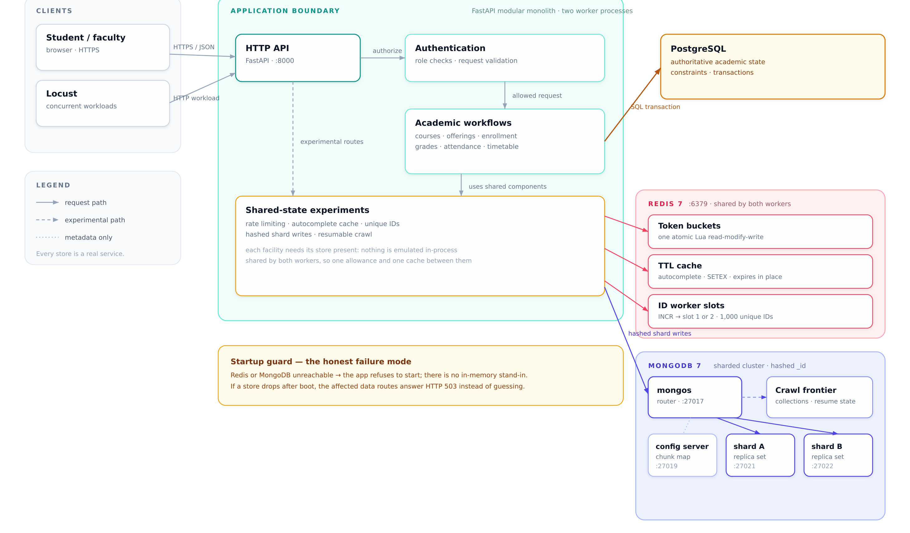
ARCHITECTURE
Three real stores, one startup guard
Six containers on one host: PostgreSQL, Redis, config server, two shards, mongos. Nothing is emulated in-process.
04 / 09

Slide 5
THE UNIT'S CHECKLIST
Eight components, each with a job you can observe
COMPONENT | WHAT IT DOES HERE | WHERE THAT STATE ACTUALLY LIVES
Cache | autocomplete results with server-side expiry | Redis · TTL 20 s, allkeys-lru
Unique IDs | time-sortable 64-bit identifiers | Redis worker slots
Rate limiter | one quota shared by every process | Redis · atomic Lua
URL shortener | create and redirect (307) | PostgreSQL
Web crawler | robots-aware frontier, resumable | MongoDB collections
Autocomplete | prefix search over the catalogue | Redis in front of PostgreSQL
Consistent hashing | 100 virtual nodes, routing shown | application ring
Sharding | hashed shard key, real chunk moves | MongoDB · 2 shards + mongos
Each one answers on a live endpoint under /system-design/ — not on a slide.
Orbit SIS · system design · 22 October 2026
05 / 09

Slide 6
CLAIM 1
It refuses to run on a lie
Take Redis away and the honest answer is 503 with the store named.
A per-process fallback would have answered 200 — and silently doubled every client's quota. Availability loses to honesty here, on purpose.
AT BOOT
$ uvicorn app.main:app
RuntimeError: Required state stores
are not available:
- Redis unreachable at :6399
ERROR: Application startup failed.
AT RUNTIME, WITH REDIS KILLED
Recovery is the store coming back — not a restart.
$ podman stop sis-redis $ curl /courses
[503] {"status": "degraded",
"store": "redis",
"detail": "…cannot decide…"}
Orbit SIS · system design · 22 October 2026
06 / 09

Slide 7
CLAIM 2
Our hash ring disagrees with the database — in public
Two answers, one endpoint.
The left number is the consistent-hashing ring from the lecture. The right is what mongos actually does with a hashed shard key. They disagree, and the API says so with a boolean.
The ring routes. moveChunk moves. One of those is a drawing; the other changed 129 documents between two replica sets on this machine.
THE ROUTING DISAGREEMENT, AS SERVED
$ curl /system-design/route/DEMO-KEY-1
{ "ring_prediction": "sis-shard-b",
"actual_owner": "sis-shard-a",
"agrees": false }
THE MOVEMENT IS REAL
$ curl -X POST …/move-chunk
{ "from_shard": "sis-shard-a",
"to_shard": "sis-shard-b" }
Orbit SIS · system design · 22 October 2026
07 / 09

Slide 8
CLAIM 3
The invariants hold when things go wrong
5 / 20
3 → 0
1,000
0
seats under concurrency
one bucket, two workers
IDs from two slots
pages refetched
One 5-seat offering, 20 simultaneous
enrolments: 5 x 201, 15 x 409,
enrolled_count = 5.
Worker A spends all three tokens;
worker B is refused.
Two processes never mint the
same number: 1,000 generated,
0 collisions.
A second crawl took 5 URLs off
the persisted frontier and
fetched none twice.
The shared thing lives in the store, not in the process.
Every number here came out of the running stack, and the suite asserts the counts, not the vibe.
Orbit SIS · system design · 22 October 2026
08 / 09

Slide 9
HONEST LIMITS · AND THE CLOSE
What this is not
— One host. No failover, no backup, no replication test.
— Redis is volatile on purpose: a restart resets the buckets.
— Crawler is polite: 3 pages in 7.1 s at 0.5 s delay.
— Load numbers predate the migration, so they are not quoted.
— One cache flag was deleted, never defaulted to off.
— The suite wipes the dev database — a rough edge, not a secret.
A demo you cannot re-run
is a story.
./run.sh
checks the machine, starts six containers, seeds the data, polls /health
./stop.sh
stops it, then proves every port is closed
github.com/sujith0613/sis-system-design

