Slide 1

Project Title - Agriculture Performance Analysis
Name:Akash B College Name:Rao Bahadur Y. Mahabaleswarappa Engineering College
AICTE STU ID : STU6a3fb009a37911782558729

Slide 2

PROBLEM STATEMENT
Agriculture performance depends on crop selection, climate, soil conditions, irrigation, input usage and market economics. Farmers and decision-makers need a simple way to compare these factors and identify practices associated with better yield, profitability and water efficiency. This project analyzes 4,000 farm records to uncover patterns in yield, production, profit, irrigation performance and disease/pest risk.

Slide 3
Agriculture Performance Analysis is a data-driven study of farm-level records containing crop, season, location, weather, soil, input, irrigation, yield, revenue, cost, profit, water use and disease/pest risk. The workflow includes data loading, cleaning, descriptive statistics, grouping by crop/season/state/irrigation method, correlation analysis and visualization. The objective is to convert raw agricultural data into clear insights that can support better farm planning.

Slide 4

WHO ARE THE END USERS?
• Farmers – compare crop and irrigation performance. • Agricultural officers – monitor regional patterns and risks. • Agribusiness planners – evaluate production and profitability. • Researchers/analysts – study relationships between inputs, yield and water use. • Students – learn practical data visualization using an agricultural dataset.

Slide 5

Technology Used
Programming: Python Data handling: Pandas, NumPy Visualization: Matplotlib Environment: Jupyter Notebook / VS Code Data source: Agriculture farm CSV dataset Methods: Descriptive statistics, group-by analysis, correlation and visualization

Slide 6
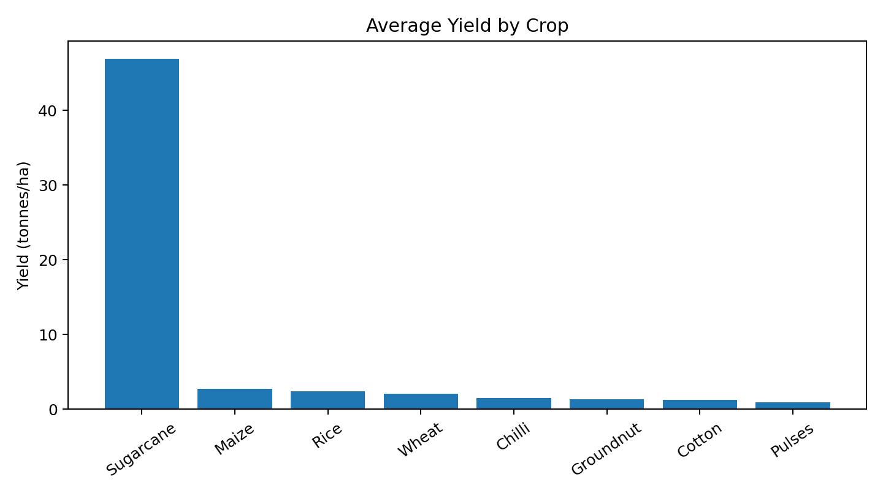
RESULTS
Crop Performance
Average yield: 5.27 t/ha Highest average: Sugarcane (46.94 t/ha)
Key finding: Sugarcane has a much higher average yield in this dataset than the other crops. Crop-level comparisons should therefore consider both yield and economic outcomes.

Slide 7
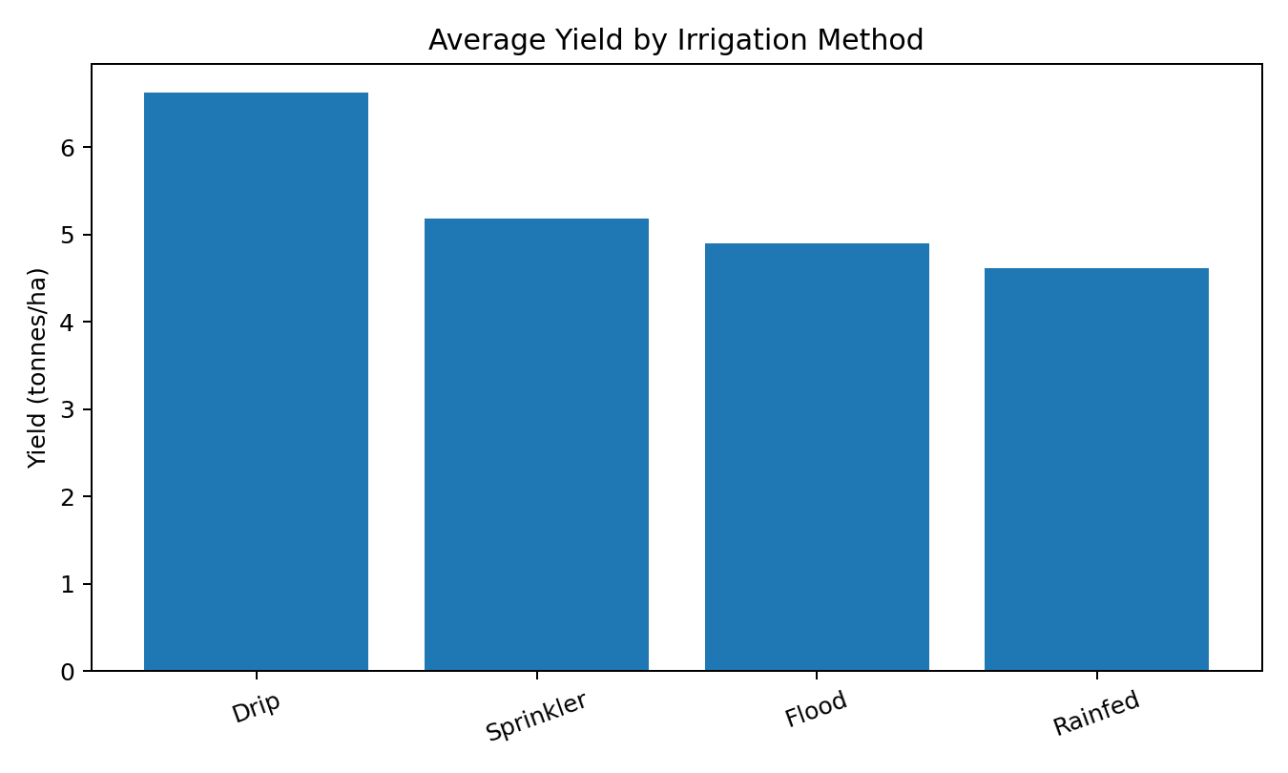
RESULTS
Irrigation Performance
Drip yield: 6.62 t/ha Drip profit: ₹219,626
Key finding: Drip irrigation shows the highest average yield among the four irrigation methods in the dataset. It also has the highest average profit.

Slide 8
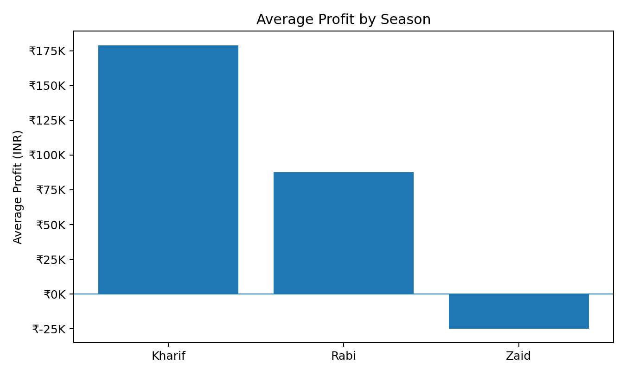
RESULTS
Seasonal Profitability
Kharif: ₹178,915 Rabi: ₹87,689 Zaid: ₹-24,805
Key finding: Kharif has the strongest average profit, while Zaid has a negative average profit in this dataset.

Slide 9
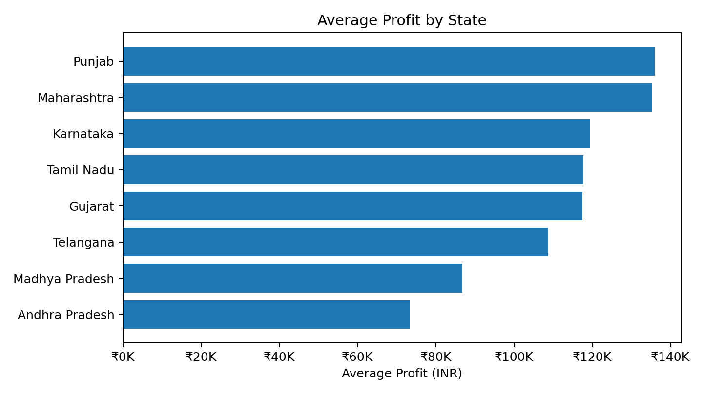
RESULTS
State-wise Performance
Top average profit: Punjab ₹136,026 Overall average profit: ₹111,556
Key finding: Punjab records the highest average profit among the states represented. Andhra Pradesh has the lowest average profit.

Slide 10
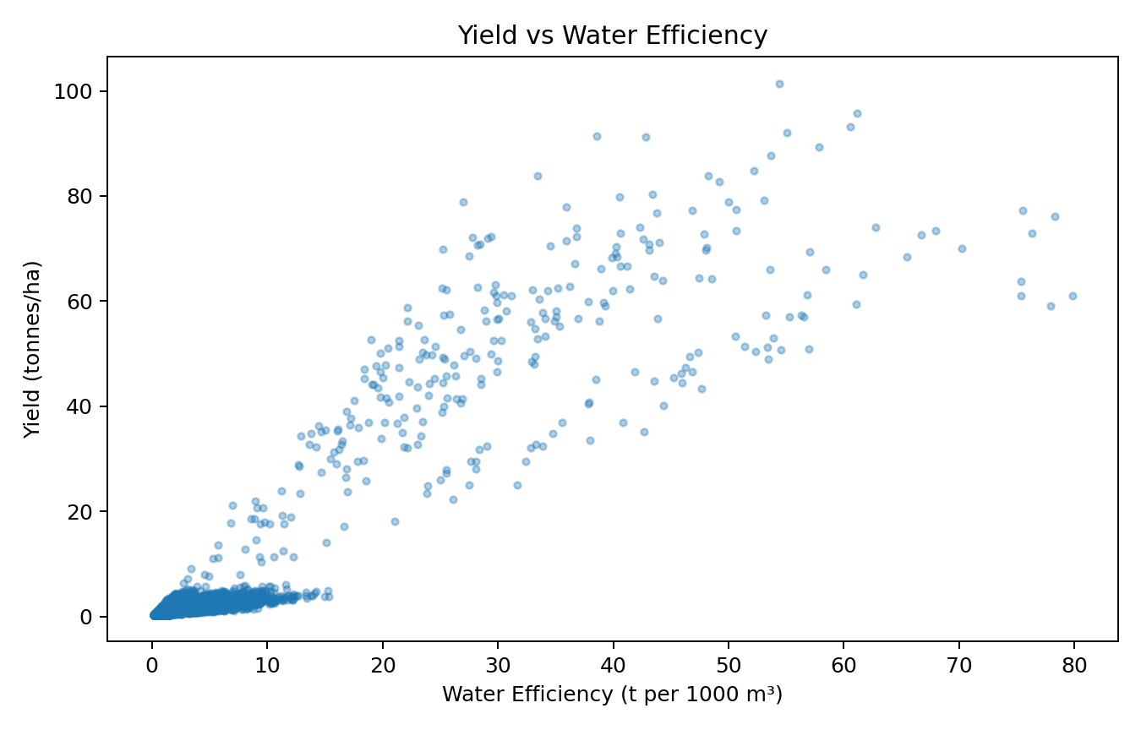
RESULTS
Water Efficiency
Average efficiency: 5.39 t/1000m³ Yield–efficiency correlation: 0.92
Key finding: Yield and water-efficiency move strongly together in the dataset. This indicates that water productivity is an important performance indicator to monitor.

Slide 11
Future scope
1. Predictive yield forecasting
2. Crop recommendation & risk alerts 3. Weather and soil-based decision support 4. Interactive Power BI / Streamlit dashboard 5. Time-series analysis with historical farm data

Slide 12
GitHub Link
Project repository link: https://github.com/Akash2875/Agriculture_Performance_Analysis

Slide 13
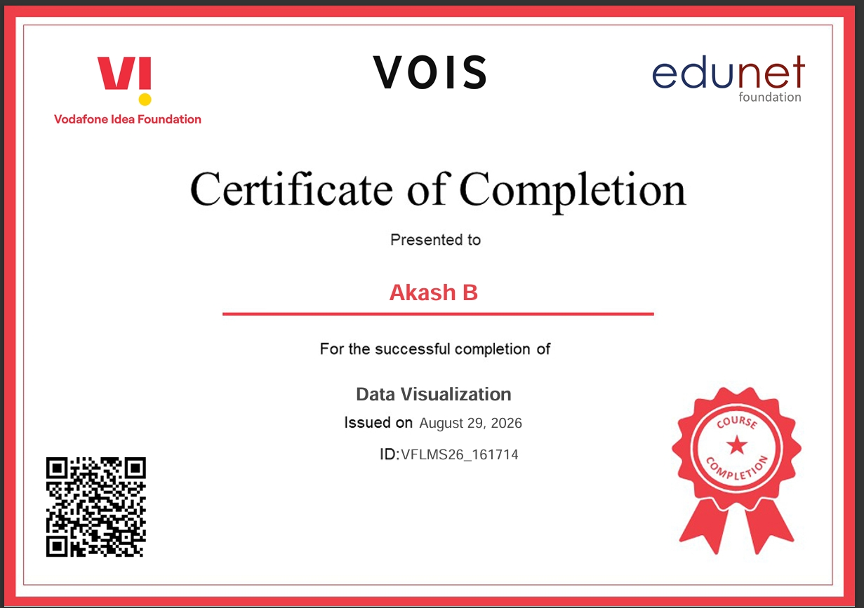
VOIS Course completion certificate - Course name - Data Visualization
Certificate

Slide 14
Thank you
.

