Slide 1

Natural Language Processing
Rohit Kate
Information Extraction

Slide 2
Reading
Section 5.4, Textbook 1
Section 8.4, Textbook 2

Slide 3


Information Extraction (IE)
Information extraction is the task of identifying specific structured information from unstructured text
Transforms unstructured information from a corpus into structured databases for downstream applications
All the capabilities of database systems then become available
IE for proteins and
their interactions
Applications
Biomedical literature
Protein interaction database
Unstructured
Structured

Slide 4
Information Extraction (IE)
Can be applied to different types of text for extracting various types of information:
Newspaper articles
Company acquisitions
Crimes
Scientific articles
Protein interactions
Genes and diseases
Newsgroup messages
Drug interactions
Classified ads
Job postings
Clinical notes
Diseases and treatments
…
Not necessary to analyze whole sentences!
Shallow
Looking only for specific (pre-defined) information of interest

Slide 5
Job Posting IE Template
title:
salary:
company:
recruiter:
state:
city:
country:
language:
platform:
application:
area:
req_years_experience:
desired_years_experience:
req_degree:
desired_degree:

Slide 6
Sample Job Posting
SOFTWARE PROGRAMMER
Position available for Software Programmer experienced in generating software for PC-Based Voice Mail systems. Experienced in C Programming. Must be familiar with communicating with and controlling voice cards; preferable Dialogic, however, experience with others such as Rhetorix and Natural Microsystems is okay. Prefer 5 years or more
experience with PC Based Voice Mail, but will consider as little as 2 years. Need to find a Senior level person who can come on board and pick up code with very little training.
Present Operating System is DOS. May go to OS-2 or UNIX in future.

Slide 7
Sample Job Posting
SOFTWARE PROGRAMMER
Position available for Software Programmer experienced in generating software for PC-Based Voice Mail systems. Experienced in C Programming. Must be familiar with communicating with and controlling voice cards; preferable Dialogic, however, experience with others such as Rhetorix and Natural Microsystems is okay. Prefer 5 years or more
experience with PC Based Voice Mail, but will consider as little as 2 years. Need to find a Senior level person who can come on board and pick up code with very little training.
Present Operating System is DOS. May go to OS-2 or UNIX in future.

Slide 8
Extracted Job Posting Template
title: SOFTWARE PROGRAMMER
salary:
company:
recruiter:
state:
city:
country:
language: C
platform: PC \ DOS \ OS-2 \ UNIX
application:
area: Voice Mail
req_years_experience: 2
desired_years_experience: 5
req_degree:
desired_degree:

Slide 9
Information Extraction Tasks
Two main subtasks:
Named Entity Recognition (NER) or Named Entity Extraction
Relation Extraction

Slide 10
Named Entity Recognition
Specific type of information extraction in which the goal is to extract names of particular types of entities such as person, location, organization, or protein name, etc.
Not trivial:
Could be ambiguous
“Austin” could be a person or location
No exhaustive list of protein names; new proteins are continually discovered

Slide 11
Named Entity Recognition
Entity types: Person, Location and Organization
Austin lives in Los Angeles, California and works there for an American company called ABC Inc.
Person
Location
Location
Organization

Slide 12
Relation Extraction
Once entities are recognized, identify specific relations between entities
Work_For(Person, Organization)
OrgBased_In(Organization, Location)
Located_In(Location, Location)
Live_In(Person, Location)

Slide 13
Relation Extraction
Work_For
OrgBased_In
Live_In
OrgBased_In
Located_In
Live_In
Austin lives in Los Angeles, California and works there for an American company called ABC Inc.
Person
Location
Location
Organization

Slide 14
Biomedical Abstract
TI - Two potentially oncogenic cyclins, cyclin A and cyclin D1, share common properties of subunit configuration, tyrosine phosphorylation and physical association with the Rb protein
AB - Originally identified as a ‘mitotic cyclin’, cyclin A exhibits properties of growth factor sensitivity, susceptibility to viral subversion and association with a tumor-suppressor protein, properties which are indicative of an S-phase-promoting factor (SPF) as well as a candidate proto-oncogene …
Moreover, cyclin D1 was found to be phosphorylated on tyrosine residues in vivo and, like cyclin A, was readily phosphorylated by pp60c-src in vitro.
In synchronized human osteosarcoma cells, cyclin D1 is induced in early G1 and becomes associated with p9Ckshs1, a Cdk-binding subunit.
Immunoprecipitation experiments with human osteosarcoma cells and Ewing’s sarcoma cells demonstrated that cyclin D1 is associated with both p34cdc2 and p33cdk2, and that cyclin D1 immune complexes exhibit appreciable histone H1 kinase activity …

Slide 15
Named Entity Recognition (protein names)
TI - Two potentially oncogenic cyclins, cyclin A and cyclin D1, share common properties of subunit configuration, tyrosine phosphorylation and physical association with the Rb protein
AB - Originally identified as a ‘mitotic cyclin’, cyclin A exhibits properties of growth factor sensitivity, susceptibility to viral subversion and association with a tumor-suppressor protein, properties which are indicative of an S-phase-promoting factor (SPF) as well as a candidate proto-oncogene …
Moreover, cyclin D1 was found to be phosphorylated on tyrosine residues in vivo and, like cyclin A, was readily phosphorylated by pp60c-src in vitro.
In synchronized human osteosarcoma cells, cyclin D1 is induced in early G1 and becomes associated with p9Ckshs1, a Cdk-binding subunit.
Immunoprecipitation experiments with human osteosarcoma cells and Ewing’s sarcoma cells demonstrated that cyclin D1 is associated with both p34cdc2 and p33cdk2, and that cyclin D1 immune complexes exhibit appreciable histone H1 kinase activity …

Slide 16
Relation Extraction (protein interactions)
TI - Two potentially oncogenic cyclins, cyclin A and cyclin D1, share common properties of subunit configuration, tyrosine phosphorylation and physical association with the Rb protein
AB - Originally identified as a ‘mitotic cyclin’, cyclin A exhibits properties of growth factor sensitivity, susceptibility to viral subversion and association with a tumor-suppressor protein, properties which are indicative of an S-phase-promoting factor (SPF) as well as a candidate proto-oncogene …
Moreover, cyclin D1 was found to be phosphorylated on tyrosine residues in vivo and, like cyclin A, was readily phosphorylated by pp60c-src in vitro.
In synchronized human osteosarcoma cells, cyclin D1 is induced in early G1 and becomes associated with p9Ckshs1, a Cdk-binding subunit.
Immunoprecipitation experiments with human osteosarcoma cells and Ewing’s sarcoma cells demonstrated that cyclin D1 is associated with both p34cdc2 and p33cdk2, and that cyclin D1 immune complexes exhibit appreciable histone H1 kinase activity …

Slide 17
Rule-Based Methods for NER
Manually write rules, sometimes in the form of regular expressions (string patterns)
Could have three separate patterns for each entity type:
Pre-filler patterns: before the entity
Filler patterns: entity
Post-filler patterns: after the entity
Example for protein NER:
Pre-filler: \w+genic cyclin
“\w+” means 1 or more alphanumeric characters, e.g. “oncogenic cyclin”
Post-filler: proteins?
“s?” makes “s” optional
Example: oncogenic cyclin cyclin A protein
Pre-filler
Protein
Post-filler

Slide 18
Adding Linguistic Information to Rules
Linguistic information could be added to rules using NLP methods
Part-of-speech (POS) tagging
Mark each word as a noun, verb, preposition, etc.
Syntactic parsing
Identify phrases: NP, VP, PP
Semantic word categories (e.g. from WordNet)
KILL: kill, murder, assassinate, strangle, suffocate
Example: NER for “crime victim” from news articles
Prefiller: [POS: V, Hypernym: KILL]
Filler: [Phrase: NP]
Example: … assassinated Abc …
Pre-filler
Crime victim

Slide 19
Rules for Relation Extraction
Manually write rules for relation between two entities
“PERSON live * LOCATION”
“*” means any number of words
“interaction between * PROTEIN * PROTEIN
Such rules can also be automatically learned from training data
Rules for NER or relation extraction are usually accurate but do not cover a lot of cases
They are also brittle - one different word and they will not match

Slide 20
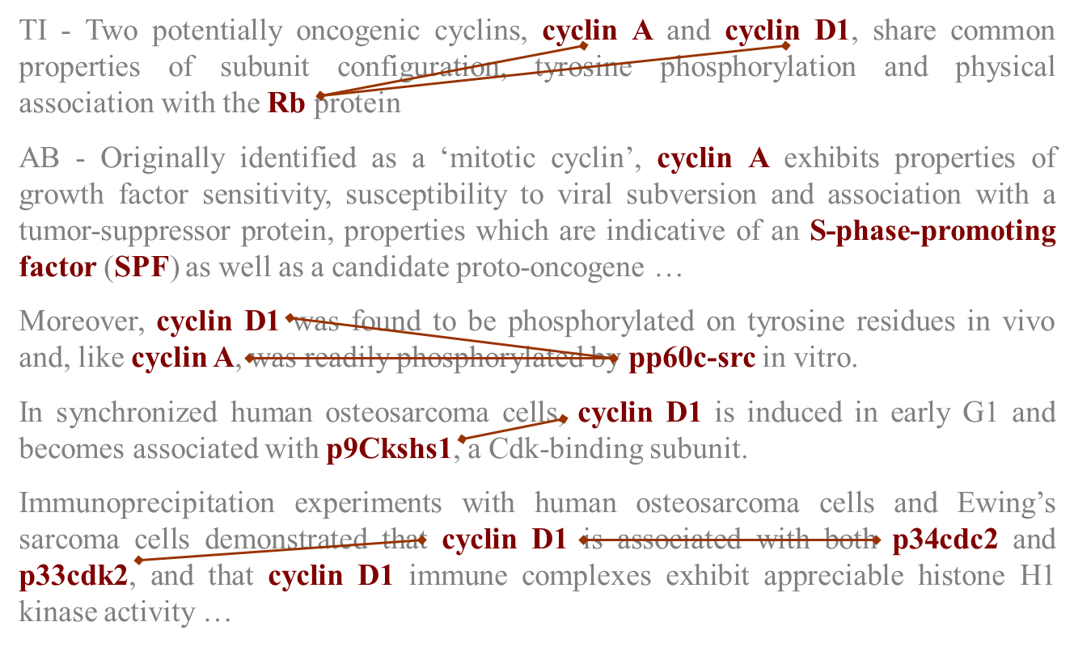


Machine Learning for IE
ML Method
Annotated training data for specific
entities and their relations
Learned IE System
New Text
Extracted Information

Slide 21
Named Entity Extraction as Classification
If the candidate entities are given (or automatically determined, say as all noun phrases, or in worst case all substrings) then train a classifier to classify candidate entities according to their types or “none” type
Features: Word itself, surrounding words, POS tags, type of phrase, capitalization, gazetteers (list of names), etc.
Use a good multi-label classifier or use a classifier for each type

Slide 22
Named Entity Recognition as Classification
Austin lives in Los Angeles, California and works there for an American company called ABC Inc.
Person: 0.8
Location: 0.2
Organization : 0.0
None: 0.0
Person: 0.0
Location: 0.99
Organization : 0.01
None: 0.0
Person: 0.0
Location: 0.9
Organization : 0.05
None: 0.05
Person: 0.2
Location: 0.1
Organization : 0.1
None: 0.6
Person: 0.0
Location: 0.1
Organization : 0.9
None: 0.0

Slide 23
Named Entity Recognition as Classification
Austin lives in Los Angeles, California and works there for an American company called ABC Inc.
Person
Location
Location
None
Organization

Slide 24
Named Entity Extraction as Classification
Disadvantages:
Need good candidate entities otherwise they some entities will be missed
Each classification is done independently, the decisions do not influence each other

Slide 25
Named Entity Recognition as Sequence Labeling
NER can be casted as a sequence labeling task
But what should be the labels?
Unlike POS tagging, not all words have labels
An entity could be over multiple words
Suppose the entity is PERSON
Label a word part of a person as PERSON
Label a word not part of any PERSON as “Other”
Example:
John Smith worked for Microsoft .
PERSON PERSON OTHER OTHER OTHER

Slide 26
Named Entity Recognition as Sequence Labeling
In the previous example, are “John” and “Smith” two different persons or same person?
How can the sequence labeling differentiate?
Solution:
Use a special label to indicate beginning (B) of an entity: B-PERSON
Other tokens are indicated as inside (I) using the label I-PERSON

Slide 27
Named Entity Recognition as Sequence Labeling
Two persons case:
One person case:
B-PERSON B-PERSON OTHER OTHER OTHER
John Smith worked for Microsoft .
B-PERSON I-PERSON OTHER OTHER OTHER
John Smith worked for Microsoft .

Slide 28
Named Entity Recognition as Sequence Labeling
If there are multiple entity types, then use “Begin” and “Inside” labels for each type and an “Other” (or “Outside”) label
These labels are also known as BIO labels or BIO tags
Austin lives in Los Angeles, California and works there for an American company called ABC Inc.
B-PER
O
O
B-LOC
I-LOC
B-LOC
O
O
O
O
O
O
O
O
B-ORG
I-ORG

Slide 29
Named Entity Recognition as Sequence Labeling
Sometimes entity may not be over contiguous words
Example: Left ventricle is moderately dilated
Extracted disorder: Left ventricle dilated
BIO labels can still be used in these cases:
Left ventricle is moderately dilated
B-DIS I-DIS OTHER OTHER I-DIS

Slide 30
Named Entity Recognition as Sequence Labeling
Once NER is casted as a sequence labeling task, any sequence labeling method can be used
One can use RNNs (with LSTM or GRU cells) for doing NER
Bi-directional RNNs can look in both directions for doing NER
Give correct BIO labels for training and train the model
Use predicted BIO labels to extract the entities

Slide 31

Named Entity Recognition Using Bi-LSTM
Use BIO labels as output tokens:
B-PERSON
I-PERSON
OTHER
Output layer
Output layer
Output layer
LSTM Cell (unrolled)
…
…
John
Smith
worked

Slide 32
Relation Extraction as Classification
Given two entities of required types in a sentence, classify whether a type of relation exists between them or not
Features can be: words before, in between and after; words of the entities; syntactic information (syntactic tree path or dependency path between the two entities); etc.
Live_In ??
Austin lives in Los Angeles, California and works there for an American company called ABC Inc.
Person
Location

Slide 33
Relation Extraction Using LSTM
LSTM networks have been used to classify dependency path between two entities as having a relation or not
Dependency path: each word depends on which other word in the sentence
was
cat
chased
a
with
by
ago
collar
dog
days
a
red
a
two
fat
A cat with a red collar was chased by a fat dog two days ago.

Slide 34
Evaluating IE
Measure for each entity type and for each relation type:
Total number of correct extractions: N
Total number of extractions by the system: E
Number of extractions that are correct: C
Compute average value of metrics adapted from IR:
Recall = C/N
Precision = C/E
F-Measure = Harmonic mean of recall and precision
These could be computed for each type of entity and reported, or averaged over all entity types and reported

Slide 35
Evaluation Measures (for binary classification)
There is a trade-off between precision and recall
Extract everything: 100% recall, very low precision
Extract very few examples that you are most confident on: Very high precision, very low recall
Precision and recall should always be reported together

