Slide 1

Natural Language Processing
Rohit Kate
Machine Translation

Slide 2
Reading
Section 6.2, Textbook 1
Section 9.4, Textbook 2

Slide 3
Machine Translation (MT)
Automatically translate from one natural language into another
Primary goal - Preserve the meaning of the source language while observing the language conventions of the target language
Mary didn’t slap the green witch.
Maria no dió una bofetada a la bruja verde.
English to Spanish

Slide 4
Machine Translation (MT)
Applications:
Help users understand text from a language they do not know
Travelling
Assisting human translators through computer-aided- translation
Make the process fast
Reduce cost

Slide 5
MT is Difficult
An apocryphal story about an early MT system:
“The spirit is willing but the flesh is weak.”
English to Russian
Russian to English
“The vodka is good but the meat is rotten.”

Slide 6
MT is Difficult
An apocryphal story about an early MT system:
“Out of sight, out of mind.”
English to Russian
Russian to English
“Invisible idiot.”

Slide 7
Linguistic Issues Making MT Difficult
Lexical gaps:
Some words in one language do not have a corresponding word in the other
French:
rivière (river that flows into ocean)
fleuve (river that does not flow into ocean)
Hindi:
taau (father’s older brother)
chacha (father’s younger brother)
German:
schadenfreude (feeling good about another’s pain)
Japanese:
oyakoko (filial piety)
Yupik (a native Alaskan language)
50 different words for snow
There are also many words in English which are not in other languages
How will you translate “snow” into Yupik? How will you translate “schadenfreude” into English?

Slide 8
Linguistic Issues Making MT Difficult
Syntactic issues:
Order of Subject, Verb and Object:
SVO (e.g. English, Chinese)
E.g. I ate apple.
These languages use prepositions.
I entered in cave.
SOV (e.g. Hindi, Japanese)
E.g. I apple ate.
These languages use postpositions.
I cave in entered.
VSO (e.g. Arabic, Irish)
E.g. Ate I apple.

Slide 9
Linguistic Issues Making MT Difficult
Syntactic issues:
Pro-drop (pronoun-dropping) languages regularly omit subjects that must be inferred
English is not pro-drop, but an example: “Going shopping. Want to come?”
There is no Japanese word for “I”
In Chinese, Japanese & Spanish subject pronoun can be dropped if clear from the context

Slide 10
Linguistic Issues Making MT Difficult
Semantic issues:
Semantic ambiguities must be properly resolved for correct translation:
“John plays the guitar.” → “John toca la guitarra.”
“John plays soccer.” → “John juega el fútbol.”
Too difficult to preserve stylistic aspects or intended effects (e.g. puns, suspense, etc.)

Slide 11
How to do MT?
MT can be done at various levels
Word level
Syntactic level
Semantic level
Interlingua
Intermediate common representation
Vauquois Triangle captures this idea
Introduced by Bernard Vauquois

Slide 12
Vauquois Triangle
Interlingua
Semantic
Parsing
Analysis
(increasing
depth)
Semantic
structure
Semantic Transfer
Semantic
structure
Generation
SRL &
WSD
Syntactic
structure
Syntactic
structure
Syntactic Transfer
parsing
Direct transfer
Words
Words
Source Language
Target Language

Slide 13
Direct Transfer
Morphological Analysis
Mary didn’t slap the green witch. →
Mary DO:PAST not slap the green witch.
Lexical Transfer
Mary DO:PAST not slap the green witch.
Maria no dar:PAST una bofetada a la verde bruja.
Lexical Reordering
Maria no dar:PAST una bofetada a la bruja verde.
Morphological generation
Maria no dió una bofetada a la bruja verde.

Slide 14
Syntactic Transfer
Simple lexical reordering does not adequately handle more dramatic reordering such as that required to translate from an SVO to an SOV language
Need syntactic transfer rules that map parse tree for one language into one for another
English to Spanish:
NP → Adj Nom ⇒ NP → Nom ADJ
English to Japanese:
VP → V NP ⇒ VP → NP V
PP → P NP ⇒ PP → NP P

Slide 15
Semantic Transfer
Some transfer requires semantic information
Semantic roles can determine how to properly express information in another language
In Chinese, PPs that express a goal, destination, or benefactor occur before the verb but those expressing a recipient occur after the verb
Transfer Rule
English to Chinese
VP → V PP[+benefactor] ⇒ VP → PP[+benefactor] V

Slide 16
Interlingua
Ideally the best way of doing MT
Have a way to translate every language into an intermediate “meaning representation” and a way translate a “meaning representation” into every language
Huge savings in a multilingual environments
No need to have transfer rules between every pair of languages
If N languages then instead of NxN transformation mechanisms only 2N transformation mechanisms needed
Disadvantages:
May lead to unnecessary disambiguation and too detailed semantic analysis than needed
Difficult to come up with one general “meaning representation”, but works for sublanguage domains (like weather forecast, or repair manuals)

Slide 17
Picking a Good Translation
A good translation should be faithful and correctly convey the information and tone of the original source (S) sentence
A good translation should also be fluent, grammatically well structured and readable in the target (T) language
Final objective:
Translation Model
Language Model

Slide 18
Statistical MT
Manually encoding comprehensive bilingual lexicons and transfer rules is difficult
Before deep learning methods, most MT was done using statistical methods
These method would build probability-based translation models and language models
Probabilities of n-grams for language model
Probabilities of word translation P(green|verde) and syntactic transformations for translation model

Slide 19
Statistical MT
Decoding:
Cannot explicitly enumerate and test the combinatorial space of all possible translations
Algorithms were developed to heuristically search the space of translations using beam-search etc.

Slide 20
Neural Machine Translation (NMT)
Encoder/Decoder framework maps sentence in source language to a representation which is then mapped to a sentence in the target language
Train model "end to end" on sentence-aligned parallel corpus
The encoder/decoder architecture has been improved using the attention mechanism in a transformer model
Encoder
LSTM
Decoder
LSTM
F₁, F₂,…,F_{n}
h_{n}
E₁, E₂,…,E_{m}

Slide 21
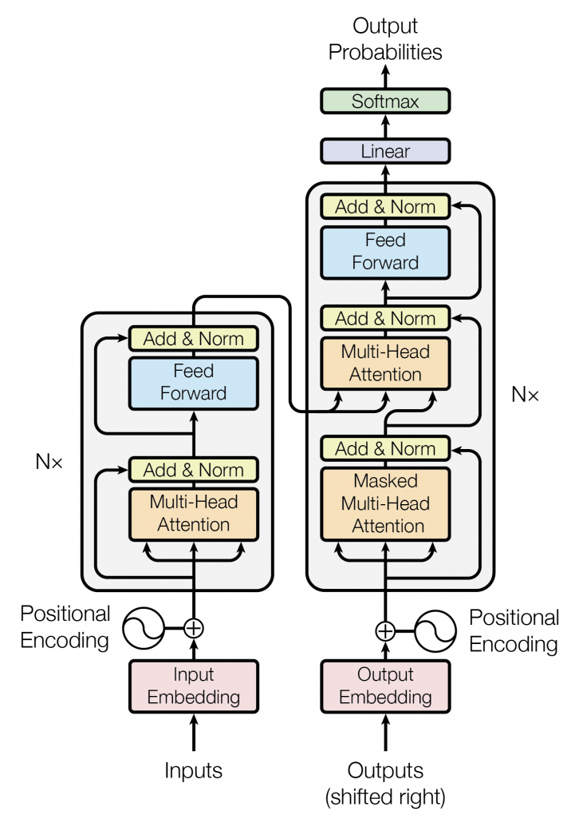
Neural Machine Translation (NMT)
Attention in Decoder:
Encoder-decoder attention
Corresponds to translation model
Self-attention
Corresponds to language model

Slide 22
Neural Machine Translation (NMT)
NMT has superseded statistical MT
Better translations and more fluent target language sentences
Trained end-to-end
Single network that takes input sentence and generates output sentence
Statistical MT required submodels for intermediate things such as word-alignments
Where does NMT fall in the Vauquois Triangle?
From users’ perspective direct transfer, but probably implicitly goes up the triangle in deeper layers

Slide 23
Training Data for MT
For training statistical or deep learning models, training data is needed in the form a parallel corpus or bitext that contains the same set of documents/sentences in the two languages
One well-known old corpus: The Canadian Hansards (parliamentary proceedings in French and English)
https://www.isi.edu/division3/natural-language/download/hansard/
1.3 million sentence pairs
CLARIN: 82 parallel corpora
https://www.clarin.eu/resource-families/parallel-corpora
Other parallel corpora:
http://www.statmt.org/moses/?n=Moses.LinksToCorpora
Includes multilingual sentences from European parliament (EU)
https://ai4bharat.iitm.ac.in//samanantar/
Parallel corpora collection between English and Indian languages

Slide 24
A Sample from Hansards Corpus
English | French
THIRTY-SIXTH PARLIAMENT OPENING OF FIRST SESSION Parliament having been summoned by Proclamation to meet this day for the dispatch of business: The Senate met at 10:30 a.m. COMMUNICATION FROM GOVERNMENT HOUSE The Hon. the Speaker: Honourable senators, I have the honour to inform you that I have received the following communication from Government House which reads as follows: September 22, 1997 Sir, I am commanded to inform you that the Right Honourable Antonio Lamer, Chief Justice of the Supreme Court of Canada, in his capacity as Deputy Governor General, will proceed to the Senate Chamber to open the First Session of the Thirty-Sixth Parliament of Canada on Monday, the 22nd day of September, 1997, at 11:00 a.m. I have the honour to be, Secretary to the Governor General The Speaker of the Senate The Hon. the Speaker: Honourable senators, pursuant to rule 135(4), the sitting is suspended until 10:55 a.m. | TRENTE-SIXIÈME LÉGISLATURE OUVERTURE DE LA PREMIÈRE SESSION Le Parlement ayant été convoqué par proclamation pour l'expédition des affaires aujourd'hui, La séance est ouverte à 10 h 30. COMMUNICATION DE LA RÉSIDENCE DU GOUVERNEUR GÉNÉRAL Son Honneur le Président: Honorables sénateurs, j'ai l'honneur de vous informer que j'ai reçu la lettre suivante de la résidence du Gouverneur général: Le 22 septembre 1997 Monsieur le Président, Je suis chargé de vous faire part que le très honorable Antonio Lamer, Juge en chef de la Cour suprême du Canada, en sa qualité de Gouverneur général suppléant, se rendra à la salle du Sénat aujourd'hui,le lundi 22 septembre 1997, à 11 heures pour ouvrir la première session de la trente-sixième législature du Canada. Veuillez agréer, La secrétaire du Gouverneur général Le Président du Sénat Son Honneur le Président: Honorables sénateurs, conformément au paragraphe 135(4) du Règlement, la séance est suspendue jusqu'à 10 h 55.

Slide 25
Human Evaluation of MT
Ask humans to estimate (some fixed scale) MT output on several dimensions
Fluency: Is the result grammatical, understandable, and readable in the target language
Fidelity: Does the result correctly convey the information in the original source language.
If rater is bilingual: judge translated sentences with respect to the source sentences
If rater is monolingual: judge translated sentences with respect to the reference translations

Slide 26
Automatic Evaluating MT
Human subjective evaluation is the best but is time-consuming and expensive
Need an automated evaluation measure
Cheaper and faster than human evaluation
Could be used to evaluate multiple models and their variations (e.g. tuning parameters on validation set) to select the best model

Slide 27
Automatic Evaluating MT
Is there always one correct translation?
Maria no dió una bofetada a la bruja verde.
Mary did not slap the green witch.
Mary did not smack the green witch.
Mary did not hit a green sorceress
How do we evaluate if there are multiple correct answers?
Common evaluation measures, such as accuracy, precision, recall, etc. are not appropriate for MT

Slide 28
Automatic Evaluation of MT
Collect one or more human reference translations of the source
Compare MT output to these reference translations
Score result based on similarity to the reference translations
Multiple evaluation measures:
BLEU
ROGUE
NIST
TER
METEOR
Slides 28-37 are adapted from Ray Mooney’s NLP course at UT Austin.

Slide 29
BLEU
BiLingual Evaluation Understudy - BLEU
Determine number of n-grams of various sizes that the MT output shares with the reference translations
Compute a modified precision measure of the n-grams in MT result

Slide 30
BLEU Example
Cand 1: Mary no slap the witch green.
Cand 2: Mary did not give a smack to a green witch.
Ref 1: Mary did not slap the green witch.
Ref 2: Mary did not smack the green witch.
Ref 3: Mary did not hit a green sorceress.
Cand 1 Unigram Precision: 5/6

Slide 31
BLEU Example
Cand 1: Mary no slap the witch green.
Cand 2: Mary did not give a smack to a green witch.
Ref 1: Mary did not slap the green witch.
Ref 2: Mary did not smack the green witch.
Ref 3: Mary did not hit a green sorceress.
Cand 1 Bigram Precision: 1/5

Slide 32
BLEU Example
Cand 1: Mary no slap the witch green.
Cand 2: Mary did not give a smack to a green witch.
Ref 1: Mary did not slap the green witch.
Ref 2: Mary did not smack the green witch.
Ref 3: Mary did not hit a green sorceress.
Clip match count of each n-gram to maximum
count of the n-gram in any single reference
translation (if there were ten “a”s in Cand 2, we do not want
to count all of them as correct!)
Cand 2 Unigram Precision: 7/10

Slide 33
BLEU Example
Cand 1: Mary no slap the witch green.
Cand 2: Mary did not give a smack to a green witch.
Ref 1: Mary did not slap the green witch.
Ref 2: Mary did not smack the green witch.
Ref 3: Mary did not hit a green sorceress.
Cand 2 Bigram Precision: 4/9

Slide 34
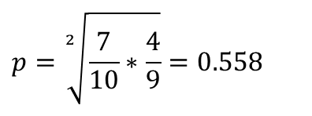
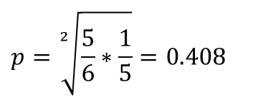
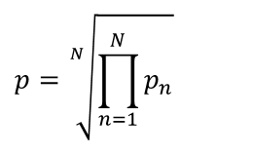
Modified N-Gram Precision
Geometric mean of n-gram precision over all n-grams up to size N (typically 4)
$$p=\sqrt[N]{\prod_{n=1}^{N}{p_{n}}}$$
$$p=\sqrt[2]{\frac{5}{6}∗\frac{1}{5}}=0.408$$
Cand 1:
$$p=\sqrt[2]{\frac{7}{10}∗\frac{4}{9}}=0.558$$
Cand 2:

Slide 35
Brevity Penalty
Perfect precision can be obtained when just one matching word is output – hence also need a recall-type measure
Not easy to compute recall to complement precision since there are multiple alternative gold-standard references and don’t need to match all of them
Instead, use a penalty for translations that are shorter than the reference translations
Define effective reference length, r, for each sentence as the length of the reference sentence with the largest number of n-gram matches. Let c be the candidate sentence length.

Slide 36
BLEU Score
Final BLEU Score: BLEU = BP × p
Cand 1: Mary no slap the witch green.
Best Ref: Mary did not slap the green witch.
Cand 2: Mary did not give a smack to a green witch.
Best Ref: Mary did not smack the green witch.

Slide 37
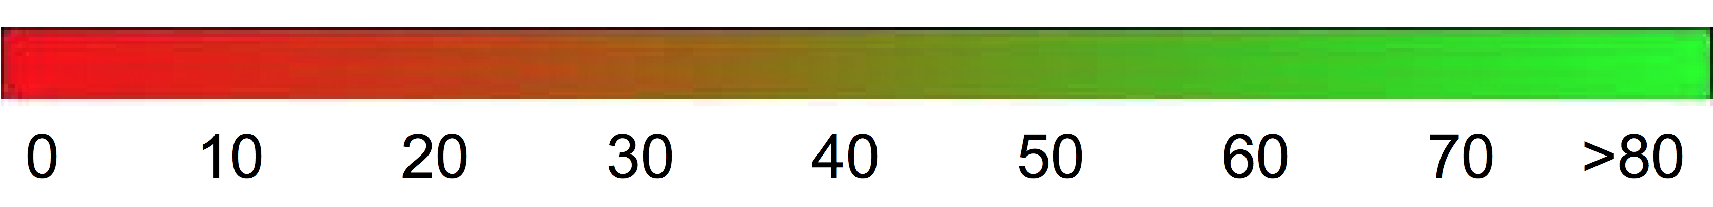
BLEU Score
Between 0 and 1, higher the better
Sometimes reported as percentage, 0-100
Interpretability:
Over 30: Understandable translations
Over 50: Good and fluent translations

Slide 38
BLEU Score
Implemented in Hugging Face’s evaluate library:
https://huggingface.co/spaces/evaluate-metric/bleu
https://huggingface.co/spaces/evaluate-metric/sacrebleu

Slide 39
BLEU Score Issues
BLEU has been shown to correlate with human evaluation when comparing outputs from different MT systems
Limitations
It does not consider meaning
It does not consider sentence structure
It does not handle morphology well
Better MT evaluation metric is a research topic
Other MT evaluation metrics have been proposed that claim to be overcome the limitations of BLEU

Slide 40
MT Systems
Google Translate
https://translate.google.com/
Microsoft Translator
https://www.bing.com/translator
Systran Translate
https://www.systran.net/en/translate/
Oldest MT company
Apertium
https://www.apertium.org/
Open source

Slide 41
MT Tools
Hugging Face
One can fine-tune pre-trained T5 transformer model
https://huggingface.co/docs/transformers/tasks/translation
Keras
See MT code examples
https://keras.io/examples/nlp/

