Slide 1

Natural Language Processing
Rohit Kate
Attention Mechanism

Slide 2
Reading
Sections 8.1-8.3 (skip 8.2.2), Textbook 1

Slide 3
Recall: RNN-Based Encoder-Decoder Architecture
Used for applications such as machine translation, in which the input and output sequences could be of different lengths
Encoder (e.g. LSTM) maps one sequence to a "deep vector“, also called “context vector”, then decoder (another LSTM) maps this vector to an output sequence
Model is trained on input/output pairs of sequences
Encoder
LSTM
Decoder
LSTM
I₁, I₂,…,I_{n}
h_{n}
O₁, O₂,…,O_{m}

Slide 4
RNN-Based Encoder-Decoder Architecture
An example:
Context vector
arbolito
verde
h1
h2
h3
LSTM
LSTM
LSTM
LSTM
LSTM
s1
green
small
tree
Encoder (Input: English)
Decoder (Output: Spanish)

Slide 5
Drawback
The context vector carries the “load” of the entire input sentence
Can every sentence be crammed into a fixed-size vector?
This is a huge bottleneck
As input sentences become longer, this mechanism is less likely to work well
But the vector has to be of fixed size – why?

Slide 6
Human Encoder-Decoder
Do humans translate by reading the sentence once and then only using its mental representation while translating?
They may look back at the sentence multiple times
For generating every word of the translation, they may look for the relevant words in the original sentence

Slide 7
Removing the Drawback
Can we achieve the following:
Not cram the whole input sentence into one vector
Allow decoder to look at the entire input at each step
And pay attention to the relevant parts of the input
But still use a fixed length vector!

Slide 8
Removing the Drawback
When generating the first word:
arbolito
LSTM
s1
Context vector
???
h1
h2
h3
LSTM
LSTM
LSTM
green
small
tree

Slide 9
Removing the Drawback
When generating the second word:
arbolito
verde
LSTM
LSTM
s1
Context vector
Current state of the decoder
???
h1
h2
h3
LSTM
LSTM
LSTM
green
small
tree

Slide 10
Removing the Drawback
Can we just concatenate h1, h2, h3 etc.?
Then a longer sequence will require the decoder to take a larger input size => no longer a fixed length

Slide 11
Attention Mechanism
Let us do the following:
Take a weighted sum of h1, h2 & h3 based on their “similarity” with s1
That is, get a context (s1) dependent summary of the input (h1, h2 and h3)

Slide 12
Attention Mechanism
arbolito
LSTM
LSTM
s1
Context vector
h1*f(s1,h1) + h2*f(s1,h2) + h3*f(s1,h3)
h1
h2
h3
LSTM
LSTM
LSTM
green
small
tree
f: Function, such as cosine similarity (with softmax, so that they add to 1)

Slide 13
Attention Weights
arbolito
verde
Which word is most relevant?
LSTM
LSTM
s1
Context vector
h1*0.9 + h2*0.05 + h3*0.05
h1
h2
h3
LSTM
LSTM
LSTM
green
small
tree

Slide 14
Attention Weights
Loosely speaking, alignments will be like these based on the weights (after having trained with a large parallel corpus)
arbolito
verde
green
small
tree
green
small
tree

Slide 15
Attention Mechanism
What have we achieved?
Get a context-dependent summary of the input to generate each output word
Instead of cramming the whole sentence into one vector and passing it for generating all the words
Still use a fixed sized vector at every step
Additionally, we have a mechanism to pay more attention to more relevant words at each step
Attention is a mechanism in neural networks to focus on the relevant parts of the input depending on the context

Slide 16
Attention Mechanism
In the terminology of attention mechanism:
values
query
keys
h1*f(s1,h1) + h2*f(s1,h2) + h3*f(s1,h3)
In this case, keys and values were same (they often are).
The terminology comes from information retrieval.

Slide 17
Attention Mechanism
There are multiple ways to define the “f” function between query and keys (also called compatibility or alignment function)
Similarity functions, e.g. cosine similarity
Functions with learnable weights
We will get to this later
It needs to go through softmax so that the attention weights add to 1

Slide 18
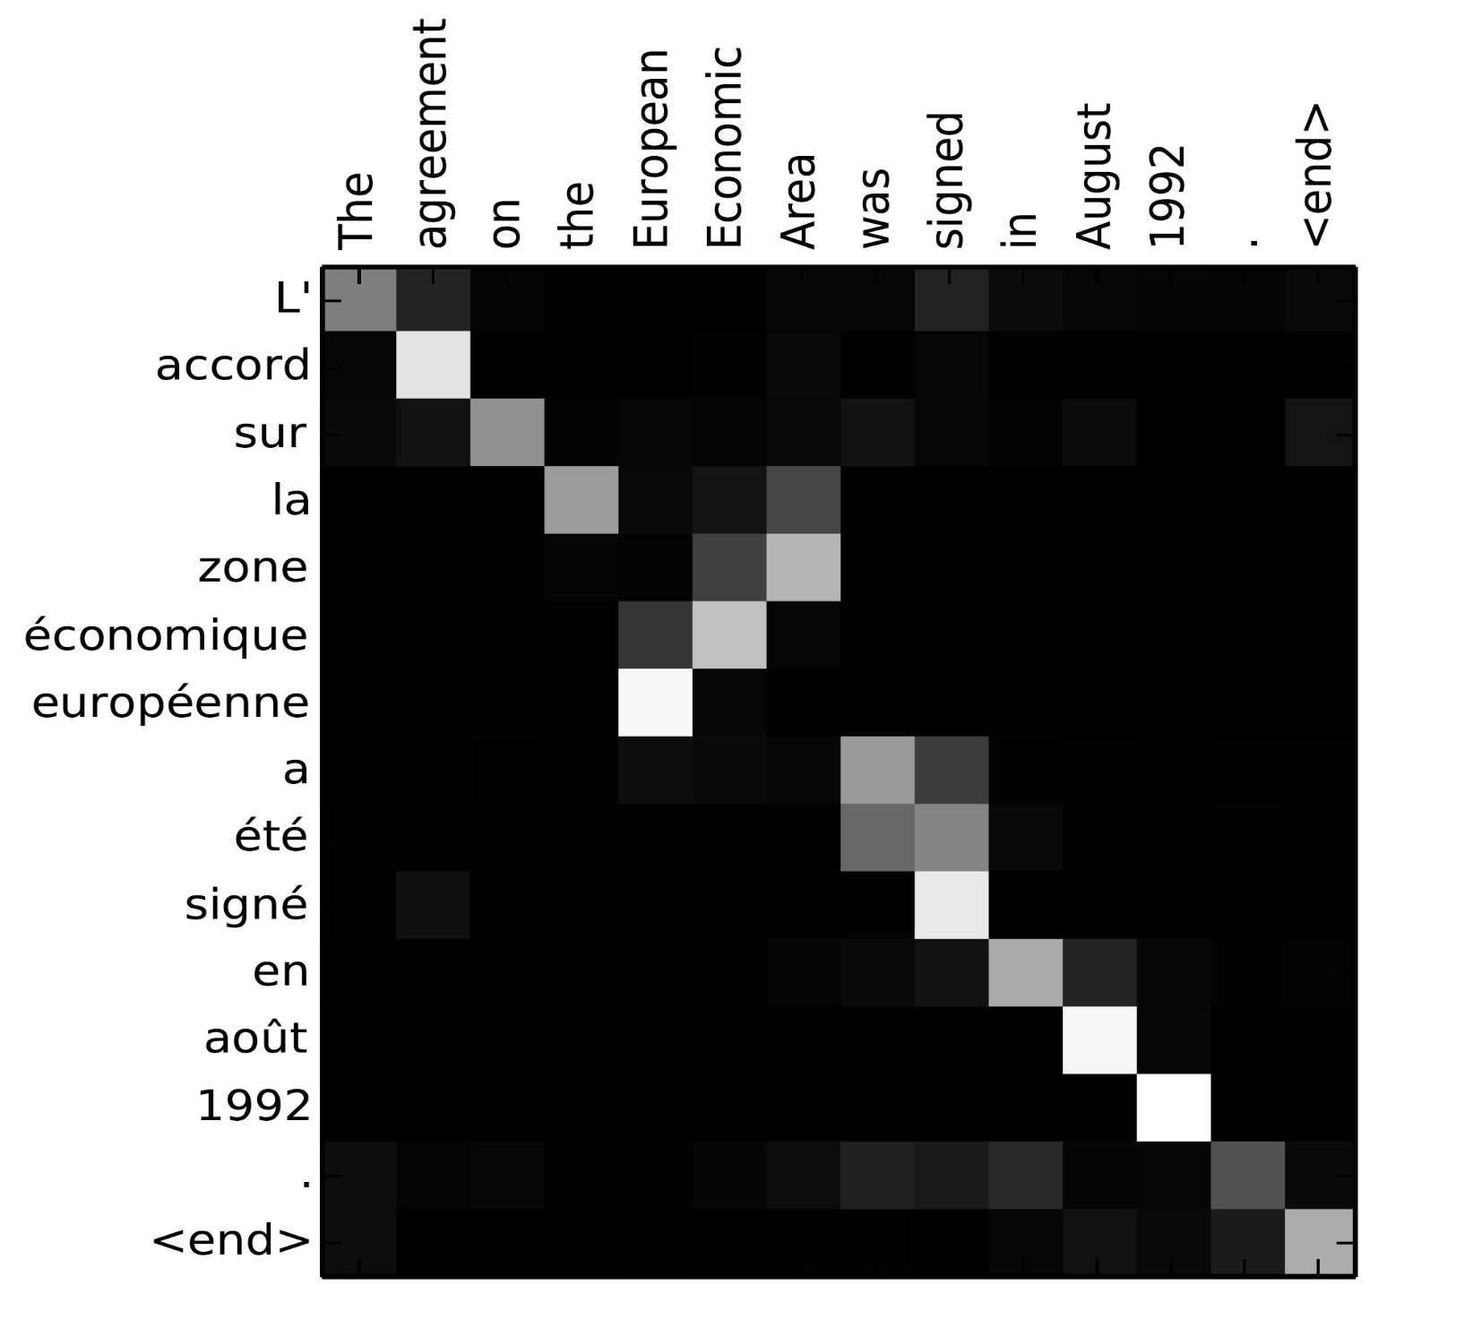
Attention for Interpretation
Alignment matrix for a French sentence and its English translation.
Image from Bahdanau et al., 2015

Slide 19
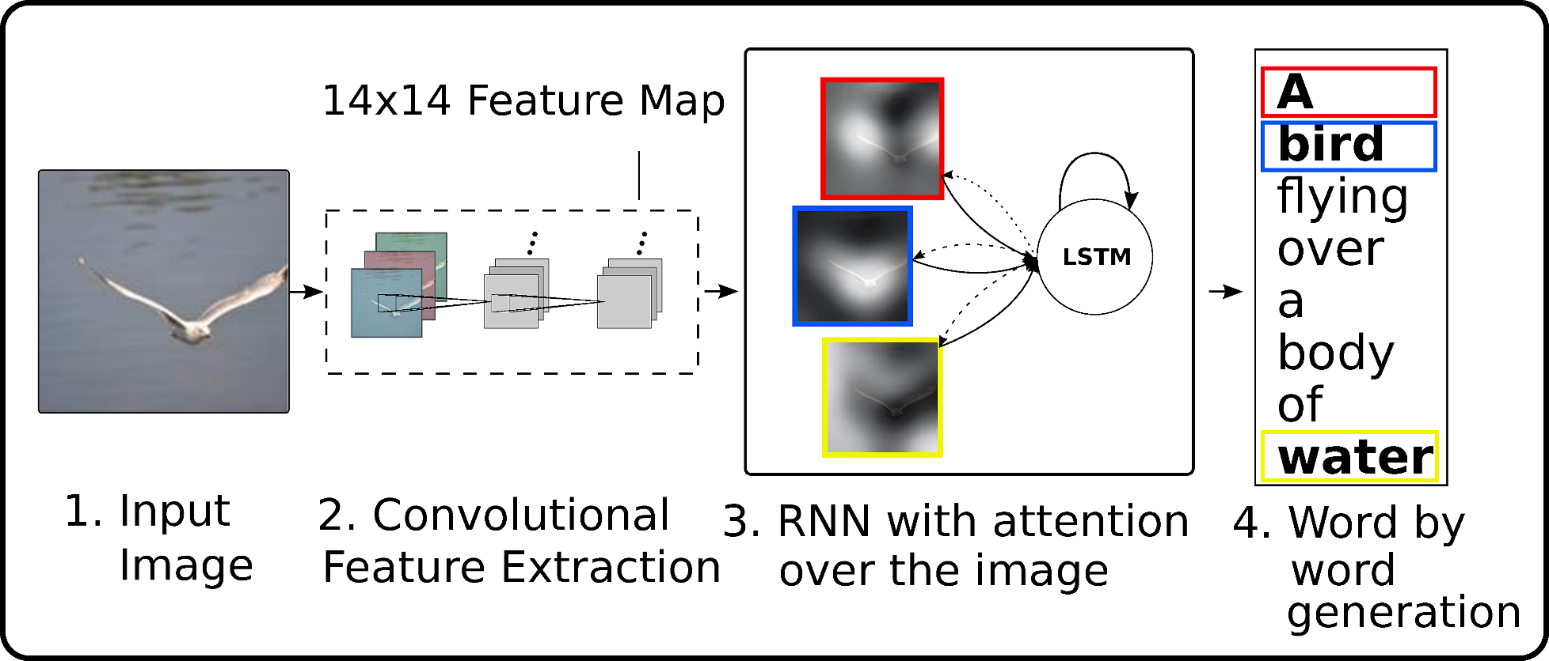
Attention for Interpretation
Attention-based caption generation: Given an image, automatically generate its caption
Image is first transformed to feature maps using convolutional neural networks
An attention-based RNN generates its caption
Attention over image feature maps
Image from Xu et al. 2015.

Slide 20


Attention for Interpretation
Attention weights can be used to get insights into where the network was looking in the image when it generated a word
A bird flying over a body of water .
Image from Xu et al. 2015.

Slide 21
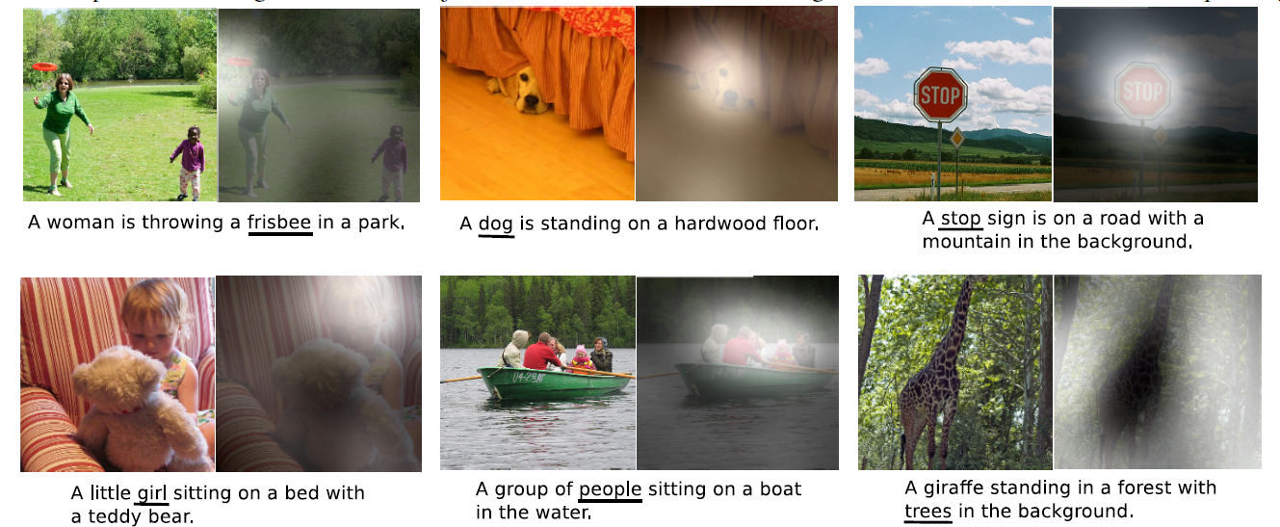
Attention for Interpretation
Image from Xu et al. 2015.

Slide 22
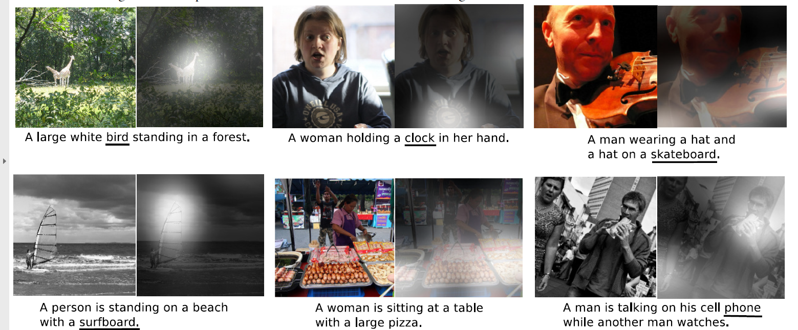
Attention for Interpretation
It can also be used to get insights into its mistakes
Image from Xu et al. 2015.

Slide 23
Sequential RNNs
Let us look at this again:
Why not do the same
thing here??
We have now removed this
bottleneck using attention
arbolito
verde
h1
h2
h3
LSTM
LSTM
LSTM
LSTM
LSTM
s1
green
small
tree
Encoder (Input: English)
Decoder (Output: Spanish)

Slide 24
Self-Attention
Instead of cramming the sequence seen so far into a vector (hidden state) and looking at only the new element, the basic idea is that everything looks at (pays attention to) everything else
When the context for attention is also from the input, it is called self-attention
Query, key and values are all from the same input

Slide 25
Self-Attention
green
small
tree

Slide 26
Self-Attention
green
small
tree

Slide 27
Self-Attention
green
small
tree

Slide 28
Self-Attention
New representation of green in terms of green, small and tree
Also known as contextual embedding: Interpreting a word in its context
green*f(green,green) +
small*f(green,small) +
tree*f(green,tree)
green*f(small,green) +
small*f(small,small) +
tree*f(small,tree)
green*f(tree,green) +
small*f(tree,small) +
tree*f(tree,tree)
green
small
tree
Note: Each word stands for its vector representation (embedding)

Slide 29
Self-Attention
New representation of small in terms of green, small and tree
green*f(green,green) +
small*f(green,small) +
tree*f(green,tree)
green*f(small,green) +
small*f(small,small) +
tree*f(small,tree)
green*f(tree,green) +
small*f(tree,small) +
tree*f(tree,tree)
green
small
tree

Slide 30
Self-Attention
New representation of tree in terms of green, small and tree
green*f(green,green) +
small*f(green,small) +
tree*f(green,tree)
green*f(small,green) +
small*f(small,small) +
tree*f(small,tree)
green*f(tree,green) +
small*f(tree,small) +
tree*f(tree,tree)
green
small
tree

Slide 31
Self-Attention
Attention terminology:
green*f(green,green) +
small*f(green,small) +
tree*f(green,tree)
values
query
keys

Slide 32
Learnable Attention
What if the compatibility function (f) need to be different for different tasks?
May be for one application, “tree” should use the context of “green” more than “small”, and in another application use the context of “small” more than “green”
Solution: Introduce learnable weights for query, keys and values
But the same weights for all words – why?
Weights will be learned to adapt to the task

Slide 33
Learnable Attention
green_{v}
green_{q}
green_{k}
Dense (W_{values})
Dense (W_{query})
Dense
(W_{keys})
green
green
green

Slide 34
Learnable Attention
small_{v}
small_{q}
small_{k}
Dense (W_{values})
Dense (W_{query})
Dense
(W_{keys})
small
small
small

Slide 35
Learnable Attention
tree_{v}
tree_{q}
tree_{k}
Dense (W_{values})
Dense (W_{query})
Dense
(W_{keys})
tree
tree
tree

Slide 36
Learnable Attention
green_{v}*f(green_{q},green_{k}) +
small_{v}*f(green_{q},small_{k}) +
small_{v}*f(green_{q},tree_{k})
green’ =
green → green’
Attentions
green
small
tree
f: Function, such as cosine similarity (with softmax, so that they add to 1)

Slide 37
Learnable Attention
green_{v}*f(small_{q},green_{k}) +
small_{v}*f(small_{q},small_{k}) +
small_{v}*f(small_{q},tree_{k})
small’ =
small → small’
green
small
tree

Slide 38
Learnable Attention
green_{v}*f(tree_{q},green_{k}) +
small_{v}*f(tree_{q},small_{k}) +
small_{v}*f(tree_{q},tree_{k})
tree’ =
tree → tree’
green
small
tree

Slide 39
Advantages of Self-Attention
Through self-attention, a word gets interpreted in its context
It gets rid of the sequential nature and allows access to all the words at all the times
No issue of long-distance dependencies now!
Note: We are moving away from RNNs towards a different type of architecture
Also, faster than sequential computation, because now all can be computed in parallel
A new representation of the entire input is created (adapted to the task)
Also called self-attention layer

Slide 40
Self-Attention Inside Encoder
Self-attention can be used inside an encoder to get a new representation of the input (each word interpreted in the context)
green’
small’
tree’
Self-attention
green
small
tree

Slide 41
Multiple Layers
Why stop at one representation?
Just like multiple layers in a neural network, we can do it again a few times!
Each newer representation builds on top of the older representation and is thus allows a higher level of interpretation

Slide 42
Self-Attention Inside Encoder
We can use multiple layers of self-attention layers:
New representations
Complete Encoder
green’’’’’
small’’’’’
tree’’’’’
Self-attention
green’’’’
small’’’’
tree’’’’
Self-attention
green’’’
small’’’
tree’’’
Self-attention
green’’
small’’
tree’’
Self-attention
green’
small’
tree’
Self-attention
green
small
tree

Slide 43
Self-Attention Inside Encoder
This final encoding can be then used in the encoder-decoder architecture
Self-attention in the encoder
Attention mechanism connecting encoder to decoder (encoder-decoder attention)
Also use self-attention in the decoder
This architecture is called transformer
We will discuss it next time

