Slide 1

Natural Language Processing
Rohit Kate
Sequence-to-Sequence Models

Slide 2
Reading
Sections 6.1 and 6.4, Textbook 1

Slide 3
Sequential Models So Far
Sequence labeling:
Put a label on every element of the sequence (e.g. POS tags or BIO tags)

Slide 4
RNN-Based Sequential Labeling
B-PER
Output Layer
LSTM
John

Slide 5
RNN-Based Sequential Labeling
I-PER
Output Layer
LSTM
Smith

Slide 6
RNN-Based Sequential Labeling
O
Output Layer
LSTM
lives
Note: The prediction is not just based on the current word,
the hidden state is storing a representation of what has been generated so far.

Slide 7
RNN-Based Sequential Labeling
O
Output Layer
LSTM
in

Slide 8
RNN-Based Sequential Labeling
B-LOC
Output Layer
LSTM
Austin
Note: The final hidden state is storing a representation of the entire sentence.

Slide 9
Sequential Models So Far
Language model: Generates a sequence
Instead of predicting the label for each word, predicts the next word
Designated <start> and <end> symbols

Slide 10
RNN-Based Language Model
Please
Output Layer
LSTM
<start>

Slide 11
RNN-Based Language Model
turn
Output Layer
LSTM
Please

Slide 12
RNN-Based Language Model
off
Output Layer
LSTM
turn
Note: The prediction is not just based on the current word,
the hidden state is storing a representation of what has been generated so far.

Slide 13
RNN-Based Language Model
your
Output Layer
LSTM
off

Slide 14
RNN-Based Language Model
cell
Output Layer
LSTM
your

Slide 15
RNN-Based Language Model
phone
Output Layer
LSTM
cell

Slide 16
RNN-Based Language Model
<end>
Output Layer
LSTM
phone

Slide 17
Machine Translation Task
Consider the task translating a sentence from one language into another language
Can we use sequential labeling or language model for this task?
Multiple words may translate to one word
Word order may be different
One word may translate to multiple words
Spanish
Maria no daba una bofetada a la bruja verde .
English
Mary did not slap the green witch .

Slide 18
Machine Translation Task
We cannot use sequence labeling model
Cannot label one word with one word from the second language
We cannot use language model
While it can generate a probable sentence in the second language starting with “<start>”, how to tell it the input sentence

Slide 19
Some Other NLP Tasks
Given a sentence respond to it (as in a chat)
“How are you?” → “I am doing fine.”
Given a text, summarize it
Just like machine translation, these tasks also take a sequence as input and generate a sequence as output which may not correspond to the input word-to-word

Slide 20
Sequence-to-Sequence Models
We need a new type of model to handle such sequential inputs and outputs
Called sequence-to-sequence or seq2seq models
Fortunately, we can combine sequential labeling type of RNN and language model type of RNN to generate a sequence to sequence model
Observations:
Sequence labeling model can generate a representation of an input sentence
Language model can generate an output sentence
We combine the two!

Slide 21
RNN-Based Sequence-to-Sequence Model
LSTM
green
witch
not
Mary
did
the
slap

Slide 22
RNN-Based Sequence-to-Sequence Model
Final hidden state
represents the sentence
LSTM
Sentence Representation
witch

Slide 23
RNN-Based Sequence-to-Sequence Model
Maria
Output Layer
LSTM
Sentence Representation

Slide 24
RNN-Based Sequence-to-Sequence Model
no
Output Layer
LSTM
Maria

Slide 25
RNN-Based Sequence-to-Sequence Model
daba
Output Layer
LSTM
no

Slide 26
RNN-Based Sequence-to-Sequence Model
una
Output Layer
LSTM
daba

Slide 27
RNN-Based Sequence-to-Sequence Model
bofetada
Output Layer
LSTM
una

Slide 28
RNN-Based Sequence-to-Sequence Model
a
Output Layer
LSTM
bofetada

Slide 29
RNN-Based Sequence-to-Sequence Model
la
Output Layer
LSTM
a

Slide 30
RNN-Based Sequence-to-Sequence Model
bruja
Output Layer
LSTM
la

Slide 31
RNN-Based Sequence-to-Sequence Model
verde
Output Layer
LSTM
bruja

Slide 32
RNN-Based Sequence-to-Sequence Model
<end>
Output Layer
LSTM
verde

Slide 33
RNN-Based Sequence-to-Sequence Model
Feed the input sentence to an RNN (sequence-labeling type but with no output) which will generate a representation in the final hidden state: Encoder
Feed the final hidden state as input (instead of <start>) to an RNN-based language model
Output of the second RNN will be the translation (after training): Decoder
Or response to a chat message, or a summary, based on training

Slide 34
RNN-Based Sequence to Sequence Model
RNN-Based Sequence-to-Sequence Model
Encoder
Maria no daba una bofetada a la bruja verde .
Decoder
Output Layer
LSTM
Sentence Representation
LSTM
Mary did not slap the green witch .

Slide 35
RNN-Based Sequence-to-Sequence Model
Encoder/Decoder framework maps one sequence to a "deep vector" then another LSTM maps this vector to an output sequence.
Encoder
LSTM
Decoder
LSTM
I₁, I₂,…,I_{n}
h_{n}
O₁, O₂,…,O_{m}
Train model "end to end" on I/O pairs of sequences.

Slide 36
RNN-Based Sequence-to-Sequence Model
One could use multiple layers of RNN for encoder
Concatenation of their final hidden states is treated as the sentence representation
One could also use bidirectional RNN for encoder
Concatenation of final state from both directions is treated as the sentence representation
Instead of LSTM cells, one could use GRU cells too
Decoder cannot be bidirectional!

Slide 37
Training
The training data for seq2seq task is several examples of pair of sequences
In machine translation, it is called a parallel corpus (corpus of sentence-translation pairs)
The two RNNs (encoder and decoder) are connected
Input goes to encoder, the target is available only for the decoder
The weights of the encoder are updated during training using backpropagation of errors from the decoder

Slide 38
Decoder
The language models we had seen before were unconditional language models
No condition to generate a sentence (begins with <start> symbol)
Decoder is a conditional language model
Generates a sentence conditioned on the input
Conditioned on the sentence representation from the encoder

Slide 39
Decoder
Generates possible words as probability distribution
Probabilities
… Maria uno verde …
Softmax
LSTM

Slide 40
Decoder Training
We know the correct words from the given target
At each step of training, we feed the correct previous word as input (regardless of what it predicted)
Use cross-entropy loss to compute the difference between the predicted probability distribution and correct probability distribution (i.e. correct word)
Total loss for the sentence is the average of all the losses incurred for all the words
The loss (i.e. error) is backpropagated to the encoder

Slide 41
Decoding
Once trained, encoder-decoder can generate an output sequence given an input sequence
Decoder can be used to generate the most probable word at a time
This is called greedy decoding
Generate a word at a time that looks best
As opposed to generating an entire best sequence

Slide 42
Decoding
Greedy decoding may sometimes lead to less likely entire sequence
Suppose after “switch off”
switch off → light 0.5
switch off → cell 0.3
It will generate “light”
But suppose the probability of the sequences were as follows (given the input)
switch off light phone 0.4
switch off cell phone 0.8
Greedy decoding may not lead to the optimal sentence generation

Slide 43
Decoding
To counter greedy decoding, beam search decoding is employed
Instead of committing to the topmost word at each step, keep multiple top words as options (equal to the width of the beam, a parameter)
Try combination of all previous words to generate the next top combinations
Larger beam width => more computational time
Beam width=1 => Greedy decoding

Slide 44
Beam Search Decoding
0.1
phone
0.5
light
now
0.2
0.8
Optimal sequence
0.6
off
cell
phone
0.3
0.1
button
motor
0.1
0.1
now
switch
0.8
button
0.1
phone
0.4
light
0.4
now
0.3
0.8
on
0.2
phone
cell
0.2
button
motor
0.5
now
0.2
button
0.4
Beam width = 3

Slide 45




Other Seq2Seq Applications
Video to Text
CNN
CNN
CNN
CNN
LSTM
LSTM
LSTM
LSTM
LSTM
LSTM
LSTM
LSTM
...
LSTM
LSTM
LSTM
LSTM
LSTM
LSTM
LSTM
LSTM
Encoding stage
A
man
is
talking
...
Decoding stage
CNN: Convolutional neural network
S2VT: Sequence to Sequence Video to Text
(Venugopalan et al. 2015)

Slide 46
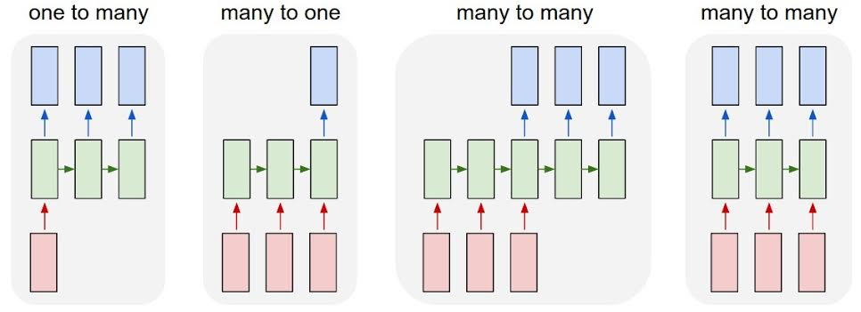
RNN Application Architectures
Image Captioning
Video Activity Recog
Text Classification
Video Captioning
Machine Translation
POS Tagging
Language Modeling

Slide 47
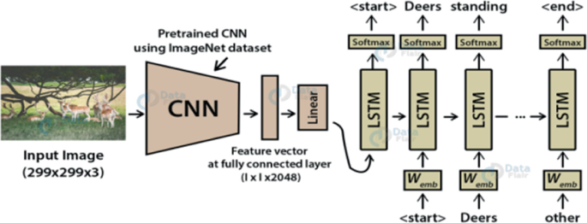
Image Captioning
Source: https://link.springer.com/chapter/10.1007/978-981-99-1983-3_37

