Slide 1


Git 101:
Git and GitHub for beginners

Slide 2

Overview
0. Install git and create Github account
1. What is version control?
2. What is git?
3. How does git work?
4. What is GitHub?
5. Quick example using git and GitHub
6. Break into teams
Github icon

Slide 3
You can find the slides at:

Slide 4
0
Install git and create GitHub account

Slide 5
Install git
Linux (Debian)
- Command: sudo apt-get install git
Linux (Fedora)
- Command: sudo yum install git
Mac
- http://git-scm.com/download/mac
Windows
- http://git-scm.com/download/win

Slide 6
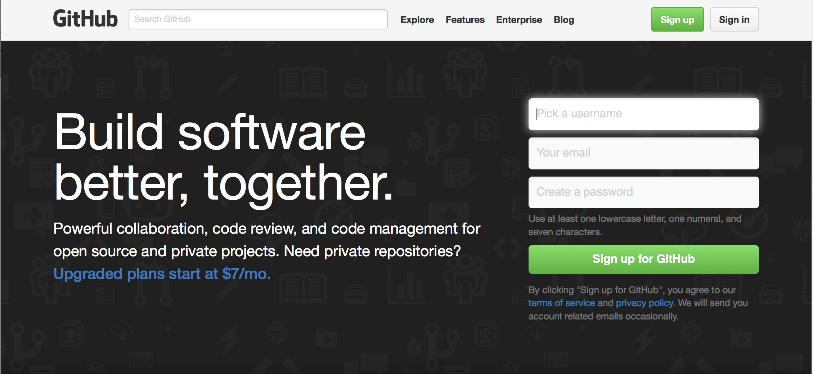
Create Github account
www.github.com
Free for public repositories

Slide 7
Please email your GitHub usernamest names
To: git101.hubspot@gmail.com
Needed to add everyone as collaborators of the tutorial repository

Slide 8
A quick request…

Slide 9
Ask questions!

Slide 10
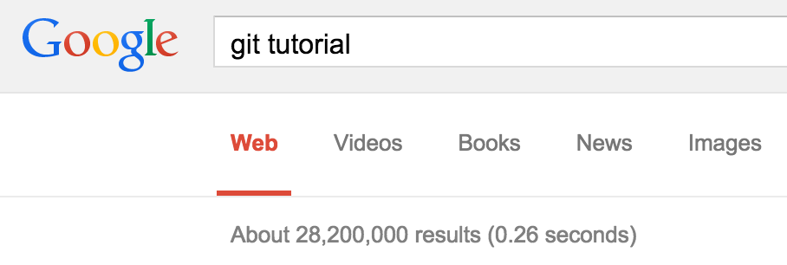

Slide 11
1
What is version control?

Slide 12
A world without version control

Slide 13
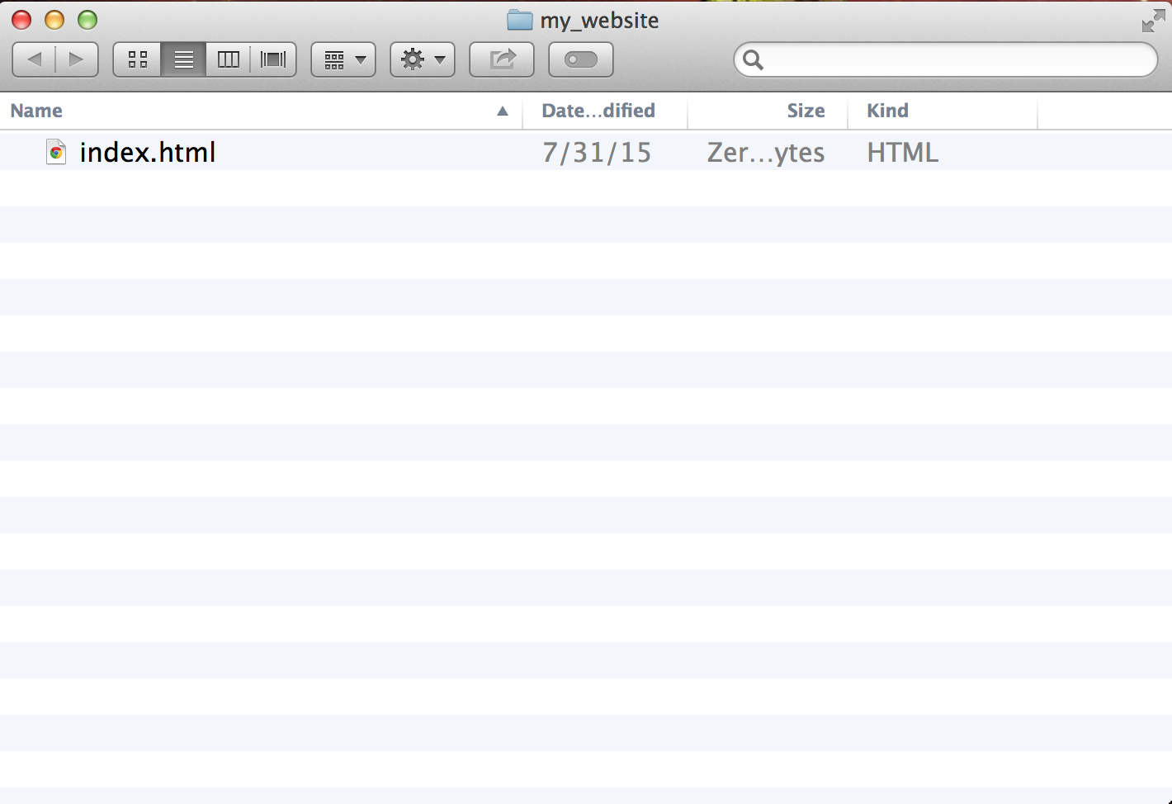
A world without version control

Slide 14
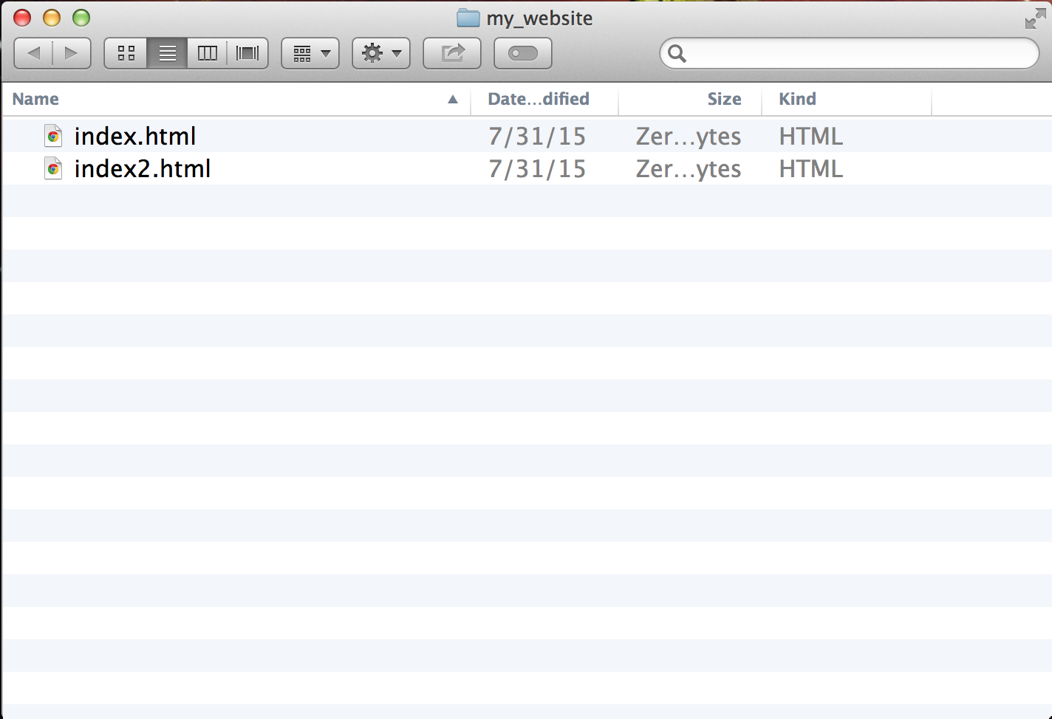
A world without version control

Slide 15
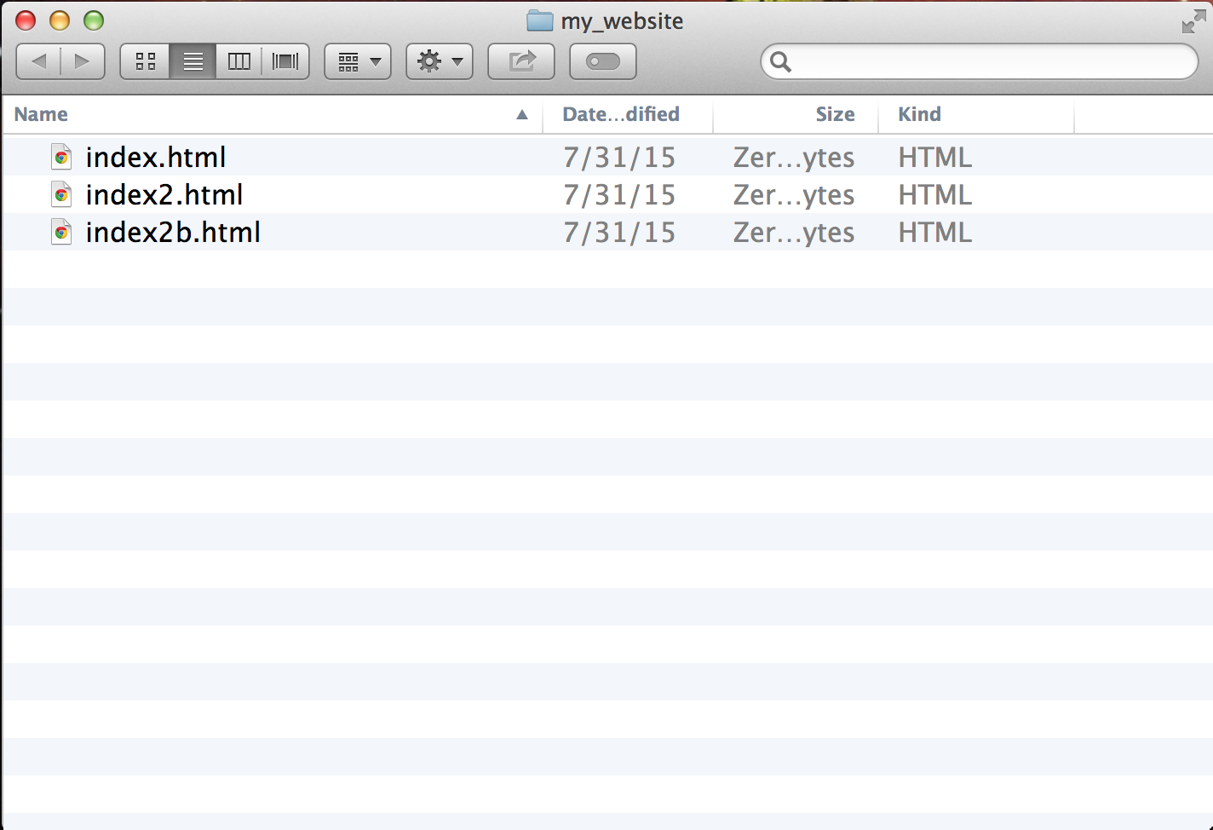
A world without version control

Slide 16
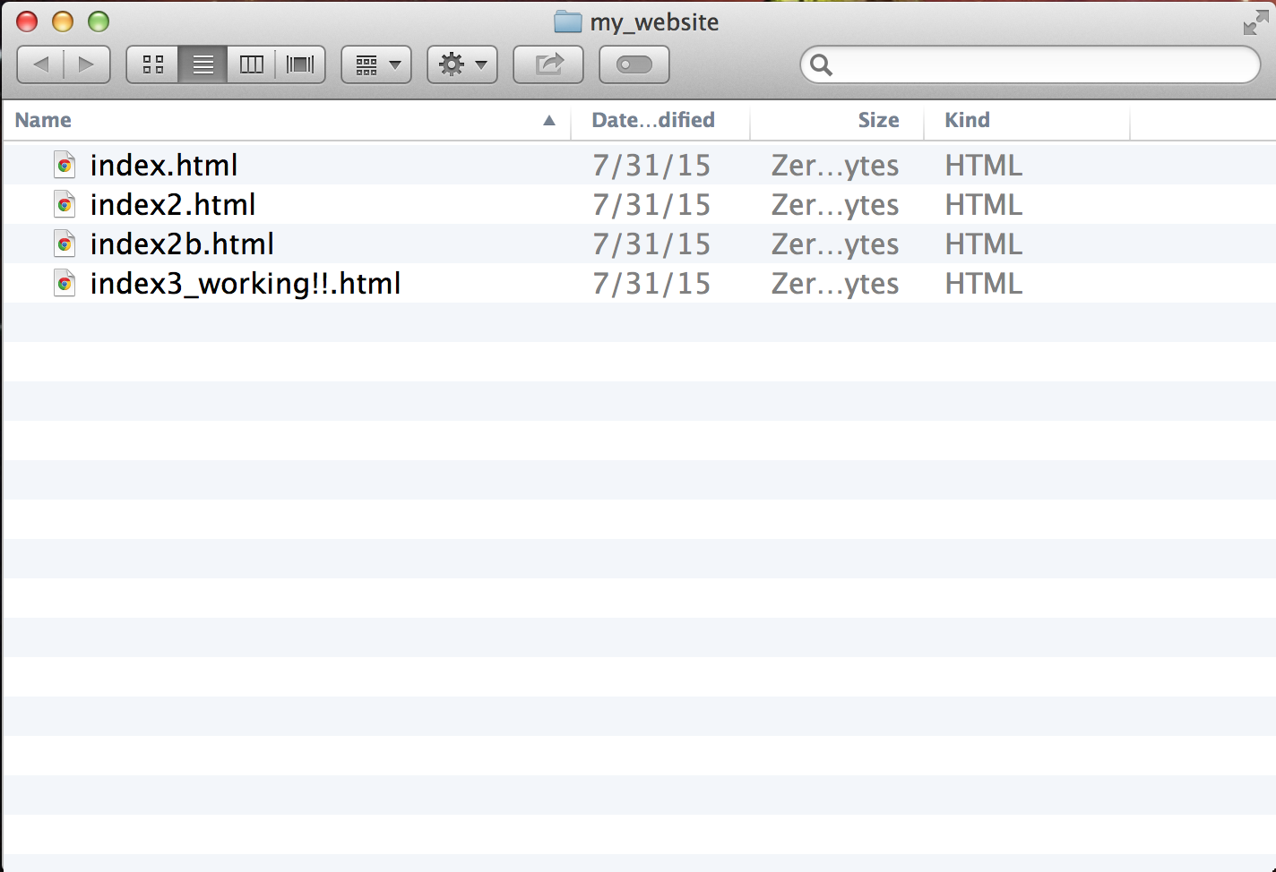
A world without version control

Slide 17
What is version control?

Slide 18
What is version control?
A system that keeps records of your file changes

Slide 19
What is version control?
A system that keeps records of your file changes
Allows for team collaboration

Slide 20
What is version control?
A system that keeps records of your file changes
Allows for team collaboration
Allows you to know who made what change, when

Slide 21
What is version control?
A system that keeps records of your changes
Allows for collaborative development
Allows you to know who made what change, when
Allows you to revert any changes and go back to a previous state

Slide 22
2
What is git?

Slide 23
What is version control?
Distributed version control
Users keep entire code and history on their location machines.
Users can make any changes without internet access
(except pushing and pulling changes from a remote server)

Slide 24

What is git?
Started in 2005
Created by Linus Torvald to aid in Linux kernel development
Git icon

Slide 25
What is git?
Git isn’t the only version control system

Slide 26

What is git?
Git isn’t the only version control system

Slide 27

What is git?
Git isn’t the only version control system

Slide 28

What is git?
Git isn’t the only version control system

Slide 29
What is git?
Git isn’t the only version control system
But it’s the
best ^{[citation needed]}

Slide 30
3
How does git work?

Slide 31
How does git work?
Can be complicated at first, but there are a few key concepts
Important git terminology in following slides are blue

Slide 32
Key Concepts: Snapshots
The way git keeps track of your code history
Essentially records what all your files look like at a given point in time
You decide when to take a snapshot, and of what files
Have the ability to go back to any snapshot
Your snapshots from later on will stay there, too

Slide 33
Key Concepts: Commit
The act of creating a snapshot
Can be a noun or verb
“I commited code”
“I just made a new commit”
Essentially, a project is made up of lots of commits

Slide 34
Key Concepts: Commit
Commits contain three pieces of information:
Information about how the files changed from previously
A reference to the commit that came before it
Called the “parent commit”
A hash code name
Will look something like: fb2d2ec5069fc6776c80b3ad6b7cbde3cade4e

Slide 35
Key Concepts: Repositories
Often shortened to ‘repo’
A collection of all the files and the history of those files
Consists of all your commits

Slide 36
Key Concepts: Repositories
Can live on a local machine or on a remote server (GitHub!)
The act of copying a repository from a remote server is called cloning
Cloning from a remote server allows teams to work together

Slide 37
Key Concepts: Branches
All commits in git live on some branch
But there can be many, many branches

Slide 38
Key Concepts: Branches
All commits in git live on some branch
But there can be many, many branches
The main branch in a project is called the master branch

Slide 39
Key Concepts: Branches
All commits in git live on some branch
But there can be many, many branches
The main branch in a project is called the master branch

Slide 40
So, what does a typical project look like?
A bunch of commits linked together that live on some branch, contained in a repository
Following images taken and modified from:
http://marklodato.github.io/visual-git-guide/index-en.html
Also a good tutorial!

Slide 41
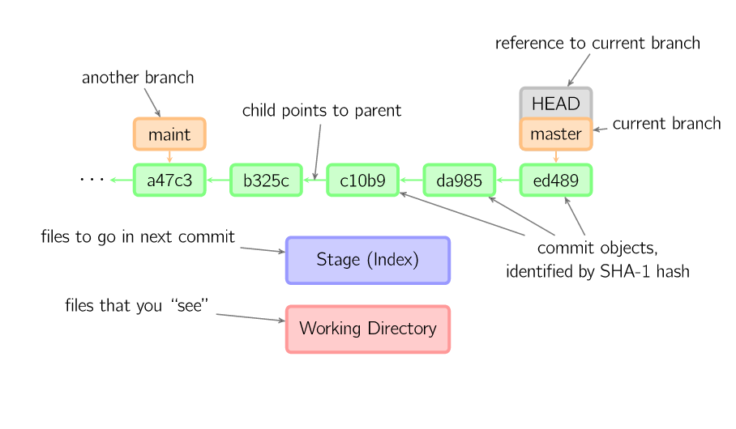
So, what does a typical project look like?
Time going forward

Slide 42
Key Concepts: Branches
Branches allow you to point at a specific commit and make changes based on that
Branches point to a specific commit… and ‘branch’ off from it

Slide 43
So, what is HEAD?
Time going forward

Slide 44
So, what is HEAD?
A reference to the most recent commit
Time going forward

Slide 45
So, what is HEAD?
A reference to the most recent commit
(in most cases – not always true!)
Time going forward

Slide 46
So, what is MASTER?
The main branch in your project
Doesn’t *have* to be called master, but almost always is!
Time going forward

Slide 47
Key Concepts:
Branches point to a specific commit
When you want to create a new feature, make a change, etc, you make a new branch based on a commit

Slide 48
Key Concepts: Branching off of the master branch
Branches point to a specific commit
When you want to create a new feature, make a change, etc, you make a new branch based on a commit

Slide 49
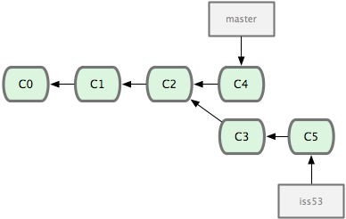
Key Concepts: Branching off of the master branch
Images from:
http://codingdomain.com/git/merging/
Time going forward

Slide 50
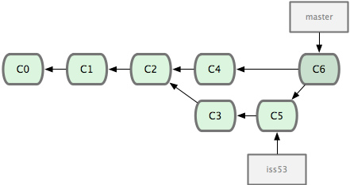
Key Concepts: Merging
Once you’re done with your feature, you merge it back into master
Time going forward

Slide 51
Key Concepts: How do you make a commit anyway?

Slide 52
Key Concepts: How do you make a commit anyway?
There are a lot of ‘states’ and ‘places’ a file can be

Slide 53
Key Concepts: How do you make a commit anyway?
There are a lot of ‘states’ and ‘places’ a file can be
Local on your computer: the ‘working directory’

Slide 54
Key Concepts: How do you make a commit anyway?
There are a lot of ‘states’ and ‘places’ a file can be
Local on your computer: the ‘working directory’
When ready to be put in a commit you put it onto into the ‘index’ or ‘staging’

Slide 55
Key Concepts: How do you make a commit anyway?
There are a lot of ‘states’ and ‘places’ a file can be
Local on your computer: the ‘working directory’
When ready to be put in a commit you put it onto into the ‘index’ or ‘staging’
Staging is the new preferred term – but you can see both ‘index’ and ‘staging’ being used.

Slide 56
Key Concepts: How do you make a commit anyway?
All git commands start with ‘git’

Slide 57
Key Concepts: How do you make a commit anyway?
The process:
Make some changes to a file
Use the ‘git add’ command to put the file onto the staging environment

Slide 58
Key Concepts: How do you make a commit anyway?
The process:
Make some changes to a file
Use the ‘git add’ command to put the file onto the staging environment
Use the ‘git commit’ command to create a new commit’.

Slide 59
Key Concepts: How do you make a commit anyway?
Time going forward

Slide 60
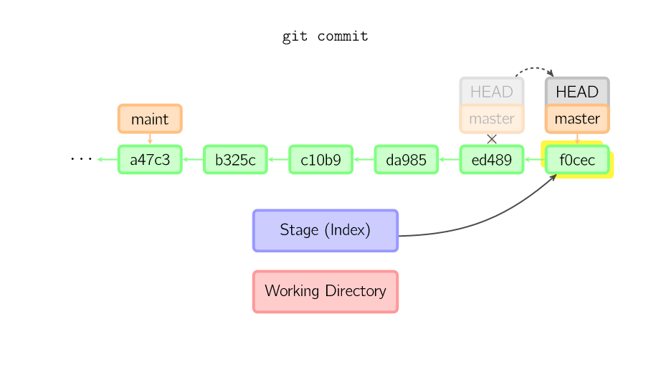
Key Concepts: How do you make a commit anyway?
Time going forward

Slide 61
4
What is GitHub?

Slide 62

What is GitHub?
www.github.com
Largest web-based git repository hosting service
Aka, hosts ‘remote repositories’
Allows for code collaboration with anyone online
Adds extra functionality ontop of git
UI, documentation, bug tracking, feature requests, pull requests, and more!
Octocat!

Slide 63
What is GitHub?
Founded in 2008
Also has an Enterprise edition for businesses
Octocat!

Slide 64
Any questions?

Slide 65
5
Quick example using git and GitHub

Slide 66
Time to break into teams!

Slide 67
http://bit.ly/1ElnhOZ
Git up, git up, git around!

Slide 68
Helpful Commands
git init
Creates a new local repository
git status
Lists all new and modified files that can be put in a commit
git add [file]
Stages one or more files so it can be put in a commit
Can be performed multiple times
git commit –am [message]
Commits the staged snapshots

Slide 69
Additional Resources

Slide 70
Additional Resources
Official git site and tutorial:
https://git-scm.com/
GitHub guides:
https://guides.github.com/
Command cheatsheet:
https://training.github.com/kit/ downloads/github-git-cheat-sheet.pdf
Interactive git tutorial:
https://try.github.io/levels/1/challenges/1
Visual/interactive cheatsheet:
http://ndpsoftware.com/git-cheatsheet.html

