Slide 1
Book My Doc
By Akash Reddy Bommireddy

Slide 2
Introduction
The "BookMyDoctor" application is designed to revolutionize the way patients access healthcare services by providing a user-friendly and efficient platform for connecting with healthcare providers. By utilizing this, patients can easily schedule appointments, access medical records, and communicate with their doctors, all from the convenience of their mobile device. With "BookMyDoctor," patients can take control of their healthcare needs and ensure they receive the personalized care they deserve.

Slide 3
Roles Involved in the BOOKMYDOC application
Administration-Admins
Doctors
Patients

Slide 4
Technologies used
Frontend : Angular
Backend : Node js
Database : MongoDB

Slide 5
ADMINS
Approves doctors registered in the application
Add/Update/Remove Specialization
Add/Update/Remove Hospitals
Can View all the appointments

Slide 6
Doctors
As a healthcare provider, you can easily register on our platform and undergo a quick admin review for approval before becoming a part of our application.
Set the availability and schedules for appointments within the app, allowing patients to easily book consultations with you.
Review and approve appointment requests, update appointment statuses, and prescribe medications after consultations, all seamlessly integrated into our user-friendly and efficient tool.

Slide 7
Patients
With the "BookMyDoctor" application, users can easily register, search for specific medical specializations, and schedule appointments with healthcare providers in just a few clicks.
Patients have the flexibility to cancel appointments if they have not yet been approved or rejected, as well as reschedule appointments to better suit their schedules.
By utilizing this app, users can conveniently access and view prescriptions stored within the tool, making it easy to stay organized and on top of their healthcare needs.

Slide 8
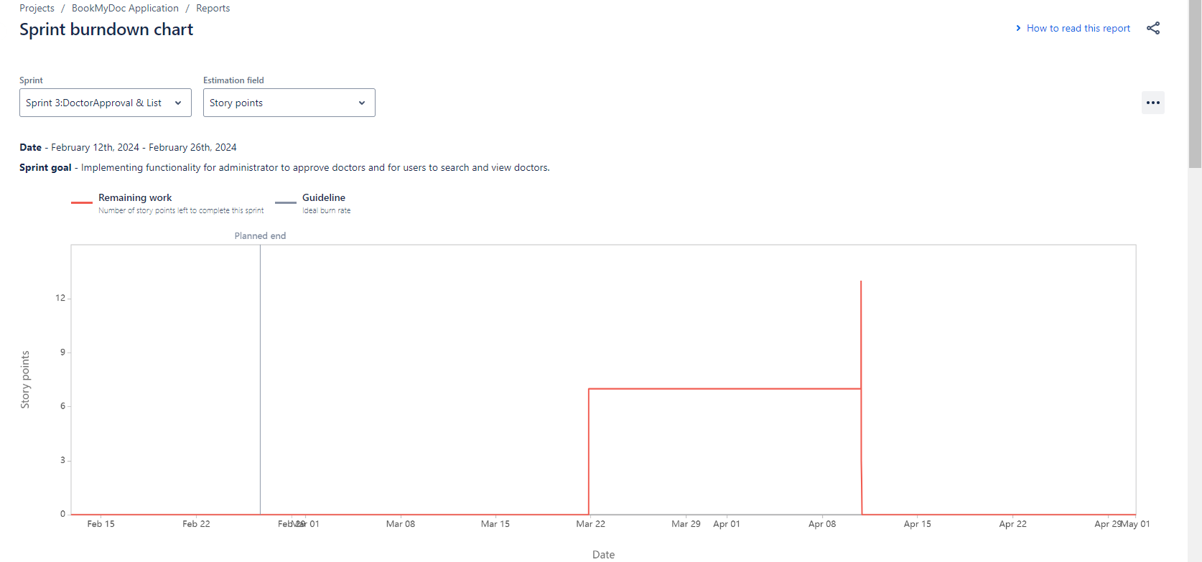
Sprint 3

Slide 9
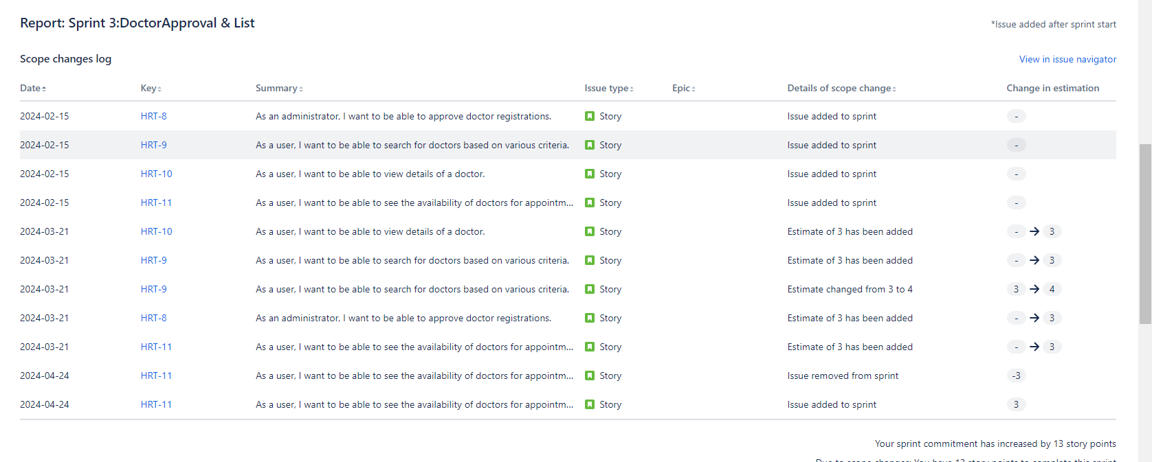
Sprint 3

Slide 10
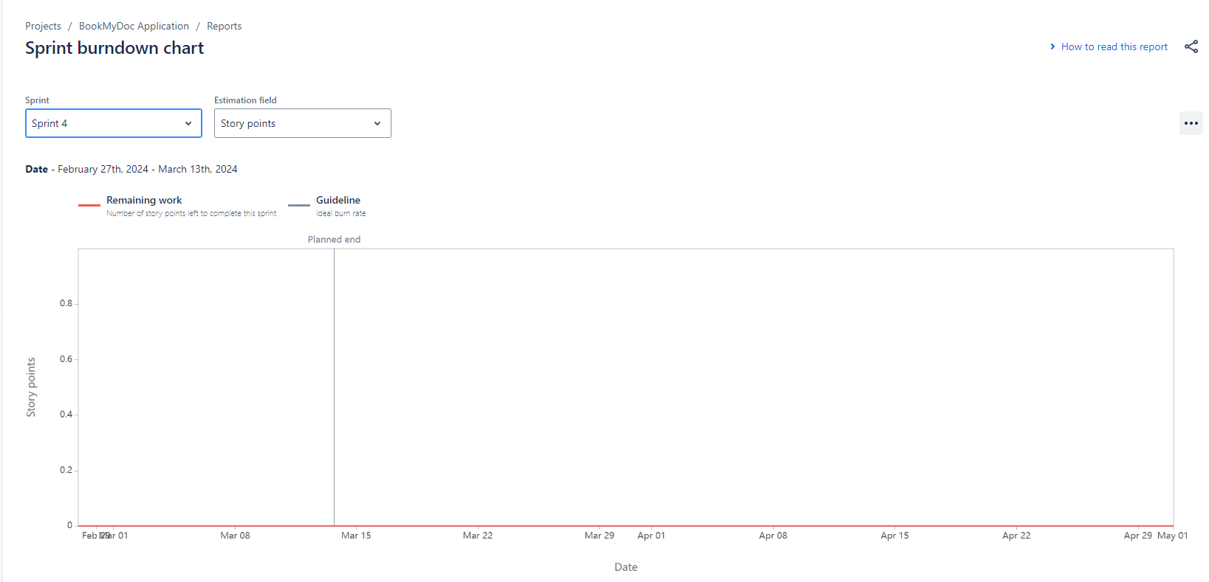
Sprint 4

Slide 11
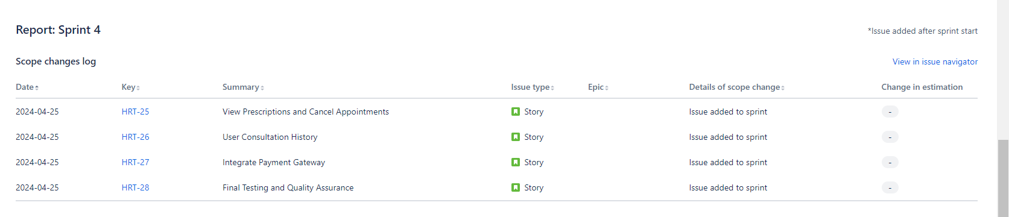
Sprint 4

Slide 12
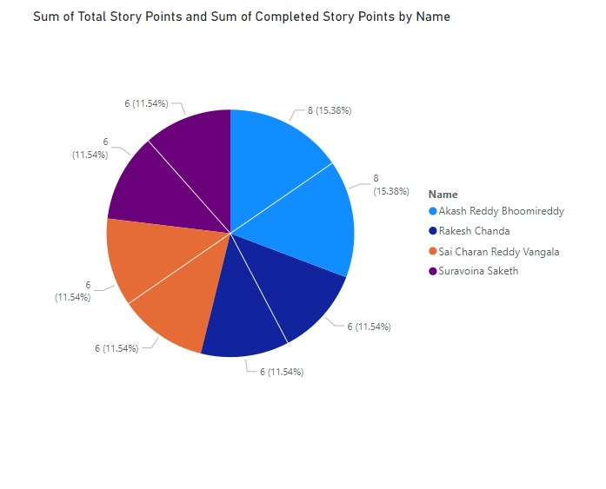
Splitting of the work

Slide 13
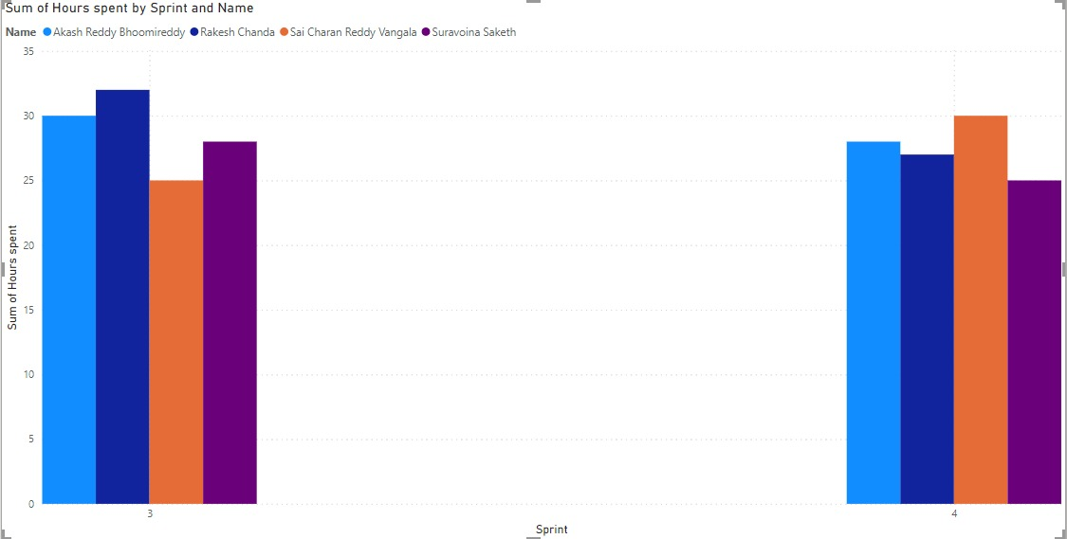
Hours Spent on Project

Slide 14
Works Well
In Sprint 3
Feature Implement
User Interface design
Backend Development
In Sprint 4
Quality Assurance
Completion of key Features

Slide 15
Didn’t well
In Sprint 3
Testing Plan
Documentation Review
In Sprint 4
More Buffer Time for Testing:
Increased focus on Security

Slide 16
Thankyou for all your patience and for all your time

