Slide 1
Graph Partition for VLSI
Team Members:
Akash Gowda K R -19BEC1129
Yeshwanth Reddy -19BEC1412
K Sai Kumar – 19BEC1073

Slide 2
Introduction
VLSI world completely revolves around integrated circuits (IC). Manufacturing process of an IC follows through a lot of different steps, out of which typically IC design cycle involves following steps:
1. System Specification.
2. Architectural Design.
3. Logic Design.
4. Logic Synthesis.
5. Physical Design.
6. Physical verification and Tapeout.
7. Wafer Fabrication.
8. Packaging.
Amongst all these steps, we will be dealing with Physical Design. Once the logical description of the design has been completely synthesized into a netlist, the physical design converts this netlist based circuit representation into a geometrical representation.

Slide 3
Contd..
Physical design further involves following steps:
1. Partitioning.
2. Floor-planning.
3.Power-planning.
4. Placement.
5. Clock-tree synthesis. (CTS)
6. Routing.
7. Timing verification.

Slide 4
Objective
Generally, It would be very time consuming or even impossible to hand-craft the circuit design of large complexity without any assistance of computer programs during all the steps discussed above. According to Moore’s law, number of transistors on a single chip doubles every 2 years, the state of the art chips consists of an entire system with millions of transistors. For example, Pentium processors from Intel has 3 million transistors. Computer programs are used widely into the industries to automate these physical design processes with no or very little human intervention. As a part of Design automation of VLSI systems course. We have to implement automatic partitioning and placement engines.

Slide 5
Role of DS/Algo analysis
Algorithm used:
Fiduccia and Mattheyeses algorithm
A classical approach to solve the Hypergraph bipartitioning problem is an iterative heuristic by Charles Fiduccia and Robert Mattheyses.This heuristic is commonly called the FM algorithm.
Data structures used:
Bucket array

Slide 6
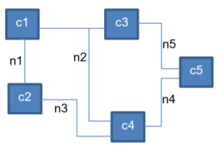
Algorithm Description
Conversion of a circuit into graph model:
we convert the circuit into Hypergraph-based model G(V,E) Where,
V: Set of cells in the circuit.
{c1, c2, c3, c4, c5}
E: Set of interconnect in the circuit.
{n1, n2, n3, n4, n5}

Slide 7
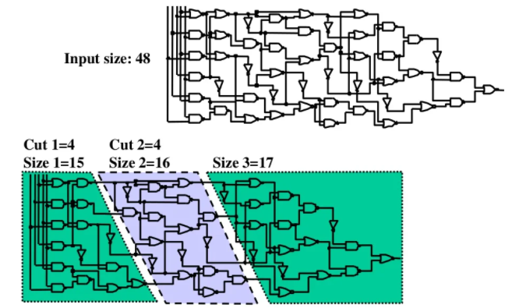
Contd..

Slide 8
Modules
Defining nodes and corresponding edges
Declaring minimum and maximum constrains
Assignment of nodes into buket arrays
Moving each node from one array to other
Calculating step gain
Calculating overall gain
Conclusion

Slide 9
ADVANTAGES
Dividing a net list into clusters to minimize number of inter-cluster connections
Influences the final quality of placement, global routing & detail routing
Interconnect dominates chip performance
– Have to minimize number of block-to-block connections (e.g. global buses)
Helps reduce chip area – Minimizes length of global wires

Slide 10

Language/Tools Used
C++
Windows / Linux OS

Slide 11
PARTITIONING WITH FIDUCCIA-MATTHEYSES ALGORITHM
A classical approach to solve the hypergraph bipartitioning problem is an iterative heuristic by Charles Fiduccia and Robert Mattheyses.
This heuristic is commonly called the FM algorithm.
WORKING:
It will move one vertex at a time to improve the cut.
Data structure wizardly makes this extremely fast.
Time complexity- O(n)

Slide 12
GAIN FOR F-M ALGORITHM
Gain = FS(x) – TE(x)
FS(x) : the no of nets that contain x as the only cell in one part
TE(x) : the no of nets that contain x entirely located in one part

Slide 13
Example 1
Graph partitioning for simple graphs

Slide 14
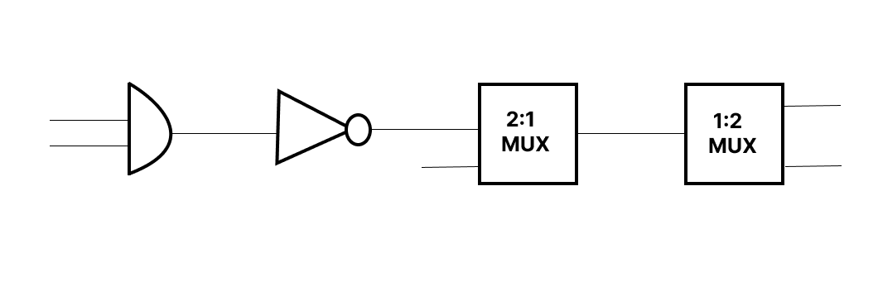
CONVERTING A CIRCUIT INTO BUCKETS AND CALCULATING CUTS
a) AND Gate
b) NOT gate
c) 2:1 MUX
d) 1:2 MUX

Slide 15
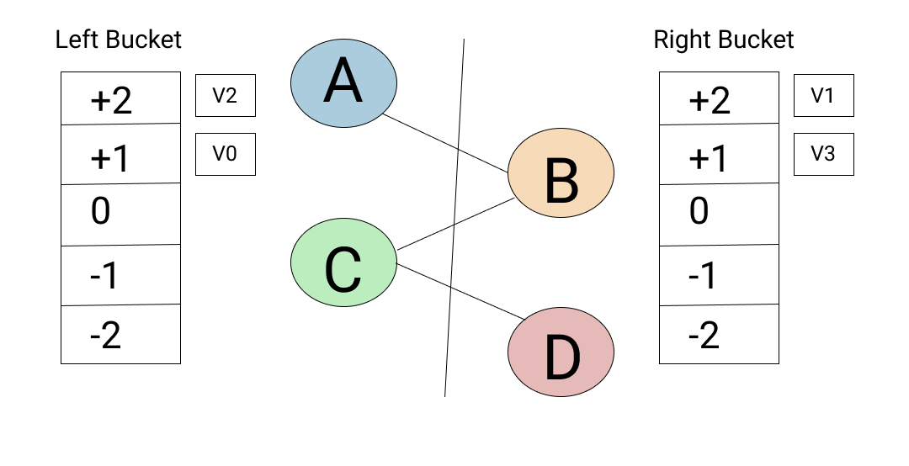
CALCULATION OF CUTS
STEP 1:
CUT | 3 | - | - | -

Slide 16
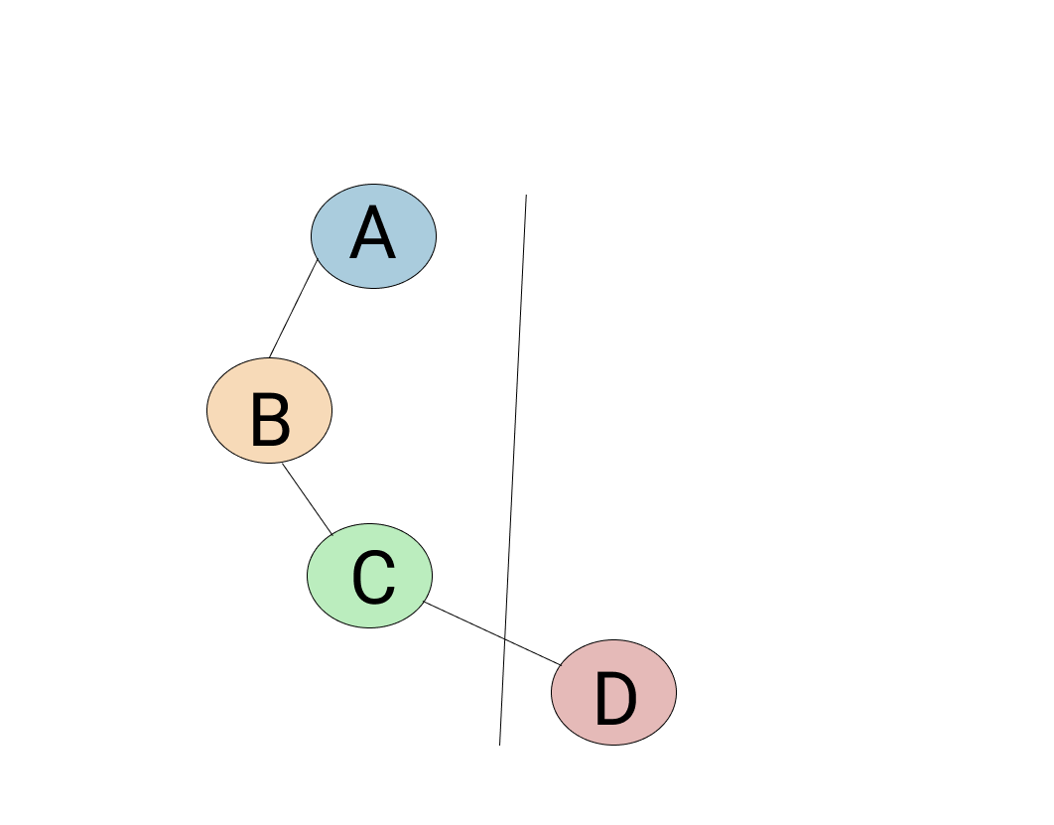
STEP 2:
 |  | V1 | V2 | V0 | V3
CUT | 3 | 1 | - | - | -

Slide 17
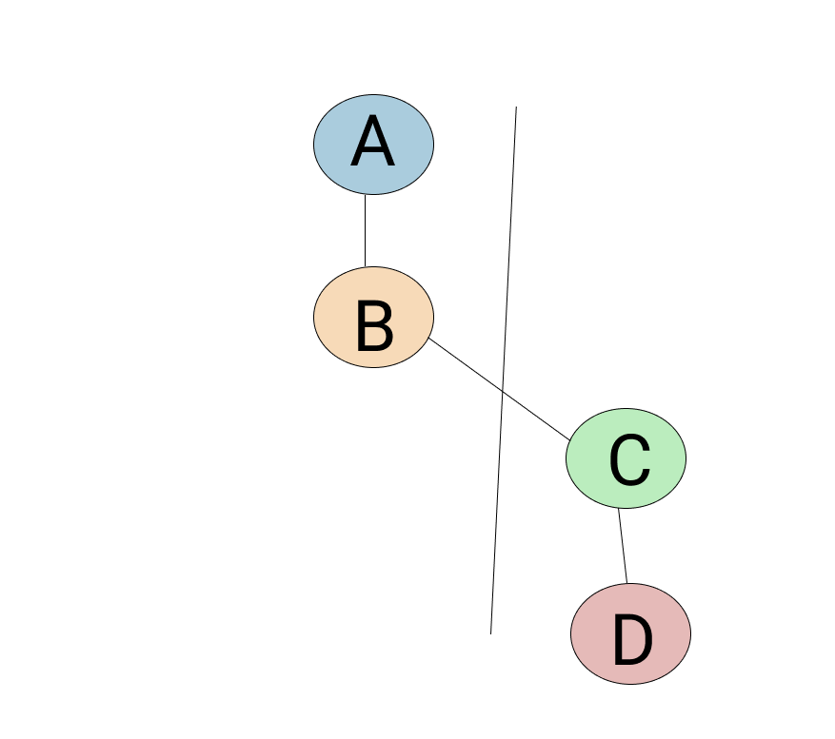
STEP 3:
 |  | V1 | V2 | V0 | V3
CUT | 3 | 1 | 1 | - | -

Slide 18
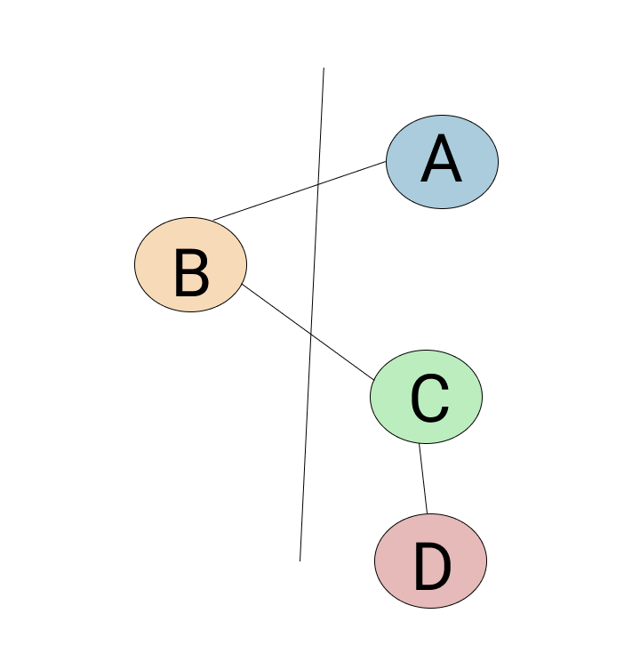
STEP 4:
 |  | V1 | V2 | V0 | V3
CUT | 3 | 1 | 1 | 2 | -

Slide 19
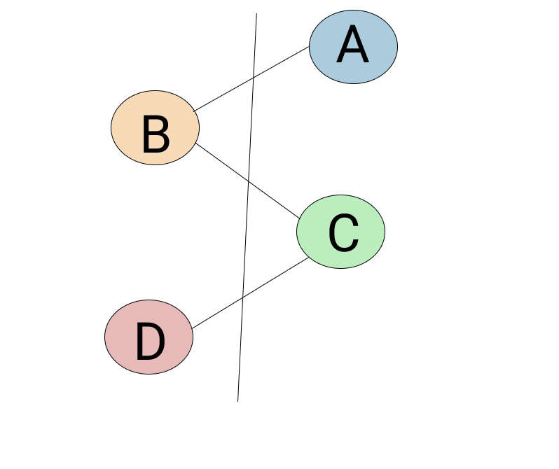
STEP 5:
 |  | V1 | V2 | V0 | V3
CUT | 3 | 1 | 1 | 2 | 3

Slide 20
Final optimal solution with constraints min 1 and max 3
So overall gain => 3 - 1 = 2

Slide 21
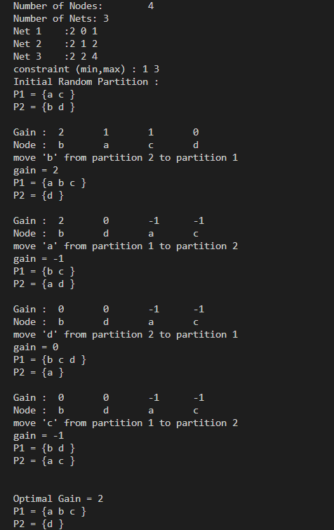
C++ Output

Slide 22
Example 2
Graph partitioning for hyper graphs

Slide 23
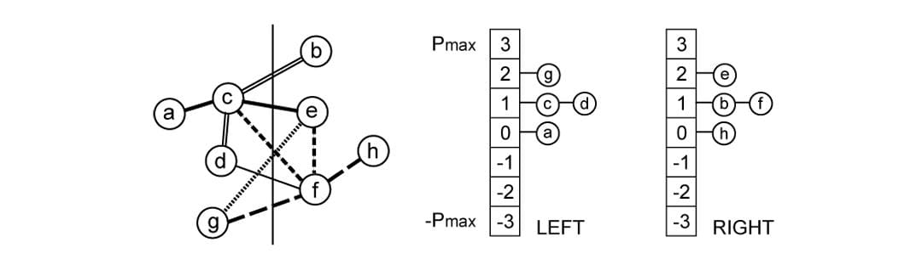
Initial Partitioning

Slide 24
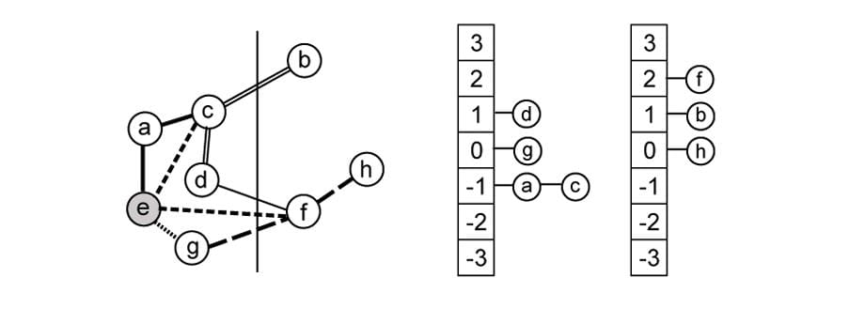
First move
 |  | E
CUT | 6 | 4

Slide 25
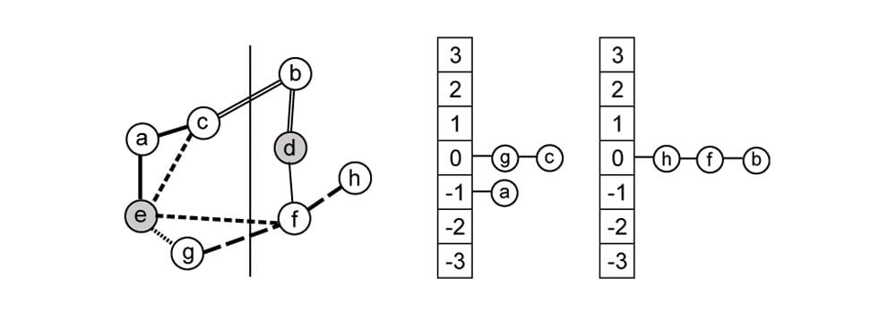
Second move
 |  | E | D
CUT | 6 | 4 | 3

Slide 26
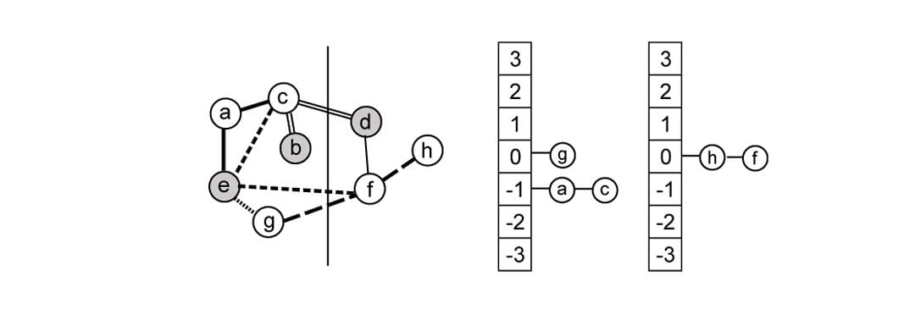
Third move
 |  | E | D | B
CUT | 6 | 4 | 3 | 3

Slide 27
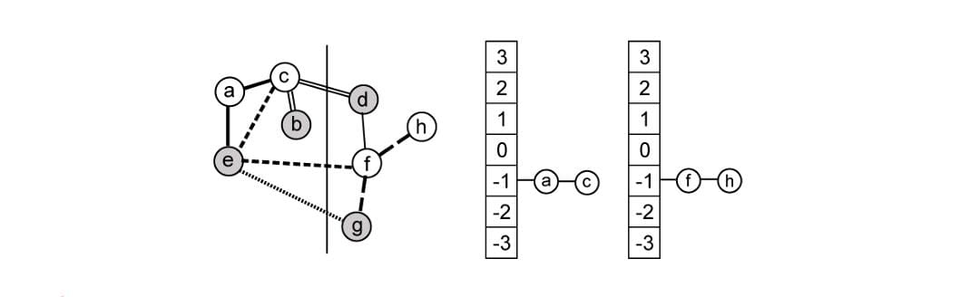
Fourth move
 |  | E | D | B | G
CUT | 6 | 4 | 3 | 3 | 3

Slide 28
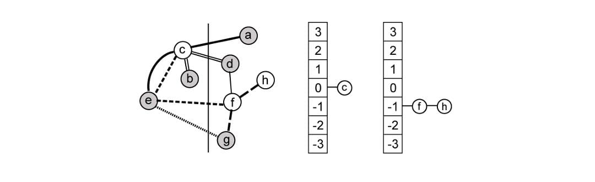
Fifth move
 |  | E | D | B | G | A
CUT | 6 | 4 | 3 | 3 | 3 | 4

Slide 29
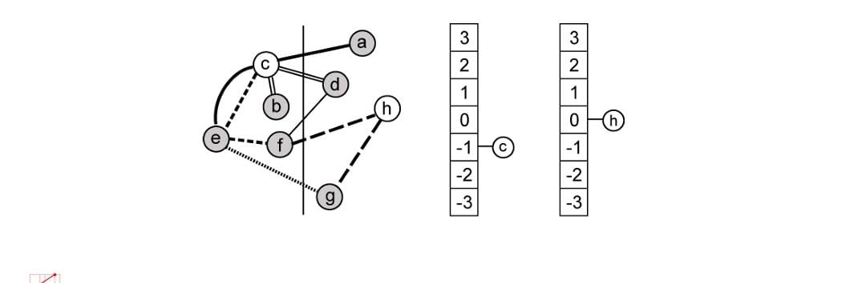
Sixth move
 |  | E | D | B | G | A | F
CUT | 6 | 4 | 3 | 3 | 3 | 4 | 5

Slide 30
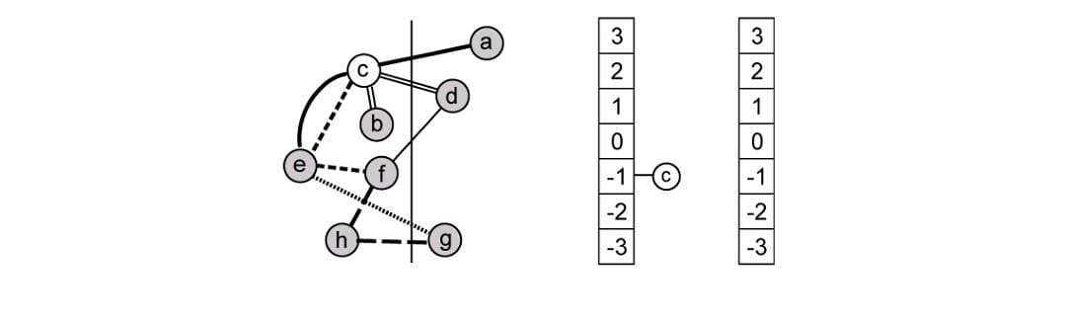
Seventh move
 |  | E | D | B | G | A | E | H
CUT | 6 | 4 | 3 | 3 | 3 | 4 | 5 | 5

Slide 31

Eighth move
 |  | E | D | B | G | A | E | H | C
CUT | 6 | 4 | 3 | 3 | 3 | 4 | 5 | 6 | 6

Slide 32
Final optimal solution with constraints min 3 and max 5
Overall gain => 6 - 3 = 3

Slide 33
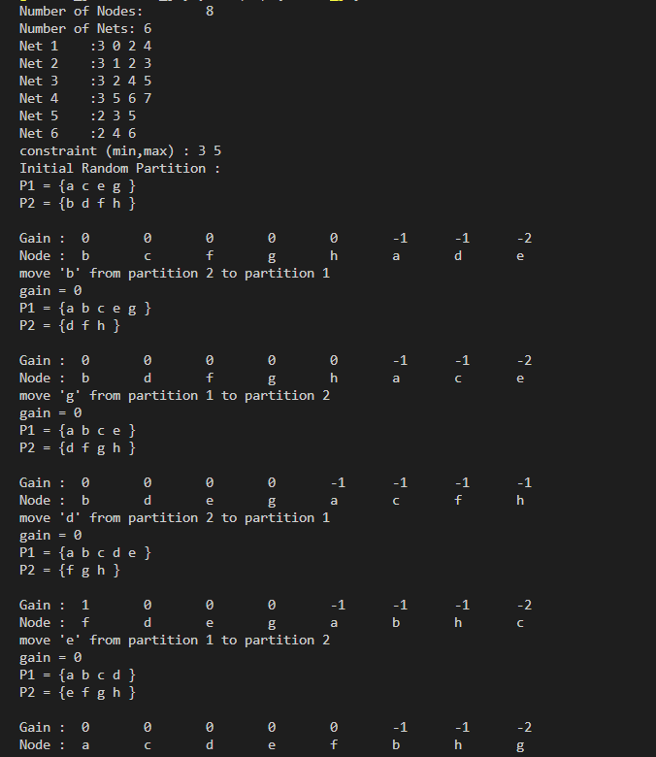
C++ Output

Slide 34
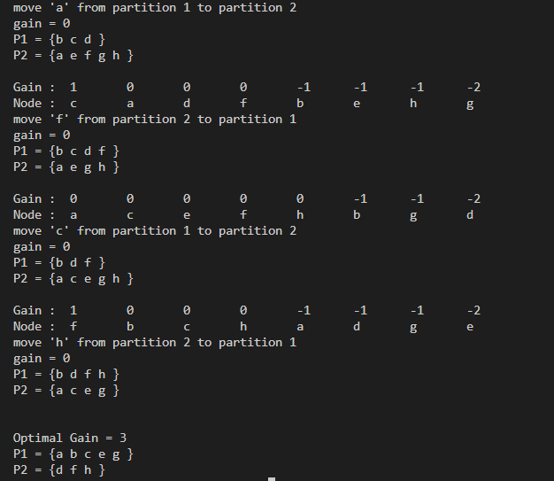

Slide 35
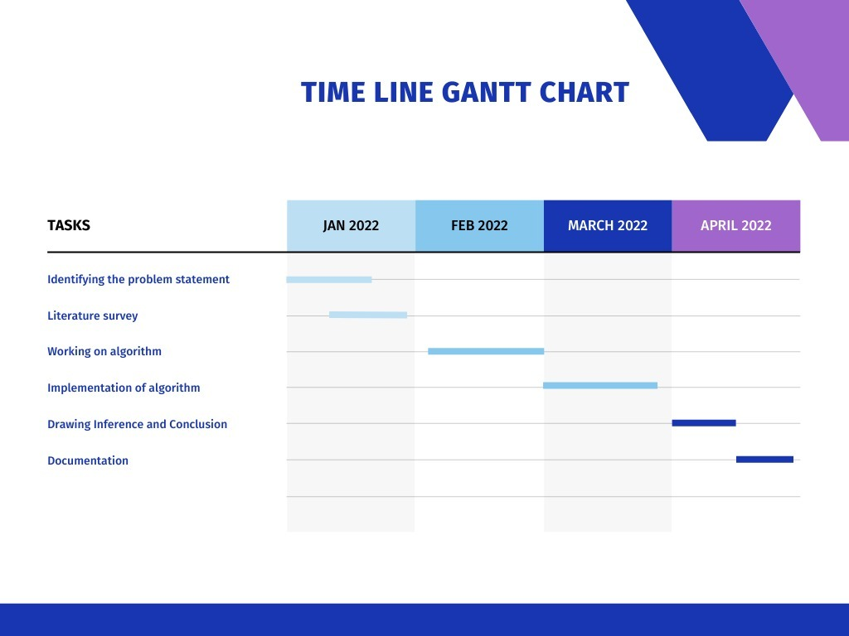

Slide 36
References
Abou-Rjeili, A., Karypis, G.: Multilevel algorithms for partitioning power-law graphs. In: 20th International Parallel and Distributed Processing Symposium (IPDPS). IEEE (2006)
Dean, J., Ghemawat, S.: MapReduce: simplified data processing on large clusters. In: 6th Symposium on Operating System Design and Implementation (OSDI), pp. 137–150. USENIX (2004)
Andersen, R., Lang, K.J.: An algorithm for improving graph partitions. In: 19th ACM-SIAM Symposium on Discrete Algorithms, pp. 651–660 (2008)
Hendrickson, B., Leland, R., Driessche, R.V.: Enhancing data locality by using terminal propagation. In: 29th Hawaii International Conference on System Sciences (HICSS 2009), vol. 1, p. 565. Software Technology and Architecture (1996)
Andreev, K., Räcke, H.: Balanced graph partitioning. Theory Comput. Syst. 39(6), 929–939 (2006)

