Slide 1

Digital Covid -19 Test App
Machine Learning Based Application
–
Developed by :- Akash Kumar (1808210015)
Akash Jauhari(1808210014)
Abhishek Kumar(1808210006)
Abhay Pratap Singh (180821003)

Slide 2
Project Agenda
Introduce problem statement.
Collect covid -19 patient dataset from hospitals.
Analyze covid -19 data and clean dataset.
Split dataset into training dataset and test dataset in 75:25 ratio.
Choose best machine learning(ML) algorithm or apply best machine learning algorithm.
Check accuracy of ml model.
Deploy ML model on GUI or other application(android & web)
Future scope of this application in medical science.

Slide 3

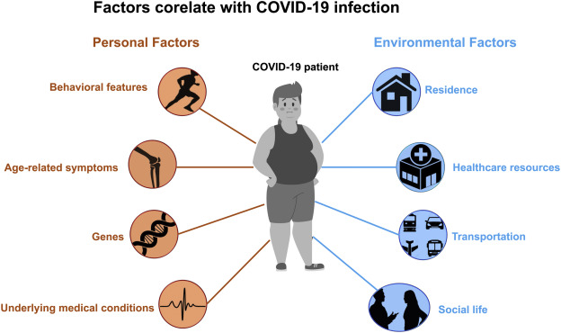
Introduce problem statement.

Slide 4
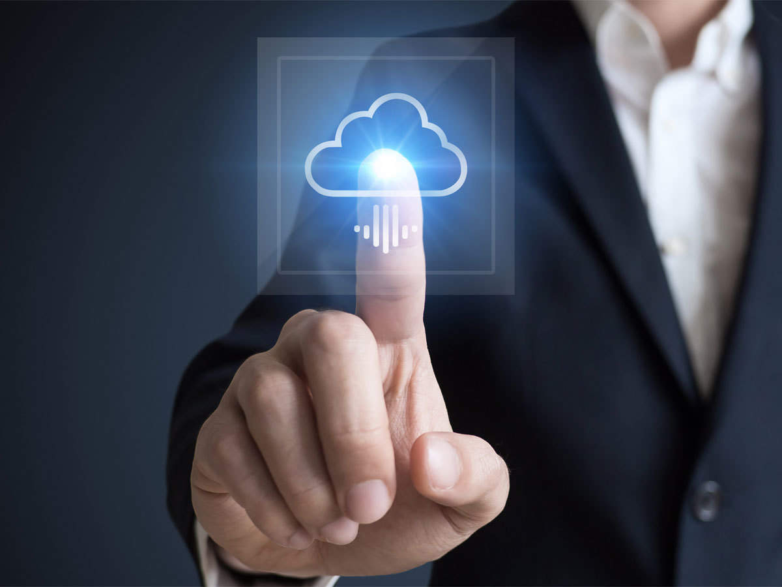
Our goal is to design a machine for automate covid-19 test

Slide 5
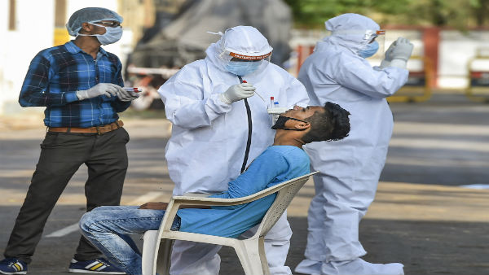
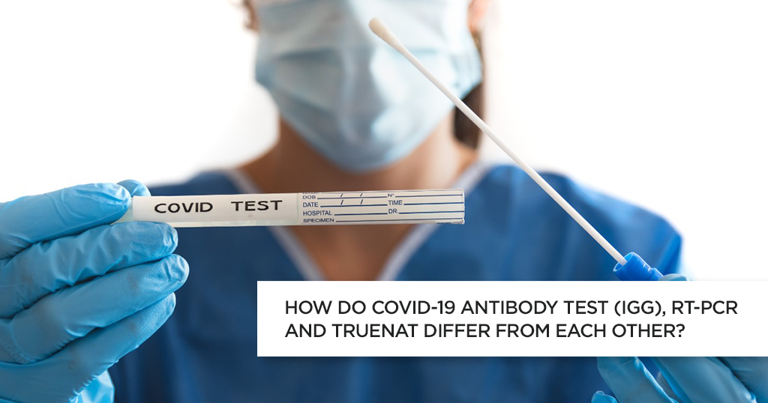
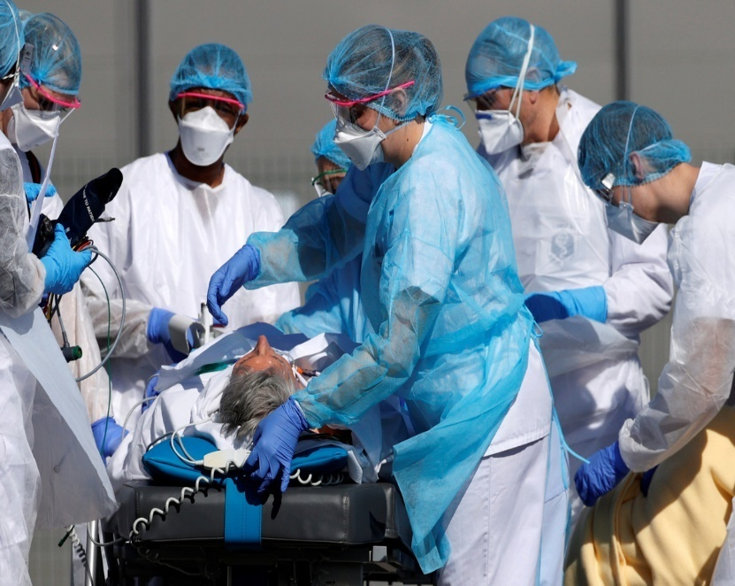
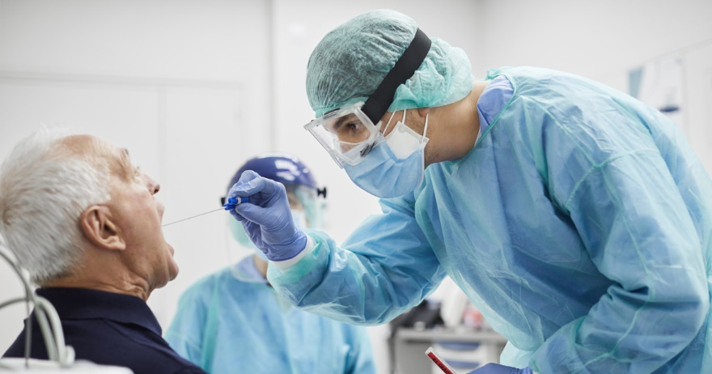
Collect covid -19 patient dataset from hospitals

Slide 6
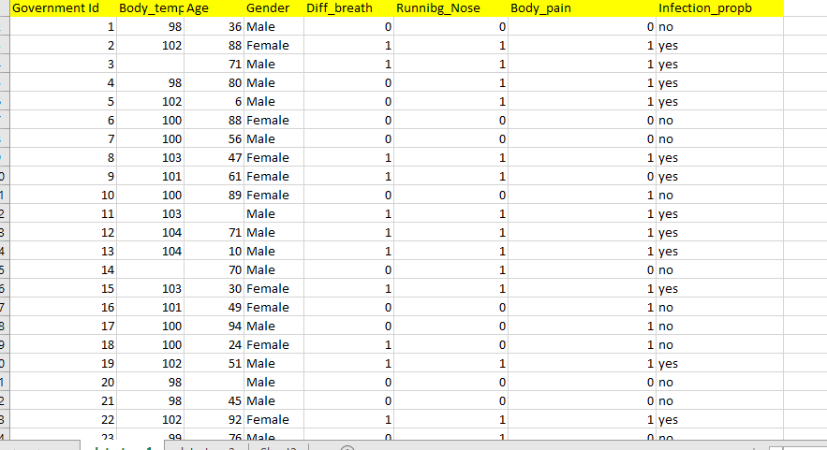
Analyze the data and start cleaning

Slide 7
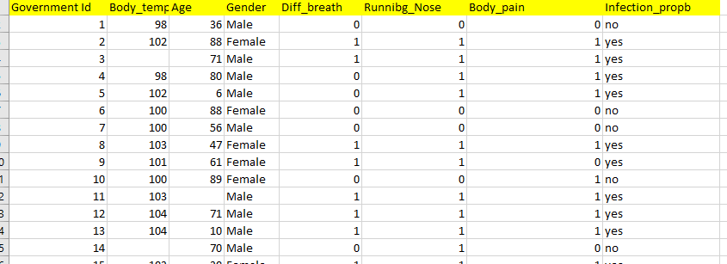
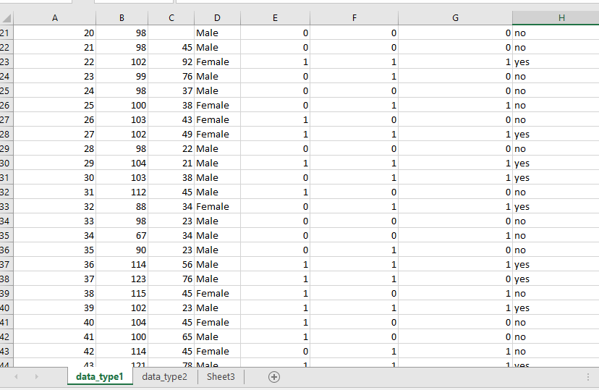
Split dataset into training dataset and test dataset in 75:25 ratio
Traning data(75%)
Test data(25)

Slide 8
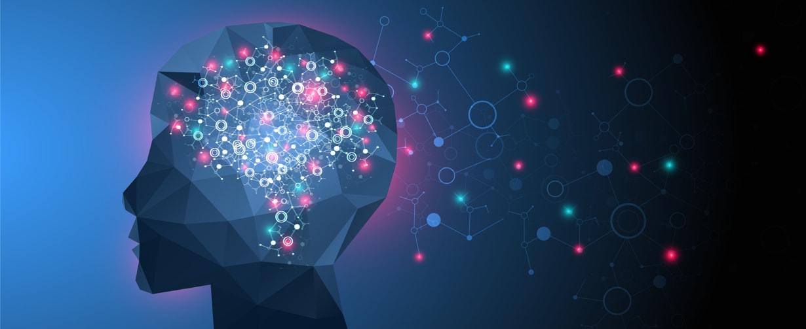
Choose best machine learning algorithm.
Logistic Regression
Naïve Bayes
Decision Tree
Random Forest
KNeighvors Classifier
SVM

Slide 9
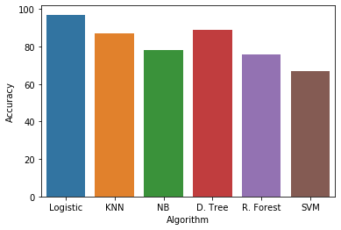
Algorithm accuracy behaviour

Slide 10
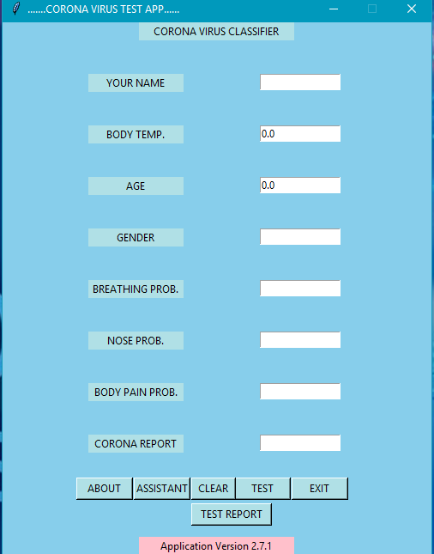
Deploy ML model on GUI or other application(android & web)

Slide 11
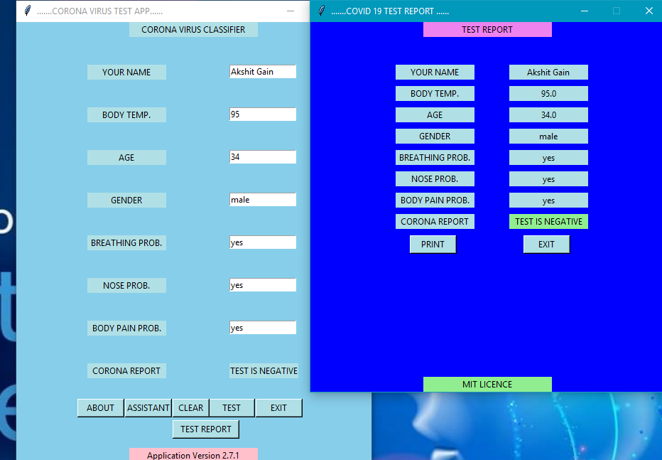
App features

Slide 12
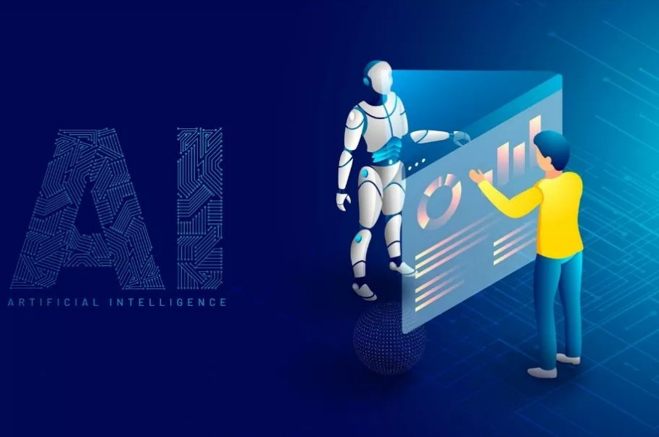
Future scope of this application in medical science

Slide 13
Thank You !

