Slide 1

Big Data & Hadoop
1). Hive Shell
2). Hive Services
3). Hive Matastore
4). Comparison With Traditional Database
Presented by :-
Akash Kumar
Anil Kumar

Slide 2
1.Hive shell
Hive shell is a primary way to interact with hive. It is a default service in hive. It is also called as CLI (command line interference). Hive shell is similar to MySQL Shell. ... The tab key will autocomplete (provides suggestions while you type into the field) Hive keywords and functions.

Slide 3
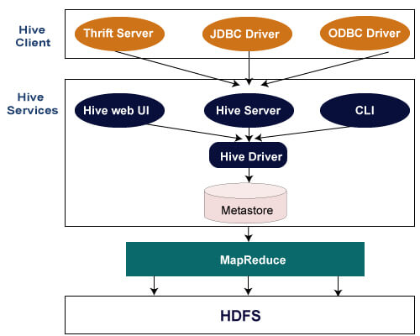
Hive Architecture
The following architecture explains the flow of submission of query into Hive.

Slide 4
2.Hive Services
The following are the services provided by Hive:- Hive CLI – The Hive CLI (Command Line Interface) is a shell where we can execute Hive queries and commands. Hive Web User Interface – The Hive Web UI is just an alternative of Hive CLI. It provides a web-based GUI for executing Hive queries and command.
Hive MetaStore – It is a central repository that stores all the structure information of various tables and partitions in the warehouse. It also includes metadata of column and its type information, the serializers and deserializers which is used to read and write data and the corresponding HDFS files where the data is stored.

Slide 5
Hive Server – It is referred to as Apache Thrift Server. It accepts the request from different clients and provides it to Hive Driver. Hive Driver – It receives queries from different sources like web UI, CLI, Thrift, and JDBC/ODBC driver. It transfers the queries to the compiler. Hive Compiler – The purpose of the compiler is to parse the query and perform semantic analysis on the different query blocks and expressions. It converts HiveQL statements into MapReduce jobs. Hive Execution Engine – Optimizer generates the logical plan in the form of DAG of map-reduce tasks and HDFS tasks. In the end, the execution engine executes the incoming tasks in the order of their dependencies.

Slide 6
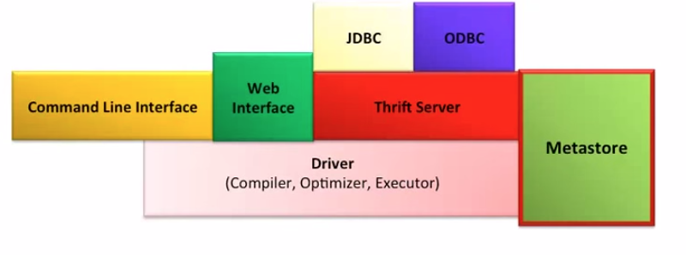
Metastore
System catalog which contains metadata about the Hive tables
Stored in RDBMS/local fs. HDFS too slow(not optimized for random access)
Objects of Metastore
Database - Namespace of tables
Table - list of columns, types, owner, storage, SerDes
Partition – Partition specific column, Serdes and storage

Slide 7
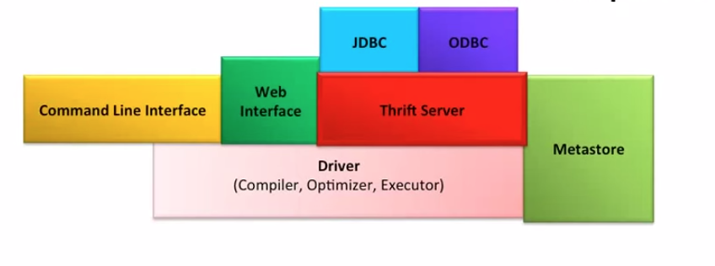
Hive Thrift Server
Framework for cross language services
Server written in Java
Support for clients written in different languages
- JDBC(java), ODBC(c++), php, perl, python scripts

Slide 8
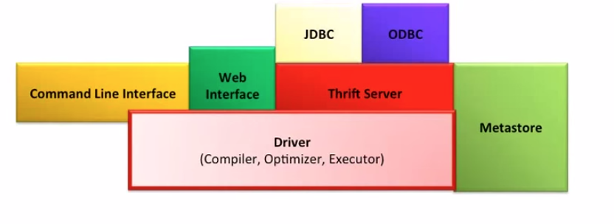
Hive Driver
Driver - Maintains the lifecycle of HiveQL statement
Query Compiler – Compiles HiveQL in a DAG of map reduce tasks
Executor - Executes the tasks plan generated by the compiler in proper
dependency order. Interacts with the underlying Hadoop instance

Slide 9
Comparison with traditional database
Hive
Rdbms
It is used to maintain data warehouse.
It uses HQL (Hive Query Language).
Normalized and de-normalized both type of data is stored.
It supports automation partition
It is used to maintain database.
It uses SQL (Structured Query Language).
Normalized data is stored.
It doesn’t support partitioning.

Slide 10
Thank You!

