Slide 1

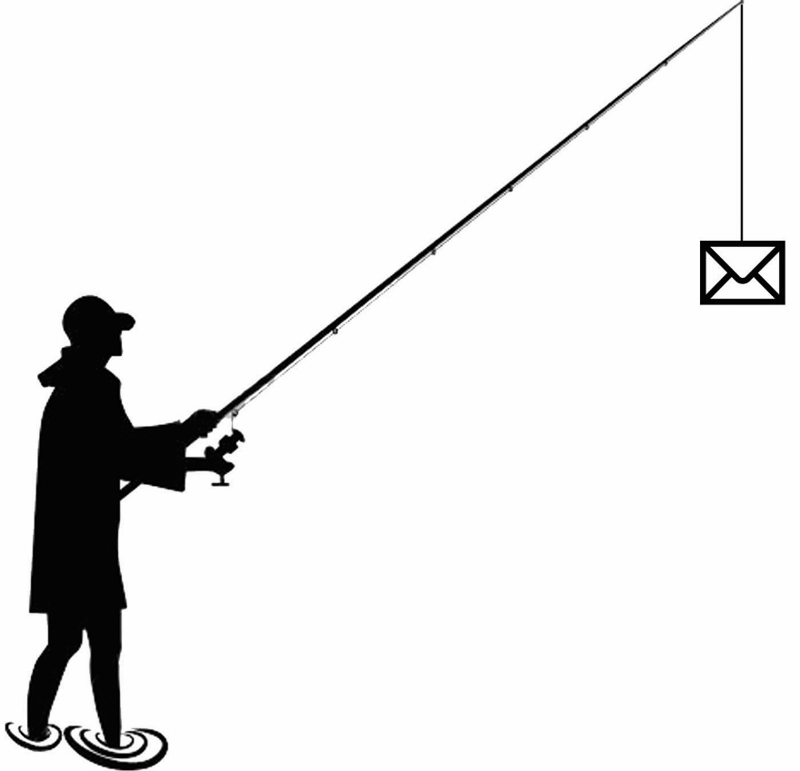

Phishing & SMShing Awareness
Awareness is Key.
By Akash Rathod & Alisha
Cyber Security Student

Slide 2


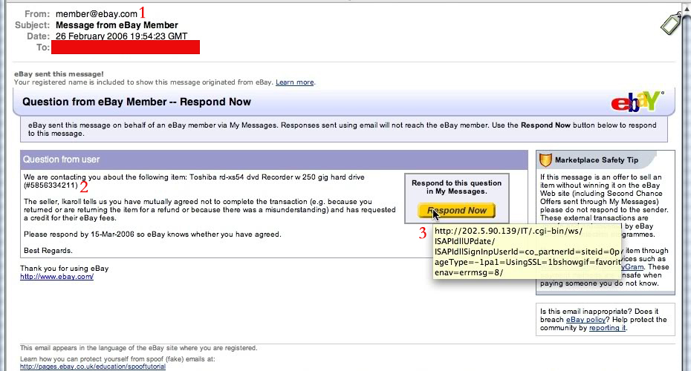
Examples of Phishing Attacks
Clone Phishing
Objective of Phishing and SMShing…
What is phishing and Smishing?
How does work Phishing?
Most common Phishing Type.
How to identify a Phishing attack?
How do We protect against Phishing?
Phishing the most common cause of Ransomware attack.
Impact of phishing attack and How to be prepared.
Conclusion
These emails are harder to spot because they look exactly like legitimate emails you would normally receive. The first cue that something is not right with this email is the sender. It is a generic address, member@ebay.com. You would never see this from a legitimate email, you would see the username of the buyer/seller; e.g.; valdostarocks@ebay.com
The question you have to ask yourself is did I buy anything from ebay recently, and if I did, is this what I purchased? If no to these questions, then you more than likely have a phishing email.
The last piece is the most critical in seeing if the email is in fact a phishing email. If you hover your mouse over the button it is wanting you to press, you see that this is not taking you to an ebay.com site, but rather an external site that will more than likely try to steal your ebay credentials.

Slide 3
What is “Phishing” & “SMShing”?
Phishing is a criminal activity using social engineering techniques.
“Phishers” attempt to fraudulently acquire sensitive information, such as passwords, personal information, military operations, and credit card/financial details, by masquerading as a trustworthy person or business in an electronic communication.

Slide 4
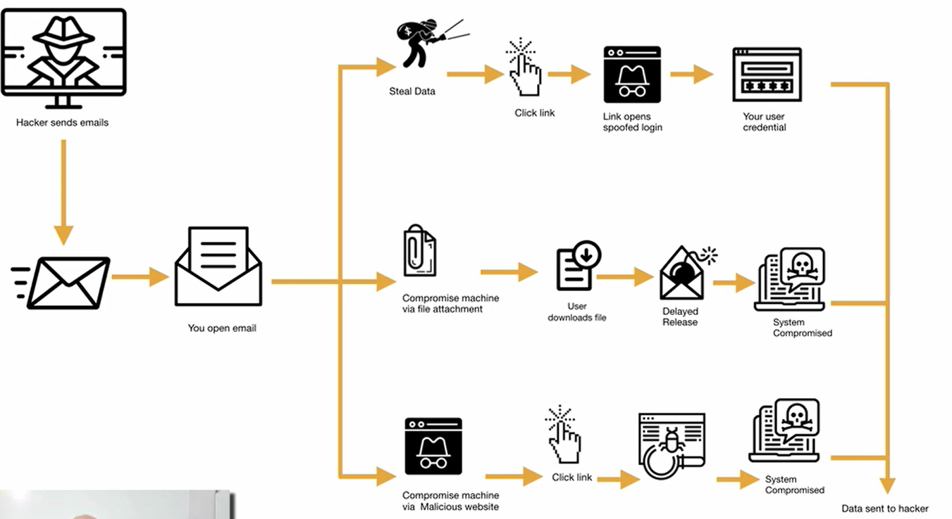

How does work Phishing?
System compromised
Steal data
Hacker Send email
Click
Your user credential
Links open
spoofed logins
Compromise machine via file attachment
User download file
You open email
Delayed Release
System compromised
Compromise machine via Malicious website
Click link
Data sent to hacker

Slide 5
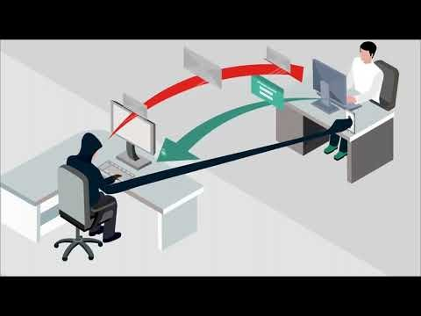
How does work Phishing in actual vedio…

Slide 6
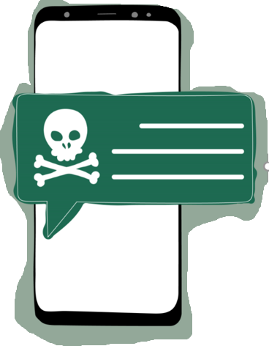
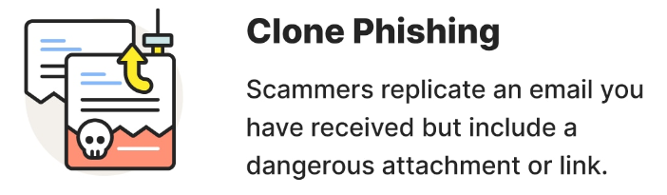
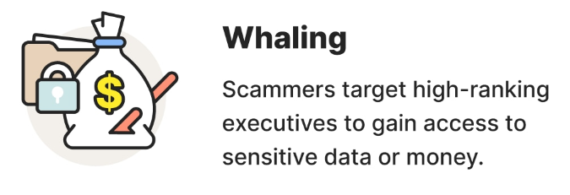
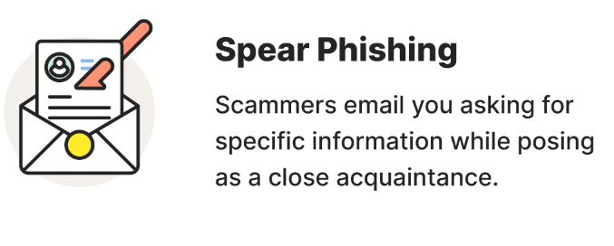
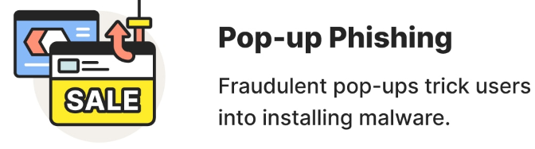
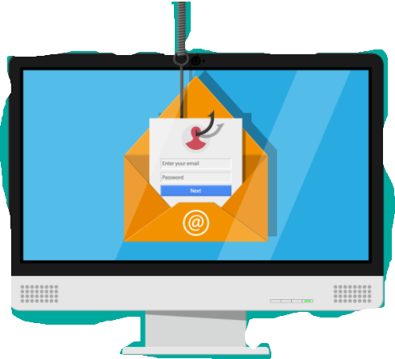
Most common Phishing Type.
SMiShing SMiShing is a phishing attack via SMS, or test messages. These scams try to trick you into clicking a link in atext messages.
Email Phishing
Phishing is when attackers send malicious emails designed to trick people into falling for a scam

Slide 7
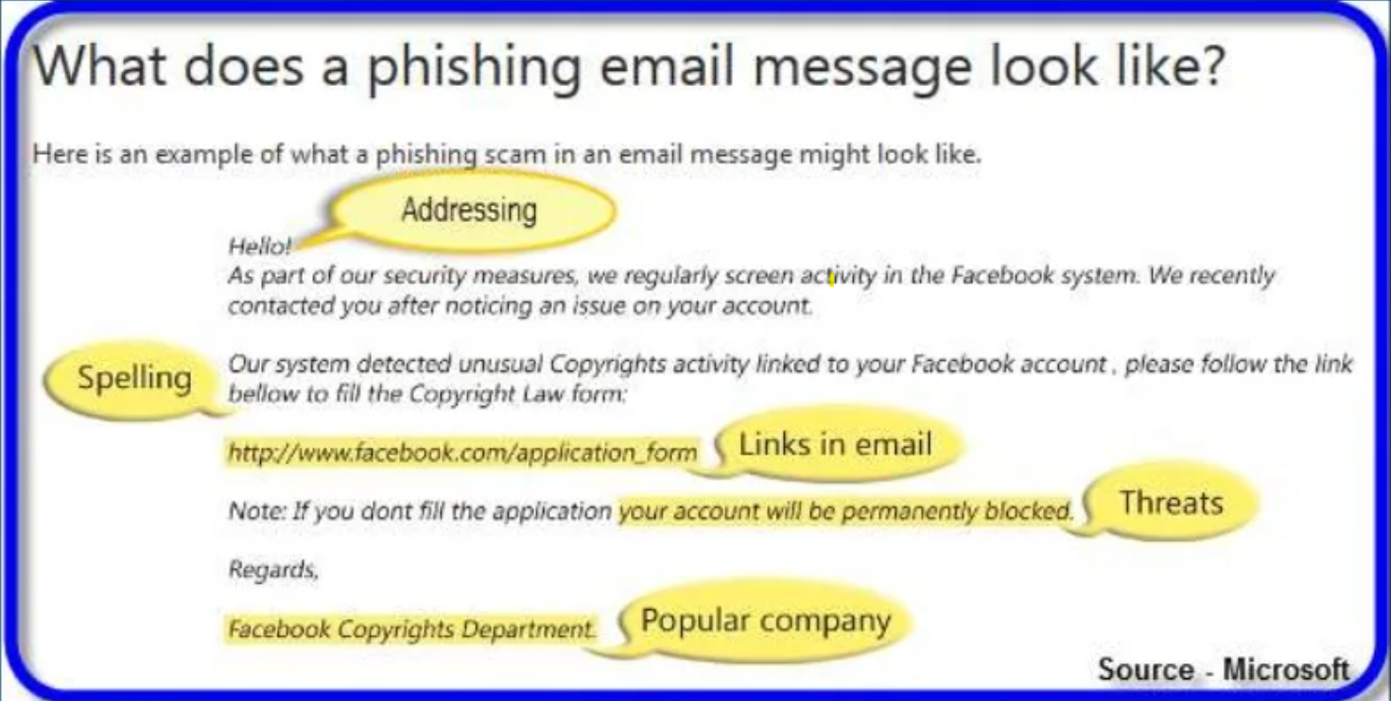
How to identify a phishing attack.

Slide 8
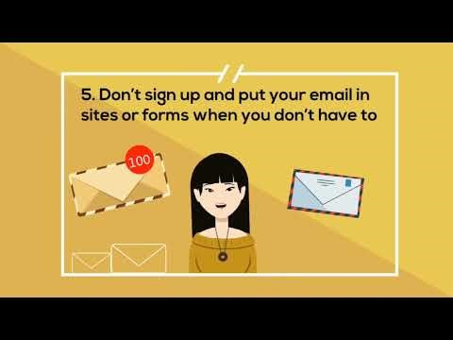
How do We protect against phishing attack.

Slide 9
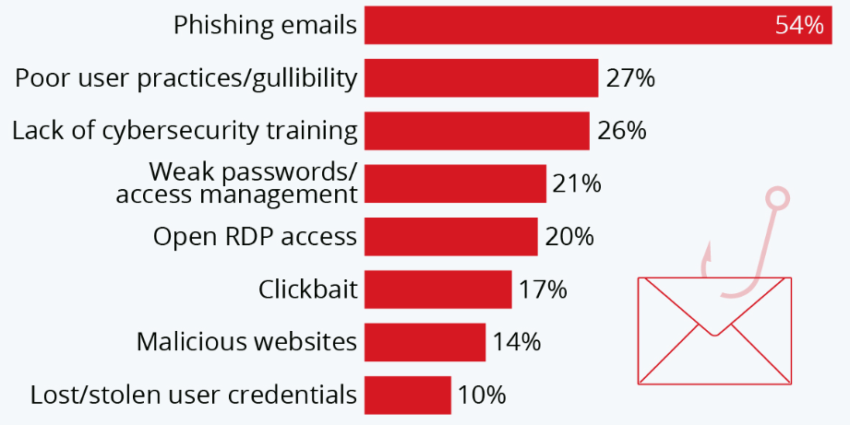
Phishing the most common cause of Ransomware attack.
Your users lack security awareness. ...
Criminals are (unsurprisingly) following the money. .
You're not performing sufficient due diligence.
Criminal organisations are sitting on a mountain of funds.
Low-cost phishing and ransomware tools are easy to get hold of.

Slide 10
Impact of phishing attack and How to be prepared.
Phishing has a list of negative effects on a business, including loss of money, loss of intellectual property, damage to reputation, and disruption of operational activities.
These effects work together to cause loss of company value, sometimes with irreparable repercussions.
Pro tip: Implementing shorter, yet more consistent cybersecurity awareness training helps to keep phishing prevention top of mind for employees
Empower your end users with tools that give them the information they need when reading an email – do they know this sender? Is the link suspicious? Offering in-the-moment notifications can allow end users to become your best line of security defence.

Slide 11
Conclusion
No single technology will completely stop phishing.
However, a combination of good organization and practice, proper application of current technologies, and improvements in security technology has the potential to drastically reduce the prevalence of phishing and the losses suffered from it.
The best software to protect your self is your own Sense

Slide 12
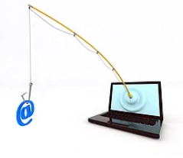
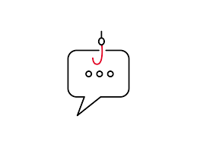
Thank you for being a part of the content of this Cyber Awareness Week. Your ability to identify a phishing attack is important.

