Slide 1
HR Data Analysis and Visualization Using MySQL and Power BI
By –
Akash Kumar (23030141003)
Swarn Prabha (23030141069)

Slide 2
Agenda
1. Introduction
2. Data Collection and Preparation
3. Data Cleaning and Transformation
4. Exploratory Data Analysis
5. Data Visualization with Power BI
6. Key Insights and Findings
7. Conclusion and Recommendations

Slide 3
INTRODUCTION
In this project, we conducted a comprehensive analysis of HR data to gain insights into the workforce's demographics, distribution, and employment trends. Using MySQL for data management and Power BI for visualization, the objective was to identify key patterns that can inform better HR practices and strategic decision-making. This analysis will help in understanding factors like employee turnover, tenure, and diversity, and provide actionable insights for improving HR processes.

Slide 4
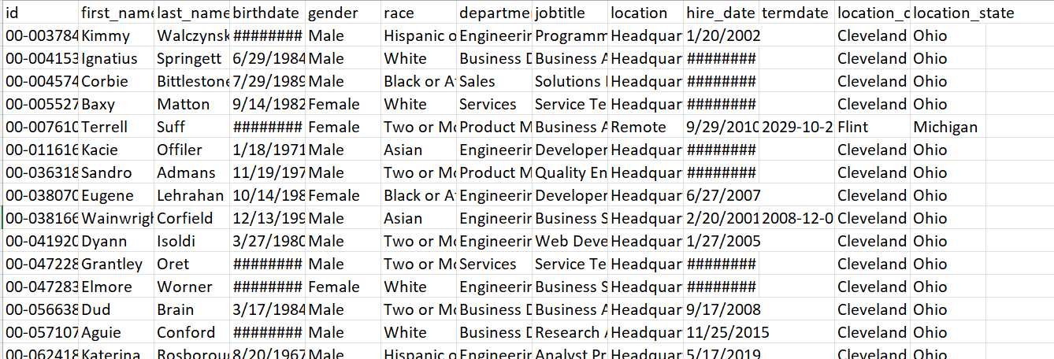
Data Overview
Name: Human Resources.csv
Source: Kaggle.com/hr_data
Size: 22215 rows and 13 columns
Data Period: 2000-2020

Slide 5
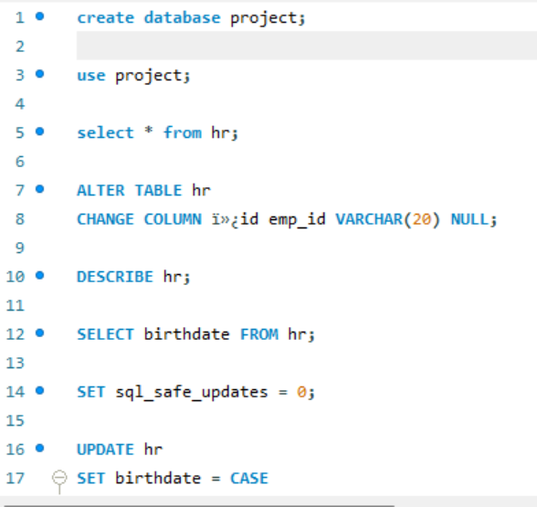
Data Preprocessing
Creating Database :
Established a new database named project in MySQL.
Importing Data :
Loaded HR data into the ‘hr’ table within the database.
Initial Exploration
Performed preliminary checks using ‘select’ and ‘describe’ statements.

Slide 6

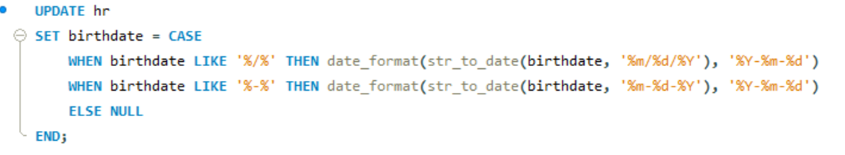

Data Cleaning - Overview
Objective:
Ensure data accuracy, consistency, and readiness for analysis.
Key Cleaning Steps:
Renaming columns for clarity.
Formatting date fields appropriately.
Handling missing and invalid data.
Adding calculated fields (e.g., Age).

Slide 7
Exploratory Data Analysis - Overview
Purpose : Uncover patterns, trends, and insights within the HR data.
Key Questions Explored:
-- 1. What is the gender breakdown of employees in the company?
-- 2. What is the race/ethnicity breakdown of employees in the company?
-- 3. What is the age distribution of employees in the company?
-- 4. How many employees work at headquarters versus remote locations?
-- 5. What is the average length of employment for employees who have been terminated?
-- 6. How does the gender distribution vary across departments and job titles?
-- 7. What is the distribution of job titles across the company?
-- 8. Which department has the highest turnover rate?
-- 9. What is the distribution of employees across locations by city and state?
-- 10. How has the company's employee count changed over time based on hire and term dates?
-- 11. What is the tenure distribution for each department?

Slide 8
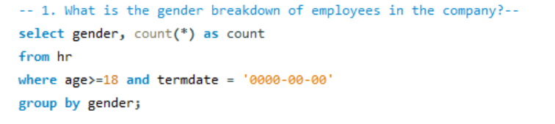
Gender Breakdown
Objective:
Determine the distribution of genders among current employees.
Findings:
Present the count and percentage of each gender category.

Slide 9
Data Visualization with Power BI
Visuals Used:
Bar charts, line charts, and tables to display key metrics.
Heatmaps to highlight correlations between variables.
Purpose:
Provide a clear, visual understanding of the data.
Identify trends in employee attrition.

Slide 10
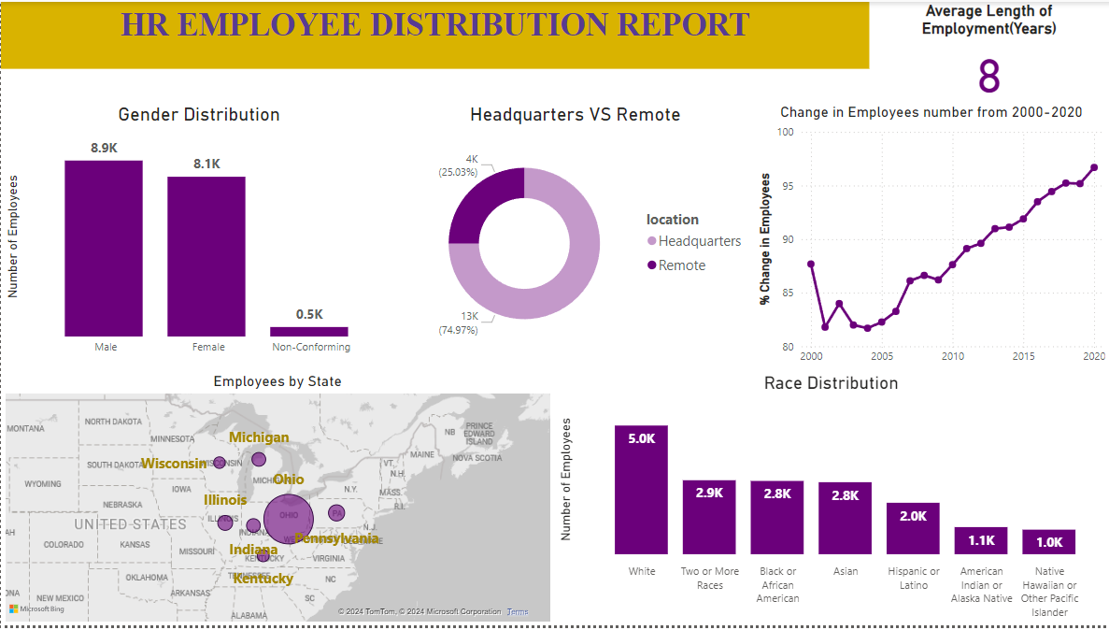

Slide 11
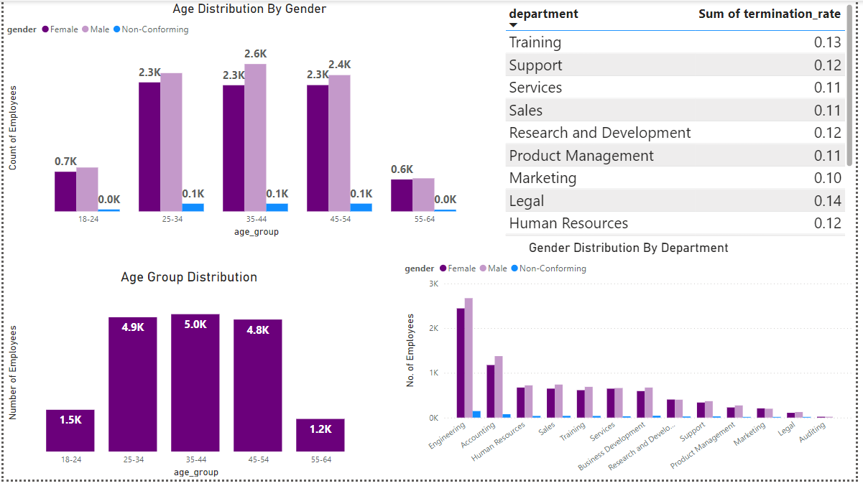

Slide 12

A

