Slide 1

HUMAN FACTORS IN CYBERSECURITY: THE ROLE OF EMPLOYEE AWARENESS IN REDUCING CYBER THREATS
Notes:
“Good morning everyone. Today I am going to present my research on Human Factors in Cybersecurity.
The main idea of my research is that cybersecurity is not only about technology. Employees also play an important role because their actions and decisions can either increase or reduce security risks. In this presentation, I will explain the research problem, common types of attacks, the research methodology, my main findings.

Slide 2

Background and Context
The organisations are also increasingly depending on information technology in their daily operations.
The number of cyber threats to organisational systems and valuable information is increasing.
Human behaviour is also a vulnerability of cybersecurity (Khadka and Ullah, 2025).
Organisational security may be threatened by serious employee errors.
Notes:
First, I would like to explain the background of my research. Today, organisations depend heavily on information technology for their daily operations. At the same time, cyber threats against organisational systems and information are increasing.
One important factor is human behaviour. Employees can sometimes make mistakes that create security risks. For example, an employee may click on a phishing link or share sensitive information. Therefore, technical security alone may not be enough. Employee awareness is also an important part of cybersecurity.”

Slide 3
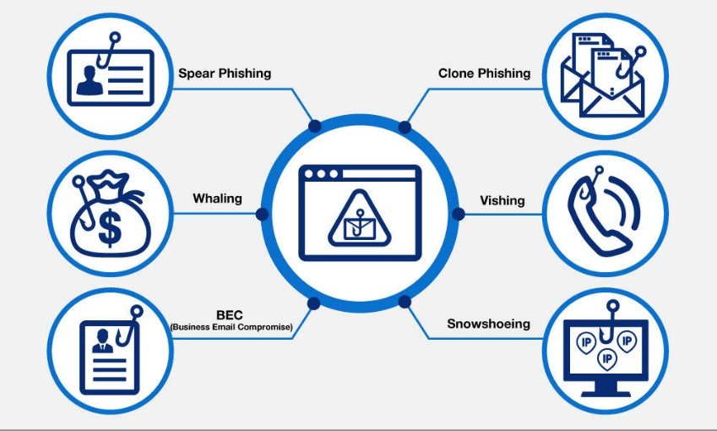
Research Problem
Technical cybersecurity investments are unable to solve employee-related security vulnerabilities (Shah et al., 2023).
Employees are also able to press on malicious links or provide confidential information.
Weak passwords can as well expose us to organisational cyber threats.
The developed cybersecurity protection may be undermined by the policy noncompliance.
Notes:
The main research problem is that organisations are investing a lot in cybersecurity technologies, but employee-related vulnerabilities still exist. Employees may accidentally click on malicious links, share confidential information, or use weak passwords.
Another problem is that employees may not always follow security policies correctly. Because of this, even strong technical security controls can be weakened by human behaviour. So, my research focuses on understanding how employee awareness can help reduce these types of cybersecurity risks.”

Slide 4
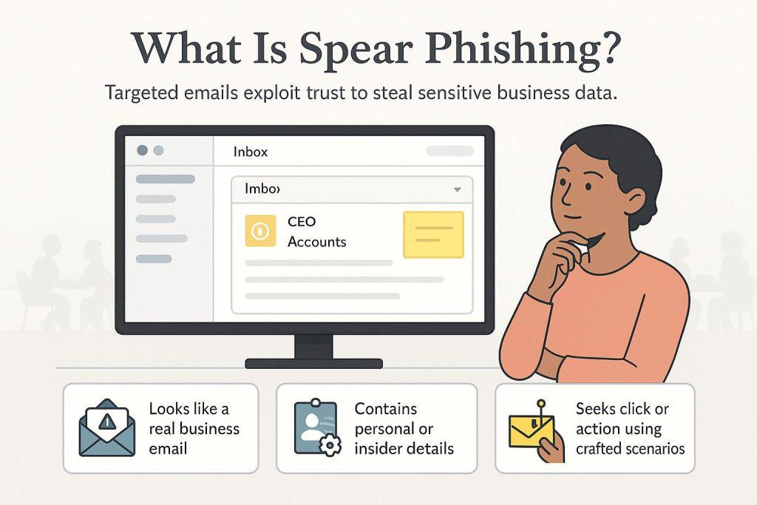
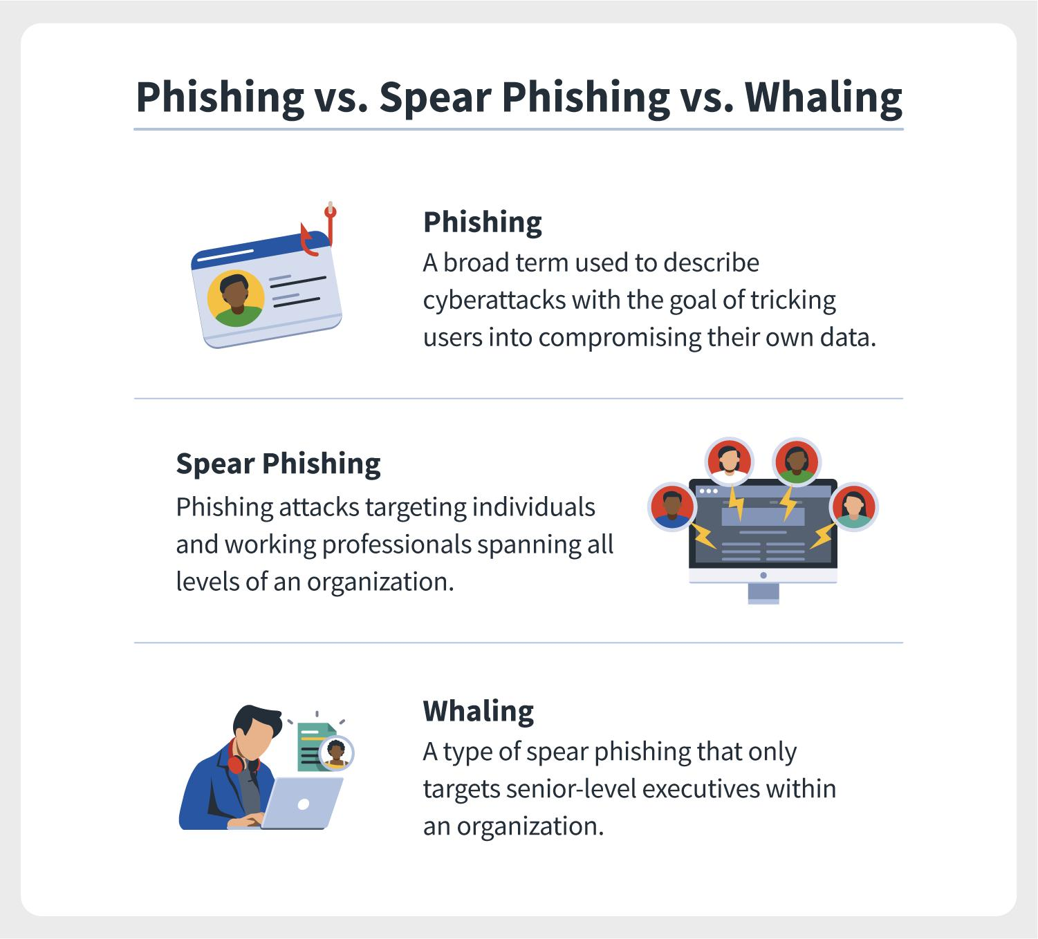
Types of Attacks
Spear Phishing : An employee receives a personalized fake email from their manager.
Whaling : A CEO receives a fake invoice requesting a large payment.
Notes:
This slide shows some common types of attacks that can target employees. Spear phishing is a personalised fake email, for example, an email that appears to come from a manager. Whaling is similar, but it specifically targets senior people such as a CEO.

Slide 5
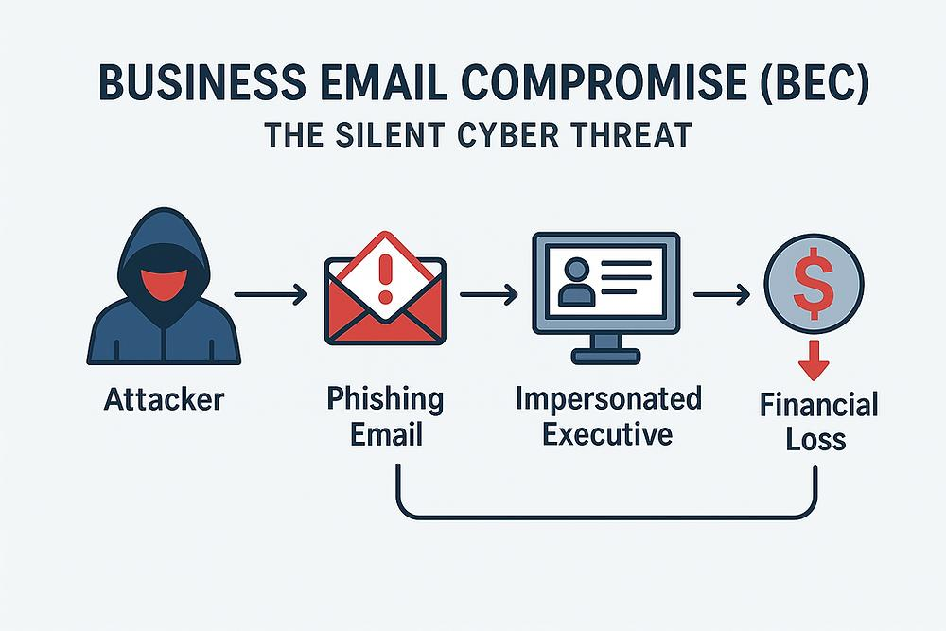
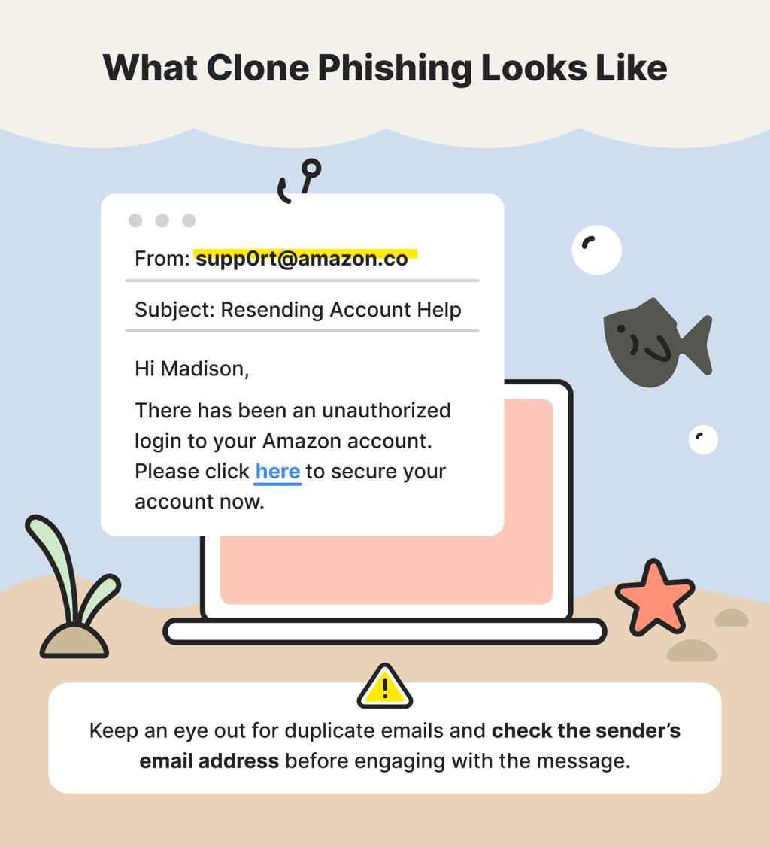
BEC : A fake finance manager requests a payment to a fraudster's bank account
Clone Phishing : A copied delivery email contains a fake tracking link.
Notes:
Clone phishing uses a copied version of a real email but replaces the original link with a malicious one.
BEC, or Business Email Compromise, can involve a fake finance manager asking for a payment.

Slide 6
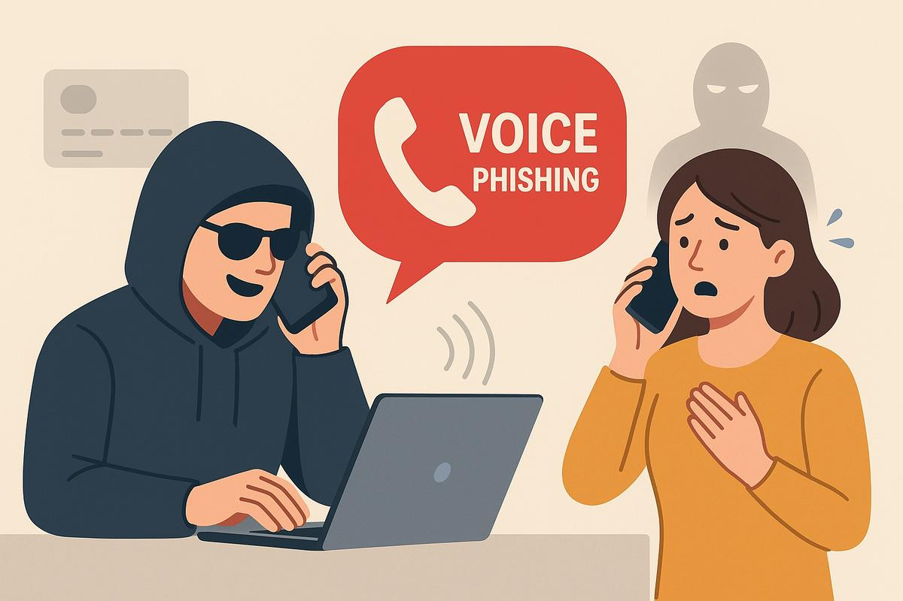

Vishing: A fraudster pretends to be a bank employee and asks for confidential details.
Snowshoeing: Attackers send phishing emails from many different domains to avoid email security filters.
Notes:
Other examples include snowshoeing, which uses many domains, and vishing, where attackers use phone calls to collect confidential information.”

Slide 7
Aim and Research Objectives
The study focuses on how well the employees are aware of the practice of cybersecurity within the organisation.
It looks at typical human elements that contribute to cybersecurity threats.
It measures effectiveness of awareness programmes in past research studies.
It develops recommendations on how to make employees more aware of cybersecurity.
Notes:
“The main aim of my research is to explore the importance of employee awareness in reducing cyber threats.
I have four main objectives. First, I want to understand the relationship between employee awareness and organisational cybersecurity.
Second, I want to identify common human factors that contribute to cyber risks.
Third, I want to examine the effectiveness of cybersecurity awareness programmes.
Finally, I want to provide recommendations that organisations can use to improve employee awareness and security behaviour.”

Slide 8
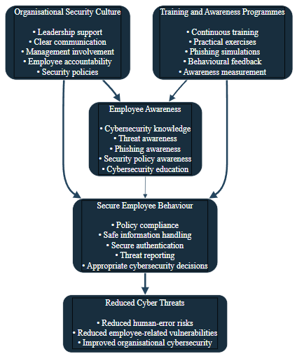
Literature and Theoretical Framework
Human factors HFs are critical in putting organisations at risk of cybersecurity attacks.
Protection Motivation Theory is a theory that describes the intentions of protection behaviour related to security.
Theory of Planned Behaviour: The theory of Planned Behaviour looks at issues that affect employee behaviour.
Both models promote the interpretation of cybersecurity awareness and behavioural responses (Abrahams et al., 2024).
Notes:
For the literature and theoretical framework, my research looks at cybersecurity as both a technical and a human issue.
I focus on two theories: Protection Motivation Theory and the Theory of Planned Behaviour.
Protection Motivation Theory helps explain how people respond when they perceive a security threat and how this can influence their protective actions.
The Theory of Planned Behaviour focuses on factors such as attitudes, social influence, and control.
These theories help me understand why employees behave differently when dealing with cybersecurity.

Slide 9
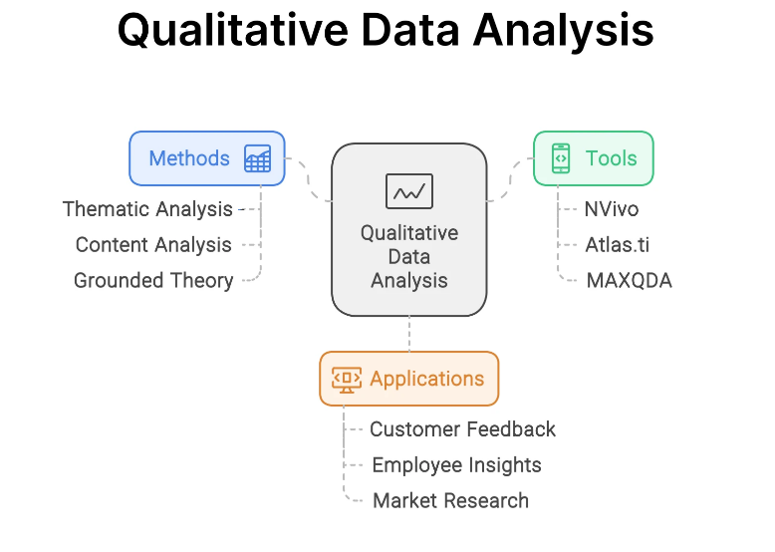
Research Methodology
The study has an interpretivist philosophical approach to analysis.
An inductive approach extracts themes through existing literature (Bishop et al., 2025).
The primary evidence base is provided by secondary qualitative research.
The thematic analysis determines patterns found in the sampled sources.
Notes:
For my research methodology, my research focuses on understanding employee behaviour and awareness.
I also use an inductive approach, which means I identify themes and patterns from the existing evidence instead of starting with fixed conclusions.
My research is based on secondary qualitative data.
it includes academic journal articles, conference papers, industry reports, and government publications.
Then i use thematic analysis to identify common patterns and findings across the sources.

Slide 10
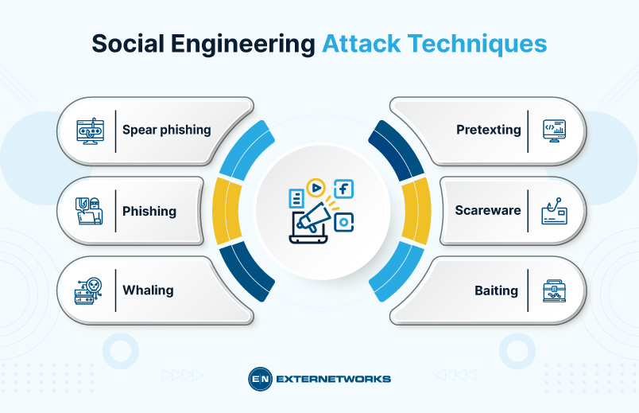
Finding One: Human Error
Human error represents an important organisational cybersecurity vulnerability.
Phishing can exploit judgement and decision-making of staff (Chaudhary et al., 2022).
Weak password habits may enhance the risk of unauthorised access.
Social engineering involves manipulation of the employees through the use of trick communication.
Notes:
My first main finding is human error. Human behaviour can be an important cybersecurity vulnerability in organisations. Employees may make mistakes such as clicking on suspicious links, using weak passwords, or responding to scams.
Phishing attacks are especially important because they try to influence an employee's judgement and decision-making.
Social engineering also uses communication and manipulation to trick employees. Therefore, this finding shows why employee awareness is important alongside technical cybersecurity controls.”

Slide 11
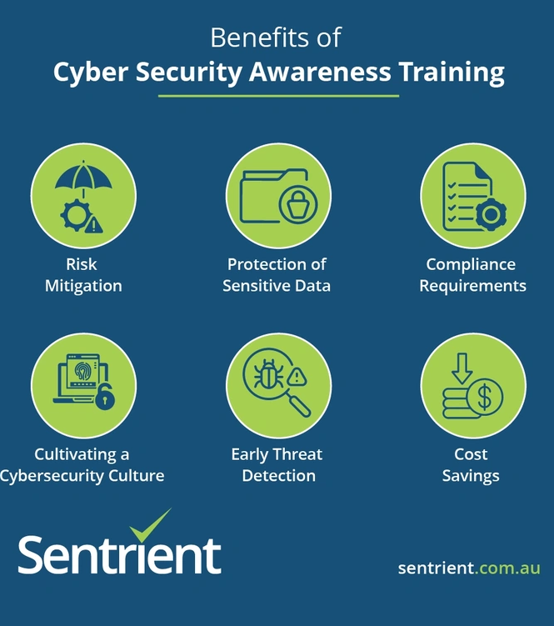
Finding Two: Awareness Programmes
Staff awareness may be increased by cybersecurity awareness programmes.
Training promotes awareness of typical cyber threats.
Employee participation influences the quality and responsibility of the awareness programme.
Continuous learning can reinforce proper cybersecurity behaviours.
Notes:
My second finding is about cybersecurity awareness programmes. These programmes can help employees understand common cyber threats and learn the correct security behaviours.
However, awareness should not only be based on one training session. Continuous learning and regular reinforcement can help employees remember what they have learned and apply it in their daily work. Employee participation is also important because awareness programmes are more useful when employees actively engage with them.”

Slide 12
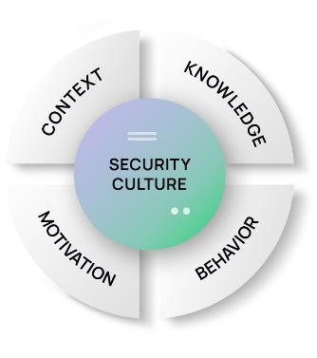
Finding Three: Security Culture
The organisational culture affects the day-to-day cybersecurity behaviour of the workers.
Security cannot be the prerogative of special technical groups (Taherdoost, 2024).
Management can support organisation awareness practices.
The common responsibility promotes greater participation of employees in terms of security.
Notes:
My third finding focuses on organisational security culture. Cybersecurity should not be considered only the responsibility of the IT or security department. Employees across the organisation also handle information and systems, so everyone has a role to play.
Management can support this by promoting security awareness and encouraging employees to take responsibility. When security becomes part of the organisation's everyday culture, employees can become more involved in protecting organisational information

Slide 13
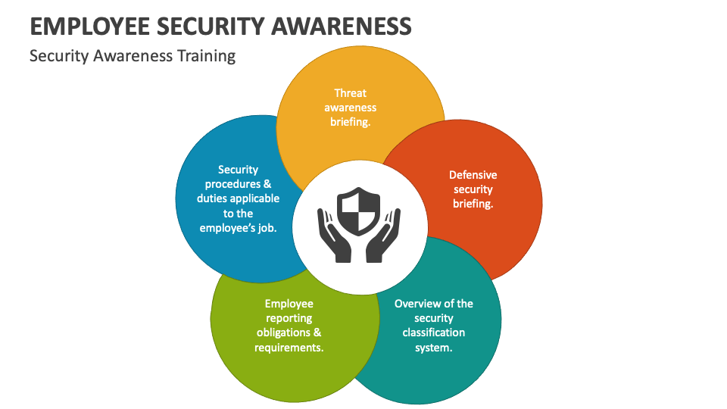
Discussion and Organisational Recommendations
Technical cybersecurity controls in organisations need to be supplemented by awareness.
The training should address realistic, employee-specific cybersecurity risks.
Security policies in organisations should be reinforced through constant communication.
The management must promote responsibility and collective security.
Notes:
Based on my findings, technical cybersecurity controls should be supported by employee awareness. Organisations should provide training that focuses on realistic risks that employees may actually face, such as phishing and social engineering.
Security policies should also be communicated regularly instead of being shared only once. Management has an important role in creating accountability and encouraging collective responsibility. So, the main recommendation is to combine technical controls with continuous employee awareness.”

Slide 14
Conclusion and Future Research
Employee awareness is a major human factor related to cybersecurity.
Human behaviour can influence the vulnerability of organisations to cyber threats.
Proper awareness requires continuous organisational support and involvement.
The effectiveness of awareness programmes over time requires further research in the future.
Notes:
To conclude, my research shows that employee awareness is an important part of organisational cybersecurity. Human behaviour can influence how exposed an organisation is to cyber threats.
Therefore, organisations should not focus only on technical security. They should also provide continuous support and awareness for employees. For future research, it would be useful to study the long-term effectiveness of awareness programmes and how organisations can maintain safe employee behaviour over time.”

Slide 15
References
Abrahams, T.O., Farayola, O.A., Kaggwa, S., Uwaoma, P.U., Hassan, A.O. and Dawodu, S.O., 2024. Cybersecurity awareness and education programs: a review of employee engagement and accountability. Computer Science & IT Research Journal, 5(1), pp.100-119.
Bishop, L.M., Asquith, P.M. and Morgan, P.L., 2025. The employee cybersecurity awareness framework. Human Behavior and Emerging Technologies, 2025(1), p.1025045.
Chaudhary, S., Gkioulos, V. and Katsikas, S., 2022. Developing metrics to assess the effectiveness of cybersecurity awareness program. Journal of Cybersecurity, 8(1), p.tyac006.
Khadka, K. and Ullah, A.B., 2025. Human factors in cybersecurity: an interdisciplinary review and framework proposal: K. Khadka, AB Ullah. International Journal of Information Security, 24(3), p.119.
Shah, M.U., Iqbal, F., Rehman, U. and Hung, P.C., 2023. A comparative assessment of human factors in cybersecurity: Implications for cyber governance. IEEE Access, 11, pp.87970-87984.
Taherdoost, H., 2024. A critical review on cybersecurity awareness frameworks and training models. Procedia computer science, 235, pp.1649-1663.
Notes:
This slide shows the main academic sources that I used for my research. These sources include research on human factors, cybersecurity awareness, employee behaviour, and awareness programmes.

Slide 16
Thank You
Notes:
Thank you very much for listening to my presentation.

