Slide 1

Azure AKS: Accelerating Cloud-Native Development
Empowering modern application strategies for agility.
Driving scalability and operational efficiency in the cloud.

Slide 2
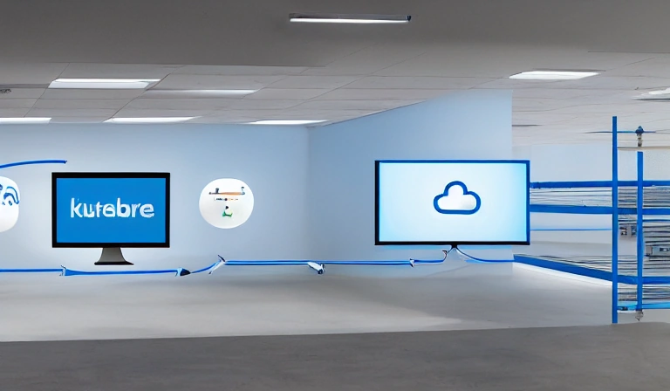
Executive Summary: Unlocking Business Agility with AKS
**Situation:** Businesses demand rapid, scalable application deployment.
**Complication:** Managing complex container orchestration is resource-intensive.
**Question:** How can organizations simplify operations and accelerate innovation?
**Answer:** Azure AKS offers a managed, secure, and scalable platform for modern applications.

Slide 3

Understanding Azure Kubernetes Service (AKS)
**Definition:** AKS is a fully managed Kubernetes service on Microsoft Azure.
Simplifies deployment, management, and scaling of containerized applications.
Integrates seamlessly with Azure services for comprehensive solutions.
Reduces operational overhead for Kubernetes cluster management.

Slide 4
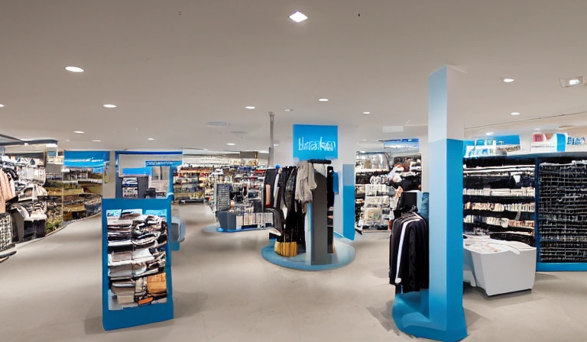
AKS: A Business Analogy for Managed Orchestration
Imagine a highly automated factory floor for software production.
AKS manages the machinery (Kubernetes) and underlying infrastructure.
Teams focus on building products (applications), not maintaining tools.
Ensures consistent production and rapid scaling on demand.

Slide 5
Azure AKS Architecture: Core Components
**Control Plane:** Managed by Azure, handles orchestration tasks and cluster state.
**Worker Nodes:** Your virtual machines running containerized applications.
Leverages Azure networking, storage, and monitoring for robust operations.
Provides high availability and automated upgrades for core components.

Slide 6
Key Benefits: Driving Efficiency and Innovation
**Scalability:** Automatically adjusts resources to meet fluctuating demand.
**Developer Agility:** Accelerates development cycles with consistent environments.
**Operational Efficiency:** Reduces infrastructure management burden and costs.
**Cost Optimization:** Pay-as-you-go model with efficient resource utilization.

Slide 7
Enhancing Security and Governance with AKS
Integrates with Azure Active Directory for robust identity management.
Implements network policies for secure communication between services.
Leverages Azure Security Center for continuous threat detection and protection.
Ensures compliance with built-in governance tools and policies.

Slide 8
Streamlining DevOps Practices with AKS
Facilitates continuous integration and continuous delivery (CI/CD) pipelines.
Supports GitOps for declarative infrastructure and application management.
Automates deployments and rollbacks for faster, more reliable releases.
Fosters collaboration between development and operations teams.

Slide 9
Case Study: Global Retailer's Digital Transformation
**Challenge:** Slow application deployment and scaling issues during peak seasons.
**Solution:** Migrated core e-commerce platform to Azure AKS.
**Results:** Achieved 40% faster feature delivery and 99.9% uptime [Infosys Research, 2023].
Realized significant cost savings on infrastructure and operations.

Slide 10
Strategic Action Plan for AKS Adoption
**Phase 1: Assessment & Pilot:** Evaluate current applications, define use cases.
**Phase 2: Design & Build:** Architect AKS environment, establish CI/CD pipelines.
**Phase 3: Migrate & Optimize:** Transition applications, fine-tune performance and costs.
**Phase 4: Govern & Scale:** Implement policies, expand AKS usage across the organization.

Slide 11
Appendix: Glossary of Key Terms
**Kubernetes:** Open-source system for automating deployment, scaling, and management of containerized applications.
**Container:** Lightweight, portable, executable software package that includes everything needed to run it.
**Pod:** The smallest deployable unit in Kubernetes, representing a single instance of a running process.
**Node:** A worker machine in a Kubernetes cluster, which runs containerized applications.
**Deployment:** A Kubernetes object that manages a set of identical Pods, ensuring a desired state.

