Slide 1
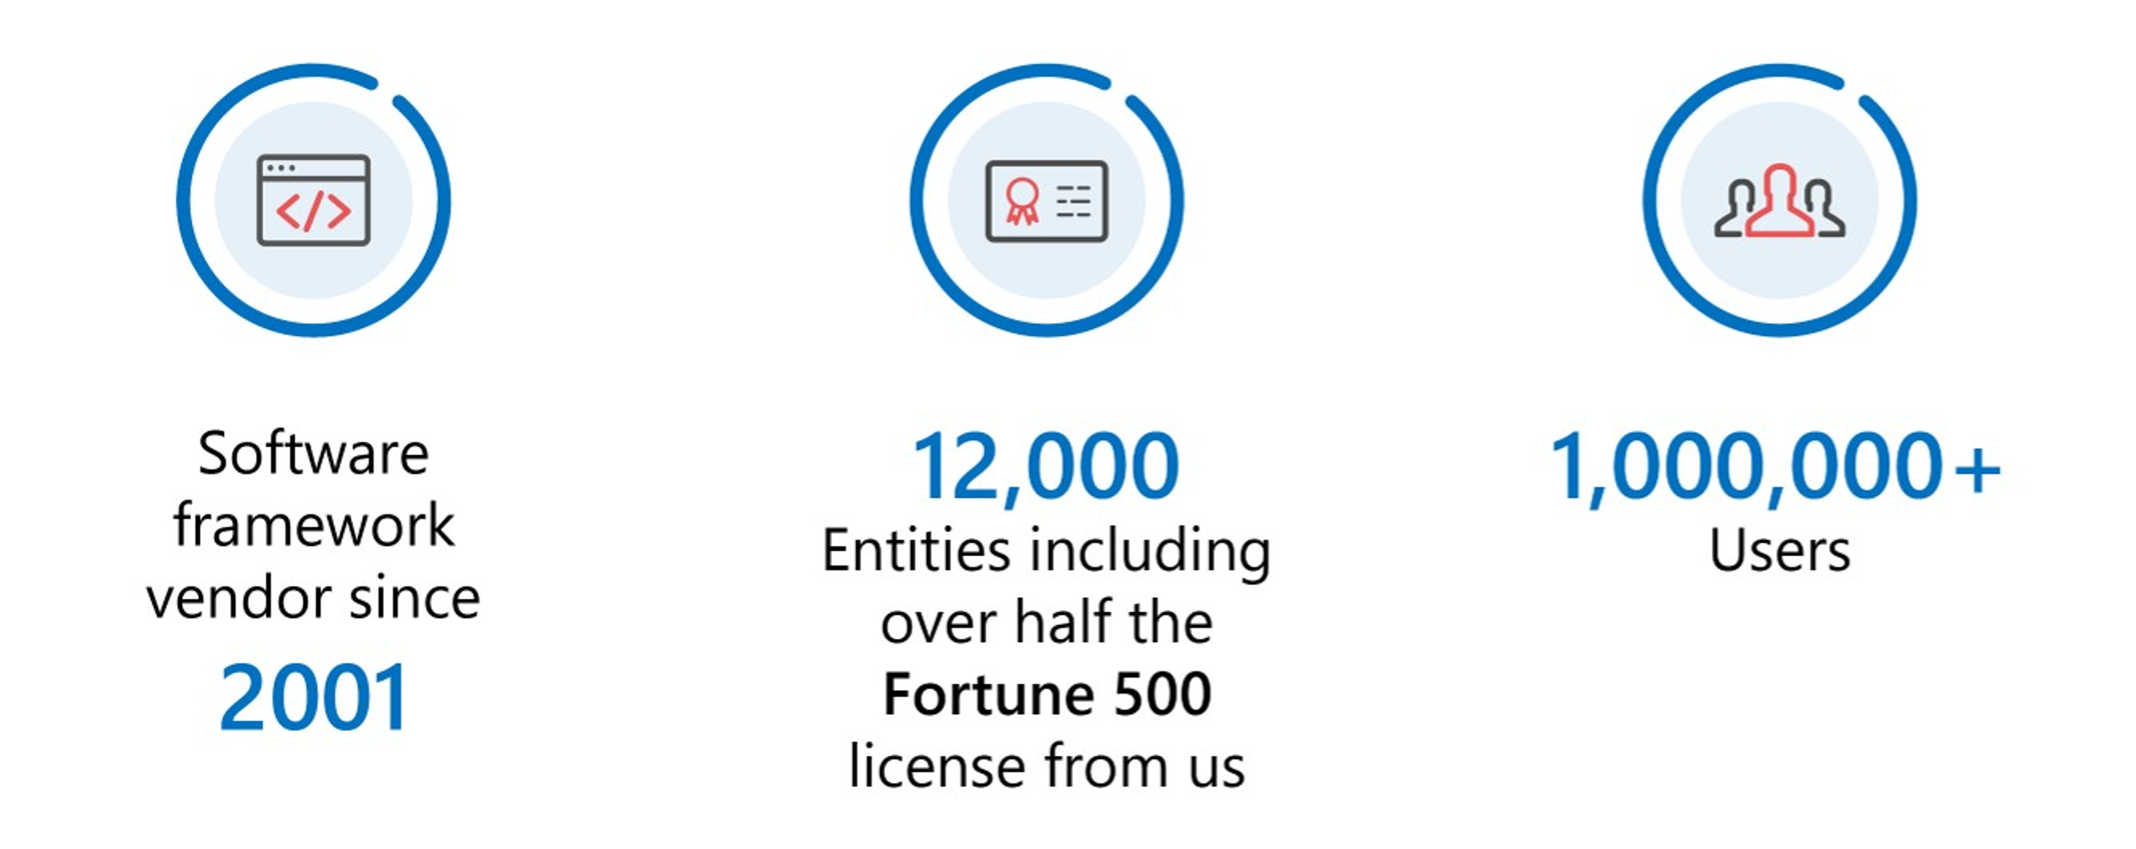
About Adventure Works Cycles

Slide 2
Thank You

