Slide 1
Incident Prediction
Team Name = T4
Mentor Name = Kavi Priya Ma’am,
Vinod Sir
Date = 02/07/2021
Members
Ankur Choudhary
Damini Shirsath
Akash Babar
Ashlesha Datir
Mahesh Chaudhari

Slide 2
Business Problem:
To predict the impact of the incident raised by the customer.
Objective:
The objective of the analysis is to predict an impact on the basis of event log of an incident management process extracted from a service desk platform of an IT company.

Slide 3
Project Architecture:
Problem identification
Decide on a problem
Data identification
Acquire data
Clean data
Extract features
Pre-processing
Deal with missing data
Feature engineering
Generate models
Model
processing
Select final model
Evaluate final model
Application
Use model

Slide 4
Exploratory Data Analysis (EDA) and
Feature Engineering

Slide 5
Important Libraries:
import pandas as pd
import numpy as np
from matplotlib import pyplot as plt
import seaborn as sns
from sklearn.model_selection import train_test_split
from imblearn.over_sampling import SMOTE
from collections import Counter
from sklearn.ensemble import ExtraTreesClassifier
from sklearn.feature_selection import mutual_info_classif
from sklearn.feature_selection import SelectKBest
from sklearn.feature_selection import chi2
from sklearn.tree import DecisionTreeClassifier
Libraries Installation :
1. pip install imblearn ➔ To balance the data

Slide 6
Data set details:
##code to find shape of the dataset
data.shape
Output ➔(141712 , 36)
Therefor from the above there are 141712 rows and 36 columns are present in the give incident_event_log dataset.
Column Names:
'number', 'incident_state', 'active', 'reassignment_count',
'reopen_count', 'sys_mod_count', 'made_sla', 'caller_id', 'opened_by',
'opened_at', 'sys_created_by', 'sys_created_at', 'sys_updated_by',
'sys_updated_at', 'contact_type', 'location', 'category', 'subcategory',
'u_symptom', 'cmdb_ci', 'impact', 'urgency', 'priority',
'assignment_group', 'assigned_to', 'knowledge',
'u_priority_confirmation', 'notify', 'problem_id', 'rfc', 'vendor',
'caused_by', 'closed_code', 'resolved_by', 'resolved_at', 'closed_at'

Slide 7
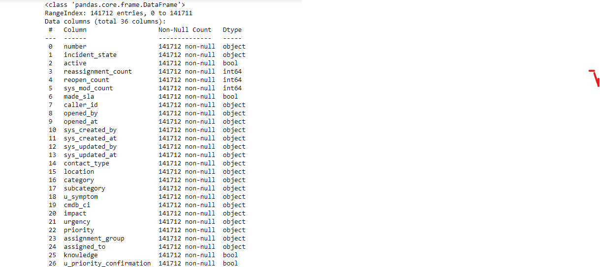
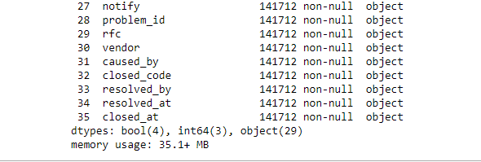
Data Information:
To find the info about the data used the code
data.info() ➔

Slide 8
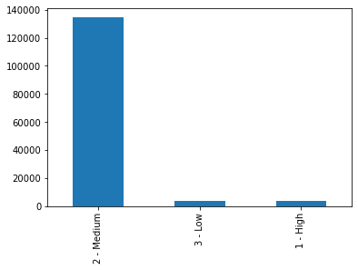
Data Visualization
Visualization of dataset :
Bar plot:
df2['impact'].value_counts().plot.bar()
From the given output it is clear that all data is concentrate in the medium values of impact ,
Therefore we can say that the data is imbalanced

Slide 9
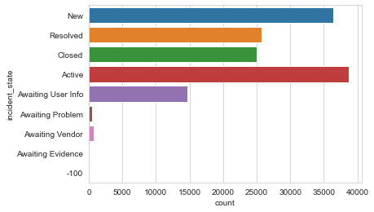
Impact on incident_state :
Incident state New and Active have high impact .
Awaiting Problem ,Awaiting Vendor and Awaiting Evidence has low impact.
Rest have medium impact.

Slide 10
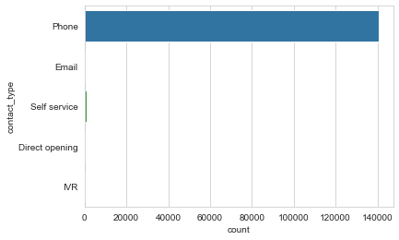
Impact on Contact_Type :
Most of the customer’s contacted via phone.

Slide 11
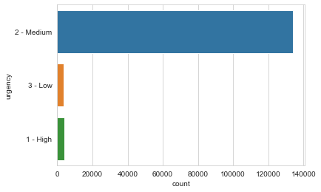
Impact on urgency :
Visualization of the level of urgency.

Slide 12
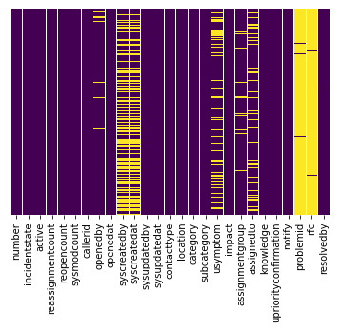
Missing Values:
Roughly 40 percent of the syscreatedby and syscreatedat data is missing.
looking at column usersymptom and assignedto less amount of data is missing nearly around 10% of data.
Looking at the problem id , rfc it looks like we are just missing too much of that data nearly 99% of data to do something useful with at a basic level.
We'll probably drop this later.
To find the missing value used :
sns.heatmap(df.isnull(),yticklabels=False,cbar=False,cmap='viridis')

Slide 13
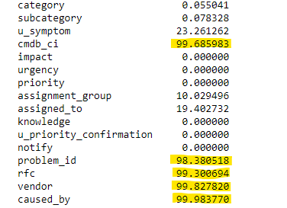
Data Cleaning:
Drop Columns:
Drop columns with more than 90% missing values
caused_by
rfc
vendor
cmdb_ci
problem_id

Slide 14
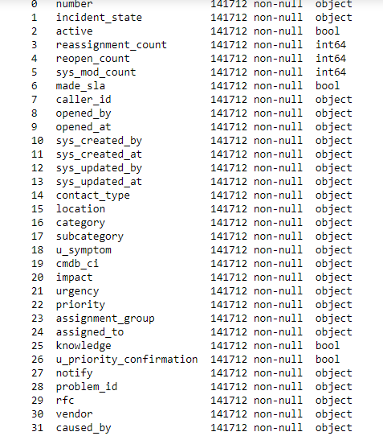
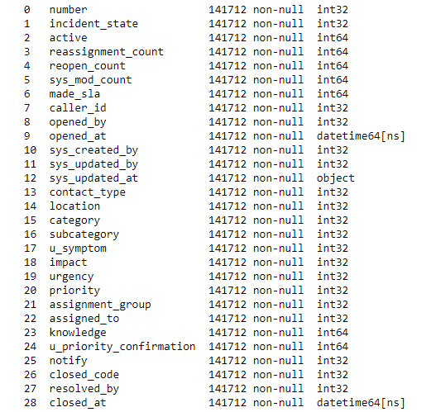
Converting Object to Integer:
LabelEncoder

Slide 15
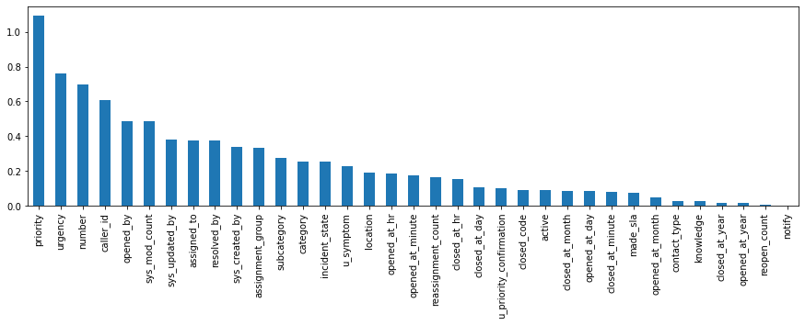
Feature for consideration :
Algorithm used: mutual_info_classif
priority 1.092835
urgency 0.762983
number 0.697378
caller_id 0.606936
opened_by 0.486160
sys_mod_count 0.484496
sys_updated_by 0.379297
assigned_to 0.374654
resolved_by 0.374008
sys_created_by 0.337257
assignment_group 0.331575
subcategory 0.274606
category 0.254383
incident_state 0.252017
u_symptom 0.229421
location 0.191954
opened_at_hr 0.186612
opened_at_minute 0.176683
reassignment_count 0.165222
closed_at_hr 0.153511
closed_at_day 0.108135
u_priority_confirmation 0.102643
closed_code 0.090624
active 0.089004
closed_at_month 0.087445
opened_at_day 0.085613
closed_at_minute 0.081194
made_sla 0.072851
opened_at_month 0.048975
contact_type 0.027660
knowledge 0.025460
closed_at_year 0.016844
opened_at_year 0.015752
reopen_count 0.004109
notify 0.000000
dtype: float64

