Slide 1
REACT QUERY

Slide 2
Tanstack Query,
Also Known as React Query
  Popular library for fetching data in React applications.
Simplifies the process of fetching, caching, and updating data
npm i @tanstack/react-query

Slide 3
Setting Up React Query
QueryClientProvider
  The entire application is wrapped within the query Client provider
  Provides an instance of the QueryClient to all its child components.
QueryClient
  Central Piece of React Query.
  Manages all data fetching and caching logic.
  Passed as a prop to QueryClientProvider

Slide 4
Query Client
  const queryClient = new QueryClient({
  defaultOptions: { queries: { staleTime: 1000 * 60 * 5 } },
  })
StaleTime:
  specifies the number of milliseconds the cached data is valid before becoming stale.
  If the query is stale ,will still get data from the cache, but a background refetch can happen under certain conditions.

Slide 5
Wrapping
  import { QueryClientProvider, QueryClient } from '@tanstack/react-query';
  const queryClient = new QueryClient();
  ReactDOM.createRoot(document.getEementd('root')).render(
  <React.StrictMode>
  <QueryClientProvider client={queryClient}>
  <App />
  </QueryClientProvider>
  </React.StrictMode>
  )

Slide 6
useQuery Hook
useQuery
  fetches data from a server or API.
  Also returns an object that contains information on the query.
queryKey
  Identifies the key to query
  Must be unique for each query in the application.
  Can be any value, such as a string, an object, or an array.
  Its used for caching.
queryFn
  Function used to fetch the data.
  It returns a promise that resolves to the data

Slide 7
useQuery
  const getAgents = async () =>{
  const response = await axios.get('http://localhost:5000/agents')
  return response.data
  }
  const agentQuery = useQuery({
  queryKey:['agents'],
  queryFn:getAgents
  })

Slide 8
Demo
  if (agentQuery.status === "loading") return <h1>Loading...</h1>
  if (agentQuery.status === "error") {
  return <h1>{JSON.stringify(agentQuery.error)}</h1>
  }

Slide 9
Demo
  return (
  <div>
  <ol>
  {agentQuery.data.map(post => (
  <li key={post.id}>{post.name}{post.phone}</li>
  ))}
  </ol>
  </div>
  )

Slide 10
Example
  import { useQuery,useQueryClient } from '@tanstack/react-query'
  const FetchAgents = () => {
  const getAgents = async () =>{}
  const queryClient = useQueryClient()
  const agentQuery = useQuery({})
  return (
  <div>
  </div>
  )
  }
  export default FetchAgents

Slide 11
refetchInterval
Sets the interval in milliseconds between each automatic fetch request.
    useQuery({
    queryKey: ['...'],
    queryFn: () => {...},
    refetchInterval: 6000;
    })
The React Query will automatically trigger a new fetch request to update the cached data after 6 seconds.

Slide 12
Mutation
Mutations are actions that a user can do in an application.
  Its action to change or create something.
It performs asynchronous operation mutations,
  Creating or updating data on a server.
Can easily update application state and user interface based on the response of the mutation.

Slide 13
useMutation Hook
Has Two parameters.
  The function that will handle the mutation,
  Object of options.
  useMutation({
  mutationFn: createAgent,
  onSuccess: data => {
  queryClient.setQueryData(["agents", data.id], data)
  queryClient.invalidateQueries(["agents"], { exact: true })
  },
  }).

Slide 14
API
  const createAgent = async ({name,phone}) =>{
  const response = await axios
  .post("http://localhost:5000/agents", {
  name: name,
  phone: phone,
  id: Date.now(),
  })
  return response.data
  }

Slide 15
Utility Methods
queryClient.invalidateQueries.
  This method marks the cached data for a specific key as outdated, which triggers retrieving the data again.

Slide 16
Component
  const CreateAgent = ()=> {
  const nameRef = useRef()
  const phoneRef = useRef()
  const queryClient = useQueryClient()
  const createAgentMutation = useMutation({
  mutationFn: createAgent,
  onSuccess: data => {
  queryClient.setQueryData(["agents", data.id], data)
  queryClient.invalidateQueries(["agents"], { exact: true })
  },
  })

Slide 17
Handle Submit
  Triggering the mutation using mutation.mutate.
  function handleSubmit(e) {
  e.preventDefault()
  createAgentMutation.mutate({
  name: nameRef.current.value,
  phone: phoneRef.current.value,
  })
  }

Slide 18
Form
  return (
  <div>
  {createAgentMutation.isError && JSON.stringify(createAgentMutation.error)}
  <form onSubmit={handleSubmit}>
  <input id="name" ref={nameRef} />
  <input id="phone" ref={phoneRef} />
  <button disabled={createAgentMutation.isLoading}>
  {createAgentMutation.isLoading ? "Loading..." : "Create"}
  </button>
  </form>
  </div>
  )
  }
  export default CreateAgent

Slide 19
Deleting
  const queryClient = useQueryClient()
  const mutation = useMutation(deleteAgent, {
  onSuccess: () => queryClient.invalidateQueries('agents')
  })
  const deleteAgent = (agent) =>{
  response = await fetch(`http://localhost:3001/notes/${agent.id}`
  return response.data
  }
  <button className='link text-gray-400' onClick={() => mutation.mutate(agent)}>Delete</button>

Slide 20
React Query - Redux
React Query concentrates on data fetching and caching
  Suitable for application that depend heavily on API calls with an emphasis on optimizing data fetching and caching efficiency,
Redux supplies a comprehensive client-side state management solution.
React Query offers a much more straightforward API and requires less boilerplate code than Redux.
Redux’s strict unidirectional data flow simplifies testing and debugging in large projects.

Slide 21
React Dev Tools
React Query comes with dedicated devtools
  npm i @tanstack/react-query-devtools
import { ReactQueryDevtools } from '@tanstack/react-query-devtools'
Floating Mode will mount the devtools as a fixed, floating element
A toggle in the corner of the screen to show and hide the devtools.
  toggle state will be stored and remembered in localStorage across reloads.

Slide 22
React Dev Tools
  <QueryClientProvider client={queryClient}>
  {/* The rest of your application */}
  <ReactQueryDevtools initialIsOpen={false} />
  </QueryClientProvider>
initialIsOpen:
  true : makes dev tools to default to being open

Slide 23
Pros of React Query
Pros
  Lightweight and fast, with a focus on data fetching and caching
  Simple API and minimal boilerplate code
  Automatic data caching and invalidation based on query parameters
Cons of React Query
  Smaller community and ecosystem compared to other libraries
  Primarily focused on data fetching and caching, and may not be suitable for complex client state management requirements

Slide 24
Pros and cons of Redux
Pros
  Well-established library with a large community and ecosystem
  Strict unidirectional data flow can make it easier to reason about and debug
  Middleware system allows for more granular control over the data flow
  Has a wide range of integrations and plugins available
Cons of Redux
  May have a larger size and performance overhead compared to other libraries
  More opinionated than some other libraries and may not be a good fit for every application
  Can have a steeper learning curve and require more boilerplate code to set up

Slide 25
REACT MATERIAL UI

Slide 26
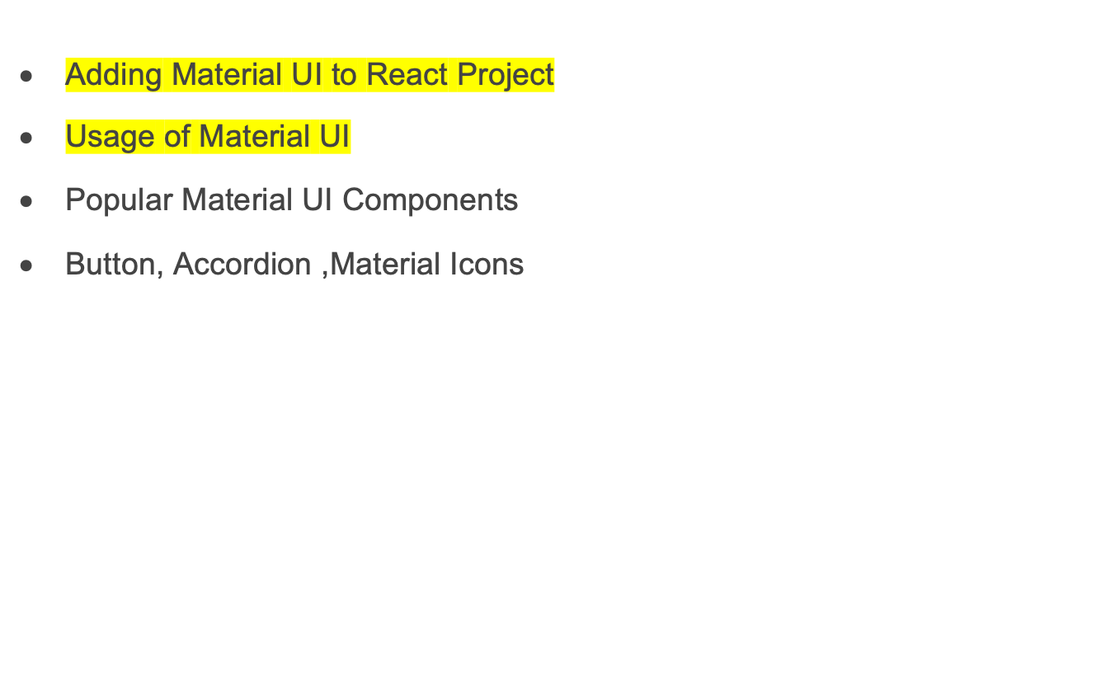
Topics

Slide 27
Introduction
Open-source React component library
  Implements Google's Material Design.
Has a comprehensive collection of prebuilt components
  Ready for use in production
It has a suite of customization options
  To implement Custom design system on top of components.

Slide 28
Advantages of Material UI
Ship faster:
  Over 2,500 open-source contributors have poured countless hours into these components.
  Focus on core business logic instead of reinventing the wheel
Customizability:
  Includes an extensive set of intuitive customizability features.
  Templates in the store gives various degree of customization.

Slide 29
Installing Material UI
Requires Reactjs version is 16.8.0 or above
  npm install @material-ui/core
  npm install @material-ui/icons
  npm install @material-ui/styles

Slide 30
Button
  import Button from '@mui/material/Button';
  export default function MyApp() {
  return (
  <div>
  <Button variant="contained">Hello World</Button>
  </div>
  );
  }
  <Button variant='outlined' onClick={() => {alert('Clicked !!')}}>Primary</Button>

Slide 31
Delete Button
  import { IconButton } from "@material-ui/core";
  import DeleteIcon from "@material-ui/icons/Delete";
  return (
  <div style={{ margin: 50 }}>
  <IconButton>
  <DeleteIcon />
  </IconButton>
  </div>
  );

Slide 32
Typography
Used for showing text,
Has different props to customize the text.
  <Typography align="left">align = left</Typography>
  <Typography variant="h3">Using Material UI</Typography>

Slide 33
Accordion
Accordions
  Used to create an expansion panel.
  Can put other contents in Accordion and it will expand/collapse on clicking its header.
Box
  Component serves as a wrapper component for most of the CSS utility needs.

Slide 34
Accordion
  <Box className={classes.accordion}>
  <Typography variant="h1" color="initial">Using Material UI</Typography>
  <Accordion>
  <AccordionSummary>
  <Typography>Product Catalog</Typography>
  </AccordionSummary>
  <AccordionDetails>
  <Typography></Typography>
  </AccordionDetails>
  </Accordion>
  <Accordion></Accordion>

Slide 35
Accordion
  import { Theme, createStyles, makeStyles } from "@material-ui/core/styles";
  const useStyles = makeStyles((theme: Theme) =>
  createStyles({
  accordion: {
  margin: theme.spacing(3),
  width: theme.spacing(100),
  },
  })
  );
const classes = useStyles();

Slide 36
Avatar
Used extensively from tables to dialog menus.
import Avatar from '@material-ui/core/Avatar';
  <Avatar alt="Remy Sharp" src="/static/images/avatar/1.jpg" />
  <Avatar className={classes.orange}>N</Avatar>

Slide 37
Data Grid
npm install @mui/x-data-grid
npm install @mui/material @emotion/react @emotion/styled
npm install @mui/material @mui/styled-engine-sc styled-components

Slide 38
Data Grid
  import { DataGrid} from '@mui/x-data-grid';
  const Example = () => {
  const rows = [
  { id: 1, col1: 'TV', col2: '45000' },
  { id: 2, col1: 'Laptop', col2: '80000' },
  { id: 3, col1: 'Printer', col2: '20000' },
  ];
  const columns = [
  { field: 'col1', headerName: 'Item Name', width: 150 },
  { field: 'col2', headerName: 'Rate Per Unit', width: 150 },
  ];

Slide 39
Data Grid
  return (
  <div style={{ height: 300, width: '100%' }}>
  <DataGrid rows={rows} columns={columns} />
  </div>
  )
  }
  export default Example

Slide 40
Documentation
https://v4.mui.com/getting-started/

Slide 41
Deployment to netlify
Step 1: Create a React Application
Step 2: npm run build
Step 3: Create Github repository
Step 4: Setup Netlify
Step 5: Go to the ‘Sites’ section from the header of the Netlify website’s dashboard.
Step 6: Select ‘Add new site’.
step 7 :‘import an existing project‘,
Step 8: Use the Default Settings
Step 9: click on the Deploy site.
Step 10 : Once the deployment gets completed, a public URL for your project with the domain ‘netlify.com‘.

Slide 42
DEPLOYING TO GCP

Slide 43
Deploying
npx create-react-app react-google-cloud
create app.yml in the root path
runtime: nodejs16
handlers:
# Serve all static files with url ending with a file extension
- url: /(.*\..+)$
static_files: build/\1
upload: build/(.*\..+)$
# Catch all handler to index.html
- url: /.*
static_files: build/index.html
upload: build/index.html

Slide 44
Deployment
Navigate to http://console.cloud.google.com/
Navigate to the Cloud Console Dashboard and create a new project.
Select Project and New Project
Search for 'App Engine' in the search bar and click on App Engine:
Click Create Application
Choose the region
In the Service account dropdown, choose the default one and click on Next:

Slide 45
Deployment
Download Google SDK
(New-Object Net.WebClient).DownloadFile("https://dl.google.com/dl/cloudsdk/channels/rapid/GoogleCloudSDKInstaller.exe", "$env:Temp\GoogleCloudSDKInstaller.exe")
& $env:Temp\GoogleCloudSDKInstaller.exe

Slide 46
Deployment
Navigate to the project directory, and run the following command:
gcloud init
Build the project using npm run build
On completion deploy to gcp
gcloud app deploy
Open with the shown url

Slide 47
JEST –REACTIVE TESTING LIBRARY

Slide 48
React Testing Library
A package created by Kent C. Dodds.
  It's a replacement for Enzyme
Provides utility functions on top of react-dom and react-dom/test-utils.
DOM testing library
  Handles DOM elements and how they behave in front of real users.
create-react-app comes with the library and its dependencies.

Slide 49
JEST
Jest is a JavaScript testing framework
  Its test runner that finds tests, runs the tests
  Determines whether the tests passed or failed.
  Offers functions for test suites, test cases, and assertions.
React Testing Library provides virtual DOMs for testing React components.

Slide 50
Test Layout
it or test:
  Describes the test itself.
  It takes as parameters the name of the test
  A function that holds the tests.
expect:
  The condition that the test needs to pass.
  It will compare the received parameter to a matcher.
a matcher:
  a function that is applied to the expected condition.
render:
  the method used to render a given component.

Slide 51
React Testing Library
Provides way to find elements using helpers.
Elements can be selected not only by the text they contain.
findByTestId
  To find elements by their data-testid attribute value.
toHaveFormValues
  A matcher to more easily assert if the form values are what we expect
ByLabelText,
  Element by a given text in label or aria-label
ByRole
  Find by aria role;
ByTestId
  Find by data-testid attribute.

Slide 52
Test DOM Elements
data-testid.
  It will be used to select these elements from the test file.
  getByTestId to select the necessary elements
  const TestElements = () => {
  const [counter, setCounter] = React.useState(0)
  return (
  <div>
  <h1 data-testid="counter">{ counter }</h1>
  <button data-testid="button-up"
  onClick={() => setCounter(counter + 1)}> Up</button>
  <button data-testid="button-down"
  onClick={() => setCounter(counter - 1)}>Down</button>
  </div>
)
}

Slide 53
Testing events
fireEvent.click()
  Fires a click event ,has several methods test events
  Utility to modify the form's state.
  it('increments counter', () => {
  const { getByTestId } = render(<TestElements />);
  fireEvent.click(getByTestId('button-up'))
  expect(getByTestId('counter')).toHaveTextContent('1')
  });

Slide 54
Component Under Test
  export const Greetings = ({
  name, onGreeting }) => {
  return (
  <div>
  <p>Hello {name}!</p>
  <button
  type="button"
  onClick={() =>
  onGreeting(`Hello ${name}!`)}> Send</button>
  </div>
  );
  };

Slide 55
Test Case
  import { fireEvent, render, screen } from "@testing-library/react";
  import userEvent from "@testing-library/user-event";
  import { Greetings } from "./GreetingComponent";
  describe("when rendered with `OnGeeting` prop", () => {
  it("should render the send button", () => {
  render(
  <Greetings name="Test Name“ onGreeting={() => {}} />
  );
  expect(
  screen.getByRole("button")
  ).toBeInTheDocument();
  });
  });

Slide 56
Test Case
  describe("when the button is pressed", () => {
  it("should call the `onGreeting` callback", () => {
  const onGreetingMock = jest.fn();
  render(
  <Greetings name="Test Name“
  onGreeting={onGreetingMock} />
  );
  fireEvent.click(screen.getByRole("button"));
  expect(onGreetingMock).toHaveBeenCalledWith(
  "Hello Test Name!");
  });
  });

Slide 57
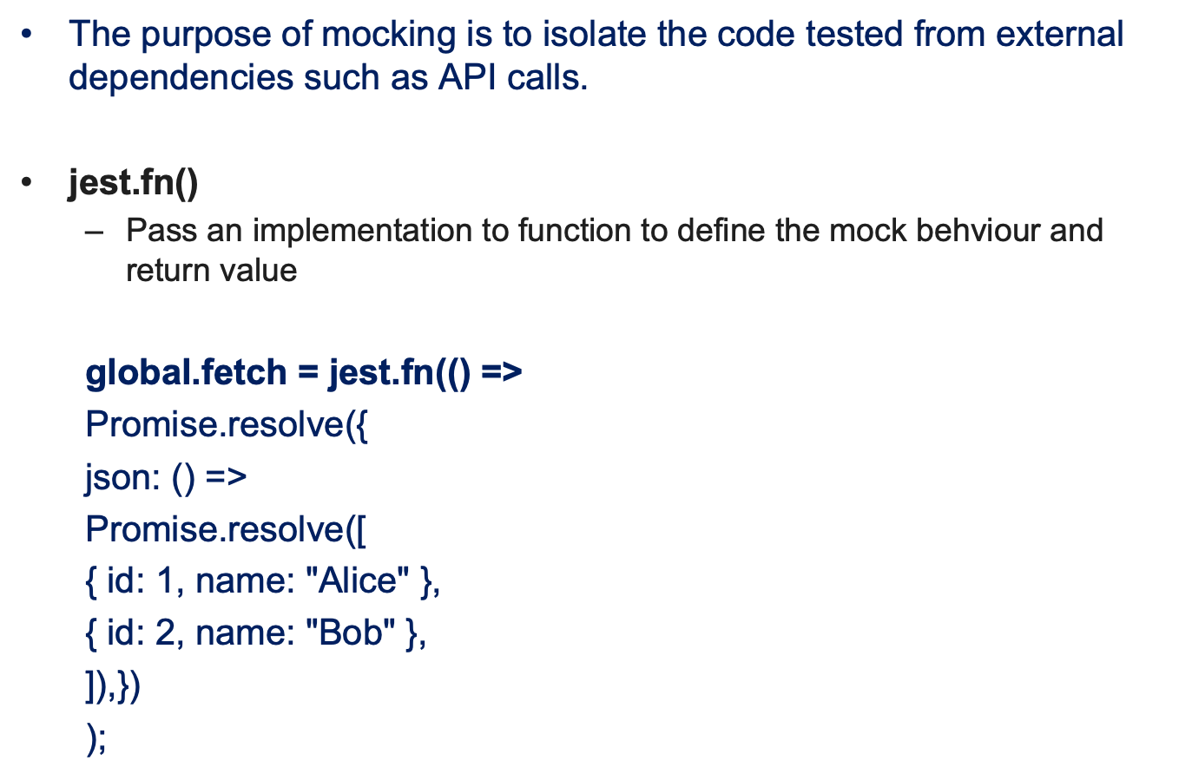
Mocking With React and JEST

Slide 58
Mocking
  import React from "react";
  import { render, screen, waitFor } from "@testing-library/react";
  import UserList from "./UserList";
  test("renders user list", async () => {
  global.fetch = jest.fn(() =>
  Promise.resolve({
  json: () =>
  Promise.resolve([
  { id: 1, name: "Alice" },
  { id: 2, name: "Bob" },
  ]),
  })
  );

Slide 59
Test With Mock
  render(<UserList />);
  await waitFor(() => {
  const userList = screen.getByText(/user list/i);
  expect(userList).toBeInTheDocument();
  const user1 = screen.getByText(/ram/i);
  expect(user1).toBeInTheDocument();
  const user2 = screen.getByText(/bob/i);
  expect(user2).toBeInTheDocument();

Slide 60
Snapshot Testing
Snapshot tests are used to make sure your UI does not change unexpectedly.
A typical snapshot test case renders a UI component,
  takes a snapshot,
  then compares it to a stored reference snapshot file.
If the two snapshots match,
  the test will pass.
If the changes are not expected, its caught the error before the change was deployed and can now address the error.
If the changes were expected, you would need to update your snapshot tests to get them to pass correctly.

Slide 61
Snapshot Testing
The first time when the test is run Jest will create a snapshot file in the __snapshots__ folder.
Can Update the Test when Jest is in watch mode by first pressing w in the command line to show more, and then pressing u to update the snapshot

