Slide 1
MIDDLEWARE

Slide 2
Middleware
A Redux middleware is a function that can intercept actions and act before it reaches the reducer.
  A place for abstracting REST calls, business logic etc.,
Benefits of a Redux middleware
  Reusable pieces of Logic can live outside React
  Keep the components clean
Two Popular middleware are redux-thunk and Saga.

Slide 3
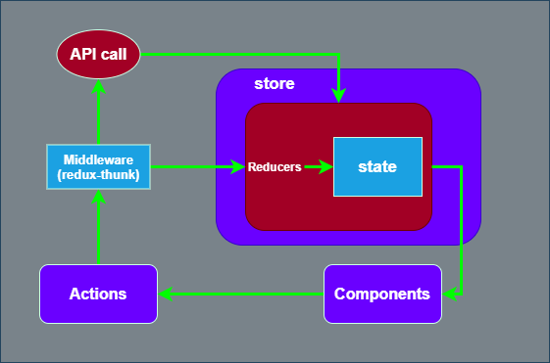

Slide 4
Two types of Action in Redux
Synchronous Action
  Returns a plain Java Script object from action creators
  No Need to make any Ajax Calls.
  The reducer will return the next state.
Asynchronous Action
  Inside the function Ajax calls to REST APIs,
  May have delay in the dispatch of an action
  Data is not fetched on the Component

Slide 5
Configure the Middleware
createSlice
  A function available via the redux toolkit library.
createAsyncThunk
  Used to handle asynchronous requests.
  Produces a definitive Redux thunk action creator.

Slide 6
Redux-thunk
In Redux, a thunk is a function that's used to perform delayed work, and is a common way to write asynchronous logic:
It’s a middleware that returns function instead of objects
They interact with a Redux store's dispatch and getState methods.
Perform a variety of tasks, including data fetching, making HTTP calls,
Manage the flow of actions in applications where user interactions trigger asynchronous actions

Slide 7
thunk as middleware
“actions” are plain objects and “reducers” are pure functions
  can’t do any API calls or dispatch actions inside them
“thunk” function
  Can move API calls like actions to live inside this function.
  Looks at every action that passes through the system
  If there is a function Call then its Invoked.

Slide 8
createSlice
CreateSlice is a function in Redux Toolkit
Automatically generates action creators and action types for the reducers specified.
Reduces the boilerplate required to add data to redux in the canonical way.
name: A string name for the slice
initialState: The initial state for the reducer
reducers: An object of reducers, which are functions that handle specific action types
extraReducers: A builder callback to update the slice's state in response to other action types

Slide 9
createSlice
  import { createSlice } from '@reduxjs/toolkit';
  const counterSlice = createSlice({
  name: 'counter',
  initialState: { value: 0, age: 5 ,firstName:'sunderasan'},
  reducers: {
  increment(state) {
  state.value += 1;
  },
  decrement(state) {
  state.value -= 1;
  },
  changeWithArg(state, action) {
  state.age = action.payload.age+10
  },
  addSkill(state,action){
  state.firstName=action.payload.firstName
  }
  },
  });
  export const { increment, decrement, changeWithArg, addSkill} = counterSlice.actions;
  export default counterSlice.reducer;

Slide 10
Component
import { increment, decrement, changeWithArg, addSkill } from './CounterSlice’;
  function Counter() {
  const count = useSelector(state => state.counter.value);
  const age = useSelector(state => state.counter.age);
  const firstName = useSelector(state => state.counter.firstName);
  const dispatch = useDispatch();
  return (
  <div>
  <p>Count: {count}</p>
  <p>{age}{firstName}</p>
  <button onClick={() => dispatch(increment())}>+</button>
  <button onClick={() => dispatch(decrement())}>-</button>
  <button onClick={() => dispatch(changeWithArg({ age: 4 }))}>prefix</button>
  <button onClick={() => dispatch(addSkill({ firstName: 'java sunderasan' }))}>prefix</button>
  </div>
  );
  }

Slide 11
Difference between Slice and Reducer
Slice:
  Represents a specific part of application state.
  Contains multiple reducer functions handling actions related to that specific feature.
  Defined using createSlice function in Redux Toolkit.
  State management by separating concerns.
Reducer:
  A single function that updates the state based on an action.
  Takes the current state and an action as input and returns the new state.
  Can be part of a slice, where each reducer within the slice handles a specific action type related to that feature.

Slide 12
Extra Reducer
A special configuration within a slice
To define reducer logic to respond to actions generated outside its own scope
Purpose:
  A slice to handle actions from other slices, which is not the default behavior where a slice typically only responds to actions it generates itself.
Use cases:
  Asynchronous actions: When one slice needs to update state based on the completion of an asynchronous operation initiated in another slice.
  Global state updates: When an action from one part of the application requires updating state in multiple slices.

Slide 13
Configuring Thunk
Generates promise lifecycle action types using name as a prefix:
It also generates a thunk that dispatches those actions automatically.
Has Two parameters:
Action type value:
  A string that generates additional Redux action type constants
PayloadCreator callback:
  A callback function that returns a promise containing the result of some asynchronous logic
  Simplifies the process of creating actions for different outcomes of an async call.
  It also handles errors correctly internally.

Slide 14
Builder API
The API call returns a promise, which can be in one of three states: pending, fulfilled, or rejected.
The standard convention for the action name is [slice name]/[action name], such as posts/fetchPosts.
In the event of an error, createAsyncThunk dispatches posts/getPosts/rejected.
  export const getTransactions = createAsyncThunk('payment/getTransactions',async()=>{
  let response = await axios.get("http://localhost:5000/payments")
  return response.data
  })

Slide 15
extrareducers
  Used to handle Actions made by createAction or createAsyncThunk
    Can also handle actions generated in other slices
createAsyncThunk generates three different action types
  pending, fulfilled, and rejected.
  Representing the lifecycle of the asynchronous operation
  These actions are handled in extraReducers section
  Usesefine specific cases for different action types from other slices.
  [fetchUsers.pending]: (state, action) => {
  state.loading = true;
  }

Slide 16
Configuring Slice
  const sliceOptions ={
  name: "payment",
  initialState:{data:[],loading:false,error:null},
  reducer:{},
  extraReducers: (builder)=>{
  builder.addCase(getTransactions.pending,(state,action)=>{
  if(state.loading){
  state.loading = true
  }
  })

Slide 17
Configuring Slice
  builder.addCase(getTransactions.fulfilled,(state,action)=>{
  if(!state.loading){
  state.data =action.payload;
  state.loading =false
  }
  })
  builder.addCase(getTransactions.rejected,(state,action)=>{
  if(state.loading){
  state.error = action.error.message
  state.loading =true
  }
  })
  },
  }
  const PaymentSlice = createSlice(sliceOptions)
  export default PaymentSlice.reducer;

Slide 18
Store
  import { configureStore } from "@reduxjs/toolkit";
  import paymentReducer from "./PaymentSlice"
  const store = configureStore({
  reducer: {
  payment: paymentReducer
  }
  })
  export default store;

Slide 19
Component
  import { useDispatch, useSelector } from 'react-redux'
  import { getTransactions } from './PaymentSlice'
  const ShowPayments=() => {
  const dispatch = useDispatch()
  const { data, loading, error } = useSelector((state) => state.payment)
  useEffect(() => {
  dispatch(getTransactions())
  }, [dispatch] )

Slide 20
Component
  return(
  <>
  {
  data.map((item)=>{
  return(
  <TableRow key={item.txnId} item={item}/>
  )
  })
  }
  </>
  )
  }
  export default ShowPayments

Slide 21
Create Action
  export const addTransactions= createAsyncThunk(
  "addtxn",
  async (data, { rejectWithValue }) => {
  const response = await axios.put(
  url,data)
  }
  retrun response.data
  );
  );

Slide 22
Extra Reducers
  [addTransactions.pending]: (state) => {
  state.loading = true;
  },
  [addTransactions.fulfilled]: (state, action) => {
  state.data.push(action.payload);
  state.loading = false;
  },
  [addTransactions.rejected]: (state, action) => {
  state.loading = false;
  state.error = action.payload.message;
  }

Slide 23
Create Component
  const [data, setData] = useState({});
  const navigate = useNavigate();
  const dispatch = useDispatch();
  const fetch = (e) => {
  setData({ ...data, [e.target.name]: e.target.value });
  };

Slide 24
Create Component
  const handleSubmit = (e) => {
  e.preventDefault();
  dispatch(createUser(users));
  navigate('/read');
  };
  ,<form className='form' onSubmit={handleSubmit}>
  <input type='text' name='name' onChange={getUserData}/>
  </form>

Slide 25
GENERATORS

Slide 26
Generators
Generators, are functions that can be paused and resumed
  function returns an iterator
Used for Two purposes
  Implementing iterables
  Blocking on asynchronous function calls
It return a generator Object ready to begin execution of function body
Executes on the first invocation of next() on the generator object itself.

Slide 27
Promise vs Generators
  fetch(url).then( (val) =>{console.log(value)})
  let val = yield fetch(url);
  console.log(val)

Slide 28
Generators
  function* genFour() {
  yield 1;
  yield 2;
  yield 3;
  return 4;
  }
let four = genFour();
Suspends on every yield and allows other code to run until the next time it resumes

Slide 29
REDUX SAGA

Slide 30
Introduction
It’s “redux for making HTTP requests.”
  A saga is an action dispatched to the API.
  Upon return, the value is reduced
  Used to update state.
Saga is implemented as a middleware to coordinate and trigger asynchronous actions (side-effects).
The Multiple Call backs in “thunk” is eliminated
Individual saga can be defined under sagas/saga.js

Slide 31
Working of Saga
Helps to dispatch events asynchronously without having to wait until data is returned.
When data comes works with a reducer to update the application state
Uses yield to pause and resume a generator function.
Fetching and reducing return values is a two step process:
  yield call
    executes the API call.
  yield put
    Takes the fetched data and sends to reducer.
    The reducer then updates the state.

Slide 32
Installation
  "dependencies": {
  "react": "^16.8.6",
  "react-dom": "^16.8.6",
  "react-scripts": "3.0.0",
  "react-redux": "^7.0.3",
  "redux": "^4.0.1",
  "redux-saga": "^1.0.2",
  "redux-logger": "^3.0.6"
  },

Slide 33
Saga Event System
Two different types of events
  saga events and reducer events.
Saga events
  Primary events that will dispatch manually from React components.
  But when a saga action returns it will fetch return value from the API.
  Fetched return value is then passed to a reducer.
Reducer events
  A reducer event that simply mirrors a given saga event.
  Common strategy is to use a postfix or prefix:
  Used to finalize the UI view.

Slide 34
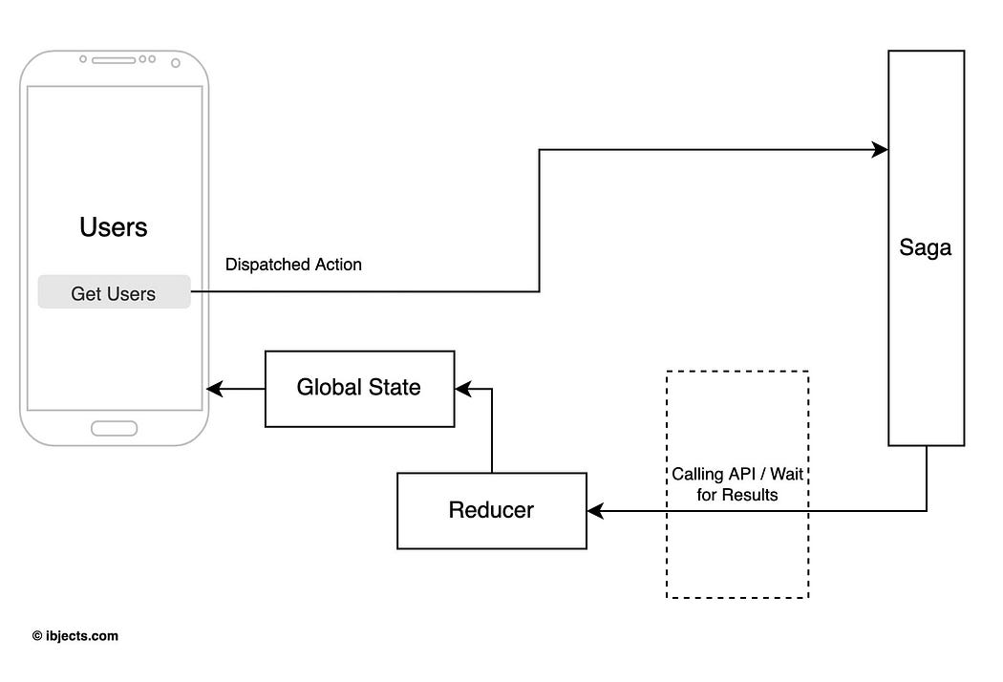

Slide 35
Declarative Effects
A sagas job is to watch for dispatched actions With Effects
Effect
  An object that has information to be interpreted by the middleware.
    Invoke asynchronous function, dispatch an action to the store
  function* actionWatcher() {
  yield takeLatest('GET_USERS', fetchUsers)
  }

Slide 36
Saga Effects
takeLatest
  Spawns a new saga on each dispatched action.
  It will be sent to the Store that matches the pattern provided.
  It will also cancel any previous saga tasks started if they are still running. and run again with the latest data available.
  takeEvery
  Spawns a saga on each action dispatched to the Store that matches pattern.
  allows concurrent actions to be handled

Slide 37
Saga Effects
Put
  Instead of dispatching an action inside the generator,
  returns an object with instructions for the middleware to dispatch the action.
  yield put({type:'ADD_ITEM_ASYNC',value:1})

Slide 38
Reducer
  import { createReducer } from "@reduxjs/toolkit";
  const initialState = {};
  const myReducer = createReducer(initialState, (builder) => {
  builder
  .addCase('GET_USERS_SUCCESS', (state, action) => {
  state.users = action.users;
  })
  .addCase('GET_USERS_FAILURE', (state, action) => {
  state.error = action.error;
  })
  .addDefaultCase((state, action) => {});
  });
  export default myReducer;

Slide 39
Sagas
  async function userFetch() {
  return axios
  .get("https://jsonplaceholder.typicode.com/users")
  .then((res) => {
  return res.data;
  })
  .catch((err) => {
  throw err;
  });
  }

Slide 40
Sagas
  function* getUsers() {
  try {
  const users = yield call(userFetch);
  yield put({ type: 'GET_USERS_SUCCESS', users });
  } catch (error) {
  yield put({ type: 'GET_USERS_FAILURE', error });
  }
  }
  function* mySaga() {
  yield takeEvery('GET_USERS_FETCH', getUsers);
  }
  export default mySaga;

Slide 41
Configure Saga Middleware
  const sagaMiddleware = createSagaMiddleware();
  const rootReducer = combineReducers({ myReducer });
  const store = configureStore({
  reducer: rootReducer,
  middleware: [sagaMiddleware]
  });
  sagaMiddleware.run(mySaga);

Slide 42
Provide the Store
  <Provider store={store}>
  <App />
  </Provider>

Slide 43
Component
  const myDispatch = useDispatch();
  const retrivedData = useSelector((state) => {
  return state.myReducer;
  });
  <button onClick={() => myDispatch({type:'GET_USERS_FETCH'})}>Call API</button>
  {retrivedData?.users &&
  retrivedData.users.map((user) => (
  <div key={user.id}>{user.name}</div>
  ))}

Slide 44
Create User
  async function addUser(user) {
  return axios
  .post("https://jsonplaceholder.typicode.com/users",user)
  .then((res) => {
  return res.data;
  })
  .catch((err) => {
  throw err;
  });
  }

Slide 45
Component
  import { all, put, call, takeEvery } from "redux-saga/effects";
  export default function* addPostSaga() {
  yield takeEvery('ADD_POST', addPost);
  }
  function* addPost(action) {
  console.log(action)
  try {
  const postResponse = yield call(addUser, action.payload);
  yield put({ type: 'ADDED_POST', payload: postResponse });
  } catch (err) {
  console.log(err);
  }
  }

Slide 46
Multiple Calls with Redux -saga
  function* fetchItemAsync(){
  const list = yield fetch('https://jsonplaceholder.typicode.com/users').then(resp=> resp.json());
  const posts =yield fetch('https://jsonplaceholder.typicode.com/posts').then(resp=>resp.json());
  yield put ({type:'FETCH_USERS_ASYNC',users:[list,posts]});
  }

