Slide 1

D . Y . Patil College Of Engineering And Technology, Kolhapur
Department of Computer Science and Engineering
Project Based Learning
NETWORK DESIGN FOR NETSURF ORGANIZATION
Class: SY CSE
Course: Computer Network Presented by,
Academic Year: 2020-21 Nikhil Pawar(SYB_143)
Pranoti Jadhav(SYB_144)
Vaishnavi Saudagar(SYB_145)
Guide: Mrs .Dhanashree Patil. Akash Bhosale(SYB_146)

Slide 2
INTRODUCTION
The given document contains information about the thought process and strategic planning required to create the Network Design of NETSURF Organization.
The sole purpose of this project is to ensure secure communication between its clients.

Slide 3
PROBLEM STATEMENT
Designing a network infrastructure for NETSURF ORGANIZATION used to transfer file between server and client with the capability of blocking harmful websites.

Slide 4
OBJECTIVE:
To create a network infrastructure to send or receive files between the clients.
To create their own firewall and.
To block the unhealthy sites based on the network policy defined by the enterprise.

Slide 5
PROPOSED SOLUTION :
Creating and simulating the design using CISCO PACKET TRACER.
Implementation of FTP protocol for sharing of files between server and clients.

Slide 6
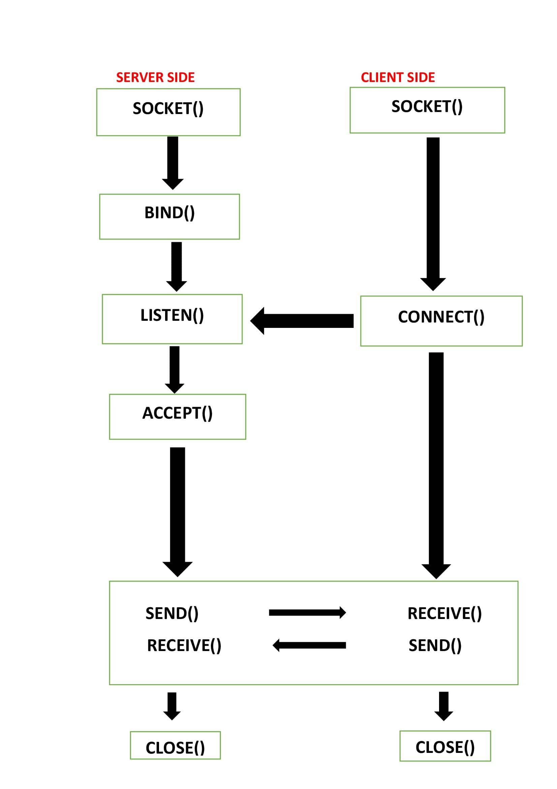
ABOUT CODE:

Slide 7
METHODOLOGY :
We will be checking if the connection is been set up or not between the server and the client using various command in command prompt.
We will be checking if user credentials matches with the data present in server.
We will be downloading the required file from the server using commands.

Slide 8
HARDWARE REQUIREMENTS :
Sr. No. | Device Name
1. | FTP Server
3. | Router
4. | Switch
5. | Connecting cable

Slide 9
SOFTWARE REQUIREMENTS
Firewall - FIREPOWER uwf
Operating System – UBUNTU
Programming language - C

Slide 10
INPUT :
The display will show the list of the files which can be accessed by the particular user.
The user just have to select the file of his choice and download it to access the file contents.

Slide 11
OUTPUT :
After completing the required security transactions the user can access the file.
So the output will be the file, client asked for.

Slide 12
Conclusion :
In this project, program provides secure communication while satisfying the security requirements of the company or the user, through different methods.

Slide 13
THANK YOU!

