Slide 1
Components and Organization of a Discrete-Event Simulation Model

Slide 2
Components of a Discrete Event Simulation Model
System state
The collection of state variables necessary to describe the system at a particular time
Simulation clock
A variable giving the current value of simulated time
Event list
A list containing the next time when each type of event will occur
Statistical counters
Variables used for storing statistical information about system performance

Slide 3
Components of a Discrete Event Simulation Model
Initialization routine
A subprogram to initialize the simulation model at time 0
Timing routine
A subprogram that determines the next event from the event list and then advances the simulation clock to the time when that event is to occur
Event routine
A subprogram that updates the system state when a particular type of event occurs (there is one event routine for each event type)
Library routines
A set of subprograms used to generate random observations from probability distributions that were determined as part of the simulation model

Slide 4
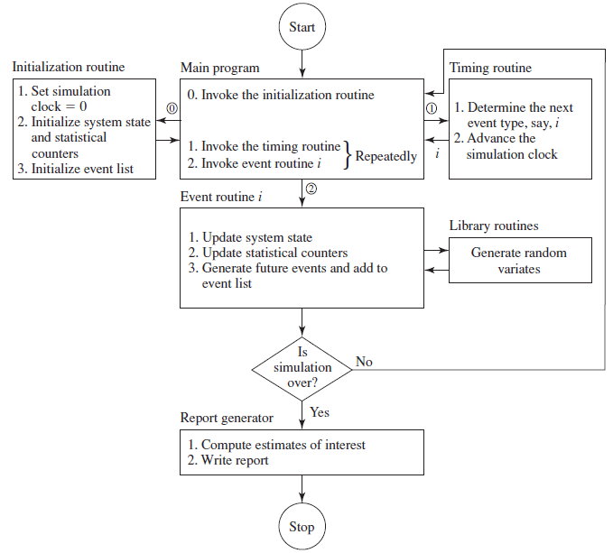
Organization of a Discrete Event Simulation Model

Slide 5
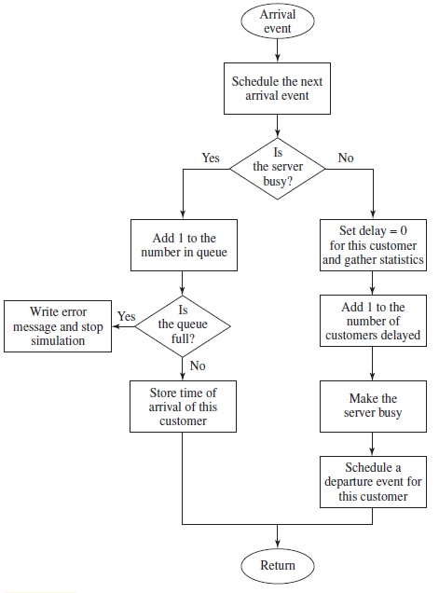
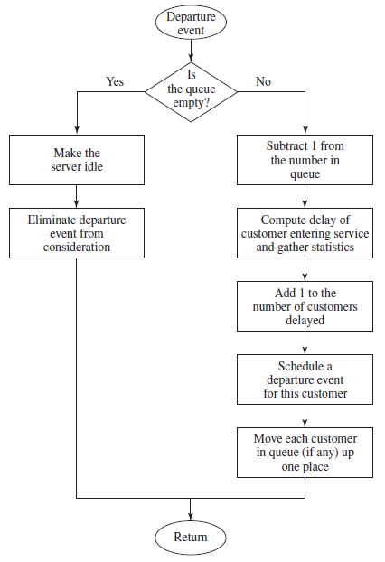
Flowcharts for arrival and departure routines

