Slide 1

University Of Global Village(Ugv) Department Of Computer science & Engineering (CSE)
Course : RDBMS Programming

Slide 2
Group Member:
NAME : | ID :
Sourav sikder | 12011033
Akash Chakrabortty | 12011192
Abu Taher Hossain | 1182368

Slide 3
ER Diagram Basic:
ER diagram (Entity Relationship Diagram) is a graphical representation of entities and their relationships to each other. It is a tool used to model and visualize the data requirements of a system.. An ER diagram typically consists of entities, attributes, and relationships

Slide 4
Entity:
An entity is an object or concept that exists independently, has a distinct identity, and can be identified uniquely. In the context of a movie ticket management system, examples of entities could include customers, movies, theaters, showtimes, and tickets.

Slide 5
Attributes:
Attributes are characteristics of an entity that describe it or provide more information about it. For example, the attributes of a customer entity could include name, email address, phone number, and payment method.

Slide 6
Relationship:
A relationship is an association between two or more entities. It describes how the entities are related to each other. For example, a customer can buy tickets for a movie, which means there is a relationship between the customer and movie entities.

Slide 7
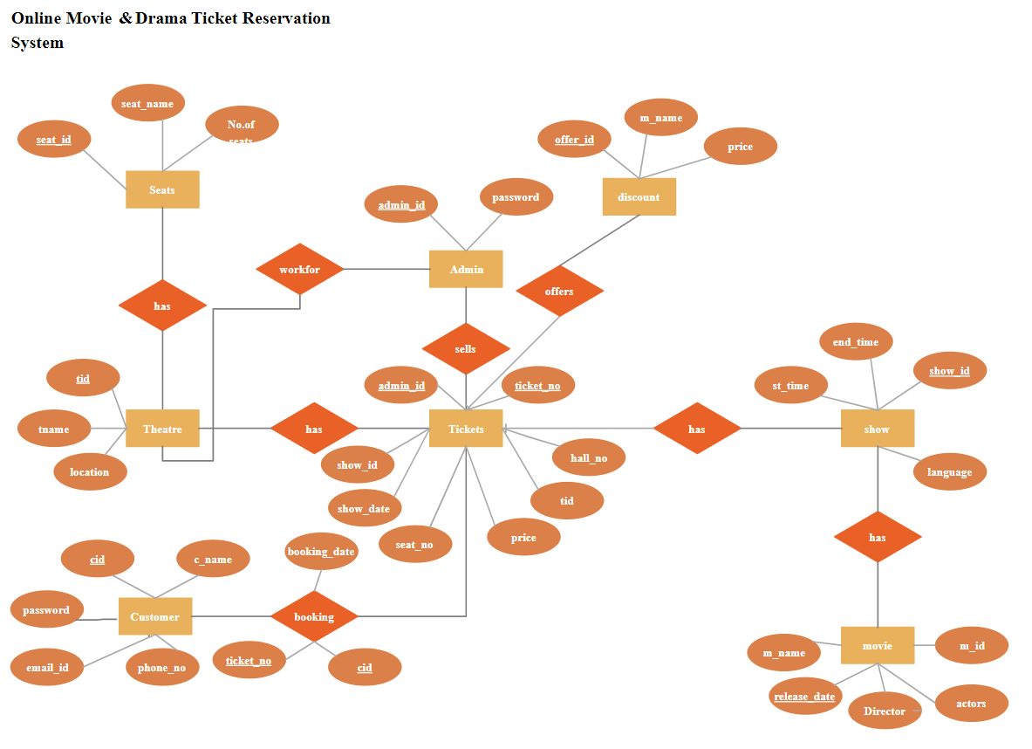
ER Diagram :

Slide 8
THE END

