Slide 1
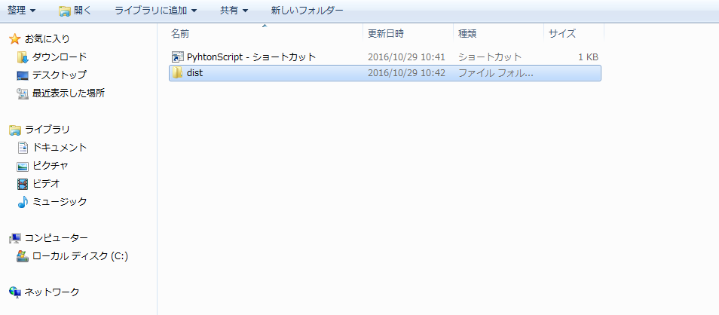
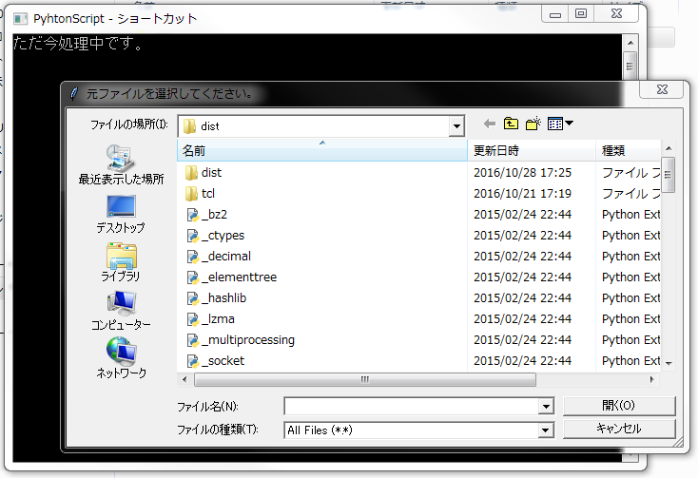
Manual
① Starting the program
【Open the file and run the shortcut】
Prohibition to Delete / edit folder
②Selection of original data
only EXCEL file is possible
※Please convert it in case of csv format.

Slide 2
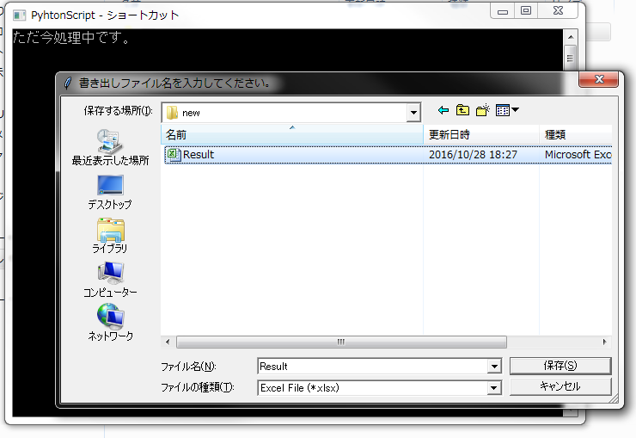
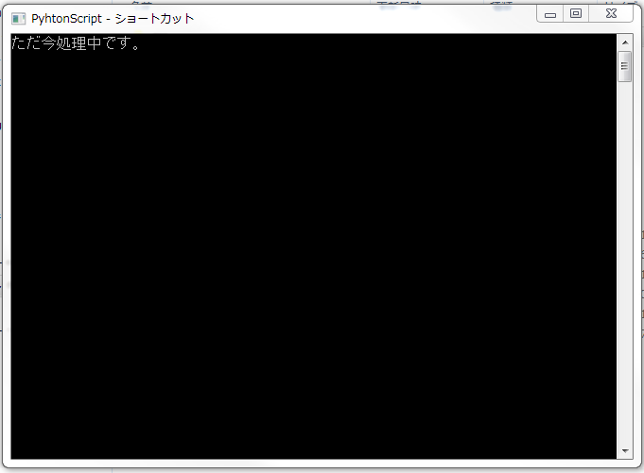
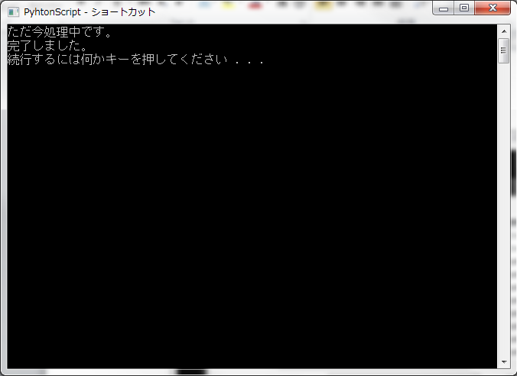
Manual
③ After completion, please enter the file storage location / file name
Enter file name
※Valid only for EXCEL format
④ completion
Processing
Completion
Press any key after completion to finish
Please close the command prompt

