Slide 1
Q4 FY2025 Revenue Review
Prepared for the Board of Directors — January 2026

Slide 2
Q4 Highlights
Full-year revenue reached $51.0M, up 18% from $43.2M in FY2024.
Cloud Services grew 31.7% year-over-year, the fastest of any segment.
Gross margin expanded to 62%, up from 58% in FY2024.
Asia-Pacific revenue grew 31% year-over-year on new enterprise contracts.
Notes:
Emphasize that Cloud Services is now the primary growth driver going into FY2026.

Slide 3
Revenue by Segment
Segment | FY2024 ($M) | FY2025 ($M) | YoY Growth
Enterprise Software | 18.5 | 23.1 | +24.9%
Cloud Services | 14.2 | 18.7 | +31.7%
Professional Services | 7.1 | 6.4 | -9.9%
Support & Maintenance | 3.4 | 2.8 | -17.6%

Slide 4
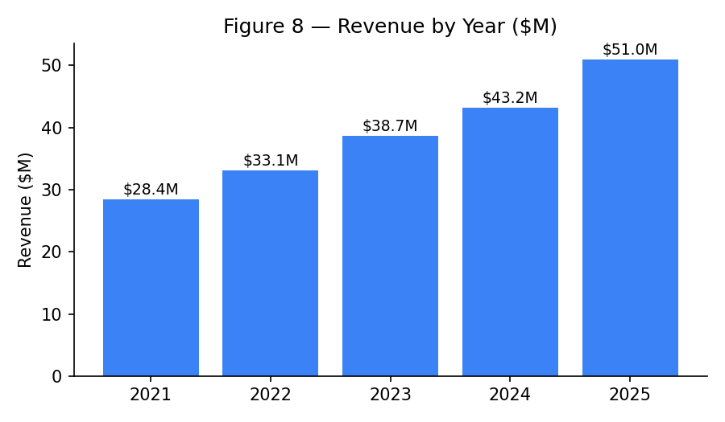
Figure 8 — Revenue by Year

