Slide 1
Empower Your Business Decisions with Data Insights at Global Electronics 💡📊

Slide 2
Agenda/Overview 💻
Table of contents
1. Introduction
2.Data Preparation
3.Exploratory Data Analysis (EDA)
3.1 Customer Spend Distribution with Violin Plot
3.2 Stacked Area Chart of Sales by Region Over Time
3.3 Circular Bar Plot of Product Category Sales
3.4 Seasonality of Sales
4.SQL Queries for Data Extraction and Analysis
5. Recommendations for Enhanced Performance
6. Conclusion

Slide 3
1. Introduction
1.1 Objective: The purpose of this analysis is to understand the key drivers of sales, customer behavior, product performance, and store distribution.
1.2 Data Overview: The dataset consists of 62,884 records related to sales, customers, products, and stores.
1.3 Tools Used:
1
SQLite
2
Pandas & Matplotlib
3
Power BI/Tableau
Reliable data storage and SQL query powerhouse
Dynamic data analysis and captivating visualizations
Unlock stunning insights with these data visualization tools

Slide 4
2.Data Preparation
2.1 Data Cleaning: The dataset was cleaned by handling missing values, converting date columns to datetime format, adjusting data types for numerical and categorical consistency, and applying categorical encoding to text-based columns.
2.2 Merging Datasets: Sales data was merged with customer, product, and store information to analyze customer behavior, product popularity, and store performance.
2.3 Outlier Detection: Outliers were detected using Tukey's method, revealing 184 outliers in Square Meters and 5940 outliers in Unit Price.
2.4 Handling Outliers: I used Capping method to handle the outliers in Square meters and Unit price

Slide 5
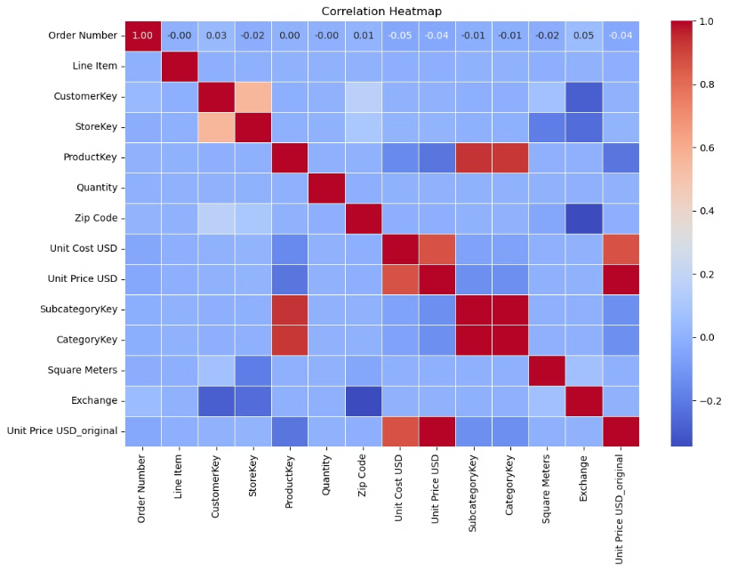
3.Exploratory Data Analysis (EDA)
Key activities in EDA include
The goal of EDA is to understand the data’s underlying patterns, detect anomalies, test hypotheses, and check assumptions. It helps identify relationships, trends, and areas that require further analysis.

Slide 6
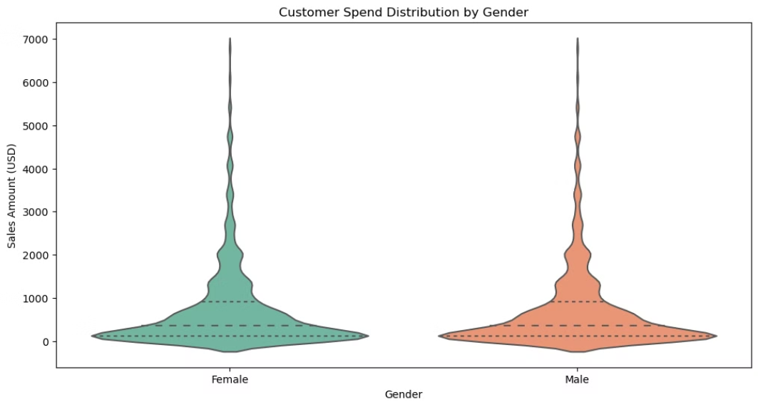
3.1 Customer Spend Distribution with Violin Plot
Purpose: This plot shows the distribution of customer spending, helping to identify the spread of spending amounts and the concentration of customers in different spending brackets.
insights: A violin plot can show the distribution of customer spend across different categories, such as age groups, gender, or location.

Slide 7
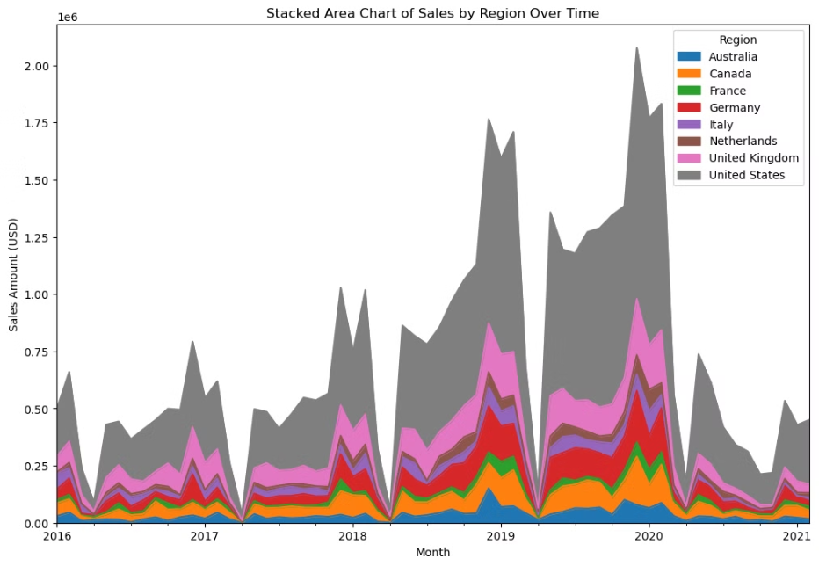
3.2 Stacked Area Chart of Sales by Region Over Time
Purpose: The chart visualizes how sales vary by region over time, allowing us to track trends and identify seasonal patterns or regional performance differences.
Insights: generate the most revenue, highlighting top-performing categories.

Slide 8
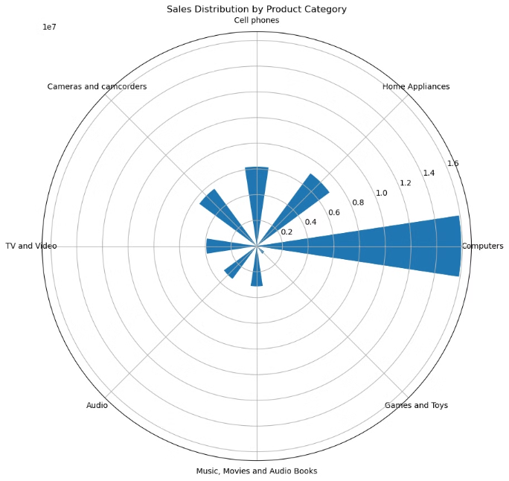
3.3 Circular Bar Plot of Product Category Sales
Purpose: This plot provides a clear, circular view of the sales distribution across different product categories, making it easy to identify which categories perform the best.
Insights: The circular bar plot visually represents the sales distribution by product category, highlighting that Computer products have the highest demand and perform the best in terms of sales.

Slide 9
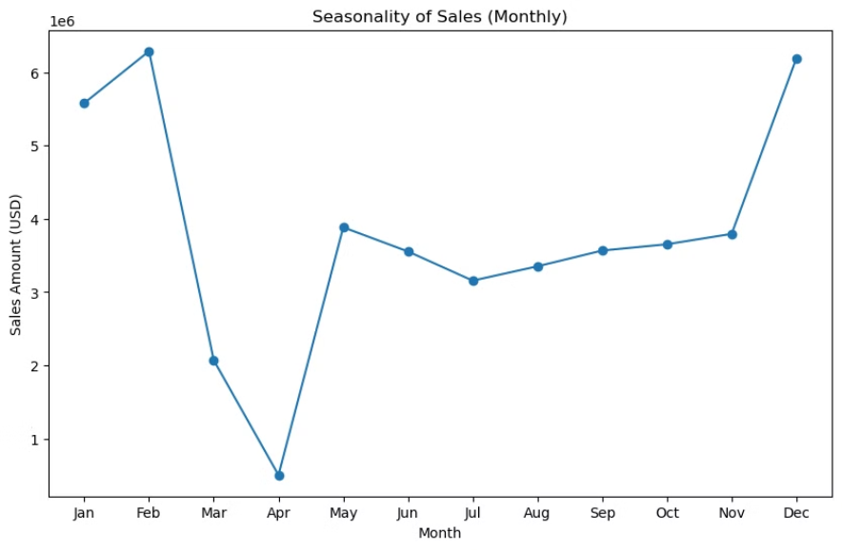
3.4 Seasonality of Sales
Purpose: The purpose of this plot is to analyze the seasonal variations in sales by plotting sales data over time, such as monthly or quarterly, to identify trends and patterns that recur at specific times of the year.
Insights: The seasonality plot highlights periods of high and low sales throughout the year, allowing businesses to identify peak sales periods (such as holidays or end-of-year spikes) and slow periods. This helps in planning promotions, inventory, and resource allocation more effectively.

Slide 10








4.SQL Queries for Data Extraction and Analysis
Customer Purchase Distribution
Top-Selling Products
Sales by Region
Average Basket Size (Number of Products per Order)
SQL Query: SELECT CustomerKey, COUNT(OrderNumber) AS PurchaseCount FROM Sales GROUP BY CustomerKey Use Case: Identify the most frequent buyers and analyze customer behavior.
SQL Query: SELECT ProductKey, SUM(Quantity) AS TotalSales FROM Sales GROUP BY ProductKey ORDER BY TotalSales DESC LIMIT 10 Use Case: Discover the best-performing products based on sales volume.
SQL Query: SELECT Region, SUM(SalesAmount) AS TotalSales FROM Sales GROUP BY Region Use Case: Analyze sales performance by region to identify geographical strengths.
SQL Query: SELECT OrderNumber, COUNT(ProductKey) AS BasketSize FROM Sales GROUP BY OrderNumber Use Case: Understand the average number of products per order, which can inform marketing strategies.
Discounted vs. Non-Discounted Sales Performance
Store Performance
Product Category Performance
Customer Age Distribution
SQL Query: SELECT DiscountFlag, SUM(SalesAmount) AS TotalSales FROM Sales GROUP BY DiscountFlag Use Case: Compare sales performance between discounted and non-discounted products.
SQL Query: SELECT StoreKey, SUM(SalesAmount) AS TotalSales FROM Sales GROUP BY StoreKey Use Case: Evaluate the performance of individual stores and identify areas for improvement.
SQL Query: SELECT Category, SUM(SalesAmount) AS TotalSales FROM Sales JOIN Products ON Sales.ProductKey = Products.ProductKey GROUP BY Category Use Case: Analyze the sales contribution by each product category.
SQL Query: SELECT FLOOR(DATEDIFF(CURDATE(), Birthday)/365) AS AgeRange, COUNT(CustomerKey) AS CustomerCount FROM Customers GROUP BY AgeRange Use Case: Segment customers based on age groups to target marketing efforts effectively.
Product Return Rate
Customer Retention
Relationship Between Store Size and Total Sales
SQL Query: SELECT ProductKey, COUNT(DISTINCT OrderNumber) AS TotalReturns FROM Returns GROUP BY ProductKey Use Case: Identify products with a high return rate and assess product quality or satisfaction issues.
SQL Query: SELECT CustomerKey, COUNT(DISTINCT OrderNumber) AS RepeatPurchases FROM Sales GROUP BY CustomerKey HAVING COUNT(DISTINCT OrderNumber) > 1 Use Case: Identify repeat customers to measure customer retention and loyalty.
SQL Query: SELECT StoreSize, SUM(SalesAmount) AS TotalSales FROM Sales JOIN Stores ON Sales.StoreKey = Stores.StoreKey GROUP BY StoreSize Use Case: Analyze how store size correlates with sales performance to plan for future expansions.

Slide 11
5. Recommendations for Enhanced Performance
Smart Pricing for Better Sales
Win Over Loyal Customers
Insight: The Discounted vs. Non-Discounted Sales analysis shows the impact of promotions on volume.
Insight: The Customer Purchase Distribution reveals your most loyal buyers and popular products.
Recommendation: Experiment with pricing, using discounts for slower movers and premium pricing for high-demand products.
Recommendation: Delight your top customers with personalized loyalty programs and tailored marketing.
1
2
3
Keep Your Best Sellers in Stock
Insight: The Top-Selling Products and Regional Sales data pinpoint your high-demand items and best-performing regions.
Recommendation: Strategically stock up on your hottest-selling products and distribute inventory based on regional demand.
Regions Optimization
Improved Customer Segmentation
Insight: Top-Selling Products and Sales by Region identify high-demand items and best-performing regions.
Insight: Customer Age Distribution helps target marketing by age groups.
Recommendation: Allocate inventory based on regional demand and prioritize stock for high-demand products to reduce stockouts.
Recommendation: Tailor promotions and advertisements based on age demographics to maximize engagement and sales.
1
2
3
Make Every Store a Top Performer
Insight: The Store Productivity and Optimal Store Size data reveal the blueprint for your high-performing locations.
Recommendation: Focus your expansion efforts on stores that match the winning formula, and optimize layouts for efficiency.
Dynamic Currency Adjustment
Get Ready for Busy Seasons
Insight:Currency exchange rates impact international sales profitability.
Insight: The Seasonality of Sales data highlights your peak and off-peak times.
Recommendation: Implement a real-time pricing adjustment strategy based on currency fluctuations to protect profit margins in international markets.
Recommendation: Ramp up marketing and inventory ahead of high-demand seasons to maximize sales.
1
2
3
Offer Product Packs to Increase Sales
Insight: The Average Basket Size reveals your commonly purchased products together.
Recommendation: Offer bundled deals for frequently bought-together items to boost average order value.

Slide 12


6. Conclusion
Our analysis of Global Electronics’ sales, customer behavior, and product performance reveals valuable insights that can drive smarter business decisions. By targeting high-demand products, optimizing store performance, and refining marketing strategies, we can effectively enhance customer satisfaction and sales. Implementing these data-driven recommendations—like creating product packs, adjusting pricing, and preparing for seasonal demand—positions us to increase profitability, streamline operations, and deliver greater value to our customers.
Thank you for your attention, and let’s discuss how we can start implementing these strategies for maximum impact!
Connect with me :

