Slide 1

Sentiment Analysis of Tweets using DistilBERT
The project involves building a sentiment analysis application using:
Fine-tuned DistilBERT model for text classification.
Gradio for an interactive web-based user interface.
Hugging Face Spaces for deployment and hosting.
The app predicts sentiment probabilities: Positive, Neutral, and Negative.

Slide 2
Problem Statement
Goal: Create a real-time sentiment analysis application for textual data using a fine-tuned machine learning model.
Challenges:
Predicting sentiments (Negative, Neutral, Positive) with high accuracy.
Developing an intuitive user interface for end users.
Handling duplicate data and improving model performance.

Slide 3
Dataset Overview
Source
Dataset Details
Preprocessing
Twitter data with sentiments.
Shape: 74,681 rows, 4 columns. Columns: Tweet\_id, Location, Review, Tweets.
Replaced "Irrelevant" with "Neutral".
Removed 2,700 duplicate entries. Tokenization using DistilBertTokenizer.

Slide 4
Preprocessing Steps
1
Handle Missing Data
2
Data Cleaning
3
Label Encoding
No null values in key columns.
Removed duplicate tweets.
Mapped sentiments to numerical labels.
4
Train-Test Split
5
Tokenization
80% for training, 20% for validation.
Texts converted to token IDs and attention masks with a max length of 128.

Slide 5
Model and Architecture
Pre-trained Model
Reason for Selection
Model Setup
DistilBERT (base uncased).
Lightweight, efficient, and suitable for text classification.
Adjusted for 3-class classification. Used PyTorch for training. GPU Utilization: Enabled for faster processing.

Slide 6
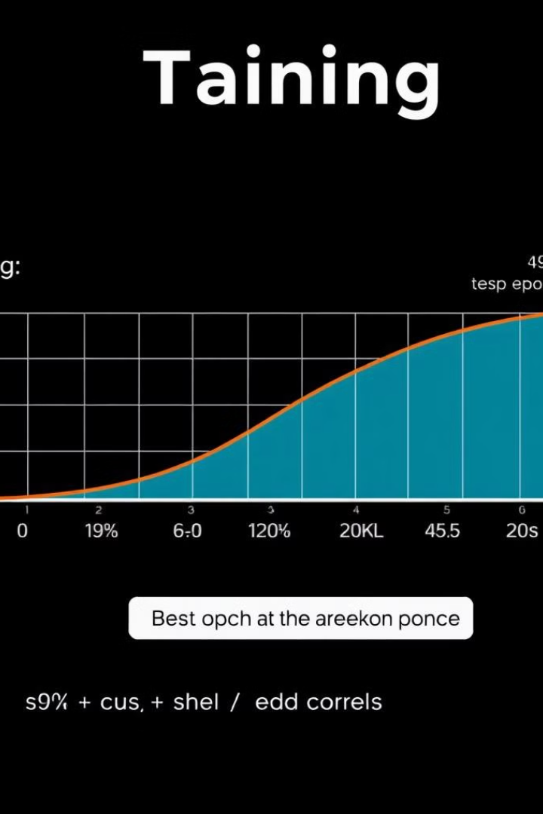




Fine-tuning and Training
Hyperparameters
Early Stopping
Learning rate: 2e-5. Batch size: 16. Epochs: 5. Weight decay: 0.01. Mixed precision (fp16).
Patience of 2 epochs.
Metrics
Training Results
Accuracy, Precision, Recall, F1-score.
Best Epoch: 4. Accuracy: 92.5%. F1-score: 92.5%.

Slide 7
Evaluation Metrics
0.315
93.4%
93.5%
Loss
Accuracy
Precision
93.4%
93.4%
Recall
F1-score

Slide 8



Deployment using Gradio
1
User-friendly Interface
2
Live Sentiment Prediction
3
Displays Predicted Sentiment

Slide 9
Application Workflow
Input
1
User types a tweet.
Processing
2
Tokenized and passed through the fine-tuned DistilBERT model.
Output
3
Predicted sentiment displayed along with confidence scores.
Hosting
4
Application shared publicly via Gradio's sharing feature.

