Slide 1


Data Analysis And Sports
By: Akash Dasmondal
Under the Guidance of
Dr. R Sivakumar

Slide 2
Pygmalion Effect
?

Slide 3
Pygmalion Effect
It is the scenario where others' expectations of a target person affect the target person's performance.

Slide 4
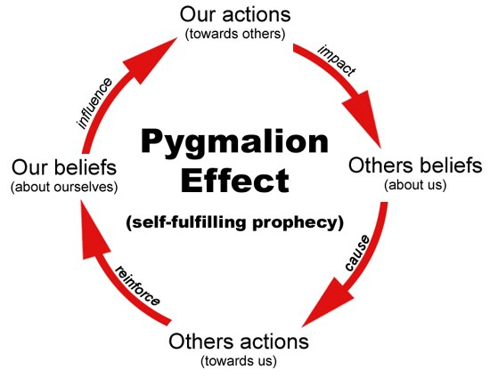

Slide 5


Slide 6
What Data Analysis ?
Process of inspecting, cleansing, transforming, and modeling data with the goal of discovering useful information, informing conclusions, and supporting decision-making.
Raw Data
Processed Data
Apply Methodology
Results

Slide 7

Components of Analysis

Slide 8
Sports Analytics Innovation
Winning in Sports Through Performance Analysis & Data Analytics
Why ?
Coaches, General Managers, Sports Analysts, Technologists.

Slide 9
Key Facto
How do you create value based on the Data?
Two tracks
On Field Analytics
Off Field Analytics

Slide 10
Psychology of Sport
Analytics may not capture a player's main strengths or weaknesses
Example
For example ... One players greatest skill may be to motivate other players. If players are not physically or mentally ready to perform then data is a waste of time.

Slide 11
Drive and Decision
Analytics must drive decisions and actions or else they're worthless.
Need more graphical representations, not excel spreadsheets Emphasis on real time apps, real time data & analysis, real time decisions
Catapult Team Tracking System
Originally formed from a partnership between the Australian Institute of Sport (AIS) and the Cooperative Research Centres (CRC) to maximise the performance of Australian athletes ahead of the Sydney Olympics, Catapult was officially founded in Melbourne in 2006.

Slide 12
Relationship ?
Relevant relationships between these variables:
Age Group
Playing Position
Ave body Mass
Cumulative minutes trained

Slide 13
Example
Example 49% of squad is 29+ years old Higher number of injuries coming from this group
During November, December, January training goes down, injury goes up

Slide 14
Goals of analysis
Remain injury free
Maintain high performance over 45 games per season, 4 games per week
Increase Player ability

Slide 15
Analytics ?
Analytics are Reasoning Artifacts …
things we use to make decisions.
New Data,
New Analytics,
Same reasoning

Slide 16
Spatial Analysis
Visualize patterns and quantify information
Visual Analytics
Translate raw game data into useful information

Slide 17
Victory Now Goes with Data
Scouting
Player Fitness
Player Development
Game-Day Strategy
Player Evaluation
Ticketing
Merchandising

Slide 18
Scouting
Any successful pro sports franchise knows that the competition starts with scouting.
It’s critical for scouts to be able to quickly spot potential value in a sea of prospective players.
Cut performance review times by transforming large volumes of data into interactive visualizations.

Slide 19
Fitness
Need to know who to bench and who play? How valuable is each player at any given time?
Who performs better under stress, or in the 18th minute of the game?
Tracking player status, training, improvements, and game-day performance is all possible with data.

Slide 20
PLAYER DEVELOPMENT
On-field wins often translates into a team’s financial success, so developing talent and adding new players adds obvious value to a club.
Teams gather huge amounts of data on players to track multiple metrics such as training intensity, game performance, recovery time, and injuries.
Whole-team intelligence is important too. How are players working together?
Are there patterns of play?
Do various actions on the field make a difference in the final score?
Visualizing this data allows tech-averse coaches to interpret immediate needs at a glance.

Slide 21
GAME-DAY STRATEGY
Data visualizations don’t just capture what happened in last week’s game; they can provide insight while the ball is still in play.
Dashboards help coaches predict outcomes with what-if scenarios by combining live data with historical data. Should a team go for a touchdown on the fourth down?
What usually happens in each scenario? Dashboards with historical data can give coaches a way to make game-winning decisions in light of past outcomes.

Slide 22
PLAYER EVALUATION
Visual dashboards are a powerful tool for accurate individual player evaluation. How is a player performing relative to last year?
Last week? Last game? Are trends emerging in an athlete’s play that need be addressed?
This data-driven evaluation clues coaches into who’s likely to play well and who may be heading for a slump. Coaches can adjust game day lineups accordingly.

Slide 23
TICKETING
Professional sports teams depend on ticket sales for their financial health.
It’s not always about people in seats; decision-makers need a 360-degree view of fan behavior, from the initial ticket purchase all the way through the final point on the board.

Slide 24
MERCHANDISNG
The home-team hat and jersey, beer, and bobble heads—what are people buying once they're inside?
With merchandising and retail data visualizations, retailers can adjust inventory on the fly when specific item revenue starts to dip.
Merchandise sales also reveal where a team’s fans live. Data can help identify new areas of the country, or the world, to concentrate sales efforts.

Slide 25
Vision of the future
Sensors everywhere
Data collected from everywhere, analyzing, optimizing, and helping (and hopefully not taking over)
Analytics and Internet of things .. Immersive world
Big data and real-time analytics will be crucial. How far are we from realizing that?

Slide 26
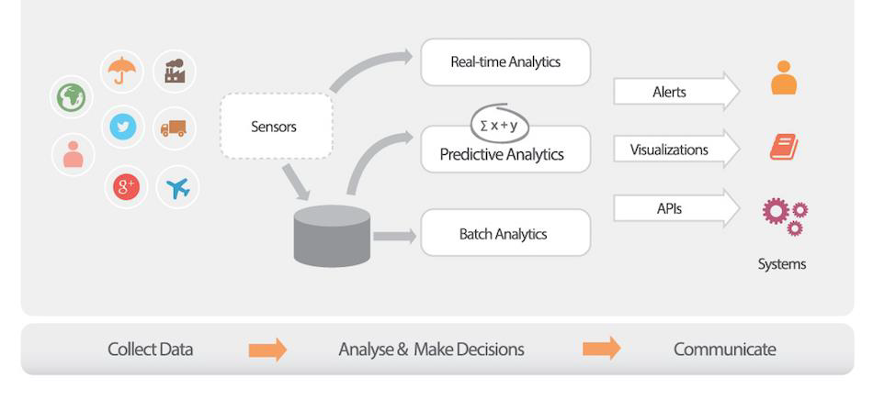
What required to build such world

Slide 27
Soccer use-cases
Dashboard on game status
Alarms about critical events in the game
Real-time game analysis and predictions about the next move
Updates/ stats etc., on mobile phone with customized offers
Study of game and players effectiveness
Monitor players health and body functions

Slide 28

Use-case 1 : running analysis 19

Slide 29
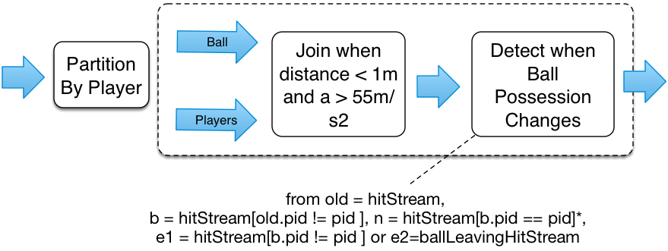
Use-case 2 : ball possession
You possess the ball from time you hit it until some one else hit it or ball leaves the ground.

Slide 30
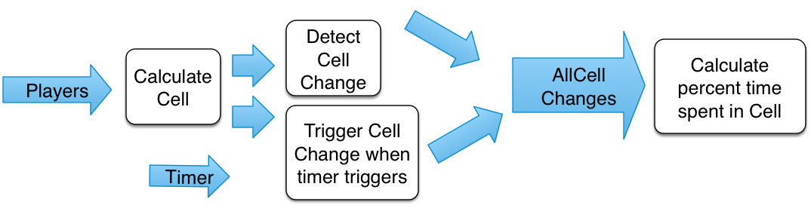
Use-case 3 : heat map of activity
Show where actions happened need updates once every second
Join With a timer.

Slide 31
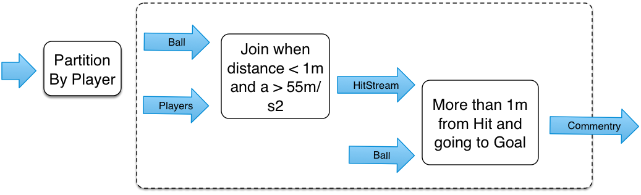
Use-case 4 : detect kick on the goal
Detect kicks on the ball, calculate direction after run ,and keep giving updates as long as it is in right direction

Slide 32
Current Examples of Big Data Application
Infiniti Red Bull Racing
Formula one is one of the most popular sports in the world, and one of the most data driven.
Red Bull racing rely on real-time information to make enhancement to cars and in race strategies. Every lap driven by the F1 car.
sensors produce enough data like tire pressure, tire temperature, suspension performance, wheel alignment and whole lot of engine statistics, the pit team uses that data to make immediate decisions.

Slide 33
Zebra Technologies
The company makes Radio Frequency Identification tags, as part of their Motion works.
Sports Solution, that attach to equipment, balls and players to track movement, distance and speed.
The tags blink 25 times per second and deliver data in 120 milliseconds.
This data is used to analyze in the post match session to understand what worked and what didn’t work for the teams.

Slide 34
Sports UV
The Company has six cameras in each NBA arena that collect data on the movements on every player and movements of the basketball 25 times per second.
This data is used by game developers to understand ball movements and incorporate them.

Slide 35
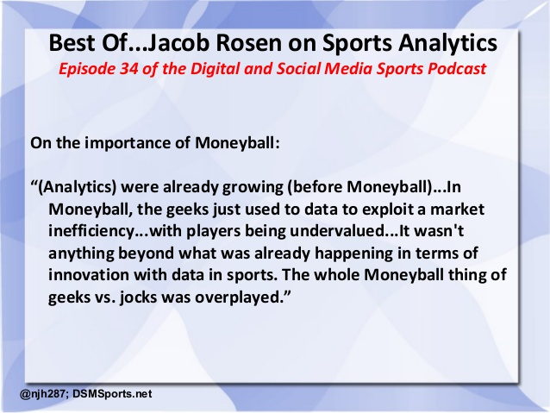
Recommended Movie

Slide 36
Conclusion
For people wanting to make a career in sports management and analytics, it is important to note that there is no sign of this field being less important and it is far from being a fact
The demand is far less than the predicted supply of experts in sports analytics.
Results from academic research show evidence that Twitter contains enough information to be useful for predicting outcomes in football games.

Slide 37
The time is right to step into and contribute to this dynamically changing field.
The report focuses on two main areas.
The first is analysis of competition, which includes player evaluation and strategy and game management.
The second is analytics that aid management of business and financial issues — this can include marketing, but that is simply a narrow part of the whole.

Slide 38
Thank You

