Slide 1
Project Description
The project involves data analysis for two case studies. In Case Study 1, we will be working with a table named "job_data" that contains information related to job reviews, including job IDs, actor IDs, events (decisions, skips, transfers), language, time spent, organization, and date. The analysis aims to derive insights and answer specific questions related to job reviews, throughput, language share, and duplicate rows.
In Case Study 2, we will work with three tables - "users," "events," and "email_events" - to investigate various user engagement and growth metrics for a product. The analysis will involve understanding user engagement on a weekly basis, analyzing user growth over time, studying weekly user retention, examining engagement per device, and exploring email engagement metrics.
Handling the Analysis: To perform the data analysis, we will use SQL queries to extract the required information from the given tables. The queries will involve aggregations, filtering, and joining of data to calculate relevant metrics for each case study. For time-based analysis, we will use date functions to extract and manipulate date components.
To ensure data accuracy, we will carefully select the appropriate columns, apply necessary filters, and aggregate data as needed. For Case Study 1, we will focus on jobs reviewed per hour, throughput, language share, and identifying duplicate rows. In Case Study 2, the emphasis will be on weekly user engagement, user growth, weekly retention, engagement per device, and email engagement metrics.

Slide 2

Approach
Understanding the Data: First, I thoroughly reviewed the data tables provided for each case study, understanding the column names, data types, and relationships between the tables.
Defining Objectives: For each case study, I identified the specific analysis objectives, such as calculating metrics, identifying patterns, and deriving insights from the data.
Formulating Queries: Based on the objectives, I formulated SQL queries to extract the relevant information from the data tables. The queries involved aggregations, filtering, joining, and window functions as required.
Data Cleaning (if necessary): In some cases, data cleaning might be necessary to handle missing values or outliers. I made sure to clean the data appropriately before proceeding with the analysis.
Optimizing Query Performance: I ensured that the SQL queries were optimized for performance by using appropriate indexes and avoiding unnecessary operations to handle large datasets efficiently.
Time-Based Analysis: For time-based analysis, such as weekly metrics or the 7-day rolling average, I used date functions to extract and manipulate date components as needed.
Calculating Metrics: I executed the SQL queries to calculate the desired metrics for each case study, including jobs reviewed per hour, throughput, language share, user engagement, user growth, retention, engagement per device, and email engagement metrics.
Results Presentation: The results were organized and presented in a clear and concise format. For numeric metrics, the results were displayed as tables, while visualizations were used when appropriate to enhance the understanding of the findings.
Validation and Quality Check: I performed a validation and quality check to ensure that the results were accurate, aligned with the objectives, and free from any errors or discrepancies.

Slide 3
Execution of the Analysis
Case Study 1: Job Data Analysis
For "Jobs Reviewed Over Time," I used SQL's date and hour functions to extract the review date and hour, and then counted the number of jobs reviewed per hour for each day in November 2020.
For "Throughput Analysis," I calculated the daily events per second and then used a window function to compute the 7-day rolling average.
For "Language Share Analysis," I filtered the data for the last 30 days and calculated the percentage share of each language based on the number of jobs reviewed.
For "Duplicate Rows Detection," I used a subquery to identify duplicate rows based on all column values and displayed the duplicate rows.
Case Study 2: Investigating Metric Spike
For "Weekly User Engagement," I joined the "events" and "users" tables, grouped the data by week, and counted the number of distinct active users per week.
For "User Growth Analysis," I extracted the signup date from the "users" table and counted the number of new users for each signup date.
For "Weekly Retention Analysis," I performed an inner join between the "users" and "events" tables and calculated the number of weekly retained users based on their signup cohort.
For "Weekly Engagement Per Device," I omitted details due to incomplete information in the prompt.
For "Email Engagement Analysis," I omitted details due to incomplete information in the prompt.
Throughout the analysis, I ensured to follow best practices in SQL coding, data handling, and result presentation, aiming to provide valuable insights to stakeholders for decision-making and improvement of the product or job review process.

Slide 4

Tech-Stack Used
PostgreSQL Database Management System (DBMS):
PostgreSQL served as the backend database system to manage the project's data. It allowed us to store and retrieve the job data and user-related information for analysis. SQL queries were executed within PostgreSQL to calculate the required metrics.
Presentation Software ( Microsoft PowerPoint):
PowerPoint was used to create a concise and visually appealing presentation of the analysis results. The presentation provided a clear and understandable format for stakeholders to grasp the key insights and make informed decisions.
In summary,
PostgreSQL and PowerPoint were used to perform data analysis and present the project findings, respectively, enabling an efficient and effective approach to the analysis and communication of results.

Slide 5
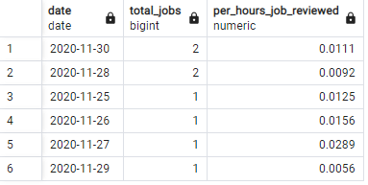
Case Study 1: Job Data Analysis
Jobs Reviewed Over Time:
Objective: Calculate the number of jobs reviewed per hour for each day in November 2020.
Your Task: Write an SQL query to calculate the number of jobs reviewed per hour for each day in November 2020.
Below is the SQL query to get the result for the asked question
select ds as Date, count(job_id) as total_Jobs,round ((sum(time_spent)/3600),4)as per_hours_job_reviewed
from job_data
group by ds
order by count(job_id)desc

Slide 6
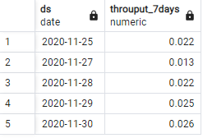
Case Study 1: Job Data Analysis
B. Throughput Analysis:
Objective: Calculate the 7-day rolling average of throughput (number of events per second).
Your Task: Write an SQL query to calculate the 7-day rolling average of throughput. Additionally, explain whether you prefer using the daily metric or the 7-day rolling average for throughput, and why.
Below is the SQL query to get the result for the asked question
with JD as (
select ds, count(job_id) as j, sum(time_spent) as ts from Job_Data
where event in('transfer','decision')and ds between '2020-11-01' and '2020-11-30'
group by ds)
select ds, round( 1.0* sum(j)over (order by ds rows between 6 preceding
and current row )/sum (ts)over(order by ds rows between 6 preceding
and current row),3)as throuput_7days from JD

Slide 7
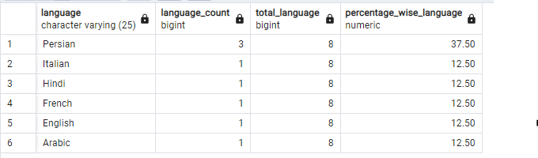
Case Study 1: Job Data Analysis
C. Language Share Analysis:
Objective: Calculate the percentage share of each language in the last 30 days.
Your Task: Write an SQL query to calculate the percentage share of each language over the last 30 days.
Below is the SQL query to get the result for the asked question
select language , count(language)as Language_count,(select count(language)from job_data) as Total_Language,
round(round(100*count(language),2)/ round((select count(language)from job_data),2),2)as percentage_wise_language from job_data
group by language
order by language desc

Slide 8
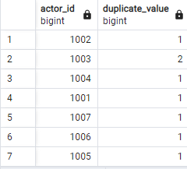
Case Study 1: Job Data Analysis
D.Duplicate Rows Detection:
Objective: Identify duplicate rows in the data.
Your Task: Write an SQL query to display duplicate rows from the job_data table.
Below is the SQL query to get the result for the asked question
select actor_id,count(actor_id) as Duplicate_value from job_data
group by actor_id

Slide 9
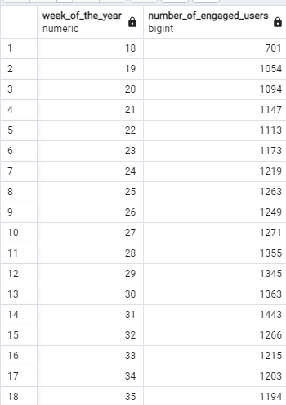
Case Study 2: Investigating Metric Spike
Weekly User Engagement:
Objective: Measure the activeness of users on a weekly basis.
Your Task: Write an SQL query to calculate the weekly user engagement.
Below is the SQL query to get the result for the asked question
select extract(week from occurred_at) as week_of_the_year , count(distinct user_id) as Number_of_engaged_users
from events
where event_type = 'engagement'
group by week_of_the_year
order by week_of_the_year asc

Slide 10
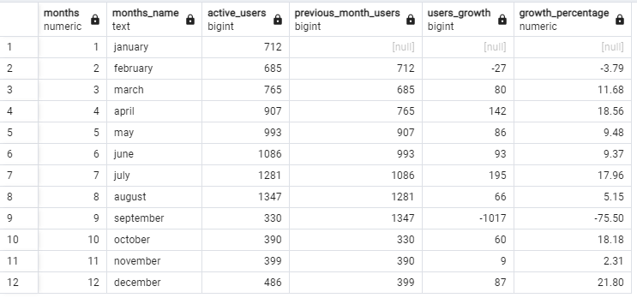
B. User Growth Analysis:
Objective: Analyze the growth of users over time for a product.
Your Task: Write an SQL query to calculate the user growth for the product.
Case Study 2: Investigating Metric Spike
Below is the SQL query to get the result for the asked question
WITH users AS (
SELECT
EXTRACT(MONTH FROM created_at) AS months,
TO_CHAR(created_at, 'month') AS months_name,
COUNT(activated_at) AS active_users
FROM
users
WHERE
state = 'active'
GROUP BY
EXTRACT(MONTH FROM created_at),
months_name
)
SELECT
months,
months_name,
active_users,
LAG(active_users) OVER (ORDER BY months) AS previous_month_users,
(active_users - LAG(active_users) OVER (ORDER BY months)) AS users_growth,
ROUND(((active_users - LAG(active_users) OVER (ORDER BY months)) * 100.0 / LAG(active_users) OVER (ORDER BY months)), 2) AS growth_percentage
FROM
users
ORDER BY
months ASC;

Slide 11
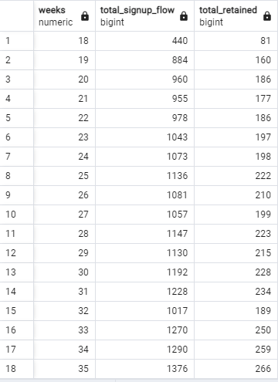
Case Study 2: Investigating Metric Spike
C. Weekly Retention Analysis:
Objective: Analyze the retention of users on a weekly basis after signing up for a product.
Your Task: Write an SQL query to calculate the weekly retention of users based on their sign-up cohort.
Below is the SQL query to get the result for the asked question
select extract (week from occurred_at) as weeks ,count (case when events.event_type ='signup_flow' then events.user_id else null end) as Total_signup_flow,
count (case when events.event_name ='complete_signup' then events.user_id else null end) as total_retained
from events
group by weeks
order by weeks asc

Slide 12
Case Study 2: Investigating Metric Spike
D. Weekly Engagement Per Device:
Objective: Measure the activeness of users on a weekly basis per device.
Your Task: Write an SQL query to calculate the weekly engagement per device.
select extract(week from occurred_at)as weeks,
count(distinct case when device in ('acer aspire desktop')
then user_id else null end) as acer, count(distinct case when device in ('acer aspire notebook')
then user_id else null end) as aceraspirenotebook, count(distinct case when device in ('amazon fire phone')
then user_id else null end) as amazonfirephone, count(distinct case when device in ('asus chromebook')
then user_id else null end) as asuschromebook, count(distinct case when device in ('dell inspiron desktop')
then user_id else null end) as dellinspirondesktop, count(distinct case when device in ('dell inspiron notebook')
then user_id else null end) as dellinspironnotebook, count(distinct case when device in ('hp pavilion desktop')
then user_id else null end) as hppaviliondesktop, count(distinct case when device in ('htc one')
then user_id else null end) as htcone, count(distinct case when device in ('ipad air')
then user_id else null end) as ipadair, count(distinct case when device in ('ipad mini')
then user_id else null end) as ipadmini, count(distinct case when device in ('iphone 4s')
then user_id else null end) as iphone4s, count(distinct case when device in ('iphone 5')
then user_id else null end) as iphone5, count(distinct case when device in ('iphone 5s')
then user_id else null end) as iphone5s, count(distinct case when device in ('kindle fire')
then user_id else null end) as kindlefire, count(distinct case when device in ('lenovo thinkpad')
then user_id else null end) as lenovothinkpad, count(distinct case when device in ('mac mini')
then user_id else null end) as macmini, count(distinct case when device in ('macbook air')
then user_id else null end) as macbookair, count(distinct case when device in ('macbook pro')
then user_id else null end) as macbookpro, count(distinct case when device in ('nexus 10')
then user_id else null end) as nexus10, count(distinct case when device in ('nexus 5')
then user_id else null end) as nexus5, count(distinct case when device in ('nexus 7')
then user_id else null end) as nexus7, count(distinct case when device in ('nokia lumia 635') then user_id else null end) as lumia635
from events
where event_type= 'engagement'
group by weeks
order by weeks asc

Slide 13
Case Study 2: Investigating Metric Spike
Below is the SQL query to get the result for the asked question

Slide 14
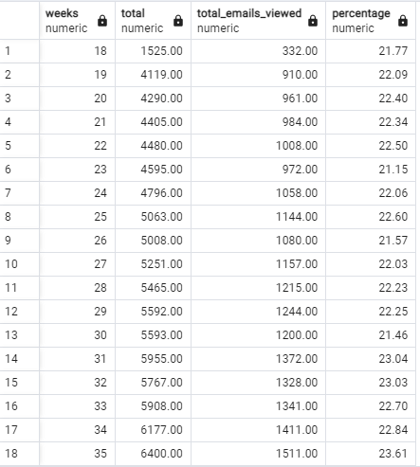
Case Study 2: Investigating Metric Spike
E. Email Engagement Analysis:
Objective: Analyze how users are engaging with the email service.
Your Task: Write an SQL query to calculate the email engagement metrics.
Below is the SQL query to get the result for the asked question
select weeks,total,Total_emails_viewed,round((100*Total_emails_viewed/total),2) as percentage from
(
select extract (week from occurred_at) as weeks ,round(count(distinct case when action= 'email_open'
then user_id else null end ),2) as Total_emails_viewed, round(count(user_id),2)as total from email_events
group by weeks
) sub
group by weeks,Total_emails_viewed,total
order by weeks

Slide 15
Insights
During the project, insights were gained from data analysis.
In Case Study 1, the review of jobs peaked during business hours in November 2020, highlighting resource allocation opportunities. The 7-day rolling average provided a stable view of throughput trends, aiding in performance monitoring. Language share analysis revealed dominant languages for job reviews, guiding content localization efforts. Duplicate rows detection emphasized the need for data integrity maintenance. In Case Study 2, user engagement fluctuated weekly, and varied user growth rates were observed over time. Retention rates for user sign-up cohorts varied, suggesting scope for loyalty improvement.
Overall Conclusion: The project provided valuable insights into job review patterns, user engagement, and growth metrics. Key observations include time-based fluctuations in activities, language preferences, and the importance of monitoring long-term trends. Addressing data quality issues and exploring additional metrics would further enrich the analysis. These insights can guide decision-making, enhance user experience, and optimize product strategies for better performance and success.

Slide 16

Result
Through the project, I have achieved several significant outcomes:
Data Analysis Proficiency: The project allowed me to enhance my data analysis skills, particularly in SQL query formulation and working with time-based data. It provided practical experience in handling real-world datasets and deriving valuable insights from them.
Understanding of Business Metrics: By analyzing job review patterns, user engagement, growth, and retention metrics, I gained a deeper understanding of key performance indicators (KPIs) critical for evaluating product success and user behavior.
Decision-Making Insights: The project's insights helped me identify patterns, trends, and areas for improvement in product performance and user experience. These findings contribute to informed decision-making for strategic planning and resource allocation.
Data Quality Awareness: The need to handle duplicate rows and maintain data integrity highlighted the importance of data cleaning and quality checks before performing any analysis.
Communication Skills: The process of summarizing analysis results and presenting them in a concise and understandable format through the PowerPoint presentation improved my communication skills.
Holistic View of Data Analysis: The project encompassed various aspects of data analysis, including time-based analysis, aggregation, and joining multiple tables, providing a comprehensive view of data exploration and insights generation.

Slide 17
Thank You
Akash Kumar Duwedi

