Slide 1
AWS-AI-Challenge
SHADE Engine for depression patients
Team Name : Brogrammers

Slide 2
Team History
Winners | Finalists
Smart India Hackathon'18, Alexa Skill Challenge'18, Ideathon'18,Bot-a-thon'17 | Hack Bangalore'18,Accenture Digital Hackathon'17,IBM-IoT Hackathon'18

Slide 3
Problem Statement
Help me with my Mood with Social-media Health Analysis and Display Engine (SHADE) is a software solution which tries to analyse your current emotions based on the content that you share on different social media websites. With advances in technology, it has now become easy to detect the emotions user is going though by using NLP on the text shared which when combined with visual recognition on the images gives a concrete solution to take calm down measures before hand he/she chooses any drastic actions.

Slide 4
Key Value Proposition
Data is fetched not only from Twitter but also from Medium.com and Instagram
Emotion detection is applied on photos shared on Instagram and twitter apart from text
Derive personality insights apart from emotion
Graphical representation of data using Google Charts (Bar Graph, Donut Pie-chart, 3D chart etc)
Recommendation engine for providing tips based upon emotion detected
Use of AWS Translate to translate all tweets to English so that other AWS services can use it effectively.
Based on emotion detected, various yoga positions have been displayed
If user is sad or feeling disgusted, it is very dangerous to leave him alone. So we have shown nearby worship places, restaurants and natural places using Google Nearby APIs so that he will come out of room and explore places and will not be alone in public places.
To show the various places like restaurants, worship places and natural places, application uses the current location of the user.

Slide 5










Technology Stack
Server Configurations
Programming Languages
Machine Learning Models
AWS Cloud
Heroku Cloud
Type – REST Servers
TF-IDF Model
LDA Model
Algorithmia’s Emotion Detection Model
Third Party APIs
AWS Translate
AWS Comprehend
AWS Polly
AWS Rekognition
Personality Insights
Tone Analyser
Custom Models

Slide 6
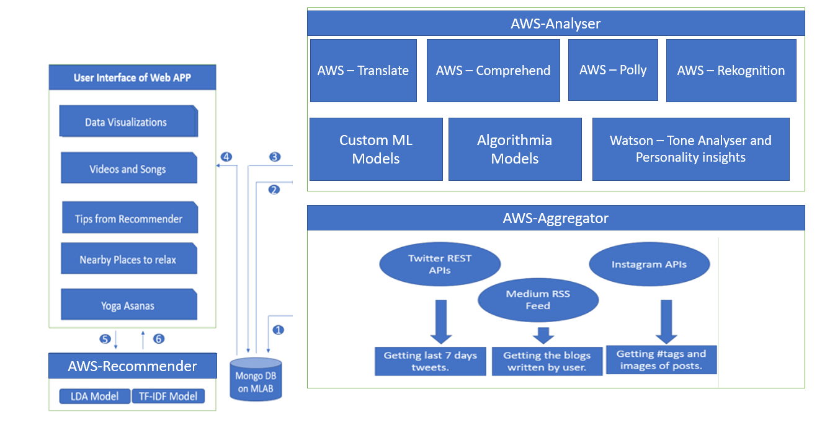
Software Architecture

Slide 7
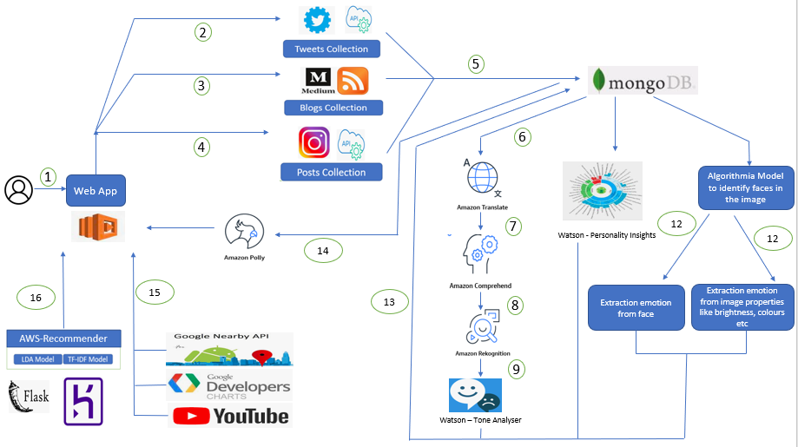
Flow Diagram

Slide 8
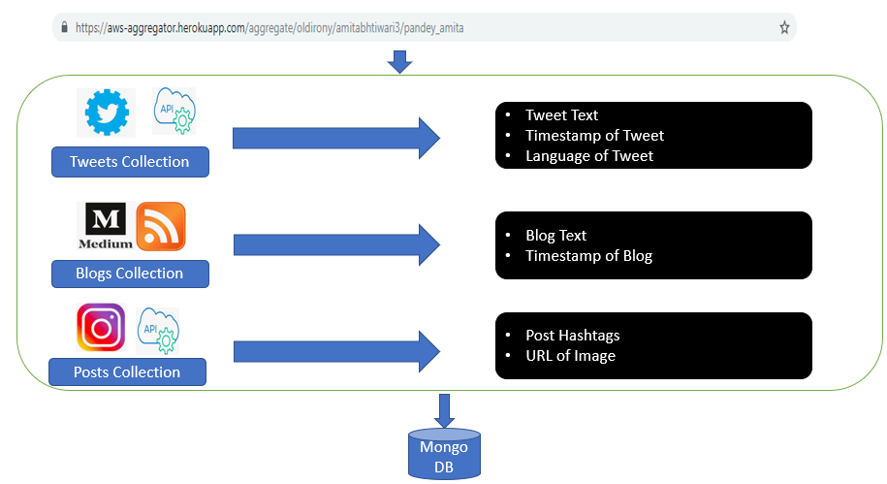
AWS-Aggregator

Slide 9
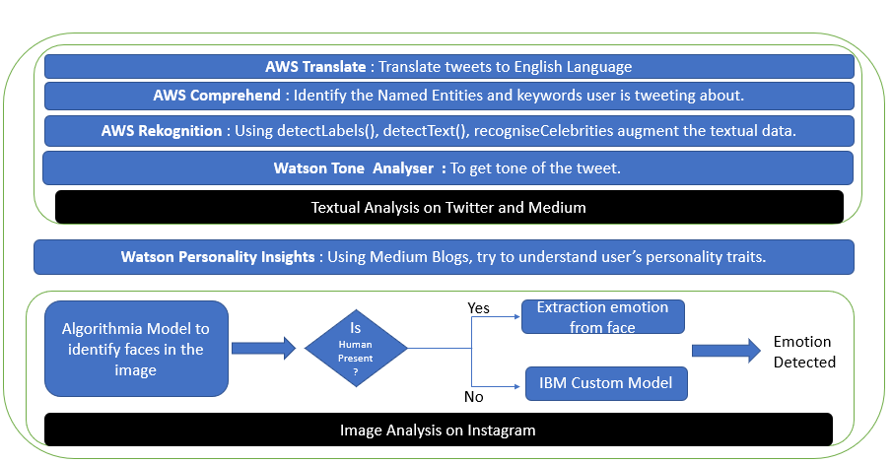
AWS-Analyser
Mongo DB

Slide 10
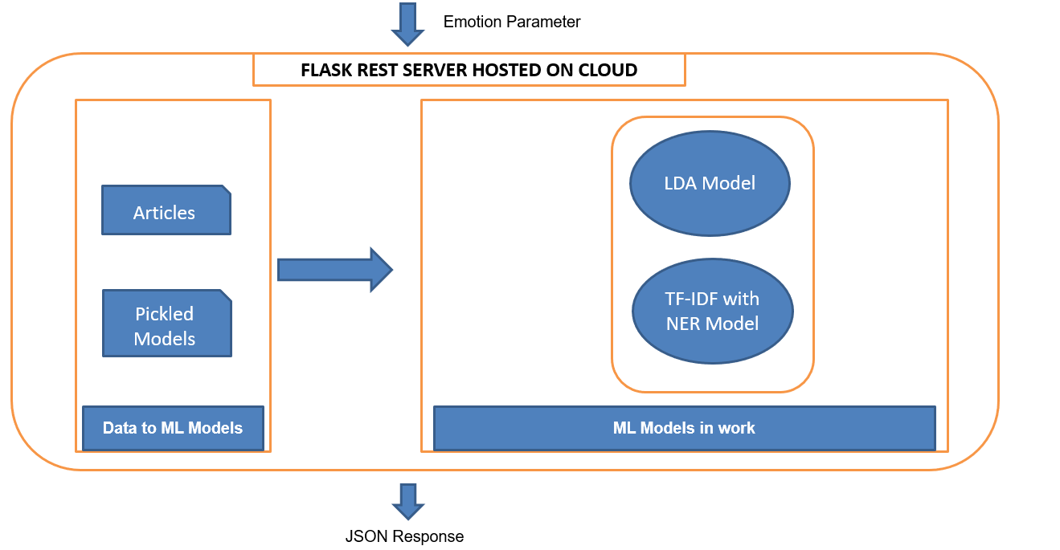
IBM-Recommender

Slide 11
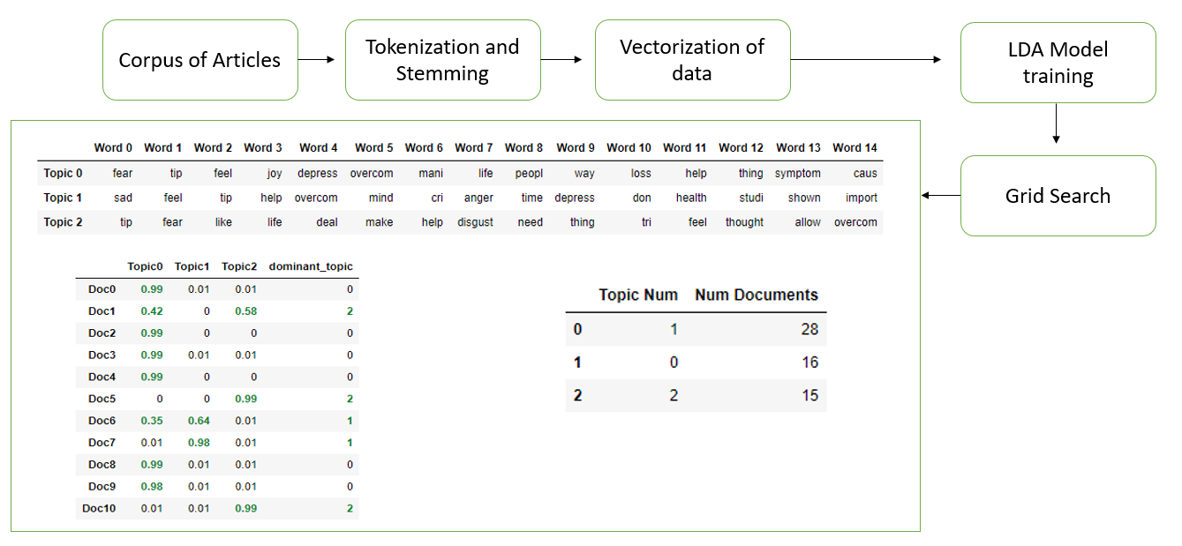
Latent Dirichlet Allocation

Slide 12
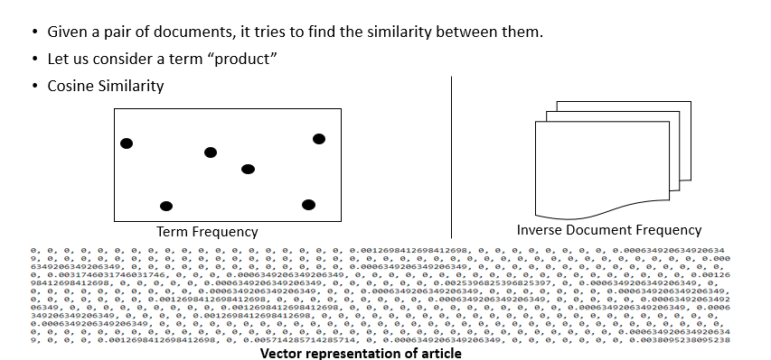
Term Frequency – Inverse Document Frequency Model

Slide 13

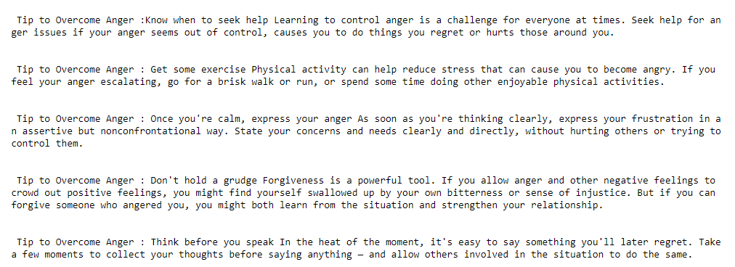

Slide 14
AWS Services :
AWS AI Modules :
AWS Translate
AWS Comprehend
AWS Rekognition
AWS Polly
AWS Cloud Service :
Deployed AWs analyser server written in Node.js on AWS Lambda

Slide 15
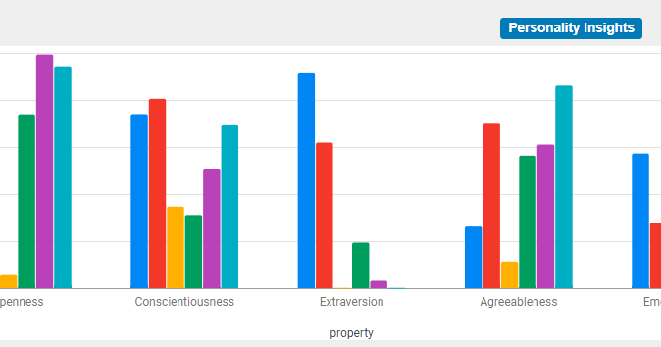
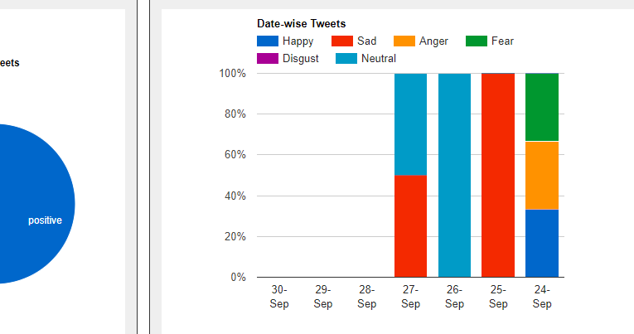
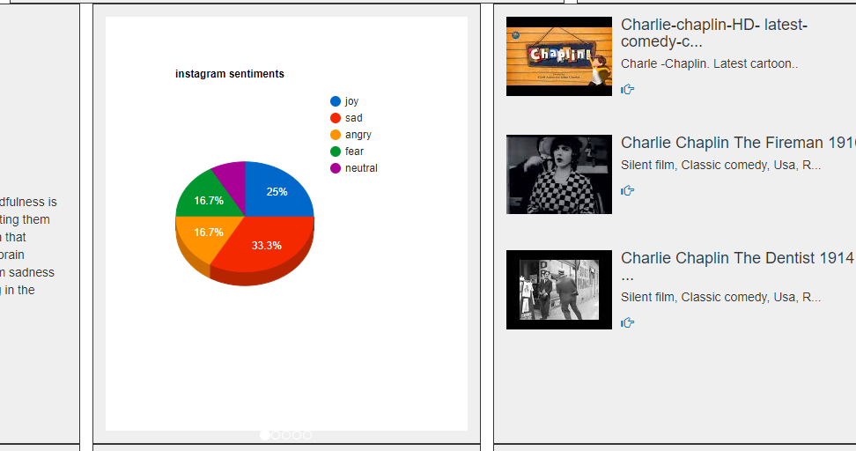
User Interface
Visual representation of data using Google Chart APIs.
Usage of glyphicons.
Usage of collapse class to show tips effectively.
Usage of Google Maps to show route for various places like temples, natural places, hotels.

Slide 16
THANK YOU

