Slide 1

Ethical Hacking and Network Defense
Ethical Hacking Overview

Slide 2
Objectives
Describe the role of an ethical hacker
Describe what you can do legally as an ethical hacker
Describe what you cannot do as an ethical hacker

Slide 3
Introduction to Ethical Hacking
Ethical hackers
Employed by companies to perform penetration tests
Penetration test
Legal attempt to break into a company’s network to find its weakest link
Tester only reports findings, does not solve problems
Security test
More than an attempt to break in; also includes analyzing company’s security policy and procedures
Tester offers solutions to secure or protect the network

Slide 4
The Role of Security and Penetration Testers
Hackers
Access computer system or network without authorization
Breaks the law; can go to prison
Crackers
Break into systems to steal or destroy data
U.S. Department of Justice calls both hackers
Ethical hacker
Performs most of the same activities but with owner’s permission

Slide 5
The Role of Security and Penetration Testers
Script kiddies or packet monkeys
Young inexperienced hackers
Copy codes and techniques from knowledgeable hackers
Experienced penetration testers write programs or scripts using these languages
Practical Extraction and Report Language (Perl), C, C++, Python, JavaScript, Visual Basic, SQL, and many others
Script
Set of instructions that runs in sequence

Slide 6
It Takes Time to Become a Hacker
This class alone won’t make you a hacker, or an expert
It might make you a script kiddie
It usually takes years of study and experience to earn respect in the hacker community
It’s a hobby, a lifestyle, and an attitude
A drive to figure out how things work

Slide 7
Tools for Security and Penetration Testers
Tiger box
Collection of OSs and hacking tools
Usually on a laptop
Helps penetration testers and security testers conduct vulnerabilities assessments and attacks

Slide 8
Penetration-Testing Methodologies
White box model
Tester is told everything about the network topology and technology
Network diagram
Tester is authorized to interview IT personnel and company employees
Makes tester’s job a little easier

Slide 9
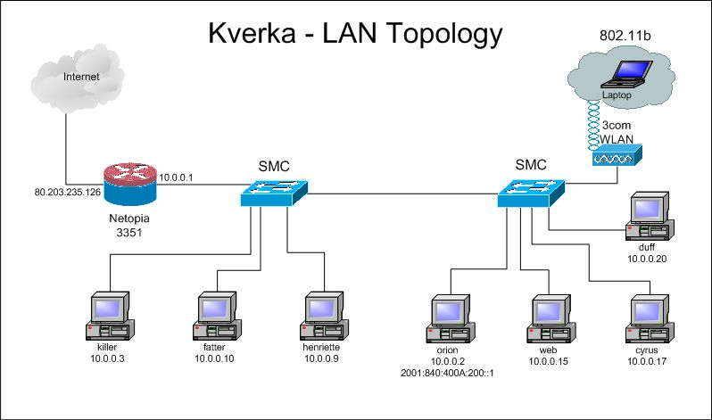
Network Diagram
From ratemynetworkdiagram.com (Link Ch 1g)

Slide 10
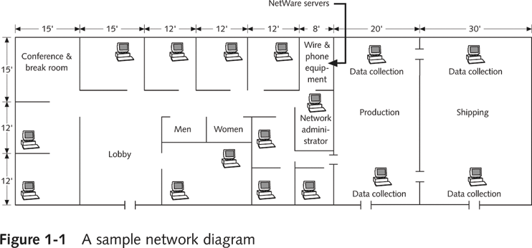
This is a Floor Plan

Slide 11
Penetration-Testing Methodologies
Black box model
Company staff does not know about the test
Tester is not given details about the network
Burden is on the tester to find these details
Tests if security personnel are able to detect an attack

Slide 12
Penetration-Testing Methodologies
Gray box model
Hybrid of the white and black box models
Company gives tester partial information

Slide 13
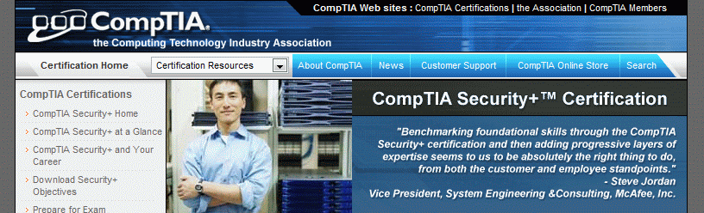
Certification Programs for Network Security Personnel
Certification programs available in almost every area of network security
Basics:
CompTIA Security+ (CNIT 120)
Network+ (CNIT 106 or 201)

Slide 14
Take Certification Tests Here
CNIT is a Prometric Vue testing center
Certification tests are given in S214
CompTIA and Microsoft
The next tests will be in the second week of April, right after Spring Break
Email sbowne@ccsf.edu if you want to take a test

Slide 15
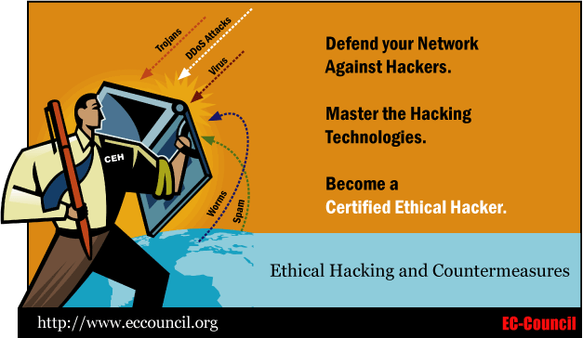
Certified Ethical Hacker (CEH)
But see Run Away From The CEH Certification
Link Ch 1e on my Web page

Slide 16
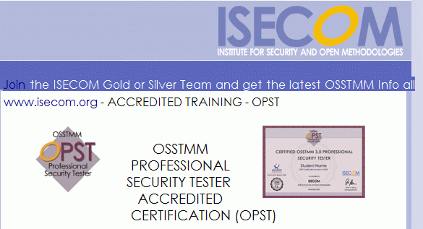
OSSTMM Professional Security Tester (OPST)
Designated by the Institute for Security and Open Methodologies (ISECOM)
Uses the Open Source Security Testing Methodology Manual (OSSTMM)
Test is only offered in Connecticut and outside the USA, as far as I can tell
See links Ch 1f and Ch 1h on my Web page

Slide 17

Certified Information Systems Security Professional (CISSP)
Issued by the International Information Systems Security Certifications Consortium (ISC²)
Usually more concerned with policies and procedures than technical details
Web site
www.isc2.org

Slide 18
SANS Institute
SysAdmin, Audit, Network, Security (SANS)
Offers certifications through Global Information Assurance Certification (GIAC)
Top 20 list
One of the most popular SANS Institute documents
Details the most common network exploits
Suggests ways of correcting vulnerabilities
Web site
www.sans.org (links Ch 1i & Ch 1j)

Slide 19
What You Can Do Legally
Laws involving technology change as rapidly as technology itself
Find what is legal for you locally
Laws change from place to place
Be aware of what is allowed and what is not allowed

Slide 20
Laws of the Land
Tools on your computer might be illegal to possess
Contact local law enforcement agencies before installing hacking tools
Written words are open to interpretation
Governments are getting more serious about punishment for cybercrimes

Slide 21
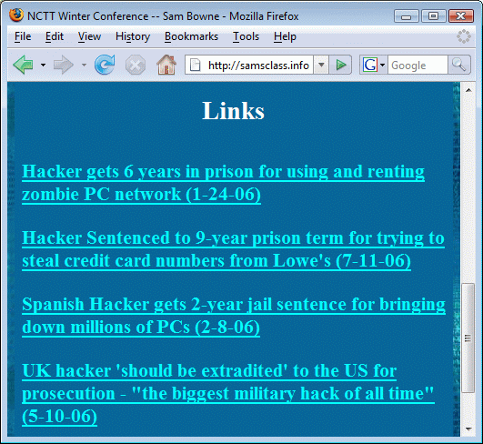
Recent Hacking Cases

Slide 22
Is Port Scanning Legal?
Some states deem it legal
Not always the case
Federal Government does not see it as a violation
Allows each state to address it separately
Read your ISP’s “Acceptable Use Policy”
IRC “bots” may be forbidden
Program that sends automatic responses to users
Gives the appearance of a person being present

Slide 23
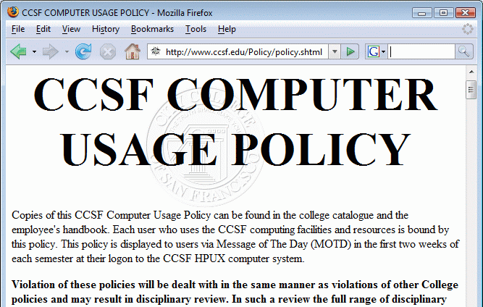
CCSF Computer Use Policy
www.ccsf.edu/Policy/policy.shtml (link Ch 1k)

Slide 24
Federal Laws
Federal computer crime laws are getting more specific
Cover cybercrimes and intellectual property issues
Computer Hacking and Intellectual Property (CHIP)
New government branch to address cybercrimes and intellectual property issues

Slide 25
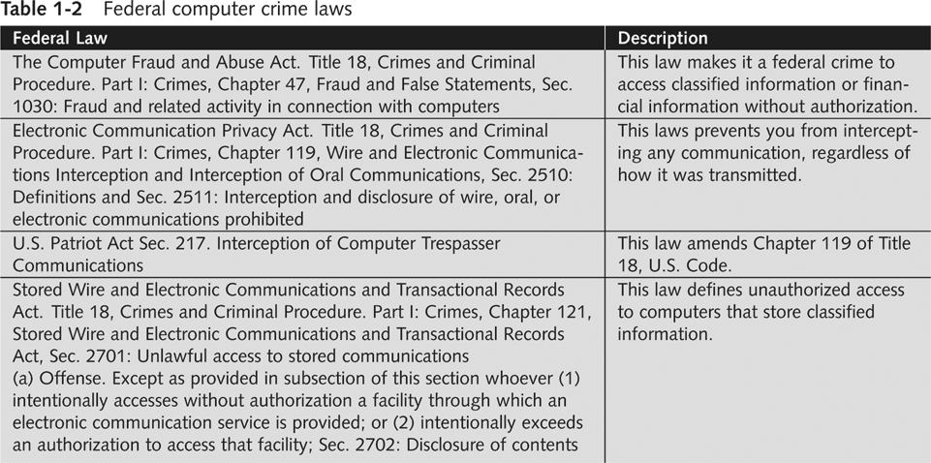

Slide 26
What You Cannot Do Legally
Accessing a computer without permission is illegal
Other illegal actions
Installing worms or viruses
Denial of Service attacks
Denying users access to network resources
Be careful your actions do not prevent customers from doing their jobs

Slide 27
Anti-Spam Vigilantes: Lycos
Ch 1l1: Lycos starts anti-spam screensaver plan: Dec 2, 2004
Ch 1l2: Lycos Pulls Anti-Spam 'Vigilante' Campaign -- Dec 3, 2004
Ch 1l3: Lycos's Spam Attack Network Dismantled -- Spammers sent the DOS packets back to Lycos -- Dec 6, 2004

Slide 28
Anti-Spam Vigilantes: Blue Frog
Ch 1m: Blue Frog begins its "vigilante approach" to fight spam -- July, 2005
Ch 1n: Russian spammer fights back, claims to have stolen Blue Frog's database, sends threating email -- DOS attack in progress -- May 2, 2006
Ch 1o: Blue Frog compromised and destroyed by attacks, urgent instructions to uninstall it, the owners have lost control -- May 17, 2006

Slide 29
Anti-Spam Vigilantes: The Future
Ch 1p: Call for help creating distributed, open-source Blue Frog replacement -- May 17, 2006
Not in textbook, see links on my page (samsclass.info)

Slide 30
Get It in Writing
Using a contract is just good business
Contracts may be useful in court
Books on working as an independent contractor
The Computer Consultant’s Guide by Janet Ruhl
Getting Started in Computer Consulting by Peter Meyer
Internet can also be a useful resource
Have an attorney read over your contract before sending or signing it

Slide 31
Ethical Hacking in a Nutshell
What it takes to be a security tester
Knowledge of network and computer technology
Ability to communicate with management and IT personnel
Understanding of the laws
Ability to use necessary tools

