Slide 1
Breast Cancer Detection and Prevention using Machine Learning
By Akash Gitty

Slide 2
Contents
1. Introduction
2. Objective
3. Proposed Methodology
4. Model Summary:
4.1 Exploratory Data Analysis
4.2 Data Preprocessing
4.3 Baseline Model Training and Evaluation
4.4 Advanced Model Training and Evaluation
4.5 Final Model and Results Comparison
5. Literature Review & Comparative Analysis
6. Future Scope
7. Conclusion
8. References

Slide 3
Introduction
Breast cancer is one of the leading causes of death among women.
Early detection and treatment significantly improves survival rates.
Machine learning (ML) can aid in early diagnosis.

Slide 4
Objective
Problem Statement
Develop a machine learning classification model that can accurately predict whether a breast tumor is benign or malignant using patient data.
Dataset: Wisconsin Breast Cancer Dataset
Goal: High accuracy, precision, and recall with a robust and interpretable model.
Stakeholders
Healthcare professionals (doctors, radiologists, pathologists)
Hospital administrators and IT departments
Patients and their families
Health tech startups and researchers
Business Use Case
Integrate ML models into diagnostic tools for faster and more accurate screenings.
Reduce diagnostic workload for physicians
Support rural healthcare centers lacking specialist access
Enable predictive healthcare systems and preventive treatment planning

Slide 5
Proposed Methodology
Data Preparation
Exploratory Data Analysis
Train Baseline Model
Build a baseline Logistic Regression and Decision Tree Model.
Advanced Models and Results Comparison
Build Random Forest, Linear SVC, SVC (Nonlinear), KNN Classifier & Ensemble Models.
Comparison of results and determine the best model.
Data Preprocessing
Compare the performance of both models.

Slide 6
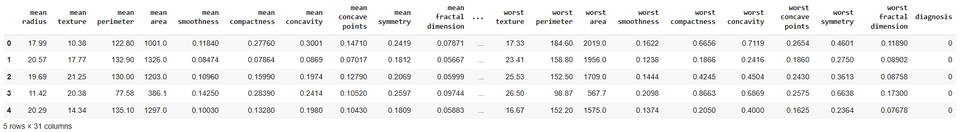
Exploratory Data Analysis
Sample Dataset
Samples: 569
Target: Diagnosis (0 = Malignant, 1 = Benign)
Features: 30 numerical features
No Missing Values Found in the Dataset.
All are numerical Features.

Slide 7
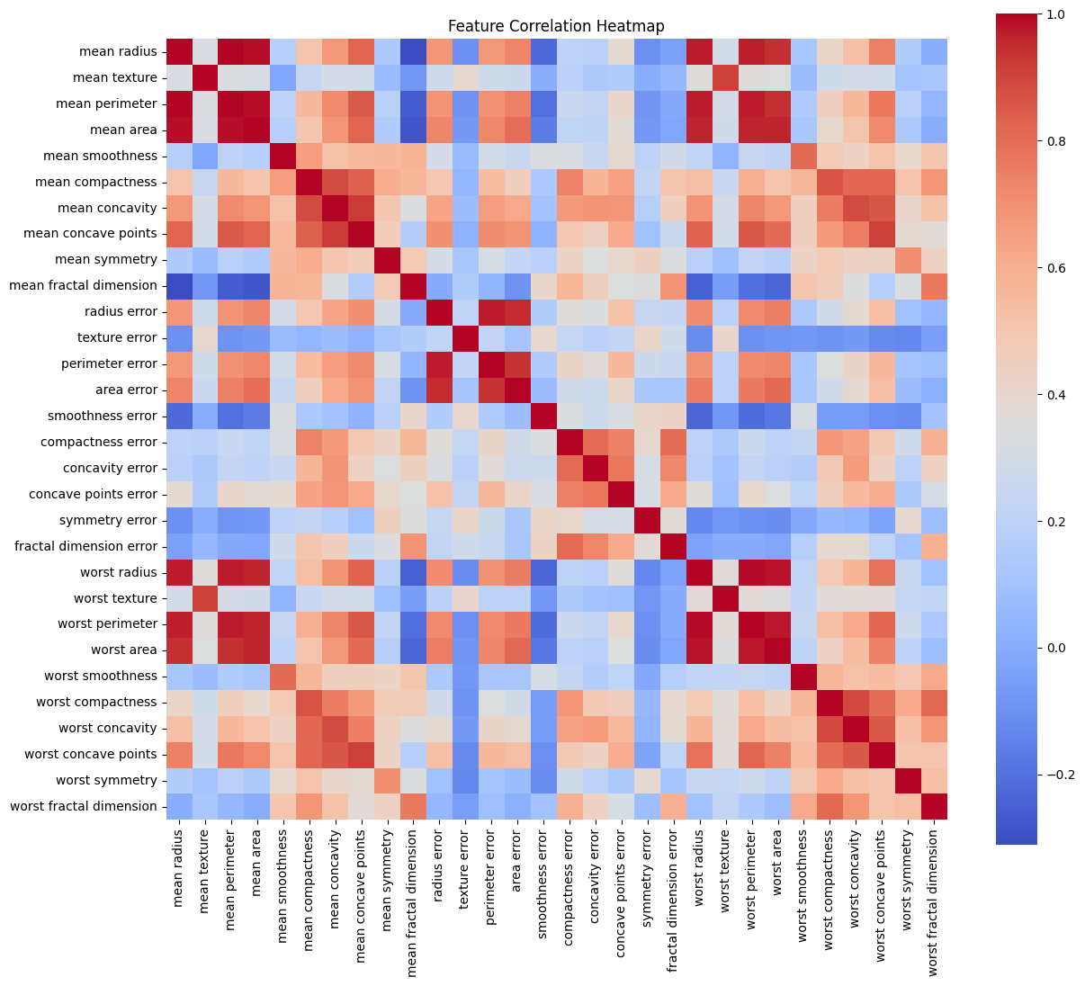
Correlation Heatmap
Key Inferences for Modelling:
Multicollinearity: The strong positive correlations between certain groups of features (like radius, perimeter, area; and compactness, concavity, concave points).
Importance of Size and Shape: Features related to the size (radius, perimeter, area) and shape/contour (compactness, concavity, concave points) of the cell nuclei appear to be highly interconnected.
Potential for Feature Reduction: Due to the high correlations.
Independent Information: Features like smoothness and symmetry (especially their mean and error versions) might provide more unique information due to weaker correlations with other features.

Slide 8
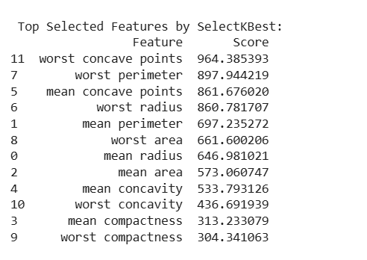
Data Preprocessing
Step 1:Feature Scaling using Min Max Scaling.
Step 2: Feature Selection into 12 important features
-> Method used: KBest Feature Selection

Slide 9
Step 3: Feature Filtering based on Correlation matrix
Step 4: Data Splitting:
-> Stratified Sampling in the ratio 80:20.
-> Random state=42 to ensure reproducibility of data.

Slide 10
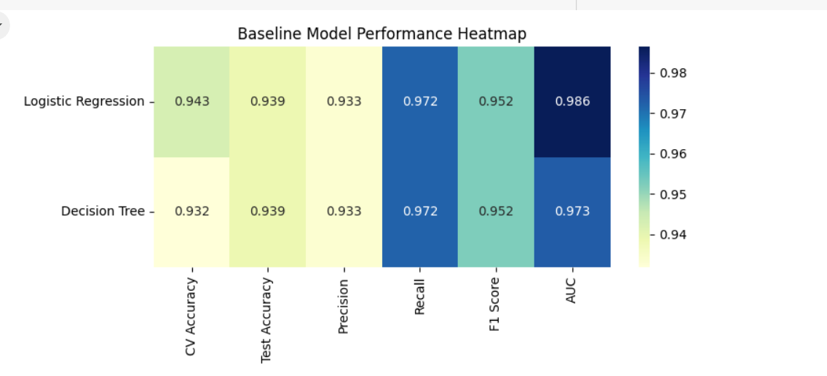
Baseline Model Training
Models used: Logistic Regression, Decision Tree.
Metrics used: CV & Test Accuracy,Precision,Recall,F1 score, AUC.

Slide 11
Baseline Model Results and Inferences
Overall, both Logistic Regression and Decision Tree models demonstrated high performance.
Key Observations:
-> Logistic Regression slightly outperformed Decision Tree in CV Accuracy and AUC.
-> Both models showed consistency across metrics (high accuracy, precision, recall, and F1 scores).
-> Cross-Validation results indicate that both models are likely to generalize well.

Slide 12
Advanced Model Training and Evaluation
Purpose: To investigate if alternative machine learning models could enhance the prediction of breast tumors.
Models Trained:
-> Linear SVC
-> SVC (Polynomial)
-> Random Forest Classifier
-> KNN Classifier
-> Ensemble (SVC, Random Forest, Logistic Regression).
Hyperparameter tuning: 5 Fold Cross Validation.
Metrics Evaluated: Accuracy, Precision, Recall, F1 score, AUC.

Slide 13
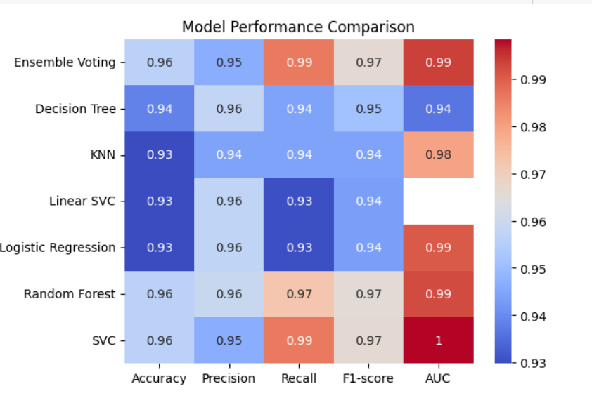
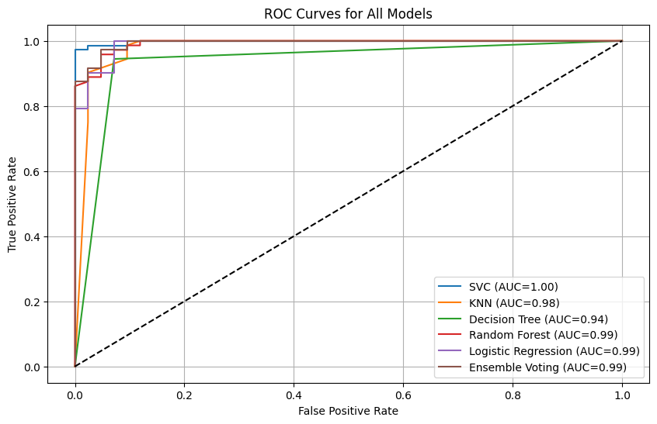
Results

Slide 14
Model Comparison
Model | Accuracy | Precision | Recall | AUC | Interpretability | Robustness
KNN | 0.93 | 0.94 | 0.94 | 0.98 | Black-Box | ✅
Linear SVC | 0.93 | 0.96 | 0.93 | 0.94 | Limited Interpretability | ✅
SVC | 0.96 | 0.95 | 0.99 | 1.00 | Black-box | ✅
Ensemble Voting | 0.96 | 0.95 | 0.99 | 0.99 | Difficult to Interpret | ✅
Random Forest | 0.96 | 0.96 | 0.97 | 0.99 | Interpretable | ✅
Logistic Regression | 0.93 | 0.96 | 0.93 | 0.99 | Very Interpretable | ✅
Decision Tree | 0.94 | 0.96 | 0.94 | 0.94 | Highly Interpretable | ❌ (can overfit)
The Random Forest model was chosen as the best model due to its high accuracy, precision, recall, and AUC, combined with its good interpretability and generalization ability.

Slide 15
Literature Review
Papers Compared:
Paper 1:Khalid et al., 2024 – “Breast Cancer Detection and Prevention Using Machine Learning, Diagnostics” (MDPI).
Paper 2: Almarri et al., 2024 – “The BCPM method: decoding breast cancer with machine learning”.
Paper 3: Naji et al., 2021 – “Machine Learning Algorithms For Breast Cancer Prediction And Diagnosis”, Procedia CS.

Slide 16
Results Comparison
ML Techniques Used | Reference | Accuracy of Existing Model | AUC score of Existing Model | Proposed Model Accuracy | Proposed Model AUC score
Random Forest | Paper 1 | 0.96 | - | 0.96 | 0.99
 | Paper 2 | 0.92 | -
 | Paper 3 | 0.96 | 0.96
SVC | Paper 1 | 0.88 | - | 0.96 | 1
 | Paper 2 | 0.91 | -
 | Paper 3 | 0.96 | 0.96
Logistic Regression | Paper 1 | 0.93 | - | 0.93 | 0.99
 | Paper 2 | 0.9 | -
 | Paper 3 | 0.95 | 0.94
Decision Tree | Paper 1 | 0.94 | - | 0.94 | 0.94
 | Paper 2 | 0.9 | -
 | Paper 3 | 0.95 | 0.94
KNN | Paper 1 | 0.92 | - | 0.93 | 0.98
 | Paper 2 | 0.91 | -
 | Paper 3 | 0.93 | 0.95

Slide 17
Future Scope
Model Enhancement:
-> Integrate deep learning models (e.g., CNNs) for image-based diagnostics.
-> Fine-tune models with larger and more diverse datasets.
Real-time Detection and Clinical Integration: Develop mobile/web applications and integrate into clinical workflows for instant predictions.
Data Expansion: Combine clinical, genetic, and imaging data for better accuracy.
Explainability: Implement explainable AI to increase clinician trust.
Continuous Learning: Enable models to learn from new patient data.

Slide 18
Conclusion
Machine learning can be a valuable tool for the early and accurate diagnosis of breast cancer.
The Random Forest model demonstrated strong performance in this study, achieving high accuracy, precision, and recall, while also offering interpretability and robustness.
These findings support the potential integration of machine learning into clinical practice to improve patient outcomes.

Slide 19
References
Code & Dataset
Code Link: https://github.com/AkashGitty97/Cloudxlab-Project-by-Akash
Dataset: Dua, D. & Graff, C. (2019). UCI Machine Learning Repository.
Books
Hastie, T., Tibshirani, R., & Friedman, J. (2009). The Elements of Statistical Learning.
Bishop, C. M. (2006). Pattern Recognition and Machine Learning, Springer.
Framework & Documentation
Scikit-learn Documentation.
Research Papers
Naji et al., 2021 – Machine Learning Algorithms For Breast Cancer Prediction And Diagnosis, Procedia CS, Vol. 191, pp. 487–492.
Almarri et al., 2024 – The BCPM method: decoding breast cancer with machine learning, BMC Med Imaging.
Khalid et al., 2024 – Breast Cancer Detection and Prevention Using Machine Learning, Diagnostics (MDPI).

