Slide 1
AROHA TECHNOLOGIES & EXDION poc execution
Notes:
This template can be used as a starter file for presenting training materials in a group setting.
Sections
Right-click on a slide to add sections. Sections can help to organize your slides or facilitate collaboration between multiple authors.
Notes
Use the Notes section for delivery notes or to provide additional details for the audience. View these notes in Presentation View during your presentation.
Keep in mind the font size (important for accessibility, visibility, videotaping, and online production)
Coordinated colors
Pay particular attention to the graphs, charts, and text boxes.
Consider that attendees will print in black and white or grayscale. Run a test print to make sure your colors work when printed in pure black and white and grayscale.
Graphics, tables, and graphs
Keep it simple: If possible, use consistent, non-distracting styles and colors.
Label all graphs and tables.

Slide 2

Objective
Gain actionable insights into Internal Rejections, Insurance Denials and Profit/Loss to optimize business operations and financial performance.
Reference Tables:
ClearingHouse_RejectionDetails
DenialAnalysis_Details
Financial_Details
InputReport
Claim_Level
Notes:
This is another option for an Overview slides using transitions.

Slide 3

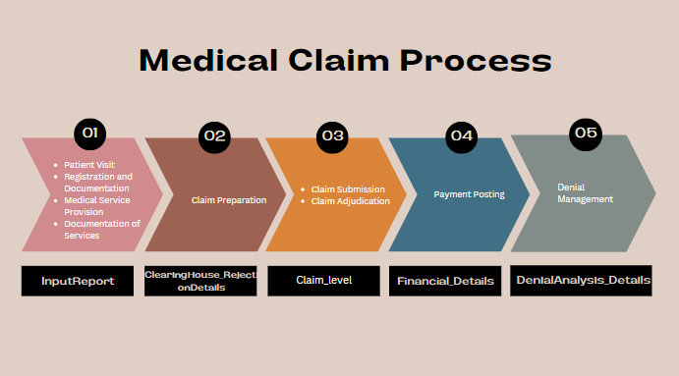

Slide 4
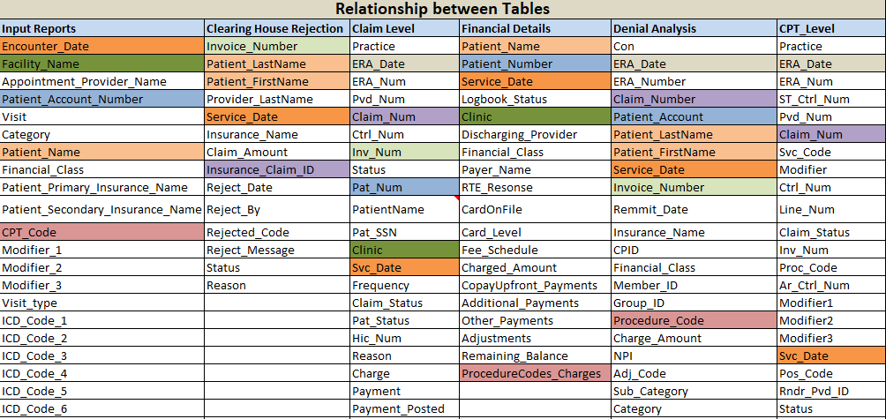
Table Analysis

Slide 5
Financial Analysis
Financial Analysis
Approaches (By Specialty and Center)
Total Patients' Visits
Count of Insurance and Self Pay
Total Self Payment Amount
Total Claim Count
Total Amount from Payers
Total received amount for Invoices
Total Claimed amount to Payers
Non-Covered amount
Received Insurance Amount (Days)
Charged and Received Amount
Top 10 Payers based on received amount
Notes:
Use a section header for each of the topics, so there is a clear transition to the audience.

Slide 6
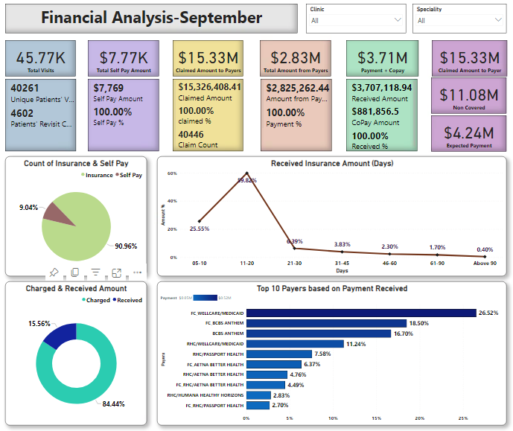
Financial Dashboard
Notes:
Use a section header for each of the topics, so there is a clear transition to the audience.

Slide 7
GC & NGC Analysis
GC & NGC Analysis
Approaches (By GC/NGC, Speciality and Center)
Total Patients' Visits
Count of Insurance and Self Pay
Total Self Payment Amount
Total Amount from Payers
Total received amount for Invoices
Total Claimed amount to Payers
Non-Covered amount
Expected amount
Rejected amount (Link to Rejection Analysis Page)
Denied amount (Link to Denial Analysis Page)
Charged and Recevied Payment amount in days
Speciality wise Payment amount recevied
Top 10 Payment received Clinics
Least 10 Payment received Clinics
Received Insurance amount
Notes:
Use a section header for each of the topics, so there is a clear transition to the audience.

Slide 8
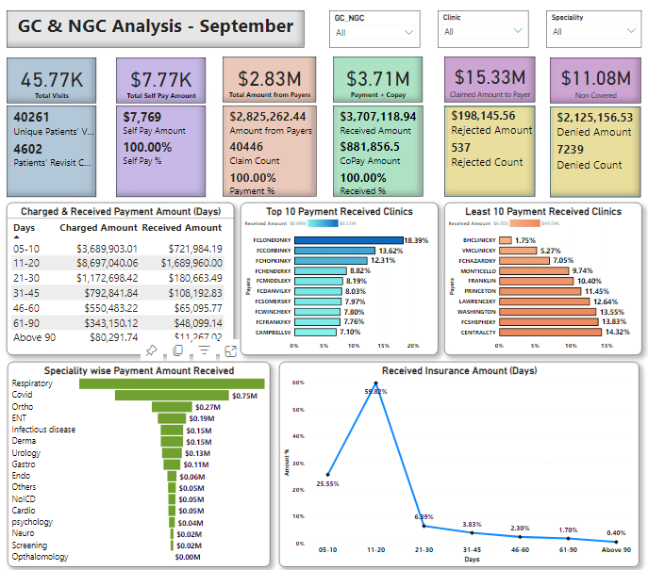
GC & NGC Dashboard
Notes:
Use a section header for each of the topics, so there is a clear transition to the audience.

Slide 9
Operational Analysis
Operational Analysis
Approaches ( Specialty and Center)
DOS to rejection receipt days
DOS to Claim payment days
DOS to Claim denials
Top 10 Procedure Codes
New Vs Established patients
Distribution of EM Level
Frequent EM Codes
Notes:
Use a section header for each of the topics, so there is a clear transition to the audience.

Slide 10
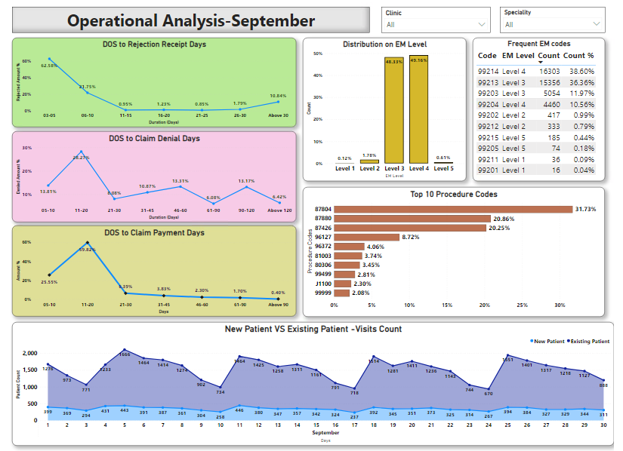
Operational Dashboard
Notes:
Use a section header for each of the topics, so there is a clear transition to the audience.

Slide 11
Rejected Analysis
Rejected Analysis
Approaches ( Speciality and Center)
Rejected Count
Rejected Amount
DOS to Rejection Days
Top 10 Clearing house Rejected Reason
Top 10 Clearing house Rejected Specalities
Top 10 Clearing house Rejected Clinics
Notes:
Use a section header for each of the topics, so there is a clear transition to the audience.

Slide 12
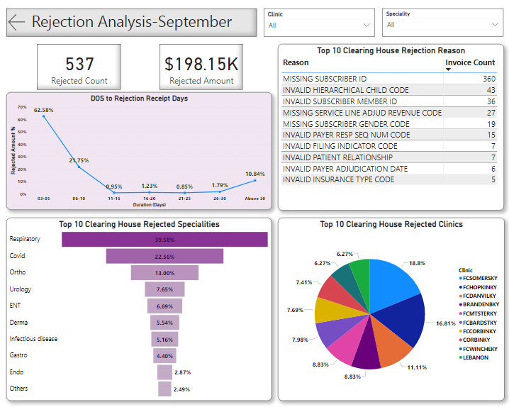
Rejected Analysis Dashboard
Notes:
Use a section header for each of the topics, so there is a clear transition to the audience.

Slide 13
Denial Analysis
Denial Analysis
Approaches ( Specialty and Center)
Denied Count
Denied Amount
DOS to Rejection Days
Top 10 Denial Categories and Sub-Categories
Top 10 Denied Payers
Denial on Specalities
Reclaim Count
Notes:
Use a section header for each of the topics, so there is a clear transition to the audience.

Slide 14
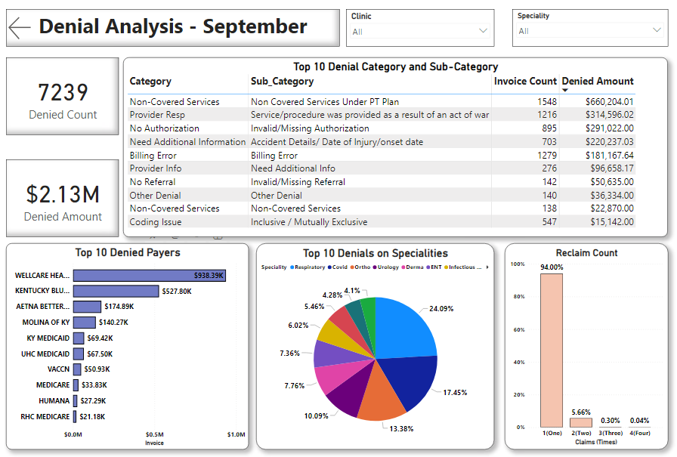
Denial Analysis Dashboard
Notes:
Use a section header for each of the topics, so there is a clear transition to the audience.

Slide 15
Received Requirements
Received Requirement
Financial | Operations | Quality | Provider
Current Revenue / Claim or Visit (By provider, speciality, center) | DOS to rejection receipt days (By provider, specialty, center) [Service date to Reject date on Clearing House Table] | First pass rate from FP to Clearing house (By provider, specialty, center) | Current volume of queries by Provider, Specialty, Center
Current Revenue / center | DOS to Date of charges posted (By provider, specialty, center) | First pass rate from FP to Payer (By provider, specialty, center) | Current Query to response rates by Provider, Specialty, center
% AR above 120 days (volume & $$, Center, Specialty) | Days to bill | Type of Rejections & Denials (By provider, specialty, center) | Current nature of Queries & related responses
Most frequent Procedures done (By Specialty, Center) | DOS to Claim payment days (By provider, specialty, center)
Self-Pay Vs Insurance (By Specialty, Center) | DOS to Claim denials (By provider, specialty, center)
 | Average days to address / work on the denials (By provider, specialty, center)
 | Average days of Claim in AR buckets (30, 60, 90) Quantity & $$ (By provider, specialty, center)
 | Current EM Level distribution (By provider, speciality, center)
 | Weightage average of current EM Levels (By provider, speciality, center)
 | New Vs Established patients (By provider, specialty, center)

Slide 16
Out of Scope
The below requirements have not been met due to insufficient data availability.
Providers
% AR above 120 days (volume & $$, Center, Specialty)
DOS to Date of charges posted (By provider, specialty, center)
Days to bill
First pass rate from FP to Clearing house (By provider, specialty, center)
First pass rate from FP to Payer (By provider, specialty, center)
Current volume of queries by Provider, Specialty, Center
Current Query to response rates by Provider, Specialty, center
Current nature of Queries & related responses

Slide 17
THANK YOU
Notes:
Use a section header for each of the topics, so there is a clear transition to the audience.

