Slide 1

BANGALORE INSTITUTE OF TECHNOLOGY
K.R Road, V.V Pura, Bengaluru-04 DEPARTMENT OF COMPUTER SCIENCE & ENGINEERING
“Detect Transaction Anomalies in Credit Card System using Machine Learning”
Presented by 19P17
1BI19CS011 Akash Jain 1BI19CS015 Aman Aditya Pandey 1BI19CS026 Arindam Dutta 1BI19CS141 Shivashankar Tadaki
Under the Guidance of
Dr. Maya B.S Assistant Professor
Department of Computer Science & Engineering

Slide 2
Agenda
Introduction
Literature Survey
Requirements Engineering
Project Planning
Applications
Conclusion
1/20

Slide 3
Introduction
Overview
Despite the promising progress made in detecting anomalies in day to day transactions, identifying frauds remains a challenging task due to semantic gap between the various predefined fraud detection models and diversities in implementing them .
Digital transactions can take place over the phone or on the internet. Accendential disclosure of any one of them leads to serious disruptions
2/20

Slide 4
Introduction
Objectives
Design and implement the technique for detecting anomalies in the credit card system using the existing algorithms.
Customizing the existing bank authentication system.
Implement the message authentication system for successful transaction to the user.
2/240

Slide 5
Ability to identify new customer behaviour patterns and adapt to changes. Unlike rule-based systems, algorithms are to be aligned with a constantly changing environment and financial conditions
Purpose
Fraud detection costs huge money loss to different financial companies and consumers so it have
.
8

Slide 6
become essential for banks and financial institutions, to minimize their losses.
With digital crime and online fraud of all kinds on the rise, its more important than ever for organizations to take firm and clear steps to prevent payment card fraud through advanced technology and strong security measures.
8

Slide 7
Literature Survey
SL. NO. | Title | Author & Year Published | PROPOSED SYSTEM | DRAWBACK AND LIMITATI ONS
1 | “Credit Card Fraud Detection Using AdaBoost and Majority Voting ” | Kuldeep Randhawa, Chu Kiong Loo, Manjeevan Seera, Chee Peng Lim, Asoke K.Nandi Year : 2019 | This paper proposes single and hybrid machine learning algorithms for financial applications using AdaBoost and Majority Voting. The AdaBoost algorithm needs a quality dataset. Noisy data and outliers have to be avoided before adopting an AdaBoost algorithm. | NA
 |  |  | .
8

Slide 8
Sl. No | Title | Author & Year Published | PROPOSED SYSTEM | DRAWBACK AND LIMITATIONS
2 | “Credit Card Fraud Detection using Machine Learning Algorithms ” | Vaishnavi Nath Dornadula, Geetha S Year:2019 | Customers are grouped (low ,medium, high)based on their transactions and behavioral patterns. Then different classifiers are applied on three different groups. A feedback mechanism to solve the problem of concept drift Oversampling the data does not provide much better results | NA
8

Slide 9
Sl. No | Title | Author & Year Published | PROPOSED SYSTEM | DRAWBA CK AND LIMITATI ONS
3 | “Credit Card Fraud Detection using Deep Learning ” | Andrea Dal Pozzolo, Oliver Caelen, Reid A. Johnson and Gianluca Bontempi. Year : 2019 | A method of Fraud Detection which is completely based on Deep Learning. We first compare it with all the renowned methods such as Random Forest, SVM, etc. Finally, we come across a conclusion that Neural Networks, even though harder to train, would be a perfect fit for the Model. | it will not show accurate results unless the skewness of the data is reduced.
 |  |  |  | 9

Slide 10
Sl. No | Title | Author & Year Published | PROPOSED SYSTEM | DRAWBACKS/ LIMITATION
4 | “Credit Card Fraud Detection using Machine Learning and Data Science ” | John Richard D. Kho, Larry A Year:2019 | This article has listed out the most common methods of fraud along with their detection methods(outliers) and reviewed recent findings in this field. It also tells, about the pseudocode , explan the implementation and experimentation results. | This idea is difficult to implement because it requires the bank cooperation ,

Slide 11
Sl. No | Title | Author & Year Published | PROPOSED SYSTEM | DRAWBACKS/ LIMITATION
5 | “Imbalanced Classification Approaches for Credit Card Fraud Detection ” | Sara Makki, Zainab Assaghir, Yehia Tahir, Rafiqul Haque Year:2019 | This paper report a rigorous experimentation and compare the performance of solutions that deal with the imbalance classification problem. we will be | Main drawback is while these approaches improve sensitivity, this improvement leads to an
 |  |  | tackling the given problem | increase in the
 |  |  | by over sampling and | number of false
 |  |  | under sampling . | alarm

Slide 12
Sl. No | Title | Author & Year Published | PROPOSED SYSTEM | DRAWBACKS/ LIMITATION
6 | “Implementing Machine Learning in detecting transaction anomalies | Ruttala Sailusha , V. Gnaneswar , R. Ramesh , G. Ramakoteswara Rao | The idea is to classify the transactions in the dataset using Random Forest and the Adaboost | Drawback is although some results are not satisfactory. So, we would like to implement
 | ” | Year:2020 | algorithms. we choose algorithm that best fits | deep learning algorithms
 |  |  | includes gathering
 |  |  | dataset to deploying
 |  |  | model and performing
 |  |  | result analysis. We split
 |  |  | the data into the training
 |  |  | and the testing data to
 |  |  | develop our models.
 |  |  | Finally, the accuracy,
 |  |  | precision recall, and F1-
 |  |  | score is calculated

Slide 13
Sl. No | Title | Author & Year Published | PROPOSED SYSTEM | DRAWBACKS/ LIMITATION
7 | “Implementing Hybrid model in the Fraud Detection ” | A. Maria Nancy, G. Senthil Kumar, S. Veena Year:2020 | The idea is to study behavior pattern and classify all the attributes of transaction and construct the logical graph of behavior profile (LGBP). It defines state transition probability matrix and construct behavior pattern for each user to check the transaction | NA

Slide 14
Sl. No | Title | Author & Year Published | PROPOSED SYSTEM | DRAWBACK AND LIMITATIONS
8 | “A machine learning based credit card fraud detection using the GA algorithm for feature selection ” | Emmanuel Ileberi, Yanxia Sunl , Zenghui Wang Year:2022 | This paper proposes a machine learning (ML) based credit card fraud detection engine using the genetic algorithm (GA) for feature selection. After the optimized features are chosen, the proposed detection engine uses the following ML classifiers. | Main drawback is having a limited source of dataset can limit the validation of the proposed models

Slide 15
Sl. No | Title | Author & Year Published | PROPOSED SYSTEM | DRAWBACK AND LIMITATIONS
9 | “Autonomous credit card fraud detection using machine learning approach ” | Benchaji I, Douzi S, El Ouahidi B Year:2022 | This paper proposes a Machine Learning models such as Naive bayes, SVM, and ANN which have been utilized to detect fraud in the credit card system. The suggested system’s performance is measured using sensitivity, precision, accuracy, and error rate. | NA

Slide 16
Sl. No | Title | Author & Year Published | PROPOSED SYSTEM | DRAWBACK AND LIMITATIONS
10 | “Review of Machine Learning Approach on Credit Card Fraud Detection” | Rejwan Bin Sulaiman, Vitaly Schetinin, Paul Sa Year:2022 | The idea is utilizing the real-time datasets to train the model in a privacy- preserving manner. A federated learning(decentralized) framework with ANN can enhance the ca[ability of the model to detel fraudlent transactions. | although data is not shared centrally, even the trained model will be going to learn patterns that can be possibly decoded by hackers.

Slide 17
Drawbacks of Existing System
Enormous Data is processed every day and the model build must be fast enough to respond to the scam in time.
Imbalanced Data i.e., most of the transactions (99.8%) are not fraudulent which makes it hard for detecting the fraudulent one
Data availability as the data is mostly private.

Slide 18
Drawbacks of Existing System
Misclassified Data can be another major issue, as not every fraudulent transaction is caught and reported.
Adaptive techniques used against the model by the scammers.

Slide 19
Problem Statement
“Develop an application used for detect anomalies and frauds in transaction of credit card system for providing efficient results using Machine Learning algorithms” Input:
For training set, we use around 2,84,807 transactions from Kaggle dataset.
Output:
Graph of analyzed transaction whether it is fraud or not.

Slide 20
Proposed System
In our Model, we will be applying Random forest algorithm, Naïve Bayes Model and Logistic Regression algorithm for classification of the credit card dataset .
For better result , we will be comparing with Adaboost and XGboost algorithms.
Now, Discriminator has one more additional responsibility, along with identifying the given transaction is fraud, it also signals the nearby authority for the same and the Credit Card Holder.

Slide 21
Requirement Engineering
Software Requirements
Python 3 | Python is an interpreted, high-level and general-purpose programming language. Python's design philosophy emphasizes code readability with its notable use of significant whitespace.
Pip | Pip is a package-management system written in Python used to install and manage software packages.
numpy | NumPy is a library for the Python programming language, adding support for large, multi- dimensional arrays and matrices, along with a large collection of high-level mathematical functions to operate on these arrays.
Anaconda | Anaconda is a distribution of the Python and R programming languages for scientific computing, that aims to simplify package management and deployment.
Google Colab | Colaboratory is a product from Google Research. Colab allows anybody to write and execute arbitrary python code through the browser, and is especially well suited to machine learning, data analysis.

Slide 22
Hardware Requirements
Pentium IV or higher
25 Gb hard free drive space
8 GB RAM
Standard Keyboard and Mouse
VGA and High Resolution Monitor

Slide 23
Conceptual Modelling
Use Case Diagram
Sequence Diagram
Activity Diagram
State Diagram

Slide 24
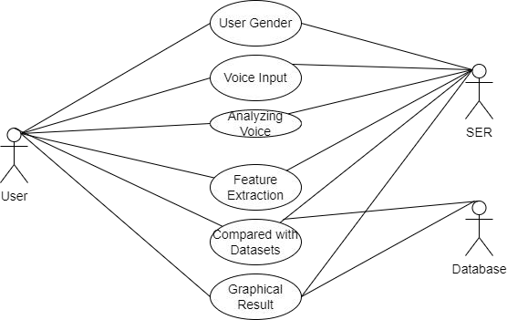


Conceptual/Analysis Modelling
Use case diagram
User Details
Card Details
C o m p a r e Transaction
A n a l y s e transaction
Allow/Block transaction
Graphical Result

Slide 25
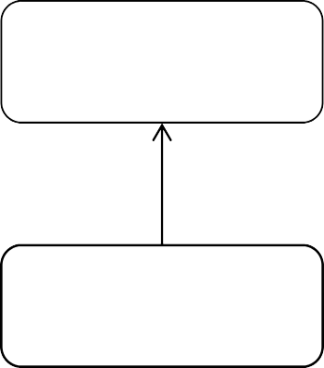
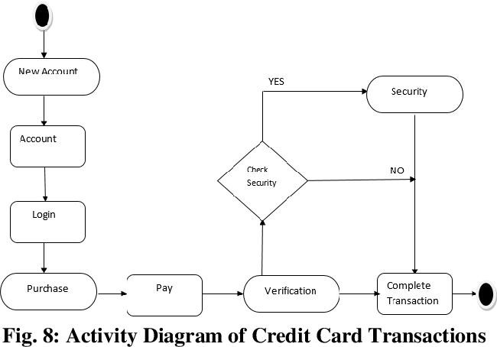
Activity diagram
Inform Cyber Cell
Raise an alarm (SOS alert)

Slide 26
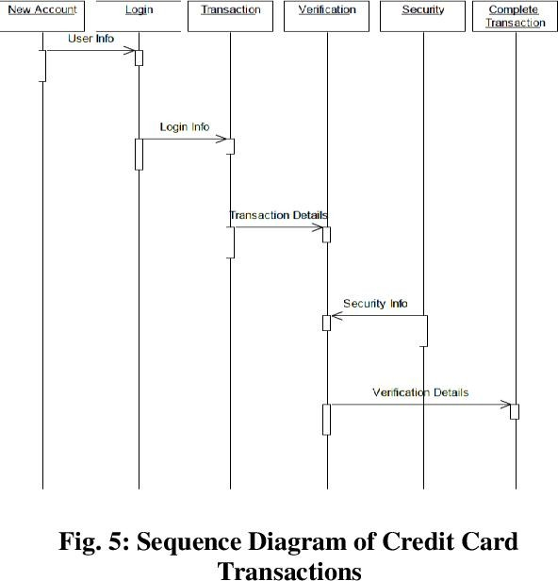
Sequence diagram

Slide 27
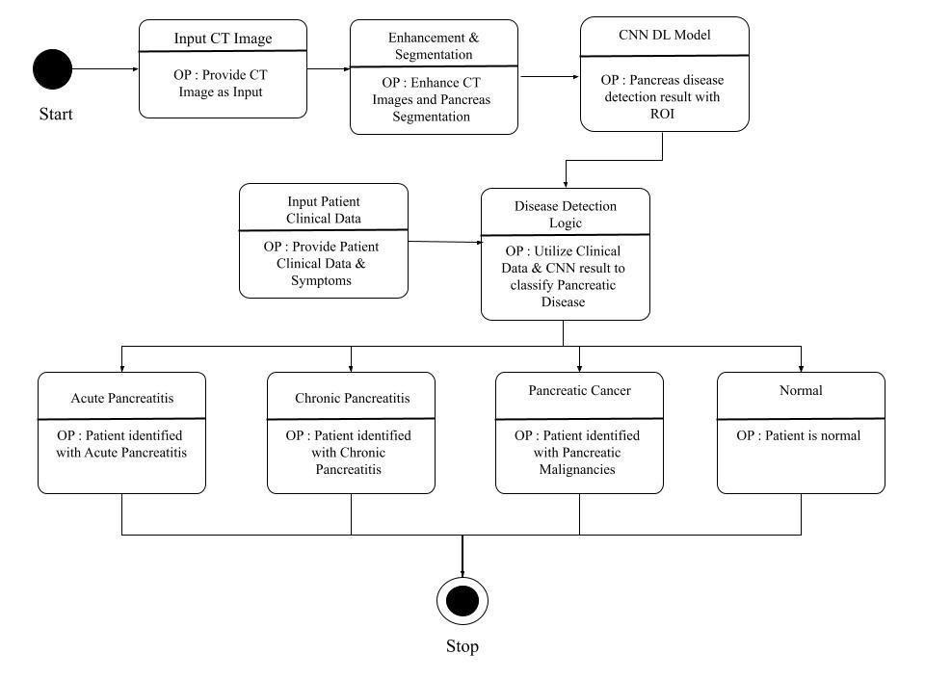
State Diagram
incoming transactions
CC transactions
Hybrid Model
OP : Set of all transactions
OP : includes reward , low interset , credit
OP : Fraud Detection System with ROC
LegitimateTransactions
Fraud Transactions
OP : OTP is sent to User
OP : SMS alert is sent to the user Mobile
OP : Alarm raised and Cyber security is informe
OP : Graphical Output and actions will be taken
Succesful transaction

Slide 28
Software Requirements Specification
Functional Requirements
Policy: Should be able to implement the policy which is the core element of the RL as it alone can define the behavior of the agent. It should map the perceived states of the environment to the actions taken on those states.
Reward Signal: The environment should be able to send an immediate signal to the learning agent at each state, and this signal is a reward signal. The agent's main objective is to maximize the total number of rewards for good actions.
Value Function: The value functionality should be able to give information about how good the situation and action are and how much reward an agent can be expected. A value function should specify the good state and action for the future.

Slide 29
Software Requirements Specification
Non-Functional Requirements
Accuracy & Performance: Learning algorithm accuracy and precision is important and output is compared to the real true result.
Transparency: It is often not clear how results are derived, causing issues in trust and transparency.
Reliability: Further effort has to be put for reliability in the system, like looking at the reliability of individual ML predictions, focusing on reliability estimation
Testability: Systematic testing of the outcome of ML systems is necessary. Major focus should be given on applying ML systems to improve software testing strategies.

Slide 30
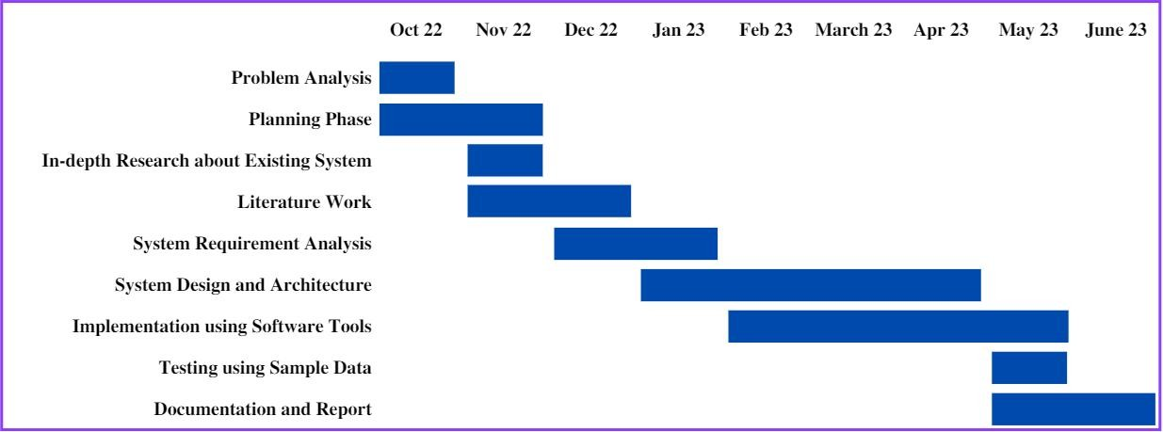
Project Planning / Scheduling
30

Slide 31
Applications
Customer service
Banking
Loan and Offerings
Payment Gateways
Merchandise Payments
31/20

Slide 32
Conclusion
In this project, Machine Learning techniques like Logistic Regression, Decision Tree and Random Forest were used to detect the fraud in credit card system.
Sensitivity, Specificity, Accuracy and Error rate are used to evaluate the performance for the proposed system.
31/20

Slide 33
References
S. Xuan, G. Liu, Z. Li, L. Zheng, S. Wang, and G. N. Surname, “Random forest for credit card fraud detection”, IEEE 15th International Conference on Networking, Sensing and Control (ICNSC) , pp.123-345 , 2022 .
Satvik Vats, Surya Kant Dubey, Naveen Kumar Pandey, “A Tool for Effective Detection of Fraud in Credit Card System”, published in International Journal of Communication Network Security ISSN: 2231
– 1882, Volume-2, Issue-1, 2022
Rinky D. Patel and Dheeraj Kumar Singh, “Credit Card Fraud Detection & Prevention of Fraud Using Genetic Algorithm”, published by International Journal of Soft Computing and Engineering (IJSCE) ISSN: 2231-2307, Volume-2, Issue-6, January 2019.

Slide 34
References
Rinky D. Patel and Dheeraj Kumar Singh, “Credit Card Fraud Detection & Prevention of Fraud Using Genetic Algorithm”, published by International Journal of Soft Computing and Engineering (IJSCE) ISSN: 2231-2307, Volume-2, Issue-6, January 2019.
Wen-Fang YU, Na Wang,“ Research on Credit Card Fraud Detection Model Based on Distance Sum”, published by IEEE International Joint Conference on Artificial Intelligence, pp.243-256 , 2020.
Andreas L. Prodromidis and Salvatore J. Stolfo; "Agent-Based Distributed Learning Applied to Fraud Detection"; Department of Computer Science- Columbia University, pp.145-167 , 2021.
P. K. Chan, W. Fan, A. L. Prodromidis, and S. J. Stolfo, ‘‘Distributed data mining in credit card fraud detection,’’ IEEE Intell. Syst. Appl., pp. 67–74, 2022.

Slide 35
References
Soltani, N., Akbari, M.K., SargolzaeiJavan, M., “A new user-based model for credit card fraud detection based on artificial immune system,” Artificial Intelligence and Signal Processing (AISP),16th CSI International Symposium on., IEEE, pp. 029- 033, 2021.
S. Ghosh and D. L. Reilly, “Credit card fraud detection with a neural network”, Proceedings of the 27th Annual Conference on System Science, Volume 3: Information Systems: DSS/ Knowledge Based Systems, pp.621-630, 2021.
Masoumeh Zareapoor, seeja.K.R, M.Afshar.Alam, “Analysis of Credit Card Fraud Detection Techniques: based on Certain Design Criteria”, International Journal of Computer Applications , pp. 975 – 8887 , Volume 52– No.3, 2021.

Slide 36

THANK YOU

