Slide 1


BANGALORE INSTITUTE OF TECHNOLOGY
K.R Road, V.V Pura, Bengaluru-04 DEPARTMENT OF COMPUTER SCIENCE & ENGINEERING
“Detect Transaction Anomalies in Credit Card System using Machine Learning”
Presented by 19P17
1BI19CS011 Akash Jain 1BI19CS015 Aman Aditya Pandey
1BI19CS026 Arindam Dutta 1BI19CS141 Shivashankar Tadaki
Under the Guidance of Dr. Maya B.S Assistant Professor
Department of Computer Science & Engineering

Slide 2
Agenda
Introduction
Highlights of
Literature Survey
Requirement Engineering
Project Planning and Scheduling
System Design
Architecture
Module Decomposition/Description
1/20

Slide 3
Agenda
Component Design
Interface Design
Data Structure Design
Algorithm Design
Implementation
Testing

Slide 4
Introduction
Overview
Despite the promising
progress made in detecting
anomalies in day to day transactions, identifying frauds
remains a challenging task due to semantic gap between the various predefined fraud detection models and diversities in implementing them.
Digital transactions can take place over the phone or on the internet. Accendential disclosure of any one of them
leads to serious disruptions.
2/20

Slide 5
Introduction
Objectives
Design and implement the technique for detecting anomalies in the credit card system using the existing algorithms.
Customizing the existing bank authentication system.
Implement the message authentication system for successful transaction to the user.
2/240

Slide 6
Ability to identify new customer behaviour patterns and adapt to changes. Unlike rule-based systems, algorithms are to be aligned with a constantly changing environment and financial conditions.
Purpose
to different have become
Fraud detection costs huge moneyloss
financial companies and consumers so it
essential for banks and financial institutions, to minimize their losses.
.
6

Slide 7
With digital crime and online fraud of all kinds on the rise, its more important than ever for organizations to take firm and clear steps to prevent payment card f raud t h r o u g h advanced technology and strong security measures.
9

Slide 8
Literature Survey
SL. NO. | Title | Author & Year Published | PROPOSED SYSTEM | DRAWBACK AND LIMITATI ONS
1 | “Credit Card Fraud Detection Using AdaBoost and Majority Voting ” | Kuldeep Randhawa, Chu Kiong Loo, Manjeevan Seera, Chee Peng Lim, Asoke K.Nandi Year : 2019 | This paper proposes single and hybrid machine learning algorithms for financial applications using AdaBoost and Majority Voting. The AdaBoost algorithm needs a quality dataset. Noisy data and outliers have to be avoided before adopting an AdaBoost algorithm. | NA
 |  |  | .
9

Slide 9
Sl. No | Title | Author & Year Published | PROPOSED SYSTEM | DRAWBACK AND LIMITATIONS
2 | “Credit Card Fraud Detection using Machine Learning Algorithms ” | Vaishnavi Nath Dornadula, Geetha S Year:2019 | Customers are grouped (low ,medium, high)based on their transactions and behavioral patterns. Then different classifiers are applied on three different groups. A feedback mechanism to solve the problem of concept drift Oversampling the data does not provide much better results | NA
9

Slide 10
Sl. No | Title | Author & Year Published | PROPOSED SYSTEM | DRAWBA CK AND LIMITATI ONS
3 | “Credit Card Fraud Detection using Deep Learning ” | Andrea Dal Pozzolo, Oliver Caelen, Reid A. Johnson and Gianluca Bontempi. Year : 2019 | A method of Fraud Detection which is completely based on Deep Learning. We first compare it with all the renowned methods such as Random Forest, SVM, etc. Finally, we come across a conclusion that Neural Networks, even though harder to train, would be a perfect fit for the Model. | it will not show accurate results unless the skewness of the data is reduced.
 |  |  |  | 9

Slide 11
Sl. No | Title | Author & Year Published | PROPOSED SYSTEM | DRAWBACKS/ LIMITATION
4 | “Credit Card Fraud Detection using Machine Learning and Data Science ” | John Richard D. Kho, Larry A Year:2019 | This article has listed out the most common methods of fraud along with their detection methods(outliers) and reviewed recent findings in this field. It also tells, about the pseudocode , explan the implementation and experimentation results. | This idea is difficult to implement because it requires the bank cooperation ,

Slide 12
Sl. No | Title | Author & Year Published | PROPOSED SYSTEM | DRAWBACKS/ LIMITATION
5 | “Imbalanced Classification Approaches for Credit Card Fraud Detection ” | Sara Makki, Zainab Assaghir, Yehia Tahir, Rafiqul Haque Year:2019 | This paper report a rigorous experimentation and compare the performance of solutions that deal with the imbalance classification problem. we will be | Main drawback is while these approaches improve sensitivity, this improvement leads to an
 |  |  | tackling the given problem | increase in the
 |  |  | by over sampling and | number of false
 |  |  | under sampling . | alarm

Slide 13
Sl. No | Title | Author & Year Published | PROPOSED SYSTEM | DRAWBACKS/ LIMITATION
6 | “Implementing Machine Learning in detecting transaction anomalies | Ruttala Sailusha , V. Gnaneswar , R. Ramesh , G. Ramakoteswara Rao | The idea is to classify the transactions in the dataset using Random Forest and the Adaboost | Drawback is although some results are not satisfactory. So, we would like to implement
 | ” | Year:2020 | algorithms. we choose algorithm that best fits | deep learning algorithms
 |  |  | includes gathering
 |  |  | dataset to deploying
 |  |  | model and performing
 |  |  | result analysis. We split
 |  |  | the data into the training
 |  |  | and the testing data to
 |  |  | develop our models.
 |  |  | Finally, the accuracy,
 |  |  | precision recall, and F1-
 |  |  | score is calculated

Slide 14
Sl. No | Title | Author & Year Published | PROPOSED SYSTEM | DRAWBACKS/ LIMITATION
7 | “Implementing Hybrid model in the Fraud Detection ” | A. Maria Nancy, G. Senthil Kumar, S. Veena Year:2020 | The idea is to study behavior pattern and classify all the attributes of transaction and construct the logical graph of behavior profile (LGBP). It defines state transition probability matrix and construct behavior pattern for each user to check the transaction | NA

Slide 15
Sl. No | Title | Author & Year Published | PROPOSED SYSTEM | DRAWBACK AND LIMITATIONS
8 | “A machine learning based credit card fraud detection using the GA algorithm for feature selection ” | Emmanuel Ileberi, Yanxia Sunl , Zenghui Wang Year:2022 | This paper proposes a machine learning (ML) based credit card fraud detection engine using the genetic algorithm (GA) for feature selection. After the optimized features are chosen, the proposed detection engine uses the following ML classifiers. | Main drawback is having a limited source of dataset can limit the validation of the proposed models

Slide 16
Sl. No | Title | Author & Year Published | PROPOSED SYSTEM | DRAWBACK AND LIMITATIONS
9 | “Autonomous credit card fraud detection using machine learning approach ” | Benchaji I, Douzi S, El Ouahidi B Year:2022 | This paper proposes a Machine Learning models such as Naive bayes, SVM, and ANN which have been utilized to detect fraud in the credit card system. The suggested system‟s performance is measured using sensitivity, precision, accuracy, and error rate. | NA

Slide 17
Sl. No | Title | Author & Year Published | PROPOSED SYSTEM | DRAWBACK AND LIMITATIONS
10 | “Review of Machine Learning Approach on Credit Card Fraud Detection” | Rejwan Bin Sulaiman, Vitaly Schetinin, Paul Sa Year:2022 | The idea is utilizing the real-time datasets to train the model in a privacy- preserving manner. A federated learning(decentralized) framework with ANN can enhance the ca[ability of the model to detel fraudlent transactions. | although data is not shared centrally, even the trained model will be going to learn patterns that can be possibly decoded by hackers.

Slide 18
Drawbacks of Existing System
Enormous Data is processed every day and the model build must be fast enough to respond to the scam in time.
Imbalanced Data i.e., most of the transactions (99.8%) are not fraudulent which makes it hard for detecting the fraudulent one
Data availability as the data is mostly private.
Misclassified Data can be another major issue, as not every fraudulent transaction is caught and reported.
Adaptive techniques used against the model by the scammers.
18

Slide 19
Problem Statement
“Develop an application used for
detect anomalies and frauds in
transaction of credit card system for providing efficient results using Machine Learning algorithms”
Input:
In input we are providing 14 features namely name,number,cvv,expiry date,ststus code,amout etc.
Output:
Analyzed transaction whether it is fraud or not and informing cyber cell and customers accordigly.

Slide 20
Proposed System
In our Model, we will be applying Random forest algorithm, Naïve Bayes Model and Logistic Regression algorithm for classification of the credit card dataset .
For better result , we will be comparing with Adaboost and XGboost algorithms.
Now, Discriminator has one more additional along with identifying the given transaction
responsibility, is fraud, it also
signals the nearby authority for the same and the Credit Card Holder.

Slide 21
Requirement Engineering
Software Requirements
Python 3 | Python is an interpreted, high-level and general-purpose programming language. Python's design philosophy emphasizes code readability with its notable use of significant whitespace.
Pip | Pip is a package-management system written in Python used to install and manage software packages.
numpy | NumPy is a library for the Python programming language, adding support for large, multi- dimensional arrays and matrices, along with a large collection of high-level mathematical functions to operate on these arrays.
Anaconda | Anaconda is a distribution of the Python and R programming languages for scientific computing, that aims to simplify package management and deployment.
Google Colab | Colaboratory is a product from Google Research. Colab allows anybody to write and execute arbitrary python code through the browser, and is especially well suited to machine learning, data analysis.

Slide 22
Requirement Engineering
Hardware Requirements
Pentium IV or higher
25 Gb hard free drive space
8 GB RAM
Standard Keyboard and Mouse
VGA and High Resolution Monitor

Slide 23
Conceptual Modelling
Use Case Diagram
Sequence Diagram
Activity Diagram
State Diagram

Slide 24
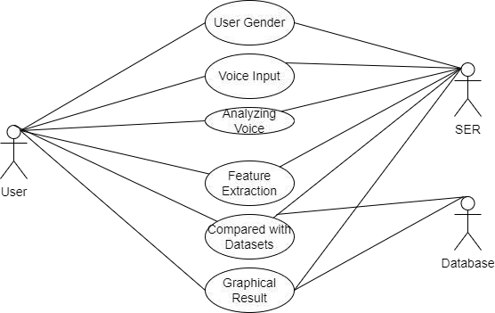


Conceptual/Analysis Modelling
Use case diagram
User Details
Card Details
C o m p a r e Transaction
A n a l y s e transaction
Allow/Block transaction
Graphical Result

Slide 25
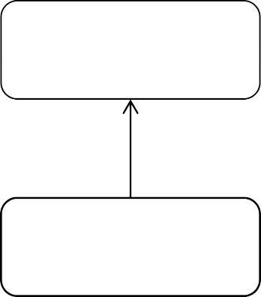
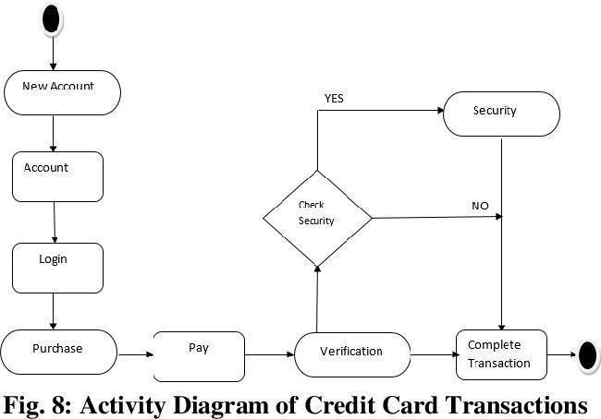
Activity diagram
Inform Cyber Cell
Raise an alarm (SOS alert)

Slide 26
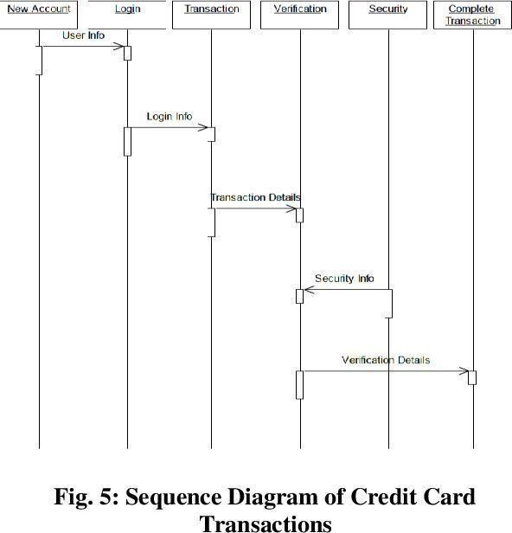
Sequence diagram

Slide 27
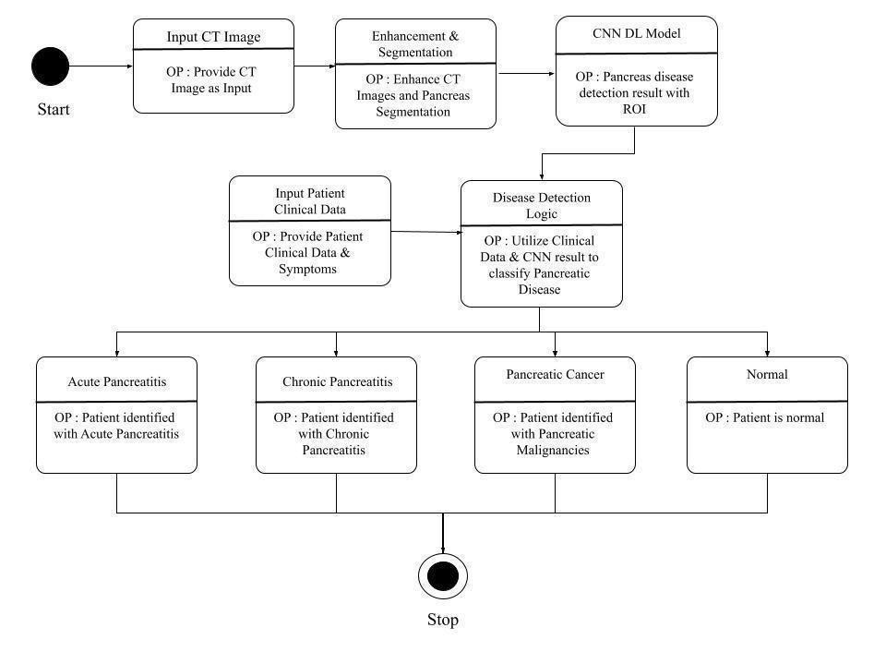
State Diagram
incoming transactions
CC transactions
Hybrid Model
OP : Set of all transactions
OP : includes reward , low interset , credit
OP : Fraud Detection System with ROC
LegitimateTransactions
Fraud Transactions
OP : OTP is sent to User
OP : SMS alert is sent to the user Mobile
OP : Alarm raised and Cyber security is informe
OP : Graphical Output and actions will be taken
Succesful transaction

Slide 28
Software Requirements Specification
Functional Requirements
Data Pre-processing: In this step, the data is collected from various
sources and cleaned, transformed, and prepared for analysis. The data pre- processing includes data cleaning, data integration, data transformation, data reduction, and data normalization
Training: Once the data is pre-processed, the next step is to train the model. In this step, the credit card fraud detection model is trained on a large
dataset of credit card transactions that include both fraudulent and non- fraudulent transactions

Slide 29
Software Requirements Specification
Forecasting: The final step in credit card fraud detection is forecasting. In this step, the trained model is applied to new credit card transactions to detect fraudulent activities in real-time. The forecasting process involves the comparison of new transactions with the trained model's patterns and rules. If a transaction is flagged as fraudulent, the system will immediately block the transaction, preventing the fraudster from making unauthorized purchases.

Slide 30
Software Requirements Specification
Non-Functional Requirements
Accuracy & Performance: Learning algorithm accuracy and precision is important and output is compared to the real true result.
Reliability: Further effort has to be put for reliability in the system, like looking at the reliability of individual ML predictions,
focusing on reliability estimation
Flexibility: The system is required to be flexible and adaptive to similar problems and unseen data.

Slide 31
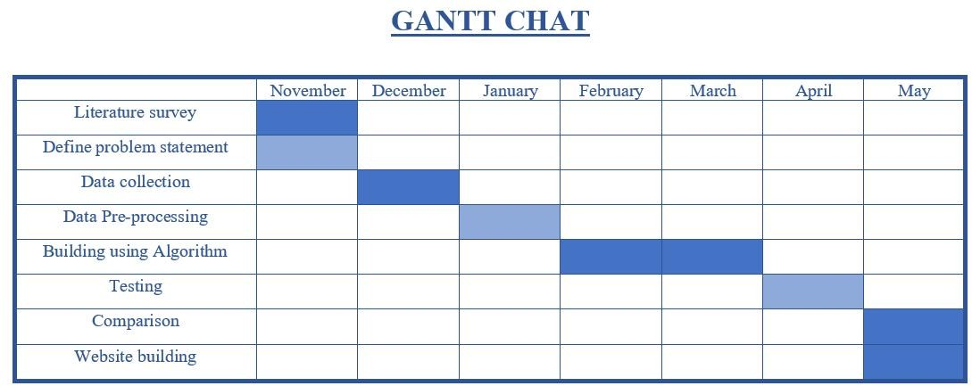
Project Planning / Scheduling
30

Slide 32
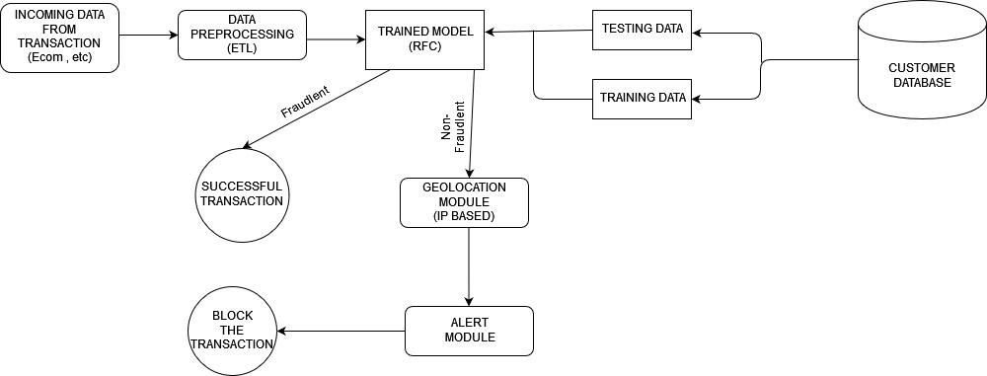
System Design

Slide 33
Module Description
Data preprocessing:
Data pre-processing is used to remove the noisy data ,inconsistent data, remove the missing values.
The ETL steps included are
The Extract step involves gathering data from various sources
The Transform step involves cleaning and processing the data to ensure its quality and consistency.
Finally, in the Load step, the transformed and cleaned data is loaded into a data warehouse or database for analysis.

Slide 34
Training Module:
It consists of the sample output data and the corresponding sets of input data that have an influence on the output. Model validation is a set of processes and activities designed to ensure that an ML/AI model is performing as it should, including both its design objectives and its utility for the end user.
Geolocation Module:
An IP-based geolocation module is a component or service that uses the IP address of a device to determine its geographical location using IPv4 and locate the nearest Cybercell Station . Cybercell team can use geolocation data to detect and prevent fraudulent transactions.

Slide 35
Alert Module:
The messaging module can be integrated into a larger system or can be a standalone application. The messaging module can support various communication channels like SMS, MMS, email, push notifications, instant messaging, and social media messaging.

Slide 36
Component Design/Detailed Class Diagram
Data loading and preprocessing: This component involves loading the dataset and preprocessing it to remove any missing values or outliers.
Data segmentation: This component involves dividing the data into two segments - fraudulent and non-fraudulent transactions.
Exploratory data analysis: This component involves analyzing the dataset to identify any patterns or correlations between the variables.
Model building: This component involves building a Random Forest Classifier model to predict fraudulent transactions.
Model evaluation : This component involves evaluating the performance of the model using metrics such as accuracy, precision.

Slide 37
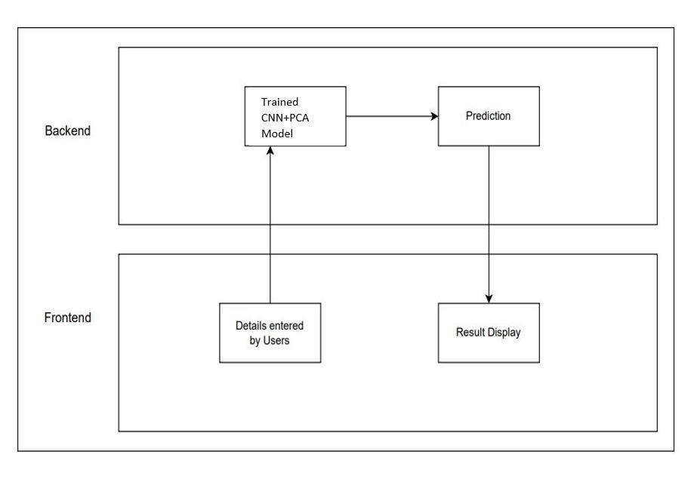
Interface Design
Random Forest

Slide 38
User interface is the front-end application view to which user interacts in order to use the software.
The visual part of a computer application or operating system through which a client interacts with a computer or software.
There are text boxes to enter user details .
There are buttons to predict the transactios and to reset the entered data.

Slide 39
Data Structure Design
Pandas DataFrame: The credit card dataset is loaded into a Pandas DataFrame, which is a two-dimensional table-like data structure with labeled rows and columns. It is used to manipulate and analyze the data, as well as perform operations such as selecting and dropping columns, splitting data into input features and output features, and filtering rows.
NumPy arrays: The input features and output feature of the credit card dataset are converted into Num Py arrays, which are homogeneous arrays of fixed size with efficient element-wise operations. They are used to store and manipulate numerical data and are a popular data structure in machine learning.

Slide 40
StandardScaler: A StandardScaler object is used to scale the input features to have zero mean and unit variance. It is applied to the NumPy arrays of the training and testing sets and is a useful data structure for preprocessing data before applying machine learning models.
Lists: Lists are used to specify the column names to load from the CSV file and to define the input data point to make predictions on.
Variables: Variables are used to store the various objects and data structures, such as the X_train, y_train, and model variables.

Slide 41
Algorithms
Collect the dataset: Gather the credit card data you will use for training and testing your model.
Prepare the data: Preprocess the data, clean it, and transform it into a format that can be used by the algorithm.
Split the data: Split the data into a training set and a testing set. The training set will be used to train the algorithm, and the testing set will be used to evaluate its performance.
Train the model: Fit the Random Forest Classifier to the training data.
Make predictions: Use the trained model to make predictions on the testing data.

Slide 42
Evaluate the model: Measure the performance of the model using various metrics such as accuracy, precision, recall, F1- score, and Matthews correlation coefficient.
Tune the model: If the performance of the model is not satisfactory, you can adjust the hyperparameters of the algorithm to improve its performance.
Deploy the model: Once you are satisfied with the performance of the model, you can deploy it in a production environment to make predictions on new data.

Slide 43
Implementation
First, the necessary packages are imported, including the RandomForestClassifier from sklearn.ensemble.
The credit card transaction data is loaded from a CSV file using Pandas, and a list of columns to use for analysis is created.
The data is then subset using the list of columns, and its shape and descriptive statistics are printed.
The fraction of fraud cases in the dataset is calculated and printed, along with the number of fraudulent and valid transactions.
The amount details of the fraudulent and valid transactions are printed.

Slide 44
Implementation
A correlation matrix is created using the data, and it is displayed as a heatmap using Seaborn.
The data is divided into predictors (X) and target (Y), and then converted to Numpy arrays.
The data is then split into training and testing sets using the train_test_split function from sklearn.model_selection.
A Random Forest Classifier model is created using RandomForestClassifier() from sklearn.ensemble, and then fit to the training data using fit() method.

Slide 45
The model is used to make predictions on the testing data using predict() method.
The performance of the model is then evaluated using various metrics including accuracy, precision, recall, F1- score, and Matthews correlation coefficient. This is done u s i n g m e t h o d s f r o m s k l e a r n . m e t r i c s , s u c h a s accuracy_score(), precision_score(), recall_score(), f1_score(), and matthews_corrcoef(). The results of each metric are printed to the console.

Slide 46
Pseudocode
Import necessary packages
Load the dataset from the csv file using pandas
listofcol = ["Time", "Name", "Phone number", "CVV", "expiry date", "CC 1", "CC2", "CC3", "Location", "CC Status", "Merchant Category Code", "Gateway code", "Frequency", "Customer Behavior", "Amount", "Class"]
data = pd.read_csv("modifycreditcard.csv", usecols=listofcol) 3.Print the shape and descriptive statistics of the data print(data.shape)
print(data.describe())
4.Calculate the fraction of fraud cases in the dataset fraud = data[data['Class'] == 1]
valid = data[data['Class'] == 0] outlierFraction = len(fraud)/float(len(valid))

Slide 47
Print the number of fraud and valid transactions print('Fraud Cases: {}'.format(len(data[data['Class'] == 1])))
print('Valid Transactions: {}'.format(len(data[data['Class'] == 0])))
Print the amount details of the fraudulent and valid transactions print('Amount details of the fraudulent transaction') fraud.Amount.describe()
print('Details of valid transaction') valid.Amount.describe()
Create a correlation matrix and display it as a heatmap corrmat = data.corr()
fig = plt.figure(figsize=(12, 9)) sns.heatmap(corrmat, vmax=.8, square=True) plt.show()

Slide 48
Divide the data into X (predictors) and Y (target) X = data.drop(['Class'], axis=1)
Y = data["Class"]
Convert X and Y to numpy arrays xData = X.values
yData = Y.values
Split the data into training and testing sets xTrain, xTest, yTrain, yTest = train_test_split( xData, yData, test_size=0.2, random_state=42)
Create a Random Forest Classifier and fit it to the training data rfc = RandomForestClassifier()
rfc.fit(xTrain, yTrain)
Make predictions on the testing data using the trained model yPred = rfc.predict(xTest)

Slide 49
13. Evaluate the performance of the model using various metrics, including accuracy, precision, recall, F1-score, and Matthews correlation coefficient
n_outliers = len(fraud)
n_errors = (yPred != yTest).sum()
print("The model used is Random Forest classifier") acc = accuracy_score(yTest, yPred)
print("The accuracy is {}".format(acc)) prec = precision_score(yTest, yPred) print("The precision is {}".format(prec)) rec = recall_score(yTest, yPred) print("The recall is {}".format(rec))
f1 = f1_score(yTest, yPred) print("The F1-Score is {}".format(f1))
MCC = matthews_corrcoef(yTest, yPred)
print("The Matthews correlation coefficient is{}".format(MCC))

Slide 50
Conclusion
In this project, Machine Learning techniques like Decision Tree and Random Forest were used to detect the fraud in credit card system.
Sensitivity, Specificity, Accuracy and Error rate are used to evaluate the performance for the proposed system.

Slide 51
Future Enhancement
In our project the following enhancemnts are to be included -
SMS Module :SMS will be triggered upon fraud detection
Geolocation Module

Slide 52
References
S. Xuan, G. Liu, Z. Li, L. Zheng, S. Wang, and G. N. Surname, “Random forest for credit card fraud detection”, IEEE 15th International Conference on Networking, Sensing and Control (ICNSC) , pp.123-345 , 2022.
Satvik Vats, Surya Kant Dubey, Naveen Kumar Pandey, “A
Tool for Effective Detection of Fraud in System”, published in International
Credit Card Journal of
Communication Network Security ISSN: 2231
– 1882, Volume-2, Issue-1, 2022.

Slide 53
References
Rinky D. Patel and Dheeraj Kumar Singh, “Credit Card Fraud Detection & Prevention of Fraud Using Genetic Algorithm”, published by International Journal of Soft Computing and Engineering (IJSCE) ISSN: 2231-2307, Volume-2, Issue-6, January 2019.
Rinky D. Patel and Dheeraj Kumar Singh, “Credit Card Fraud Detection & Prevention of Fraud Using Genetic Algorithm”, published by International Journal of Soft Computing and Engineering (IJSCE) ISSN: 2231-2307, Volume-2, Issue-6, January 2019.

Slide 54
References
5Wen-Fang YU, Na Wang,“ Research on Credit Card Fraud Detection Model Based on Distance Sum”, published by IEEE International Joint Conference on Artificial Intelligence, pp.243- 256 , 2020.
6Andreas L. Prodromidis and Salvatore J. Stolfo; "Agent-Based Distributed Learning Applied to Fraud Detection"; Department of Computer Science- Columbia University, pp.145-167 , 2021.
7 P. K. Chan, W. Fan, A. L. Prodromidis, and S. J. Stolfo,
„„Distributed data mining in credit card fraud detection,‟‟ IEEE Intell. Syst. Appl., pp. 67–74, 2022.

Slide 55
References
8Soltani, N., Akbari, M.K., SargolzaeiJavan, M., “A new user-based model for credit card fraud detection based on artificial immune system,” Artificial Intelligence and Signal Processing (AISP),16th CSI International Symposium on., IEEE, pp. 029- 033, 2021.
9S. Ghosh and D. L. Reilly, “Credit card fraud detection with a neural network”, Proceedings of the 27th Annual Conference on System Science, Volume 3: Information Systems: DSS/ Knowledge Based Systems, pp.621-630, 2021.
10MasoumehZareapoor, seeja.K.R, M.Afshar.Alam, “Analysis of Credit Card Fraud Detection Techniques: based on Certain Design Criteria”, International Journal of Computer Applications , pp. 975 – 8887 , Volume 52– No.3, 2021.

Slide 56
THANK YOU

