Slide 1

BANGALORE INSTITUTE OF TECHNOLOGY
K. R. Road, V. V. Puram, Bengaluru - 560 004
DEPARTMENT OF COMPUTER SCIENCE AND ENGINEERING
Internship on
“Online General Store Website”
Presented by Akash Jain 1BI19CS011
Under the Guidance of
Dr. Maya B.S
Assistant Professor Department of CS&E BIT, Bengaluru
Y Vishnuvardhan
Team Lead
Exposys Data Labs Pvt. Ltd. Bangalore

Slide 2
AGENDA
About the Organization
About the Department
Introduction
System Architecture
Tasks Performed
Tools/Technologies
Implementation
Results
Reflection Notes
Conclusion

Slide 3
About the Organization
Exposys Data Labs founded in 2017 aims to solve real world business problems like Automation, Big Data and data Science. Their core team of experts in various technologies help businesses to identify issues, oppurtunities and prototype solutions using trending technologies like AI, ML, Deep Learning and Data Science. They follow a human-focussed and not technology driven approach to achieve success in their clients endeavours.
Specialized in enabling organizations meet their goals through our customized solutions in:
Software Development
Web Application Development
IT out sources services
Exposys Data Labs builds applicationns for business and customers with a motto of :
“Our discoveries are beyond belief and if you’re with us, you’ll discover a newer way to think!”

Slide 4
What Exposys Data Labs does ?
DELIVER VALUE & QUALITY : believe in creating value based solutions with world class quality which can be delivered in flexible timelines
HAVE STRONG CAPABILITIES : blend cutting edge technologies with the potential business acumen
to deliver quality e-business solutions for online enterprises
UNDERSTAND WHAT YOU NEED : believe in transforming your imagination into reality and are well-equipped brand with an experienced team to deliver your dream
CREATE YOUR DIGITAL IDENTITY : with the combination of business domain knowledge and technology, we deliver result-oriented solutions in a cost-effective manner to maximize your productivity.

Slide 5
About the Department
Web Application development department :
Exposys Data Labs is focused on helping brands grow through digital transformation services.
Their software and hardware, design and development services range from business-critical applications to powerful Augmented and Virtual Reality applications that push the boundaries of consumer, industrial, experiential, and commerce applications for the world’s most innovative brands.
As a recognized global leader in development and design, their proactive growth model empowers their clients to exceed their goals while integrating their team with theirs.
They combine powerful technologies, stunning visuals, and innovative strategies to tell your
organization’s story while delivering data-driven results.
•

Slide 6
INTRODUCTION
Online shopping is a form of electronic commerce which allows consumers to directly buy goods or services from a seller over the Internet using a web browser or a mobile app.
Consumers find a product of interest by visiting the website of the retailer directly or by searching among alternative vendors using a shopping search engine, which displays the same product's availability and pricing at different e-retailers.
An online shop evokes the physical analogy of buying products or services at a regular "bricks-and- mortar" retailer or shopping center, the process is called business-to-consumer (B2C) online shopping.
Online customers must have access to the Internet and a valid method of payment in order to complete a transaction, such as a credit card, a debit card, or other means.
4/24/2023
6

Slide 7
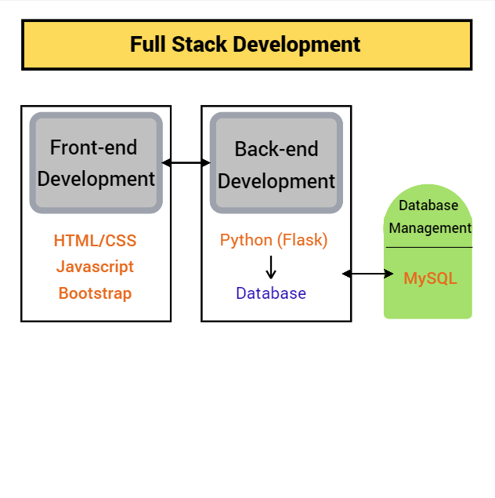
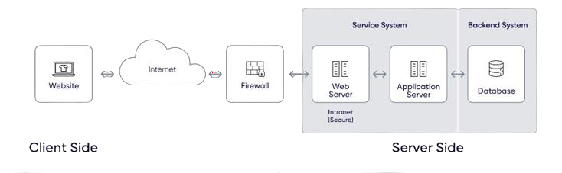
System Architecture

Slide 8
Tasks Performed
During the internship I worked on the frontend part of E-commerce Website.
I worked on the following sections –
Created the Navigation Bar on the homepage
Worked on Features & Products section of the website
Used Bootstrap templates to make design more attractive
Routing of the different sections on the same page
Participated in all over overview of the website –
Add to Cart functionality
Login/Logout page
Backend functionality (Database connection to the backend)

Slide 9


Tools/Technologies
HTML
The HyperText Markup Language or HTML is the standard markup languages for documents designed to be displayed in a web browser. It is often assisted by technologies such as Cascading Style Sheets (CSS) and scripting languages such as JavaScript.
CSS
Cascading Style Sheets (CSS) is a style sheet language used for describing the presentation of a document written in a markup language such as HTML or XML (including XML dialects such as SVG, MathML or XHTML). CSS is a cornerstone technology of the World Wide Web, alongside HTML and JavaScript.

Slide 10


Bootstrap
Bootstrap is an HTML, CSS and JS library that focuses on simplifying the development of informative web pages (as opposed to web applications). The primary purpose of adding it to a web project is to apply Bootstrap's choices of color, size, font and layout to that project. Bootstrap provides basic style definitions for all HTML elements.
MySQL
MySQL is an open-source relational database management system (RDBMS). In addition to relational databases and SQL, an RDBMS like MySQL works with an operating system to implement a relational database in a computer's storage system, manages users, allows for network access and facilitates testing database integrity and creation of backups.

Slide 11

Python(Flask
)
Flask is a micro web framework written in Python. It is classified as a microframework because it does not require particular tools or libraries. It has no database abstraction layer, form validation, or any other components where pre-existing third-party libraries provide common functions. However, Flask supports extensions that can add application features as if they were implemented in Flask itself.

Slide 12
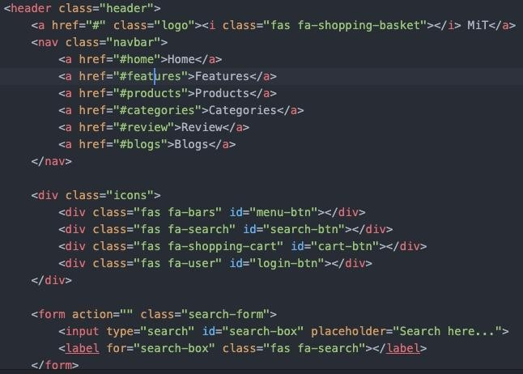
Implementation
Fig.1. Navigation Bar
Homepage –
I created the frontend for Navigation Bar and when user click any of the options, the user is routed to that particular section.
I used Bootstrap card template to create Features and Products sections
I used basic javascript to make more responsive Add to Cart & Login/Logout functionality.
Fig.2 HTML Code Snippet

Slide 13
2) Products section –
Browse products – User can see all the different products. GET request is done from backend to add products to the cart.
User can all view rating and the cost of the product on the frontend side.
Backend Process –
The admin can manage their uploaded products using SQL queries maintained in the database.
Admin can update a product : For updating the product is first retrieved from the database using product id and it is displayed to the admin. Once the admin is done with the update new data is send to the backend with a PUT request.
Admin can delete a product : Admin can delete a product by clicking on delete button which will send a DELETE request to the backend.

Slide 14
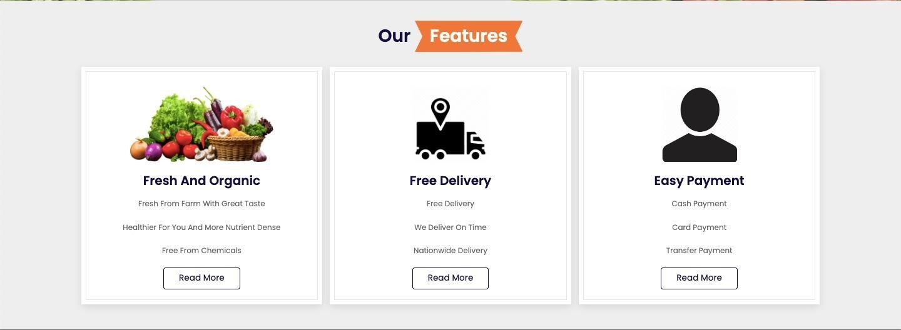
4) Features Section
Information about the items(Delivery & Payment) :
Users can read the details of the items available on the website
Users can go through the delivery policy and can avail option of their choice. So on order processing, the option is stored on database and the link of the same is send to the backend by POST request.
User can also learn about different payment policy and related discount offers(if any) Once the user add any item into the cart the status of the order will be pending in the database. Once the user clear the payment, the status will be approved, and it will be shown in the frontend.
Fig.3 Features section

Slide 15
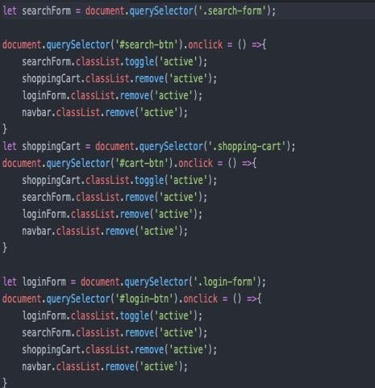
5) Other Functionalities
User login : User credentials are captured and POST request is send to the backend
to verify the credentials.
Add to Cart : Users can view the products added into the cart using GET request in the backend and when the user click on the checkout button, a GET request is sent to the backend for further steps.
Footer :A wholesome display of the information and the related links of the social media of the company.
Fig.4 Javascript Code Snippet

Slide 16
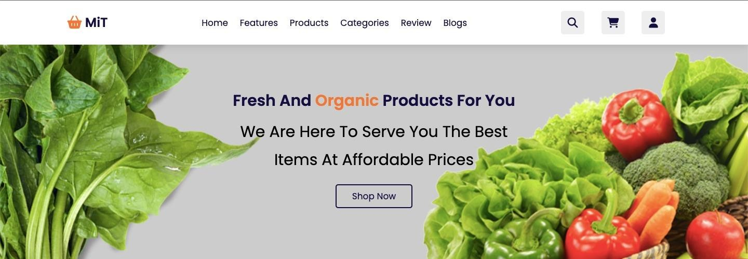
Results
Fig. 5 Navigation Bar section

Slide 17

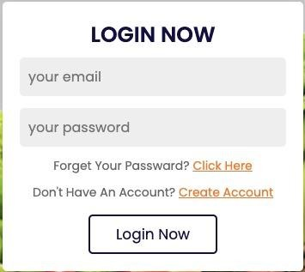
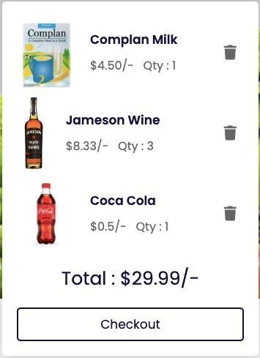
Fig. 6 Search Bar
Fig.7 Login page
Fig.8 Cart page

Slide 18
Fig. 9 Features section

Slide 19
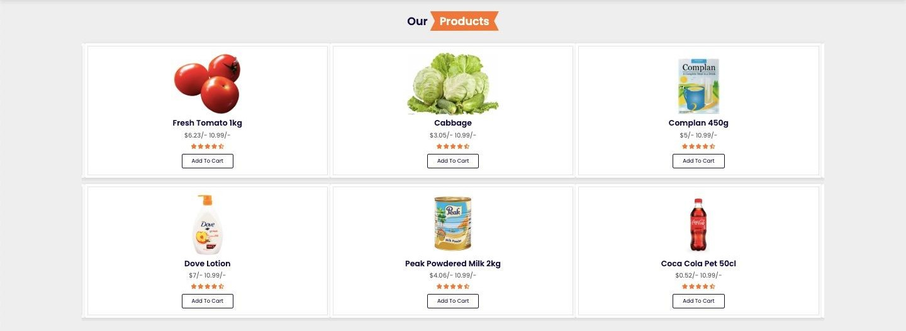
Fig. 10 Products section

Slide 20
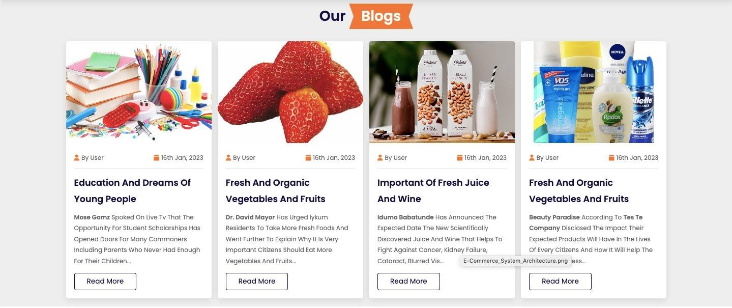
Fig.11 Blogs section

Slide 21
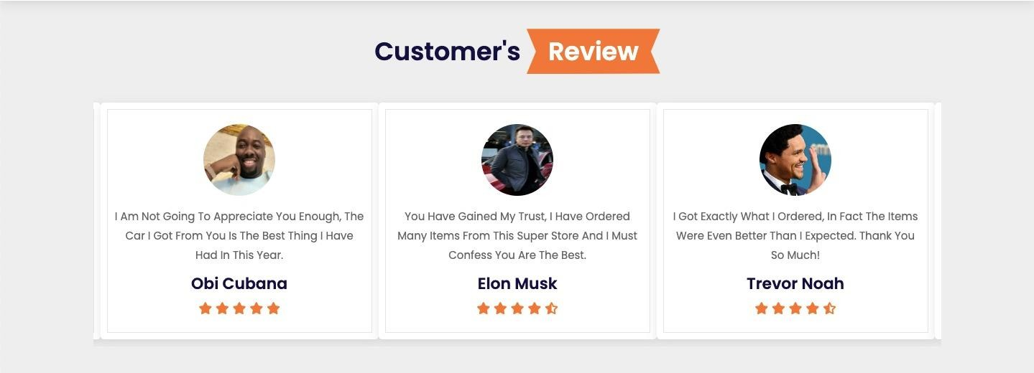
Fig.12 Customer’s Review section

Slide 22
Reflection Notes
I am thankful to having the opportunity to work with Exposys Data Labs because I discovered a program that I would like to work with and at the same time gained fabulous ideas to develop projects on Web Development.
The time I spent at Exposys Data Labs as an intern was a memorable one for me as it was rich in experience sharing and helped me discover my potential.
I had so many experiences and opportunities that I personally believe will forever shape and influence my professional life while fostering personal growth and development.
To enhance my knowledge and skills, Exposys Data Labs gave me the opportunity to intern with their
project for a period of 4 weeks.
It has been a great pleasure working and getting qualified with colorful grades from Exposys Data Labs as it has provided me a great opportunity to learn leadership skills.

Slide 23
Conclusion
I would like to conclude that It has been a great opportunity to work with such a good company with a good team. Firstly, I would also like to thank my Computer Science department for making me capable to grab such amazing opportunities. This internship gave me a confidence to work in a team and gave me industrial exposure. I understood how to deploy a website on a live server using a domain name and I learned ways to use dynamic input.

Slide 24
THANK YOU

