Slide 1
Technical seminar on "WEAPON DETECTION IN CCTV IMAGE USING DEEP LEARNING”
By:
Akash Jain (1BI19CS011)
Under the Guidance
of
Dr. Maya B.S
Assistant Professor

Slide 2
Agenda
INTRODUCTION
OBJECTIVES
LITERATURE REVIEW
PROPOSED SYSTEM
APPLICATIONS
REFERENCES

Slide 3
INTRODUCTION
DOMAIN KNOWLEDGE
The global death toll from use of guns may be as high as 1,000 dead each day. From street crimes to an individual institution attack, many precious lives suffered.
The main aim of object classification is to identify the features of an image with more accuracy. Object classification combines object localization and object detection to classify objects in an image or video.
DNN based regression is used in object detection to detect low-resolution images and helps to capture detailed information about the objects. CNN is a deep learning technique used to detect objects from an image and analyze the visual imagery of an image.

Slide 4
OBJECTIVES
The goal is to build a CNN Attuned Object Detection Scheme (AODS) is initiated for harmful object detection from CCTV inputs.
Once a CNN is built, it can be used to classify the contents of different images.
CNNs can classify images by detecting features, like how the human brain detects features to identify objects. Images are made up of pixels.

Slide 5
LITERATURE REVIEW
"Firearm Detection and Segmentation Using an Ensemble of Semantic Neural Networks," 2019 European Intelligence and Security Informatics Conference (EISIC),
The paper was published in year 2019
Proposed System:
This paper is based on a weapon detection system that was developed using deep Convolutional Neural Networks (CNNs) for detecting individual parts of a firearm in images and videos.
The proposed method can be used for real-time detection of weapons in places where video surveillance is available (e.g., airports, stadiums, other public places),

Slide 6
Methodology:
This paper is based on detecting weapons based on deep learning method called CNN.
Pros:
The obtained detection model shows a high potential even in low quality videos and provides satisfactory results as an automatic alarm system.

Slide 7
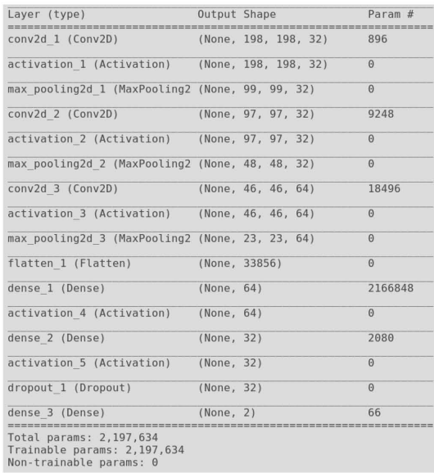
Architecture:

Slide 8
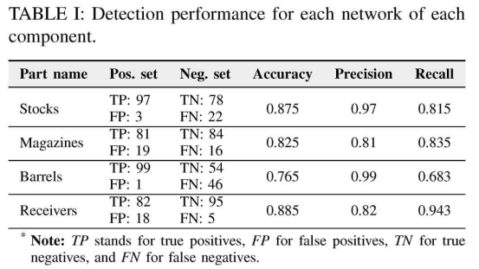

Slide 9
“Real-time concealed object detection from passive millimeter wave images based on the YOLOv3 algorithm,” L. Pang, H. Liu, Sensors,
This paper was published in year 2020
Proposed System:
This paper focused on the real-time metal contraband detection from human body for PMMW images with a small sample dataset and YOLOv3 algorithms.
Methodology:
The Yolov3-13 and Yolov3-53 target detection models with different convolutional layers were trained, and their advantages and disadvantages were analysed.

Slide 10
Pros:
The experiments shown that the YOLOv3-based contraband detection method for the PMMW images and can do the real-time detection even during large passenger flows.
In terms of detection accuracy, detection speed, and computation resource, the YOLOv3-53 model is more better and effective, even with an insufficient sample dataset.

Slide 11
"Real-time gun detection in CCTV: An open problem.“, González, Jose L. Salazar, Carlos Zaccaro, Juan A. Álvarez-García, Neural networks
This paper was published in year 2020
Proposed System:
In this paper, it presented the behaviour of a Faster R-CNN object detector using FPN and trained using synthetic and real images in a real CCTV
using artificial datasets and trained Faster–RCNN using Feature Pyramid Network with Resnet50 and improves the previous state of the art by 3.91 %.
Methodology:
R-CNN and RESNET-50

Slide 12
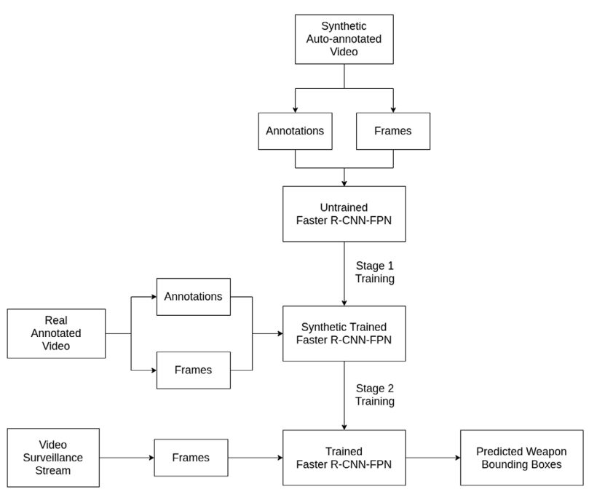
Limitations:
Because of the small size of weapons at that distance and the partial in many frames, weapon detection in real CCTV scenarios is a challenging task to perform.
Architecture:

Slide 13
“Weapon Detection in Real-Time CCTV Videos Using Deep Learning,“, M. T. Bhatti, M. G. Khan, in IEEE Access,
This paper was published in 2021.
Proposed System:
This work has presented a novel automatic weapon detection system in real-time.
Focused on detecting the weapon in live CCTV streams and at the same time reduced the false negatives and positives

Slide 14
Methodology :
Yolov4 gave very few false positive and negative values, hence achieved the most successful results.
It gave 91.73% mean average precision (MAP) and a F1-score of 91% with almost 99% confidence score on all types of images and videos.
Limitations:
The false positives and negatives even more as there is still a need for improvement.

Slide 15
“Feedback-based object detection for multi-person pose estimation”, Jaeseo Park, Signal Processing: Image Communication,
This paper was published in 2021.
Proposed System:
proposed a novel methodology for re-calibrating and optimizing object detectors for MPPE
presented a feedback-based loss optimization that uses keypoint prediction accuracy as a penalty for the bounding box detectors.
The proposed bounding box expander reduces the feature loss during the key-point estimation step.

Slide 16
Pros:
The experimental results showed that the proposed loss function and bounding box expansion method can perform real-time operations at 11 fps, which is similar to the performance of baseline models.
In addition, the proposed model achieved an accuracy of 74.2 AP, which is higher than the latest model including the human detector used in the experiment.

Slide 17
“Using human pose information for handgun detection”, Velasco-Mata, A, Neural Comput & Applic 33,
This paper was published in 2021.
Proposed System:
A novel method that combines in the same architecture the visual appearance of the handgun with the 2D human pose information is proposed.
There are certain situations in which the object cannot be viewed correctly due to camera distance, poor lighting conditions or partial or total occlusion
Methodolgy:
HRC+P (Hand Region Classifier + Pose data), using YOLOv3, this model identifies weapon focussing on hand and pose data.

Slide 18
Pros:
The tests performed with the different datasets show that the proposed method using the pose combination obtains better results in all cases.
Limitations:
In real scenarios common hand-held objects such as cell phones, keys or wallets may be an important source of false positives.

Slide 19
‘‘Automatic handgun detection with deep learning in video surveillance images’’ J. Salido, V. Lomas ,Appl. Sci.,
This paper was published in 2021.
Proposed System:
Two main purposes of this work were:
The analysis of three object CNN-based detection models applied to handgun detection; and
The analysis of the influence of incorporating explicit pose information on the quality of the results of such learning models
Methodology:
YOLOv3
The Faster R-CNN

Slide 20
“Adaptive Technique for Brightness Enhancement of Automated Knife Detection in Surveillance Video with Deep Learning”, Galab, M.K.,Arab J Sci Eng 46, 4049–4058 (2021)
Proposed System:
In this paper, the problem of light reflection is addressed in knife detection.
This paper presents an adaptive technique for brightness enhancement of knife detection in surveillance systems.
This technique overcomes the brightness problem that faces the steel weapons and improves the knife detection process

Slide 21
Methodology:
Applying DL as a feature extractor and a classifer makes the proposed technique very suitable for real-life situations.
We analyze the CNN pre-trained networks to select the best network in the detection process for the knives.
It achieves an accuracy, specifcity, sensitivity, and F1-score equal to 99.38%, 99.1%, 98.3%, and 96.1%, respectively.

Slide 22
“A multi-stream CNN for deep violence detection in video sequences using handcrafted features”. Mohtavipour, S.M., Saeidi, Vis Comput 38,
This paper was published in 2022.
Proposed System:
This paper introduced a novel multi-stream CNN for deep violence detection that covered most aspects of abnormal behaviour between persons.
The proposed network architecture included two handcrafted and deep learning parts which are used for feature extraction and data classification.

Slide 23
Methodology:
DMOF and DMEI were two novel discriminative features that trained well the CNN network to predict all input frames of datasets.
Pros:
The experimental results showed that violence detection accuracy is obtained approximately 100% for both crowded and uncrowded environments.
After the training phase of the network, processing time for evaluation of one sample is obtained about 0.14 s which is suitable for online violence detection

Slide 24
PROPOSED SYSTEM
"A neural network aided attuned scheme for gun detection in video surveillance images.“, Manikandan, V. P., and U. Rahamathunnisa, Image and Vision Computing
This paper was published in 2022.
Proposed System:
This article introduces an attuned object detection scheme for high accuracy hazardous object detection from CCTV images.
The Attuned Object Detection Scheme and other methods will be considered for this several have been proposed for the problem of action recognition.

Slide 25
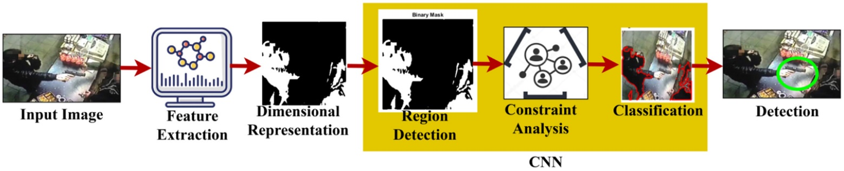
Architecture

Slide 26
APPLICATIONS
The applications of the proposed system are as follows:
Weapon detection in surveillance systems.
Detection of weapon using pose information.
Cold steel weapon detection.

Slide 27
REFERENCES
[1] M. T. Bhatti, M. G. Khan, M. Aslam and M. J. Fiaz, "Weapon Detection in Real-Time CCTV Videos Using Deep Learning," in IEEE Access, vol. 9, pp. 34366-34382, 2021,
[2] Galab, M.K., Taha, A. & Zayed, H.H. “Adaptive Technique for Brightness Enhancement of Automated Knife Detection in Surveillance Video with Deep Learning”. Arab J Sci, vol 46, pp.4049–4058 (2021)”
[3] A. Egiazarov, V. Mavroeidis, F. M. Zennaro and K. Vishi, "Firearm Detection and Segmentation Using an Ensemble of Semantic Neural Networks," 2019 European Intelligence and Security Informatics Conference (EISIC), pp.70-77, 2019

Slide 28
[4] L. Pang, H. Liu, Y. Chen, and J. Miao, “Real-time concealed object detection from passive millimeter wave images based on the YOLOv3 algorithm,” Sensors, vol. 20, no. 6, p. 1678, 2020.
[5] Mohtavipour, S.M., Saeidi, M. & Arabsorkhi, A” A multi-stream CNN for deep violence detection in video sequences using handcrafted features”. Vis Comput vol. 38, Pages 2057–2072 (2022).
[6] González, Jose L. Salazar, Carlos Zaccaro, Juan A. Álvarez-García, Luis M. Soria Morillo, and Fernando Sancho Caparrini. "Real-time gun detection in CCTV: An open problem." Neural networks vol. 132, Pages 297-308 (2020):

Slide 29
[7] J. Ruiz-Santaquiteria, A. Velasco-Mata, N. Vallez, G. Bueno, J. A. Álvarez-García and O. Deniz, "Handgun Detection Using Combined Human Pose and Weapon Appearance," in IEEE Access, vol. 9, pp. 123815-123826, 2021
[8] J. Salido, V. Lomas, J. Ruiz-Santaquiteria, and O. Deniz, ‘‘Automatic handgun detection with deep learning in video surveillance images,’’ Appl. Sci., vol. 11, no. 13, Pages 6085, Jun. 2021.
[9] Jaeseo Park, Junho Heo, Suk-Ju Kan“Feedback-based object detection for multi-person pose estimation,Signal Processing”: Image Communication,Volume 99,2021,

Slide 30
[10] Manikandan, V. P., and U. Rahamathunnisa. "A neural network aided attuned scheme for gun detection in video surveillance images." Image and Vision Computing 120 (2022).

