Slide 1

BANGALORE INSTITUTE OF TECHNOLOGY K. R. Road, V. V. Pura, Bengaluru – 560004 Department of Computer Science and Engineering
WEAPON DETECTION IN SURVIELLANCE USING DEEP LEARNING METHODS
By:
Akash Jain(1BI19CS011)
Under the Guidance
of
Dr. Maya B.S
Assistant Professor
Dept. of CSE

Slide 2
Agenda
Introduction
Literature Review
Problem Statement
Proposed System
Architecture
Methodology/Algorithm
Results ( Graph/Tables)
Applications
Conclusion
References.

Slide 3
INTRODUCTION
Introduction:
The global death toll from use of guns may be as high as 1,000 dead each day. From street crimes to an individual institution attack, many precious lives suffered.
The main aim of object classification is to identify the features of an image with more accuracy. Object classification combines object localization and object detection to classify objects in an image or video.
Domain: Deep Neural Network & Object Detection.

Slide 4
LITERATURE REVIEW
SL.No | Title | Author | Year of Publication | Adopted Methodology | Limitations
1 | Firearm Detection and Segmentation Using an Ensemble of Semantic Neural Networks | Alexander Egiazarov, Vasileios Mavroeidis, | 2019 (IEEE) | Fully Convolutional Network (FCN), Faster R-CNN (Region-based Convolutional Neural Network) | result in poor performance when the model is deployed in real-world scenarios.
2 | Real-time concealed object detection from passive millimeter wave images based on the YOLOv3 algorithm | L. Pang, H. Liu, Y. Chen | 2020 (sensors) | Yolov3-53 target detection model along Faster R-CNN. | Equipment limitations and Real-world implementation
3 | Real-time gun detection in CCTV: An open problem. | Jose L. Salazar, Carlos Zaccaro, Juan A. | 2020 (Elsevier) | Faster-RCNN, and RESNET-50 | Framework accuracy is 92%
4 | Weapon Detection in Real-Time CCTV Videos Using Deep Learning | M. T. Bhatti, M. G. Khan | 2021 (IEEE) | Faster R-CNN Inception ResNetV2, and YOLOv4. | The paper only reports F1-score, mean average precision, and recall as evaluation metrics
5 | Feedback-based object detection for multi-person pose estimation | Jaeseo Park, Junho Heo, Suk-Ju | 2020 (Elsevier) | MPPE network and an Rmpe-based model with Yolov3. | The proposed method involves modifying the object detector, which increases the training time up to 2.2 times per epoch

Slide 5
SL.No | Title | Author | Year of Publication | Adopted Methodology | Limitations
6 | Using human pose information for handgun detection | A. Velasco-Mata, N. Vallez, G. Bueno, J. A. Álvarez-García | 2021 (IEEE) | HRC+P (Hand Region Classifier + Pose data), using YOLOv3 | common hand-held objects such as cell phones, keys or wallets may be source of false positives
7 | Automatic handgun detection with deep learning in video surveillance images | J. Salido, V. Lomas, J. Ruiz Santaquiteria | 2021 (MDPI) | YOLOv3, Faster R-CNN | addition of pose information to the dataset slightly worsened the handgun detection
8 | Adaptive Technique for Brightness Enhancement of Automated Knife Detection in Surveillance Video | Galab, M.K., Taha, A. & Zayed | 2021 (Arab J Science) | pre-trained CNN models, including AlexNet, GoogLeNet, VGGNet, and ResNet | Limited applicability of model.
9 | A multi-stream CNN for deep violence detection in video sequences. | Authors- Mohtavipour, S.M., Saeidi | 2022 (Springer) | DMOF and DMEI trained on CNN | reduced performance of the proposed architecture when tested on combinational datasets
10 | A neural network aided attuned scheme for gun detection in video surveillance images | Manikandan, V. P., and U. Rahamathunisa | 2022 (Springer) | Convolutional Neural Networks (CNNs), Differential analysis | Computational time, Limitations in dimensional representation

Slide 6
Problem Statement:
To solve the accurate detection of hazardous objects like guns in CCTV images while reducing errors, complexity, and computation constraints. The proposed model uses a convolutional neural network with constraint mitigation to achieve this goal
Input: External dataset consisting of videos and images of harmful objects in CCTV.
Output: a label indicating the presence or absence of a hazardous object in the given image.

Slide 7
Proposed System
Attuned object detection scheme for hazardous object from CCTV images:
The use of a convolutional neural network (CNN) with constraint mitigation to classify and detect hazardous objects like guns in CCTV images.
Detection and classification of regions using dimension representation and Recurrent analysis until the detected region can represent error-free dimensions.
The proposed model uses an α-β representation for multiple instances, which prevents errors in computation .

Slide 8
Proposed System
Hidden layer computation analysis:
The limitations in each region are analysed using the hidden layer computations of the learning process.
It involves the use of convolutional layers and pooling layers, which are used to extract and compress the features of the input image..
They allow the neural network to extract and learn the important features of the input image, which are then used to accurately classify the object.

Slide 9
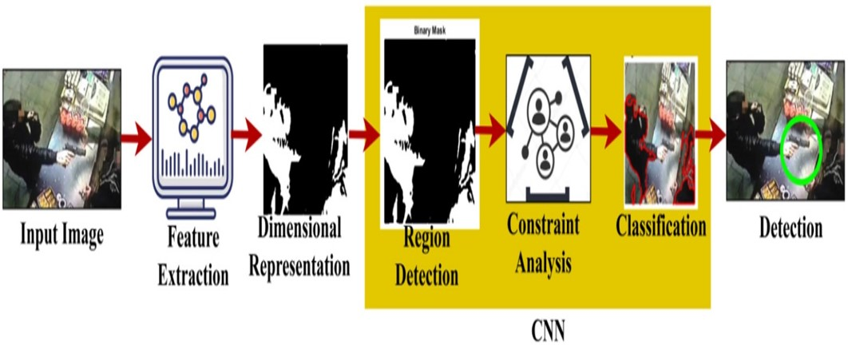
Architecture
Fig. 1: CNN Attuned Object Detection Scheme (AODS) process

Slide 10
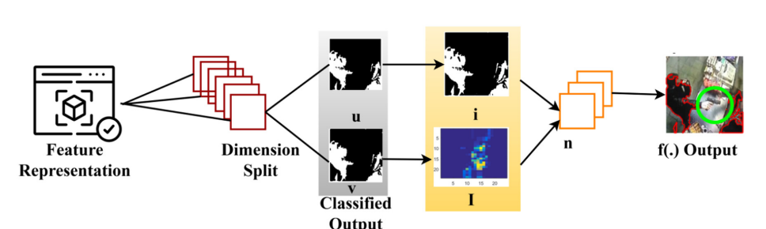
Architecture
Fig. 2 Model Overview

Slide 11
Methodology
Data Pre-processing:
First, the input image is converted to grayscale and resized to a standard size.
The image is pre-processed using Histogram of Oriented Gradients (HOG) and Local Binary Patterns (LBP) features to extract relevant information from the image.
After extracting these features, the image is segmented into regions of interest (ROIs) using the Selective Search algorithm.
The CNN is trained using an external dataset and the SoftMax classifier is used to classify the ROIs into hazardous or non-hazardous objects.

Slide 12
Methodology
Model training on external dataset:
The extracted features are used to train the model using a labelled dataset. During training, the model learns to classify objects based on the extracted features.
The proposed scheme also uses an external dataset to improve the accuracy of the model. The external dataset is used to fine-tune the CNN and improve its ability to classify objects accurately.
Overall, the model training process involves iterative training and validation steps to ensure that the model is accurate and reliable.

Slide 13
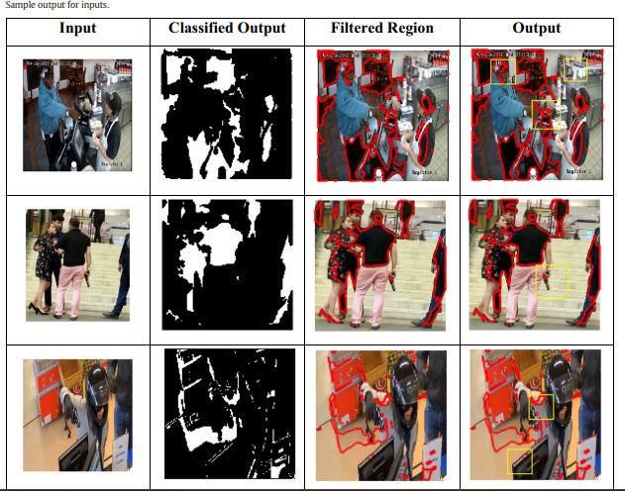
Methodology
Fig. 3: Sample Outputs for Input

Slide 14
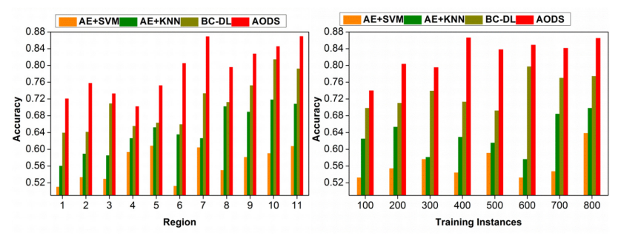
Results
The proposed attuned object detection scheme achieved an accuracy of 91.8% on the test dataset.
The accuracy improved to 99.07% with the addition of an external dataset for training.
The proposed scheme showed an improvement in accuracy by 8.08%, reduced error by 7.47% and complexity by 8.23% compared to other methods.
Fig. 6.a Accuracy Comparison among AODS, and other models.

Slide 15
Applications
Applications in security and surveillance systems where it can be used for identifying hazardous objects such as guns or explosives.
It can also be used by law enforcement agencies to track and identify suspects carrying dangerous weapons in crowded places
The model can be used for automated surveillance in industries and factories to detect any hazardous objects that can pose a threat to workers' safety.

Slide 16
Conclusion
The article presents a novel attuned object detection scheme for accurately detecting hazardous objects such as guns from CCTV images.
The proposed scheme employs a combination of dimension representation, region detection and classification using a convolutional neural network with constraint mitigation to achieve high accuracy and error reduction.
The results obtained show that the proposed scheme outperforms existing methods in terms of accuracy, error reduction, and complexity. The scheme has potential applications in various fields such as surveillance, law enforcement, and security
Future enhancements can be –
Incorporating object classification based on labels for identifying object categories and
Improving object detection for high-speed framed inputs.

Slide 17
REFERENCES
[1] M. T. Bhatti, M. G. Khan, M. Aslam and M. J. Fiaz, "Weapon Detection in Real-Time CCTV Videos Using Deep Learning," in IEEE Access, vol. 9, pp. 34366-34382, 2021,
[2] Galab, M.K., Taha, A. & Zayed, H.H. “Adaptive Technique for Brightness Enhancement of Automated Knife Detection in Surveillance Video with Deep Learning”. Arab J Sci, vol 46, pp.4049–4058 (2021).
[3] A. Egiazarov, V. Mavroeidis, F. M. Zennaro and K. Vishi, "Firearm Detection and Segmentation Using an Ensemble of Semantic Neural Networks," 2019 European Intelligence and Security Informatics Conference (EISIC), pp.70-77, 2019.
[4] L. Pang, H. Liu, Y. Chen, and J. Miao, “Real-time concealed object detection from passive millimeter wave images based on the YOLOv3 algorithm,” Sensors, vol. 20, no. 6, p. 1678, 2020.

Slide 18
[5] Mohtavipour, S.M., Saeidi, M. & Arabsorkhi, A” A multi-stream CNN for deep violence detection in video sequences using handcrafted features”. Vis Comput vol. 38, Pages 2057–2072 (2022).
[6] González, Jose L. Salazar, Carlos Zaccaro, Juan A. Álvarez-García, Luis M. Soria Morillo, and Fernando Sancho Caparrini. "Real-time gun detection in CCTV: An open problem." Neural networks vol. 132, Pages 297-308 (2020)
[7] J. Ruiz-Santaquiteria, A. Velasco-Mata, N. Vallez, G. Bueno, J. A. Álvarez-García and O. Deniz, "Handgun Detection Using Combined Human Pose and Weapon Appearance," in IEEE Access, vol. 9, pp. 123815-123826, 2021.

Slide 19
[8] ] J. Salido, V. Lomas, J. Ruiz- Santaquiteria, and O. Deniz, ‘‘Automatic handgun detection with deep learning in video surveillance images,’’ Appl. Sci., vol. 11, no. 13, Pages 6085, Jun. 2021
[9] Jaeseo Park, Junho Heo, Suk-Ju Kan "Feedback-based object detection for multi-person pose estimation, Signal Processing”: Image Communication, Volume 99,2021.
[10] Manikandan, V. P., and U. Rahamathunnisa. "A neural network aided attuned scheme for gun detection in video surveillance images." Image and Vision Computing 120 (2022)..

