Slide 1
Potato ai Disease Detection for Healthy Harvests
Akash Kadia

Slide 2
Flow structure
Project Inspiration
Features
Model
Challenges
Further Development

Slide 3
Project inspiration

Slide 4
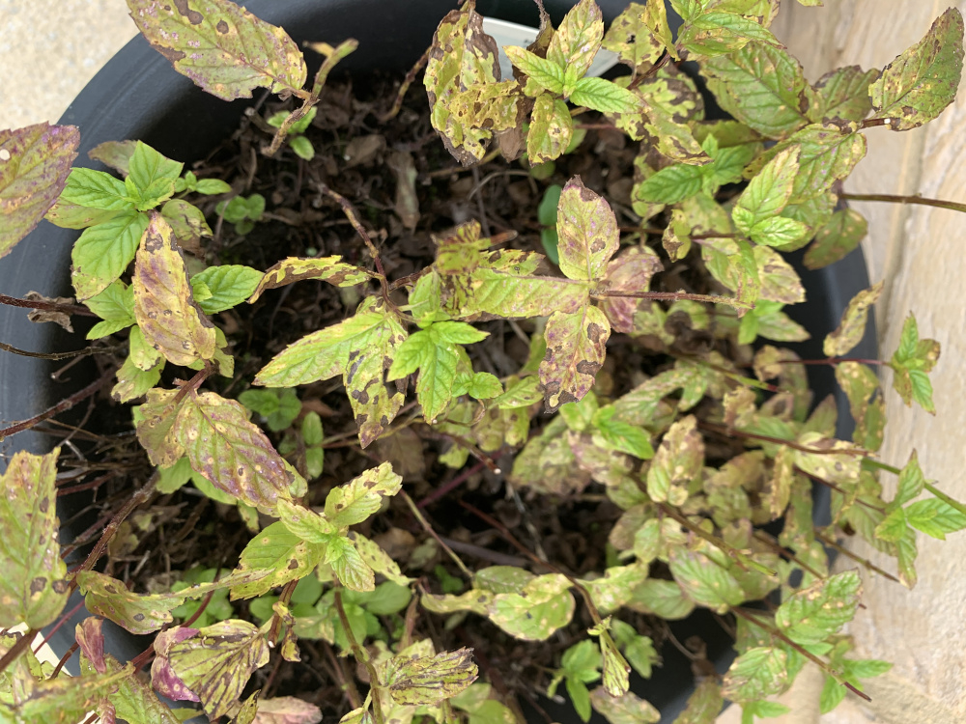
I am sorry mint!!

Slide 5
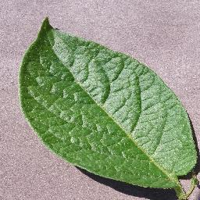
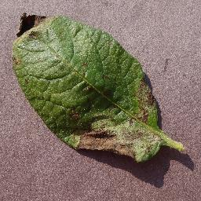
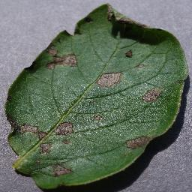
Potato diseases
Early blight
Late blight
Dataset
Caused by fungus
Kill plantation within weeks
Caused by bacteria
Kill plants within days
Kaggle
1000 photos each

Slide 6
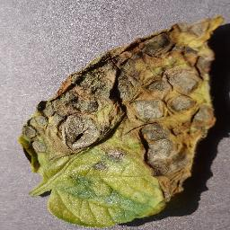
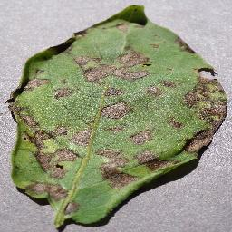
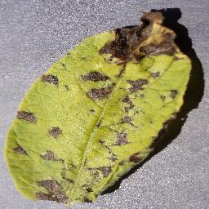
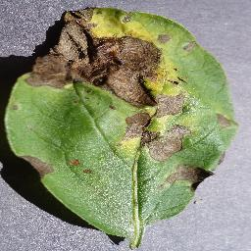
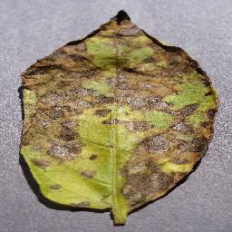
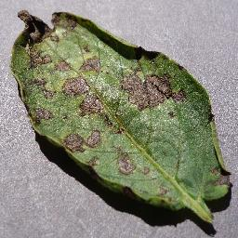
EARLY BLIGHT

Slide 7
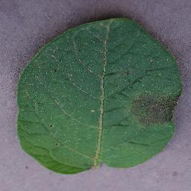
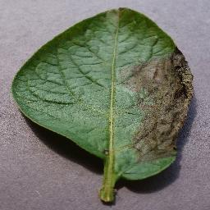
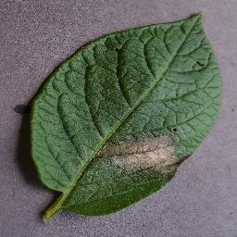
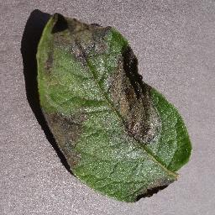
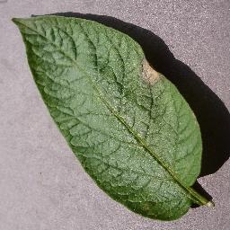
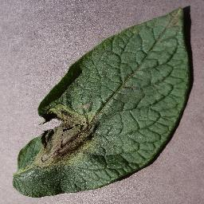
LATE BLIGHT

Slide 8
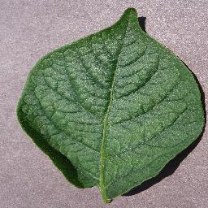
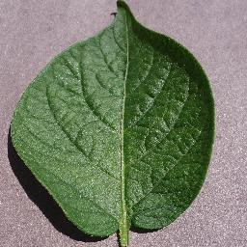
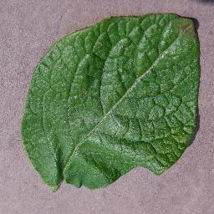
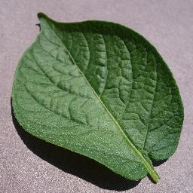
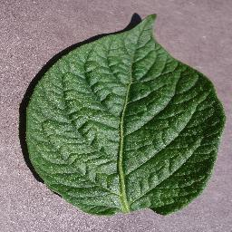
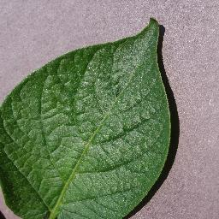
HEALTHY

Slide 9
Model building

Slide 10
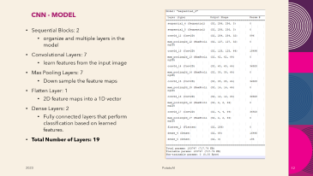
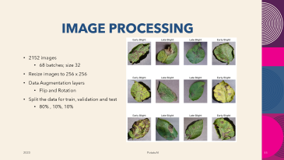
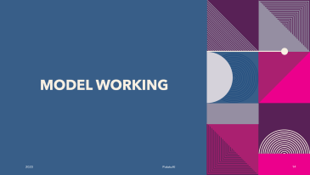
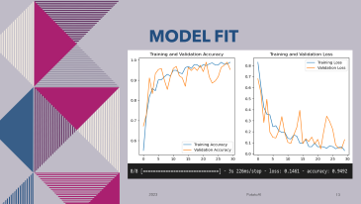
process

Slide 11
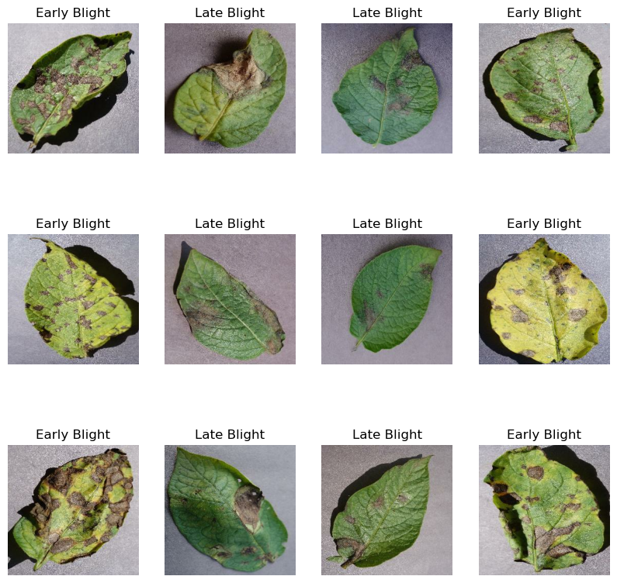
Image processing
2152 images
68 batches; size 32
Resize images to 256 x 256
Data Augmentation layers
Flip and Rotation
Split the data for train, validation and test
80% , 10%, 10%

Slide 12
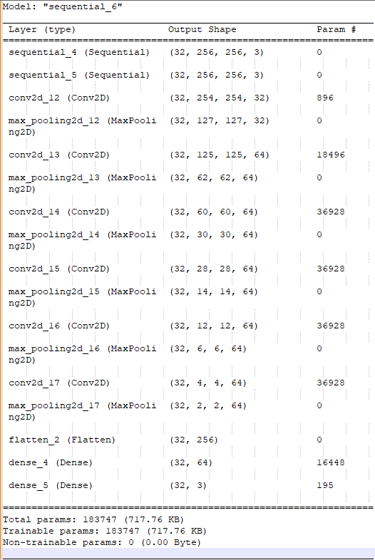
CNN - Model
Sequential Blocks: 2
organize and multiple layers in the model
Convolutional Layers: 7
learn features from the input image
Max Pooling Layers: 7
Down sample the feature maps
Flatten Layer: 1
2D feature maps into a 1D vector
Dense Layers: 2
Fully connected layers that perform classification based on learned features.
Total Number of Layers: 19

Slide 13
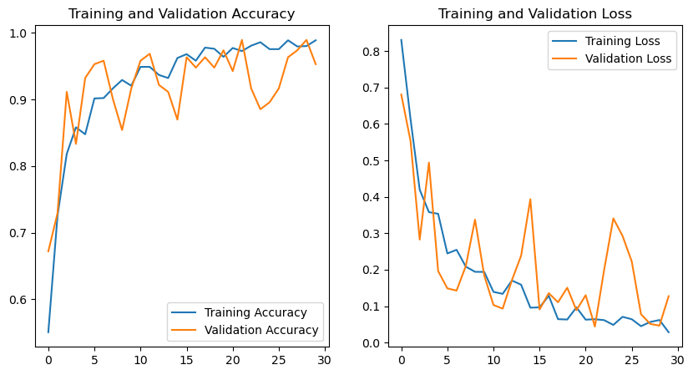
Model fit

Slide 14
Model working

Slide 15
Further Development
Website or mobile application
Model for different plants

Slide 16
THANK YOU

