Slide 1
Mid-term project YouTube Fact-check
Akash Kadia
George Edgar

Slide 2
Flow structure
Project Goal
Data Gathering Process
YOUTUBE_API
Cleaning and Creating Data Frames
Model Building
Model Result
Conclusion

Slide 3
Project Goal
Factcheck : Likes has direct relation to Views.
Gather data : YouTube Api
Clean data
Building Model and Model Output
Prove the statement is fact or myth

Slide 4


Data gathering process

Slide 5


Akash
Lesser known youtubers
randomfrankp
REWA Technology
MINDS EYE DESIGN
Zebra Technologies
Generation Tech

Slide 6
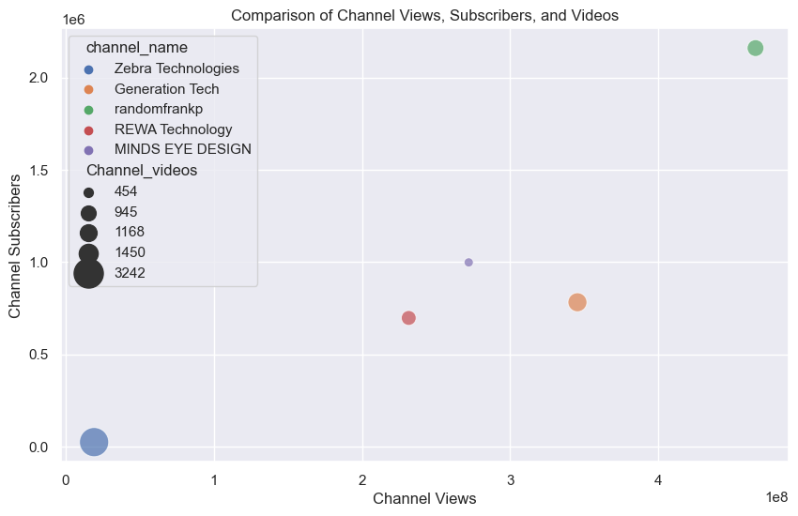

Slide 7
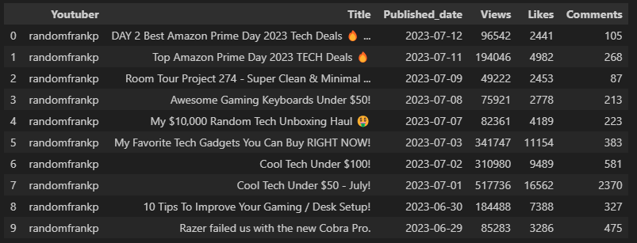

Slide 8
George
Well known youtubers
MKBHD
Quantum Tech HD
The Tech Chap
Techmoan
Mark Rober

Slide 9
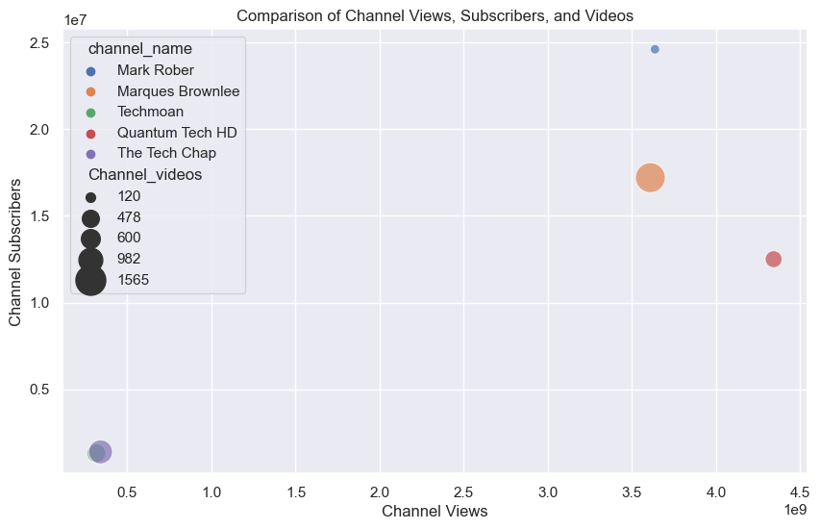

Slide 10
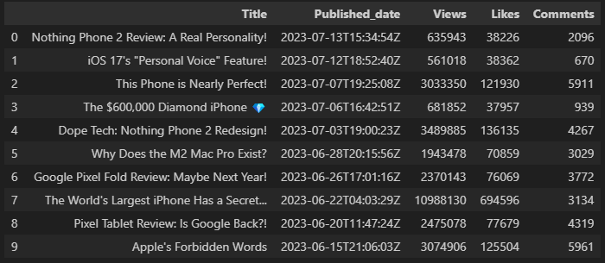

Slide 11
Model Building

Slide 12
hypothesis
Null hypothesis
The variable "Likes" does not have a significant relationship with the variable "Views" in the population.
P-value is near 1
Alternative hypothesis
The variable "Likes" have a significant relationship with the variable "Views" in the population.
P-value is less then 0.05

Slide 13
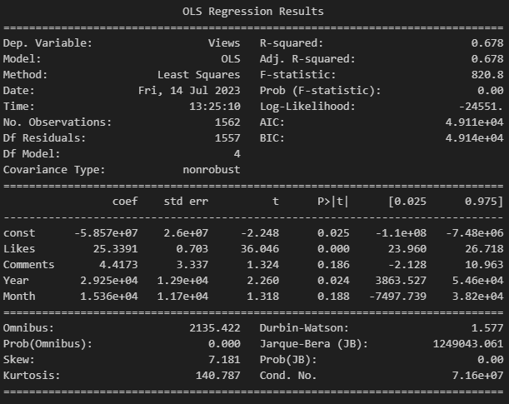
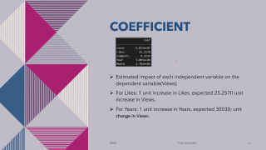
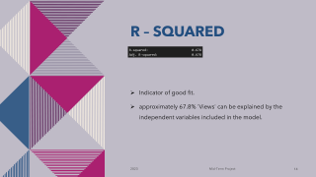
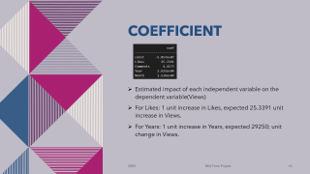
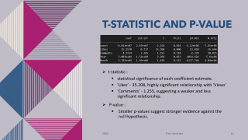
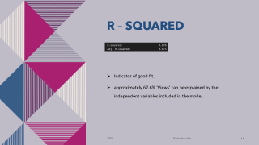
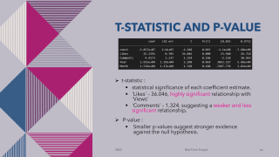
Model building
OLS Regression Model
MKBHD

Slide 14

R – Squared
Indicator of good fit.
approximately 67.8% 'Views' can be explained by the independent variables included in the model.

Slide 15
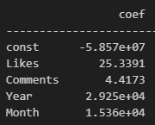
Coefficient
Estimated impact of each independent variable on the dependent variable(Views)
For Likes: 1 unit increase in Likes, expected 25.3391 unit increase in Views.
For Years: 1 unit increase in Years, expected 29250; unit change in Views.

Slide 16
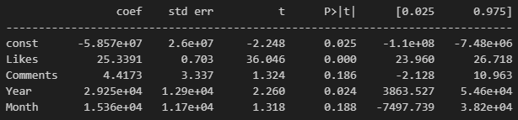
T-statistic and p-value
t-statistic :
statistical significance of each coefficient estimate.
'Likes’ – 36.046, highly significant relationship with 'Views’
'Comments’ – 1.324, suggesting a weaker and less significant relationship.
P-value :
Smaller p-values suggest stronger evidence against the null hypothesis.

Slide 17
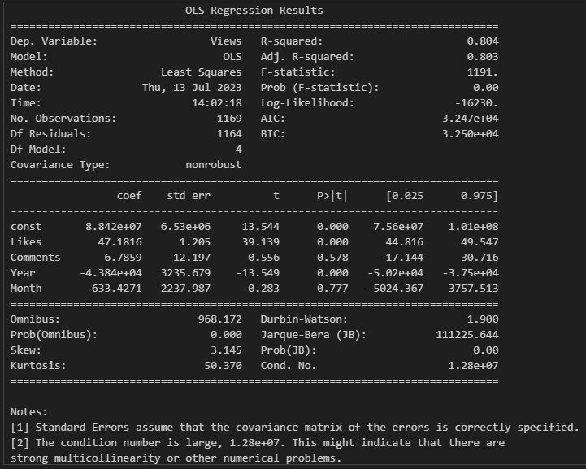
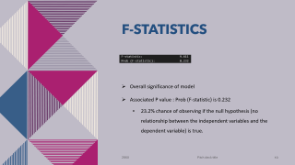
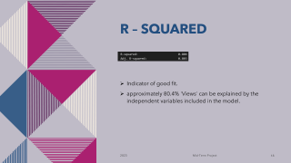
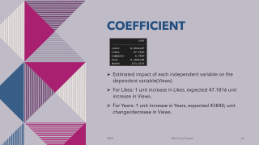

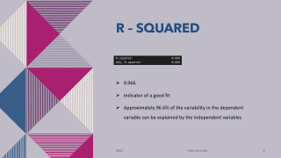
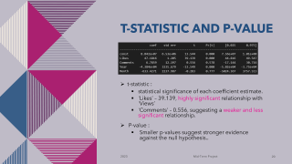
Model building
OLS Regression Model
randomfrankp

Slide 18

R – Squared
Indicator of good fit.
approximately 80.4% 'Views' can be explained by the independent variables included in the model.

Slide 19
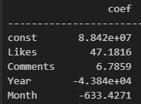
Coefficient
Estimated impact of each independent variable on the dependent variable(Views)
For Likes: 1 unit increase in Likes, expected 47.1816 unit increase in Views.
For Years: 1 unit increase in Years, expected 43840; unit change/decrease in Views.

Slide 20
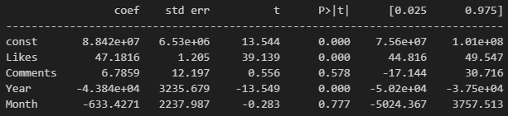
T-statistic and p-value
t-statistic :
statistical significance of each coefficient estimate.
'Likes’ – 39.139, highly significant relationship with 'Views’
'Comments’ – 0.556, suggesting a weaker and less significant relationship.
P-value :
Smaller p-values suggest stronger evidence against the null hypothesis..

Slide 21


Conclusion
Null hypothesis
The variable "Likes" does not have a significant relationship with the variable "Views" in the population.
P-value is near 1
Alternative hypothesis
The variable "Likes" has a significant relationship with the variable "Views" in the population.
P-value is less then 0.05

Slide 22

Aug. 2023
9000 Likes
10000 Likes
8000 Likes

Slide 23
Aug. 2023
9000 Likes
10000 Likes
8000 Likes

Slide 24
Conclusion
Null hypothesis
The variable "Likes" does not have a significant relationship with the variable "Views" in the population.
P-value is near 1
Alternative hypothesis
The variable "Likes" has a significant relationship with the variable "Views" in the population.
P-value is less then 0.05

Slide 25
THANK YOU

