Slide 1
Transforming and analyzing data with SQL
Akash Kadia

Slide 2
Flow structure
About Dataset
Structure of the Dataset
Discovery
Analysis Process
Outcomes
Quality Assurance
Risk
Process
Conclusion

Slide 3
About Dataset
E-commerce
Comprehensive information about activities and transactions on website
5 - Tables
All_sessions
Traffic Activities
Analytics
Analytics of all activities
Products
Product information
Sales_by_sku
Ordered product information
Sales_report
Product stock info

Slide 4
DISCOVERY

Slide 5
Analysis process
Data cleaning
Primary Data Cleaning Technics
Type Conversion
Missing/Null Values
Column Manipulation
Data Validation
Data Normalization
Advance Data Cleaning Technics
Data Validation
Data Normalization
Capitalization Normalization
Mathematical Normalization

Slide 6
Outcome
Answering Questions
Country has the highest transaction revenue
City has the highest transaction revenue
Average number of products ordered
Pattern in the categories of the products ordered
Top selling product
Channel bringing in traffic

Slide 7
Country has the highest transaction revenue

Slide 8
CITY has the highest transaction revenue

Slide 9
Average number of products ordered

Slide 10
Pattern in the categories of the products ordered(TOP 10)

Slide 11
Top selling product

Slide 12
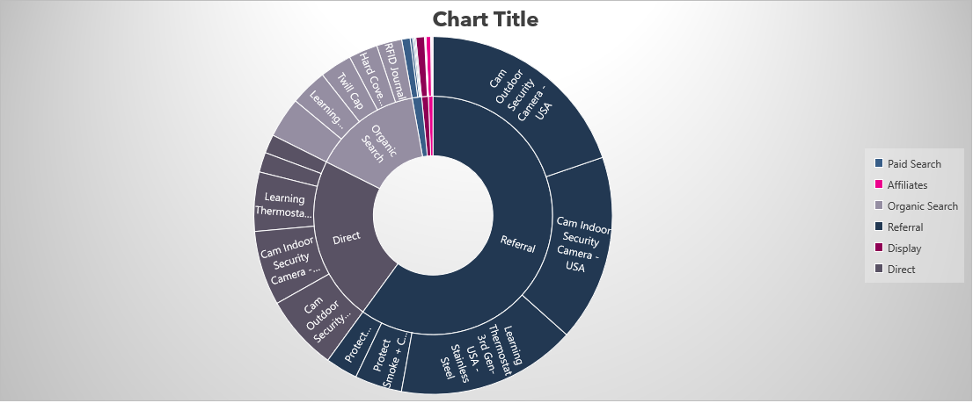
channel bringing in traffic

Slide 13
Quality Assurance

Slide 14
QA PROCESS
Process
RISK
Data Accuracy
Data Completeness
Data Transformation
Data Validation
Data Normalization
Capitalization Normalization
Mathematical Normalization
Transactionid
ORD201603011523
ORD
20160301
1523

Slide 15
CONCLUSION
Traffic Analysis
Majority of the traffic is coming from the USA market.
High user engagement and activity on the ecommerce platform uses Referral channel.
Popular Product Category:
Home category products have gained significant interest from users.
Men's apparel is also a popular category among customers.
Revenue Generation:
The product "Kick ball" has generated the highest amount of revenue.

Slide 16
THANK YOU

