Slide 1
Supervised learning Diabetes dataset
Akash Kadia

Slide 2
Flow structure
Project Goal
EDA – Exploratory Data Analysis
Preprocessing & Feature Engineering
Training ML Model
Conclusion

Slide 3
Project Goal
Supervised Learning Techniques
Build a Machine Learning model
predict whether a patient has diabetes or not

Slide 4
Exploratory Data Analysis

Slide 5
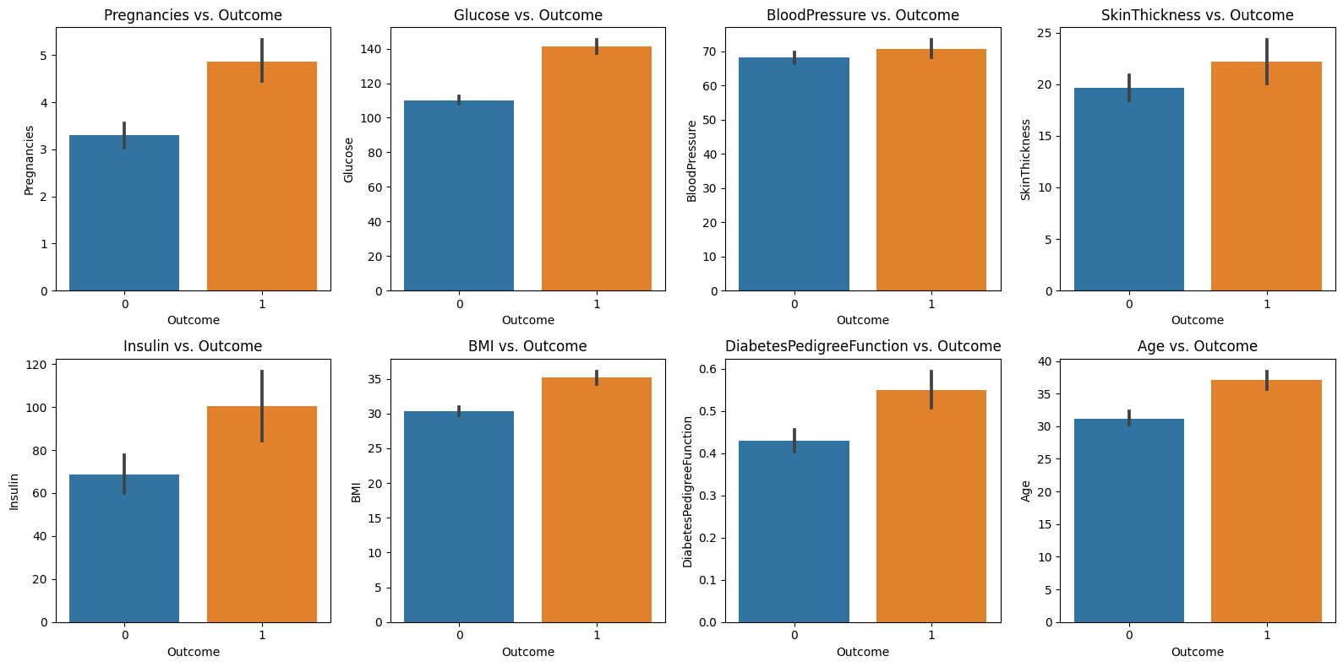
Relationship between predictor variables and the outcome variable

Slide 6
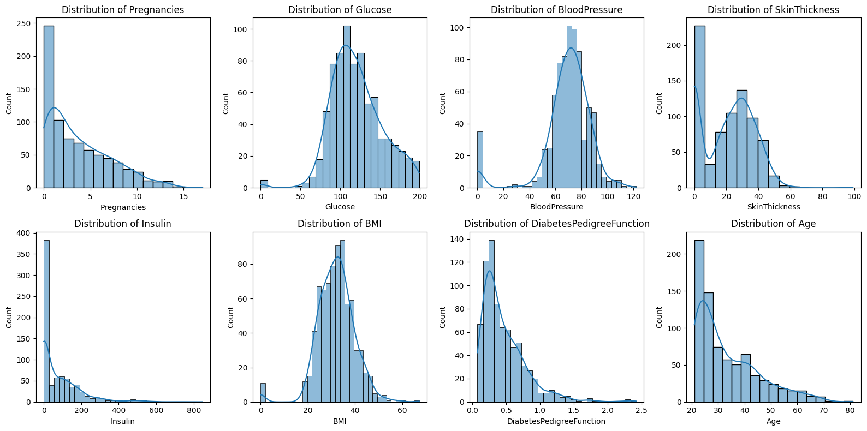
Distribution of each predictor variables

Slide 7
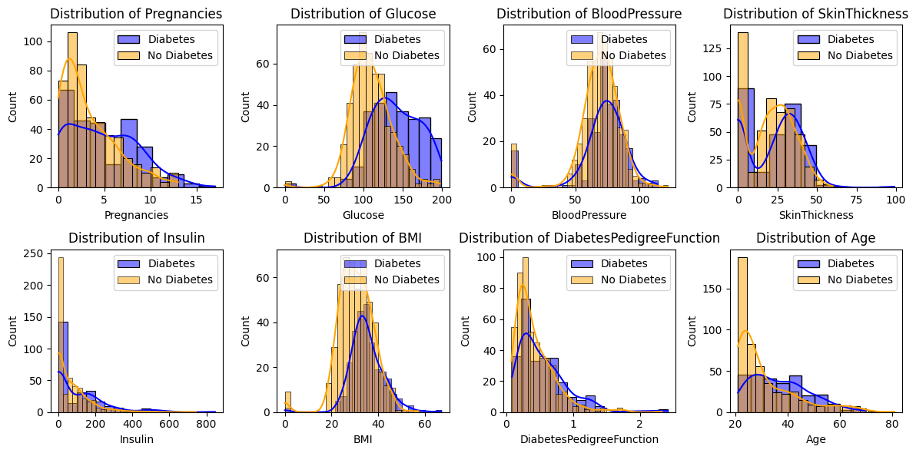
Distribution of predictor variables for individuals with and without diabetes

Slide 8
processing & Feature Engineering

Slide 9
Feature Engineering
With the help of Subject Expert
Age Group Binning
BMI Categories
Ratio
Grouping age in ranges
Figuring out Type-1 diabetes
Categories
Underweight
Normal
Overweight
Obese
Obese are more diabetes positive
Insulin to Glucose ratio

Slide 10
Model Building

Slide 11
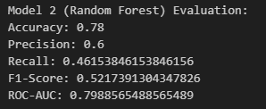
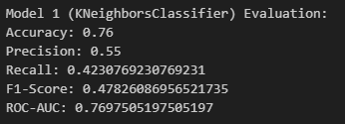
Model comparison
K Neighbors Classifier
Random Forest Classifier

Slide 12
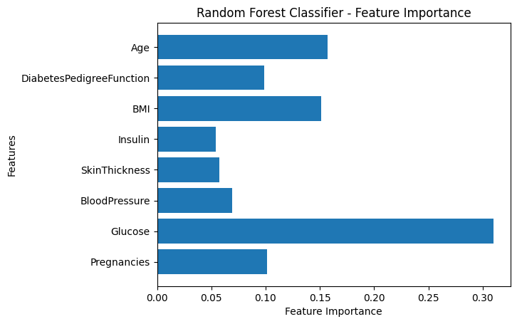
Feature Importance

Slide 13
THANK YOU

