Slide 1
unsupervised Learning Diabetes dataset
Akash Kadia

Slide 2
Flow structure
Project Goal
EDA – Exploratory Data Analysis
K-Means Clustering
Hierarchical Clustering
PCA
Conclusion

Slide 3
Project Goal
Unsupervised Learning Techniques
gain insights from the data sets to make informed decisions

Slide 4
Exploratory Data Analysis

Slide 5
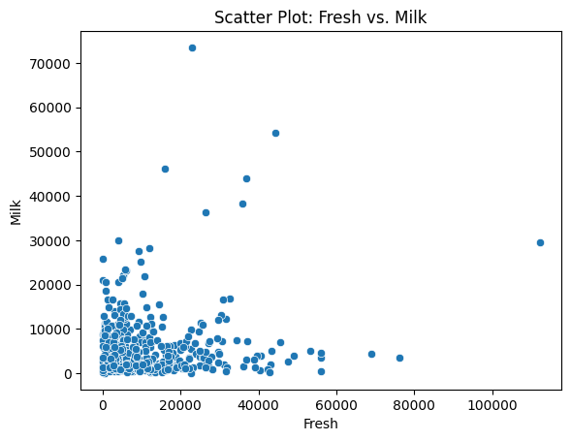
Fresh vs milk

Slide 6
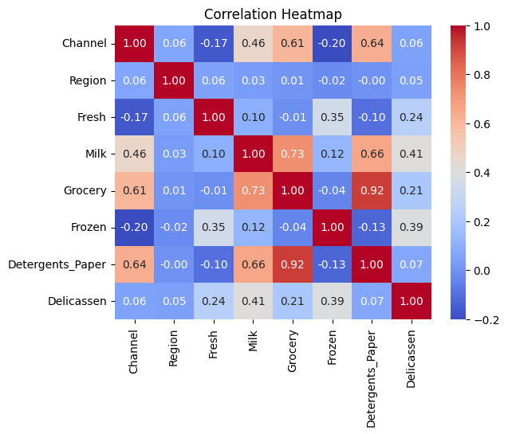
Correlation Heatmap

Slide 7
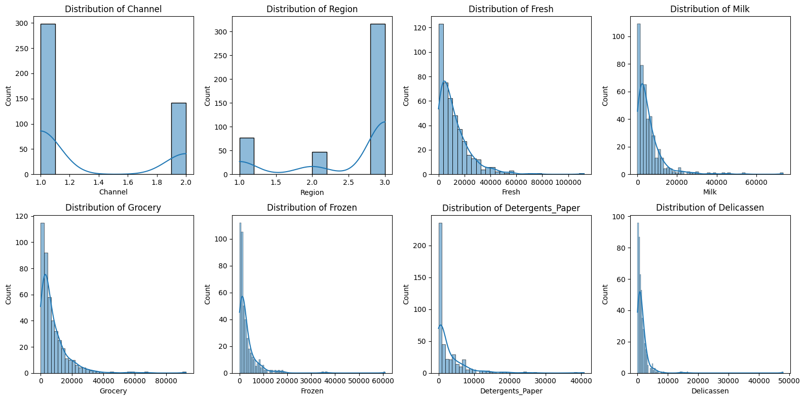
Distribution of each variable

Slide 8
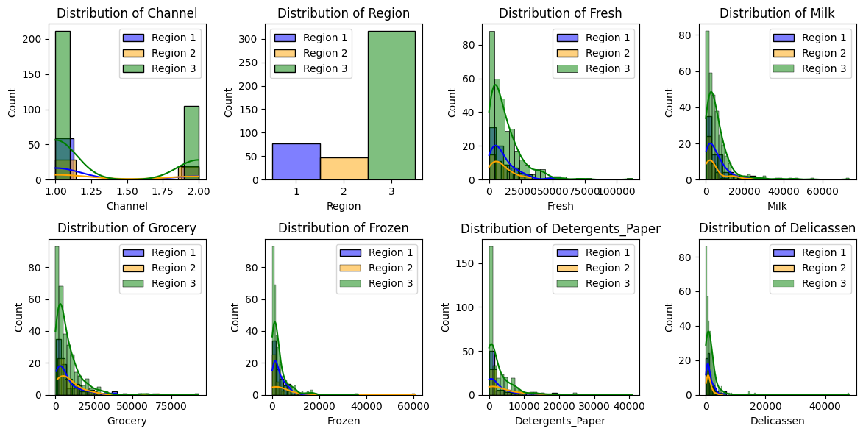
Distribution of each variable with Regions

Slide 9
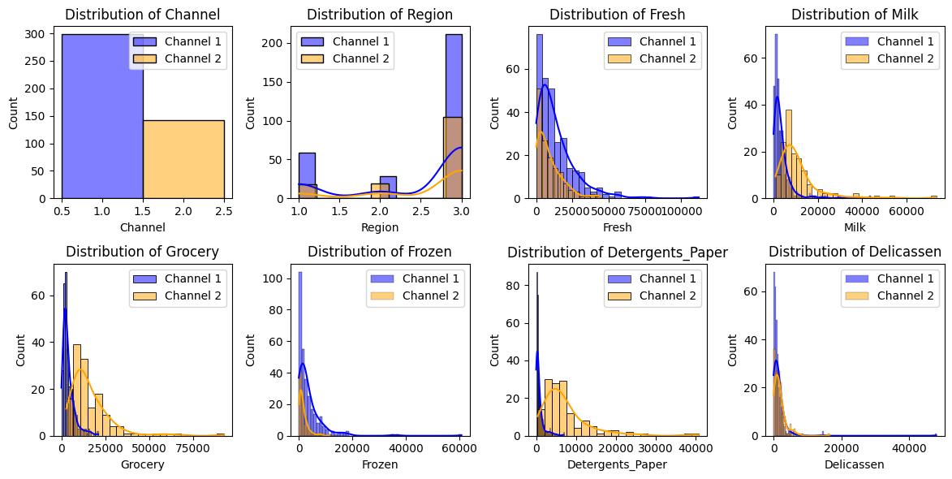
Distribution of each variable with Channels

Slide 10
K-Means Clustering

Slide 11
Hypothesis
Different customer segments can be identified based on their purchasing behavior in the 'Fresh', 'Milk', 'Grocery', 'Frozen', 'Detergents_Paper', and 'Delicassen' categories.
Process
Scaling
Scaled data
Use Elbow Method to determine K value
Perform K–Means clustering
SSE = 1074854303.35
SSE is high so scale the data for better result
For better SSE can use two scaling methods
Standardization
Normalization
Used Standardization
Use Elbow Method to determine K value
Perform K–Means clustering
SSE = 490.07
well-defined clusters

Slide 12
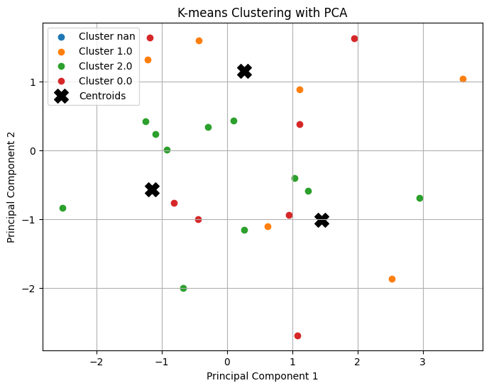
K-Means Clusters with pca

Slide 13
Hierarchical Clustering

Slide 14
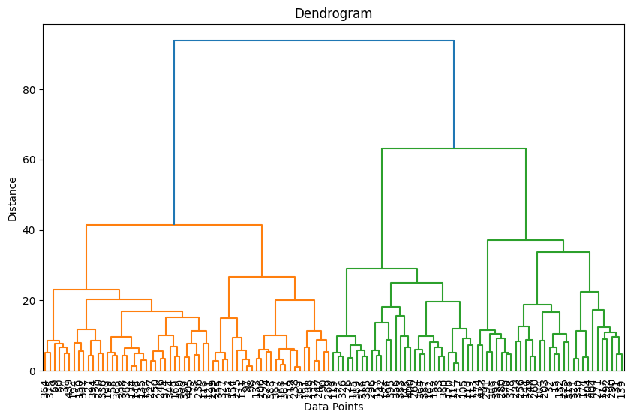
Dendrogram
Number of clusters = 3
Created cluster assignment for PCA and visualization
Can use PCA or t-SNE

Slide 15
PCA

Slide 16
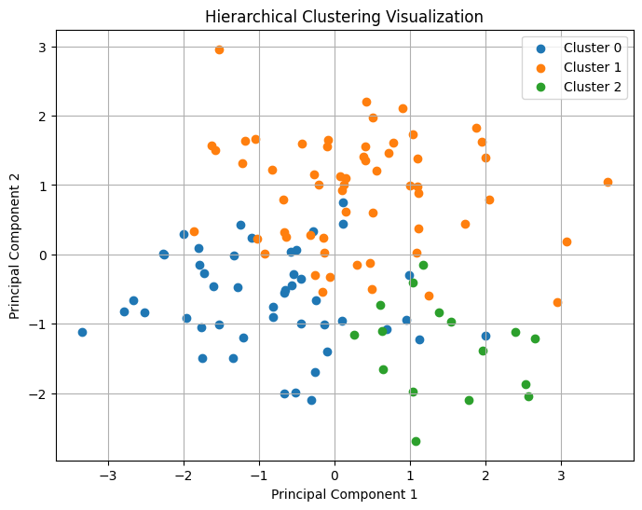
Hierarchical Clustering

Slide 17
Conclusion
The scatter plot obtained from K-means clustering shows more scattered and disrupted data points, indicating that the clusters may not be well-defined or separated in the reduced space.
The hierarchical clustering diagram exhibits well-defined clusters, suggesting that the algorithm has effectively grouped similar data points together based on the similarity measure, resulting in more cohesive and distinct clusters.

Slide 18
THANK YOU

