Slide 1
Java Intro & OOP Principles
Intro to Java
Intro to Objects and Classes
Comparison with C
Data Types
Anatomy a simple java program
Compiling/Running of java program
Notes:
1

Slide 2
Java Language
Java was created by a team of members called "Green" led by James Arthur Gosling.
When Java was created in 1991, it was originally called Oak.
It is a free and open source software (FOSS) under GNU General Public License(GPL)
First version of Java was released in 1995.
Java is an Object oriented language, simple, portable, platform independent, robust and secure.
Notes:
A group of engineers from Sun Microsystems, now acquired by Oracle Corporation, led by James Gosling created Java. It was released in 1995. The Language was originally called Oak (in 1991) after the Oak tree that could be seen in Gosling's office. They later found that Oak was a name already taken. So, popular story goes that after many hours of trying to come up with a new name, the development team went out for coffee and the name Java was born!
FOSS (GPL):
FOSS is a free and open source software and GNU General Public License
The GNU General Public License is a free, copy-left license for software and other kinds of works
Copyleft is used to describe the practice of using copyright law to offer the right to distribute copies and modified versions of a work and requiring that the same rights be preserved in modified versions of the work

Slide 3
INTRODUCTION TO JAVA
Java is an object-oriented programming language developed by Sun Microsystems, a company best known for its high-end Unix workstations.
Java is modelled after C++
Java language was designed to be small, simple, and portable across platforms and operating systems, both at the source and at the binary level.
Java also provides for portable programming with applets. Applets appear in a Web page much in the same way as images do, but unlike images, applets are dynamic and interactive.
Applets can be used to create animations, figures, or areas that can respond to input from the reader, games, or other interactive effects on the same Web pages among the text and graphics.
Notes:
3

Slide 4
INTRODUCTION TO JAVA
Java Development Kit (JDK)- Byte code
Bytecodes are a set of instructions that look a lot like machine code, but are not specific to any one processor
Platform-independence doesn't stop at the source level, however. Java binary files are also platform-independent and can run on multiple platforms without the need to recompile the source. Java binary files are actually in a form called bytecodes.
Notes:
4

Slide 5
INTRODUCTION TO JAVA
Object-Oriented Programming
Many of Java's object-oriented concepts are inherited from C++, the language on which it is based, but it borrows many concepts from other object-oriented languages as well.
Java includes a set of class libraries that provide basic data types, system input and output capabilities, and other utility functions.
These basic classes are part of the Java development kit, which also has classes to support networking, common Internet protocols, and user interface toolkit functions.
Because these class libraries are written in Java, they are portable across platforms as all Java applications are.
Notes:
5

Slide 6
Comparison among C,C++ and JAVA
 | C | C++ | JAVA
Paradigms | Procedural | Object Oriented | Object Oriented
Platform Dependency | Dependent | Dependent | Independent
Inheritance | No Inheritance | Supported | Multiple Inheritance not Supported
Exception Handling | No Exception handling | Supported | Supported
Storage Allocation | Uses malloc, calloc | Uses new , delete | uses garbage collector
Database Connectivity | Not Supported | Not Supported | Supported

Slide 7
Downloading and Installing java
JRE (Java Runtime Environment)
If this is installed only “java” is available.
If someone gives you a “.class” file, you will
be able to run it.
JDK ( Java Development Kit)
if this is installed you have both
javac (for compiling source (*.java) file)
java (for running the class (*.class) files).
Eclipse/Net-Beans
http://www.oracle.com/technetwork/java/javase/downloads/index.html
http://docs.oracle.com/javase/tutorial/essential/environment/paths.html
Notes:
7

Slide 8
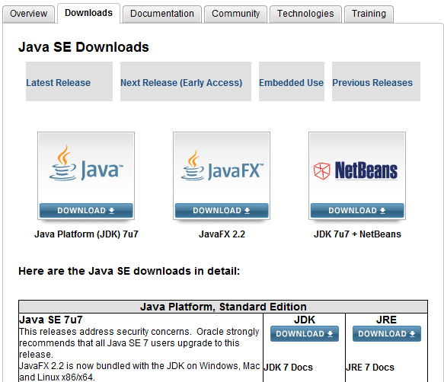
Downloading and Installing java
Notes:
8

Slide 9
Flavors Of Java
JSE
Java Standard Edition formerly known as J2SE.
This forms the core part of Java language.
JEE
Java Enterprise Edition formerly known as J2EE.
These are the set of packages that are used to develop distributed enterprise-scale applications.
These applications are deployed on JEE application servers.
JME
Java Micro Edition formerly known as J2ME.
These are the set of packages used to develop application for mobile devices and embedded systems.
Our focus
Notes:
Java also comes in several versions:
JDK 1.0 (1995)
JDK 1.1 (1997)
J2SE 1.2 (1998) ) →Playground
J2SE 1.3 (2000) → Kestrel
J2SE 1.4 (2002) → Merlin
The above 3 was called Java 2
J2SE 5.0 (2004) → Tiger
Java SE 6 ( 2006) → Mustang
Java SE 7 (2011) →Dolphin

Slide 10
Environment to compile and execute
Compile java programs
From command prompt
Through an IDE (Integrated development environment)
Eclipse →Apache
NetBeans →Oracle SDN
JBuilder → Borland
Integrated Development Environment → IBM

Slide 11
Setup JDK
http://java.com/en/download/index.jsp or find appropriate link in http://www.oracle.com/technetwork/indexes/downloads
Download Java based on the type of OS
Windows
Linux
Mac OS
Solaris
Install JDK

Slide 12
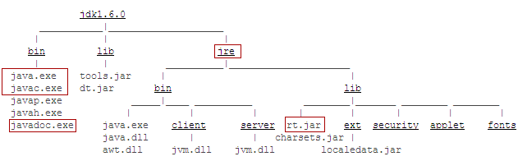
JDK installation directory
Java Runtime Environment
Java virtual machine
Java Executables
Java Predefined Classes like
String, Date, Math etc.
Notes:
rt.jar is a library file that has all predefined Java classes that are part of core Java. Jar is java archive.

Slide 13
Getting Started
The java Development Kit-JDK.
In order to get started in java programming, one needs to get a recent copy of the java JDK. This can be obtained for free by downloading from Oracle site
Once you download and install this JDK you are ready to get started. You need a text editor as well.

Slide 14
To run java program
Java Instructions need to translated into an intermediate language called bytecode
Then the bytecode is interpreted into a particular machine language (Machine code)

Slide 15
What is needed
Compiler:
A program that translates program written in a high level language into the equivalent machine language
Java virtual Machine: A software which make java programs machine independent

Slide 16
Java Virtual Machine
A software that interprets java bytecode
Java programs executed in JVM
JVM is a virtual rather than a physical machine
The JVM is typically implemented as a run time interpreter
Translates java bytecode instructions to machine readable code

Slide 17
Java Features
Java is both compiled and interpreted
Java is fully object oriented
Source Code
compile
Intermediate Code
Interpret
Run
JVM
MyFile.java
MyFile.class

Slide 18
Java Features
Java is easy to Learn.
Java is machine and platform independent
WORA principle
“WRITE ONCE RUN ANYWHERE”
Java App
Java Virtual Machine (JVM)
Operating System
Hardware

Slide 19
Java Features
Java Depends on dynamic linking of libraries.
JRE
+
JRE
JDK
JVM
+ compiler
+ libraries
+ utilities

Slide 20
Simple Hello World in Java
Hello.java
public class Hello{
public static void main(String args[])
{
System.out.println(“Hello World!”);
}}
Special statement used to display data on console. ‘println’ causes the next print statement to be printed in the next line.
main() is a method from where program execution begins.
Notes:
System.out.print prints in the same line.

Slide 21
Compilation & execution: command prompt
Save the file as Hello.java. A public class must be saved in the same name as class name.
Compile
C:\MyJava>javac Hello.java
Byte code
Hello.class
javac
Hello.java
compilation
Source code
execution
java
Platform specific code
Execute
C:\MyJava>java Hello
Notes:
javac [ options ] [ sourcefiles ]
sourcefiles can also include relative or absolute path components
–d directory
Set the destination directory for class files.
D:\ javac –d bin Test.java places Test.class in D:\bin folder. Please note that the bin folder exist before giving this command
-nowarn
Disable warning messages.
-version
Displays the version used for compilation
-target
Generate class files for specific VM version

Slide 22
JRE and bytecode
Java Bytecode is produced when Java programs are compiled.
To execute Java program, JRE must be installed in the system
JRE or Java Runtime environment contains
Java Virtual Machine
Standard class libraries (APIs)
Java Plug-in
Java Webstart
JRE gets installed automatically when JDK is installed. JRE can be installed independent of JDK as well. This will mean that Java programs can be executed in that system.

Slide 23
Integrated Development Environment (IDE)
Using a text editor and compiling from the command line is the most basic way of creating a Java program, but there are tools available to make it easier to create Java programs called IDEs
The two major ones are:
Netbeans
Eclipse
Netbeans is an IDE from Oracle, the current owners of the Java language, and thus, is very easy to use with Java.
If you install Netbeans, it will guide you through installing the JDK
Eclipse is a third-party open-source IDE that is very powerful and popular.
You may need to install the JDK successfully before installing Eclipse.

Slide 24
Introducing Eclipse Helios 3.6 IDE
IDE is where the Java programs are written, compiled and executed.
Eclipse is an open source project
Launched in November 2001
Designed to help developers with specific development tasks
GUI and non-GUI application development support
Easy integration of tools
Supported by multiple operating systems like Windows, Mac, Linux, Solaris, IBM AIX and HP-UX.

Slide 25
Eclipse as an IDE
Java Development Tooling (JDT) is used for building Java code
Provides set of workbench plug-ins for manipulating Java code
Java projects, packages, classes, methods, ....
Java compiler is built in
Used for compiling Java code
Creates errors (special markers of code) if compilation fails
Numerous content types support
Java, HTML, C, XML, ...

Slide 26
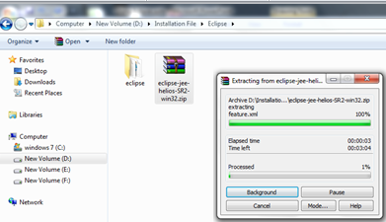
Activity: Installing Eclipse
Download Eclipse’s Install Zip File from http://www.eclipse.org
Click on the Download from the main page on http://www.eclipse.org
Choose the best site from which to download
Choose the latest build for download
Choose the platform for download and type of download (http or ftp)
Specify the location to save the downloaded file.
Unzip the downloaded file to the directory of your choice
Notes:
If Java is not installed then we need to download JVM.
Fix missing a Java VM? …
Download the latest Java Runtime Environment (JRE), e.g., v1.5.0_03 from http://java.sun.com/j2se/
Click on the downloaded EXE file to install
When given the option by the installer, identify a directory of your choice for the install files
There are two ways of specifying JVM for Eclipse:
By installing JVM under the \jre\ directory off the eclipse install directory
By specifying existing JVM in the PATH environment variable

Slide 27
Characteristics of Java Language
Simple and Secure
Object oriented language
Portable and platform independent
Robust
Multithreaded
Dynamic Linking
Secure
Performance
Java is Compiled as well as Interpreted
Java Supports Multithreading
Java is both Application And Applet based
Notes:
Simple: Syntax similar to C/C++,Same types of loops ,Same data types , no pointers, no array index out of bounds problems, no explicit memory allocation & de-allocation. Java is able to overcome memory related problems by the virtue of Garbage collection which is a tool that attempts to free unreferenced memory (memory occupied by objects that are no longer in use by the program) also called garbage, in program
Object oriented language: Java is an object oriented language. Every Java application begins with a class. There are no stand-alone functions or global variables in Java. Functions and methods are part of Java Class. Even the main method is part of a java class.
Portable and platform independent: discussed in next slides
Robust: Strong Error handling mechanism: Lot of checks are done at the compilation itself. More checks are performed at runtime system to make sure that code does not malfunction. Automatic garbage collection.
Thread:At the OS level, smallest unit of work that can be scheduled, is a thread. Thread is a sequence of execution of code. A process consists of one or more threads. Multiple threads in the same program share same resources. Unlike a multiple process, multiple threads in a process share same memory location. That is why threads are called Light weight process. Java Standard API has rich set of classes that allows us to work with multiple threads simultaneously
Dynamic Linking: The Java class loader(a represented by a class called ClassLoader) is a part of the Java Runtime Environment that dynamically loads Java classes into the Java Virtual Machine. It links classes with the executing code. Usually classes are only loaded on demand meaning that only the classes specified in the code are loaded. JVM class loaders looks for the classes specified in the following order-
Bootstrap classes :loads java libraries (rt.jar etc.)
Extensions classes : loads external libraries in lib/ext paths. For example, <JAVA_HOME>/lib/ext etc.
Classes in classpath: loads classes in CLASSPATH environment variable or system property java.class.path. (By default, the java.class.path property's value is ‘.’)
Secure: Security is in-built into Java's language rules. It has no syntax for pointers. So it is impossible to access illegal memory. Java has extensive syntax (like private, protected) to secure data from being accessed by illegal objects. It also has comprehensive API with support for a wide range of cryptographic services and for Authentication and Access Control, Secure communication. Java Compiler flags error on illegal conversions and also makes sure that all java's language rules are adhered to

Slide 28
Portable and platform independent
Java Code can be compiled anywhere
Bytecode can be executed anywhere

Slide 29
Portable
When java code executes, its behavior is exactly same in any java-aware system.
There are no platform-specific code in java programs that causes compilation problems in any other OS.
This makes Java programs are portable.
Notes:
There are no platform-specific code in java programs that causes compilation problems in any other OS. (For example in C if you include conio.h library, this will work only in Window OS and will not work in linux).
Also some features that were considered not portable in C/C++ (like sizes of int, right shift operator behavior etc.) were eliminated for Java

Slide 30
Platform Independent
A Java program requires JVM (part of JRE) to execute Java code. When java application starts to executes, Java Virtual Machine also starts.
Bytecode has instructions that Java Virtual Machine can understand and execute.
JVM converts the Bytecode to machine specific code.
Java Bytecode can be copied on to any machine that has JVM and executed. This is what makes Java Platform Independent.
“Write Once, Run any where”

Slide 31
JVM: perspectives
JVM can be looked as
a runtime instance: JVM life cycle begins when applications starts to run ( that is when main method is called) and ends when the application ends.
the abstract specification: Specification that Java team at Sun (Oracle) provides which tells JVM makers how they must design JVM for their OS.
a concrete implementation: JVM that is built specifically targeted for an OS based on abstract specification .
Notes:
When we talk about JVM in these sessions, we mean a runtime instance of JVM

Slide 32
Classpath
Classpath is an environment variable that java compiler and JVM (system class loader) use to locate the classes in the file system.
To set the classpath temporarily in command line
SET CLASSPATH=directory;%CLASSPATH%;.
Command to set classpath while compiling
javac –classpath dir1;dir2 Someclass.java
Example: javac –classpath C:/MyJava
Command to specify un-compiled source file to be compiled and included in the classpath
javac – sourcepath dir1;dir2 Someclass
Example: javac –sourcepath C:/MyJava
Providing classpath while executing
java –classpath directory1;directory2

Slide 33
public class A{
public static void main(String[] args)
{
String curDir = System.getProperty("user.dir");
System.out.println(curDir);
}
}
This code is in C:\MyJava folder. If this code is executed from C:\MyJava, it prints the current directory.

Slide 34
Commenting source code
Question: Why should you comment your code?
How much should you comment?
3 types of comment
Single line comment : //
// this is a single line comment
Multi-line comment: /* */
/* this is multi
line comment */
Documentation Comment (Doc comment): /** */
/** This class is used to represent a stack.
* @author Murali
* @version 1.0, 08/16/2010
*/

Slide 35
Some Guidelines for Doc comments
Who owns and edits the Doc Comments: usually the programmer
Doc comments for classes, methods, fields:
Brief description of what it does. In case longer description is required, link to an external document (word, pdf) can be included.
For methods, whether they are thread-safe and what runtime exception they throw must be specified.
Proper indentation of documentation for better readability.
Entities for the less-than (<) and greater-than (>) symbols should be written &lt; and &gt;. Likewise, the ampersand (&) should be written &amp;.
Revisit this after threads and exception

Slide 36
1. Java Alphabets
65536 alphabets are there
Three groups
Letter
Number
Special Characters
Easy way to remember (unicodes)

Slide 37
2. Java Words
Also called tokens
Decides how to form words
Words can be reserved words/keywords available
Words can be datatypes
Words can be identifiers/variable names
Words can be operators
Words can be Constants
Words can be literals

Slide 38
Keywords/ Reserved words
abstract | continue | for | new | switch
assert | default | goto | package | synchronized
boolean | do | if | private | this
break | double | implements | protected | throw
byte | else | import | public | throws
case | enum | instanceof | return | transient
catch | extends | int | short | try
char | final | interface | static | void
class | finally | long | strictfp | volatile
const | float | native | super | while
Note that null, true and false are not keywords
38
Notes:
goto and const are unused keywords. They are reserved for future use. Java classes are not keywords.

Slide 39
Data Types
Defines the type of data the variable can hold
Defines the size of variable/memory location
Defines the range of constant/value , a variable can hold
Two types
Primitive Data Type
Secondary Data Type (Derived and UserDefined)
39
Notes:
Value of a constant cannot be changed once a value is assigned. final keyword in front of the variable denotes constant.

Slide 40
Primitive Data Types
(Integers, Floating points, Character, Boolean)

Slide 41
Integers
There are 4 integer data types, They differ by the amount of memory used to store them.
Type | Bits | Value Range
byte | 8 | -128 to 127
short | 16 | -32768 to 32767
int | 32 | About 9 decimal digits
long | 64 | About 18 decimal digits
41
Notes:
Value of a constant cannot be changed once a value is assigned. final keyword in front of the variable denotes constant.

Slide 42
Floating Point
There are 2 floating point types.
Type | Bits | Value Range (Decimal Digits) | Precision(Decimal Digits)
float | 32 | 38 | 7
double | 16 | 308 | 15
42
Notes:
Value of a constant cannot be changed once a value is assigned. final keyword in front of the variable denotes constant.

Slide 43
Characters
A Char value stores a single character from the Unicode Character Set
A Character set is an ordered list of characters and symbols.
- ‘A’, ‘B’, ‘C’, …., ‘a’, ‘b’, …., ‘0’, ‘1’, ‘2’, … , ‘$’, …
The Unicode character set uses 16bits(2 bytes) per character.
43
Notes:
Value of a constant cannot be changed once a value is assigned. final keyword in front of the variable denotes constant.

Slide 44
Boolean
A boolean value represents a true/false condition.
The reserved words true and false are the only valid values for a boolean type.
The boolean tyoe uses one bit.
44
Notes:
Value of a constant cannot be changed once a value is assigned. final keyword in front of the variable denotes constant.

Slide 45
Identifiers / variable names
Identifiers are the names of variables, methods, classes, packages and interfaces.
An identifier is a sequence of characters that consist of letters, digits, underscores (_), and dollar signs ($), must start with a letter, an underscrore(_), or a dollar sign ($).
It cannot start start with a digit.
An identifier cannot be a reserved word (public, class, static, void, method)
45
Notes:
Value of a constant cannot be changed once a value is assigned. final keyword in front of the variable denotes constant.

Slide 46
Note
Java is case sensitive.
File name has to be the same as class name in file.
Need to import necessary class definitions.
46
Notes:
Value of a constant cannot be changed once a value is assigned. final keyword in front of the variable denotes constant.

Slide 47
Variables
Each variable must be declared before it is used.
The declaration allocates a location in memory to hold values of this type.
Variables can be:
- primitive
- reference to an object
47
Notes:
Value of a constant cannot be changed once a value is assigned. final keyword in front of the variable denotes constant.

Slide 48
Variables
Variable name must begin with
a letter (A-Z, a-z, or any other language letters supported by UFT 16)
An underscore (_)
A dollar ($)
after which it can be sequence of letters/digits.
Digits: 0-9 or any Unicode that represents digit.
Length of the variable name is unlimited
Java reserved words should not be used as variable names.
48

Slide 49
Variable Declarations
The syntax of a variable declaration is
data-type variable-name;
Example:
int total;
long count, sum;
double unitPrice;
- Assign values:
total = 0;
count = 20, sum = 50;
unitPrice = 57.28;
49
Notes:
Value of a constant cannot be changed once a value is assigned. final keyword in front of the variable denotes constant.

Slide 50
Variable Declarations
Local declarations
Class declarations
Instance declaration
Static declaration
50
Notes:
Local declarations
Declarations made inside a method
A local variable must always be initialized to a value before it can be used in calculations or display.
If a variable is used without initialization, compiler will flag an error.
Class declarations
Declarations made outside a method and inside class
A class variable is automatically assigned a default value if it is not initialized.
There are two types of class declarations
Instance declaration
Static declaration

Slide 51
Example: Variable Declarations
public class Student {
public String name;
public int rollno;
public void display(){
String title=“ABC” ;
System.out.print(title);
System.out.println(name);
title=“Roll No.:”;
System.out.print(title);
System.out.println(rollno);
}}}
Or String name=“ab”;
Class declarations
Local declaration
Must be initialized otherwise you get a compilation error !
51

Slide 52
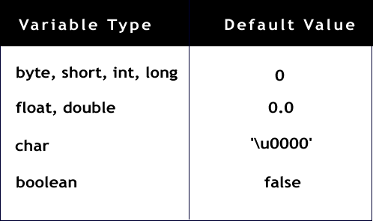
Default Values
String/
any other Object
null
52

Slide 53
Variable Declaration Example
public class DeclarationExample {
public static void main(String args[]) {
int weeks = 14;
long numberOfStudents = 120;
double averageFinalGrade = 78.6;
char ch = ‘a’;
System.out.println(weeks);
System.out.println(numberOfStudents);
System.out.println(averageFinalGrade);
System.out.println(ch);
}
}
53
Notes:
Value of a constant cannot be changed once a value is assigned. final keyword in front of the variable denotes constant.

Slide 54
Variable Naming Convention
Must begin with lower case
Must always begin your variable names with a letter, not "$" or "_".
Avoid abbreviations, use meaningful names.
If a variable consists of two or more words, then the second and subsequent words should start with upper case.
For example, rowHeight.
54
Notes:
http://download.oracle.com/javase/tutorial/java/nutsandbolts/variables.html

Slide 55
Constants
final double PI=3.14;
Constant Naming Convention
All the rules that apply for a variable, applies to constants as well except for the one given below.
Convention for constants is that they must all be in UPPER CASE. In cases where you have more than one word making up constant, words must be separated by underscore.
55
Notes:
Value of a constant cannot be changed once a value is assigned. final keyword in front of the variable denotes constant.

Slide 56
Literals
Integer Literal
Integer literals are by default int (32 bits).
They can be decimal, octal, hexadecimal or long
10, -1, 010, 0xF, 4000000000l, 4000000000L
Floating Point Literal
Floating-Point literals are by default double (64 bits).
32.4, .24, 3E1, 3e-1, 32.4d , 3E1D, 3e-1, 32.1F
Character Literal
They can be characters inside single quote, unicode char or octal character or escape sequence (next slide).
'a‘, '\u0041‘, '\101’ , ‘\n’
Boolean Literal : true, false
String Literal : “Thank You”, "\u0041\u0069 “ (Ai), “Fly\n”
56
Notes:
Note that suffix l and L are same. Similar is the case for d and D, f and F, e and E.
Also following are incorrect for boolean literal assignments:
boolean b1=1;
boolean b2=10;
boolean b3=-1;

Slide 57
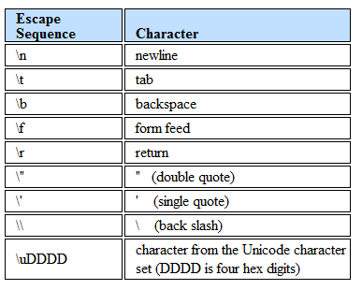
Escape Sequence
\DDD
Character from the Unicode characters
set (DDD is octal digits)
57

Slide 58
3. Java Statements
Also called Instructions
4 types
Variable Declaration Statement
Input/output Statement
Arithmetical/logical Statements
Control Statements

Slide 59
Variable Declaration Statement
Syntax :
Datatype variableName;
Example:
int roll_number;
float average;
double salaryl
char gender;

Slide 60
Input/output Statement
Output statement:
System.out.print(“Message”);
prints Message at System.out
System is a predefined Class present under JVM library.
System represents O.S
Out is a instance variable of System class, Represents Monitor

Slide 61
Output statement:
System.out.print(“Message”);
prints Message at System.out
System.out.println(“Message”);
Prints Message at System.out and takes mouse cursor next line
System.out.print(“Message\n”);
System.out.println(“Message”+variable);
System.out.println(“Message”+variable+”Message”+variable);

Slide 62
Input/output Statement
Input statement:
System.in
reads data from System.in
System is a predefined Class present under JVM library.
System represents O.S
in is a instance variable of System class, Represents keyboard

Slide 63
Input statement:
Scanner is a predefind class present in java.util package
Scanner sc=new Scanner(System.in);
Creates stream “sc” that connects keyboard to memory
sc.nextInt(); reads integer from keyboard
sc.nextFloat(); reads float from keyboard
sc.nextDouble(); reads double from keyboard
sc.next(); reads a string/sentence from keyboard

Slide 64
Arithmetical/logical Statements
Uses operators.
Java Operators:
Arithmetic Operator (+,-,*,/,%)
Assignment Operator( = )
Arithmetic-Assignment Operator(+=,-=,*=,/=,%=)
Unary Operator (++,--)
Relational Operator(<,>,<=,>=,==) - Logical
Boolean operator (&&,||,!) – Logical
Bitwise Operator (&,|,~,^,<<,>>, <<<)
Terenary/Conditional operator( ?: )
Member Operator (.)

Slide 65
Arithmetical/logical Statements
Java Operators:
Arithmetic Operator (+,-,*,/,%)
Operator | Meaning | Type | Example
+ | Addition | Binary | total=cost+tax;
- | Subtraction | Binary | cost=total-tax;
* | Multiplication | Binary | tax=cost*rate;
/ | Division | Binary | salesPrice=original/2;
% | Modulus | Binary | Remainder=value%5;

Slide 66
Arithmetical/logical Statements
Assignment Operator( = )
Operand1 = Operand2;
Operand1 is always a variable
Operand2 is either value or variable
It copies Operand2 to Operand1
Example:
X=5;
Y=x;

Slide 67
Arithmetical/logical Statements
Arithmetic-Assignment Operator(+=,-=,*=,/=,%=)
Operand1+=operand2;
Same as operand1=operand1+operand2;
Operator | Example | Equivalent | Value of variable after operation
+= | X+=5; | X=X+5; | The old value of X plus 5
-= | Y-=2; | Y=Y-2; | The old value of Y minus 2
*= | Z*=10; | Z=Z*10; | The old value of Z times
/= | a/=b; | a=a/b; | The old value of a divided by b
%= | c%=3; | c=c%3; | The remainder of the division of the old value of c divided by 3

Slide 68
Operator Precedence
No BODMAS
Multiplication, division, and remainder (%) have a higher precedence than addition and subtraction.
Operators with same Precedence evaluate from left to right.
Parenthesis can be used to force order of evaluation.

Slide 69
Arithmetical/logical Statements
Unary Operator (++,--)
++ : Increment operator
-- : Decrement operator
Operator | Meaning | Example | Description
++ | Preincrement | ++var; | Increment var by 1 and evaluates the new value in var after the increment
++ | Postincrement | Var++; | Evaluates the original value in var and increments var by 1
-- | Predecrement | --var | Increment var by 1 and evaluates the new value in var after the decrement
-- | Postdecrement | Var-- | Evaluates the original value in var and decrements var by 1

Slide 70
Arithmetical/logical Statements
Relational Operator(<,>,<=,>=,==) – Logical
These operators are used in control statements.
if(a<b) {
//
}

Slide 71
Arithmetical/logical Statements
Boolean operator (&&,||,!) – Logical
Operator | Meaning | Type | Example
&& | Boolean AND | Binary | C=A&&B; C is true only when both A and B are true. Oterwise false. A , B are true iff itheyhave positive / negative value. Else false
|| | Boolean OR | Binary | C=A||B; C is false only when both A and B are false. Oterwise true. A , B are true iff itheyhave positive / negative value. Else false
! | Boolean Not | Unary | !A ; makes true to false and vice versa

Slide 72
Arithmetical/logical Statements
Bitwise Operator (&,|,~,^,<<,>>, >>>)
Works at bit level
& : Bitwise AND
X=15 binary value 1111
Y=28 binary value 11100
Z=X&Y; 1111 & 11100 => 01111 & 11100 => 01100 =>12
2. | : Bitwise OR
X=15 binary value 1111
Y=28 binary value 11100
Z=X|Y; 1111 | 11100 => 01111 & 11100 => 11111 =>63
3. ~ : Bitwise Complement
X=15 binary value 1111
Z=~X; ~1111 => 0000 =>0

Slide 73
Arithmetical/logical Statements
Bitwise Operator (&,|,~,^,<<,>>, <<<)
Works at bit level
4. ^ : Bitwise XOR
X=15 binary value 1111
Y=28 binary value 11100
Z=X^Y; 1111 ^ 11100 => 01111 & 11100 => 10011 =>19
5. << : Left shift
X=15 binary value 1111
Y=X<<2 => 1111<<2 =>111100 =>60
6. >> : Signed Right shift
X=15 binary value 1111
Y=X>>2 => 1111>>2 =>11 =>3

Slide 74
Arithmetical/logical Statements
Bitwise Operator (&,|,~,^,<<,>>, <<<)
Works at bit level
7. >>> : unsigned Right shift
X=15 binary value 1111
Y=X>>>2 => 1111>>>2 =>11 =>3
Bitwise Zero Fill Right Shift Operator shifts the bits of the number towards the right a specified n number of positions. The sign bit filled with 0's. The symbol >>> represents the Bitwise Zero Fill Right Shift Operator.
When we apply >>> on a positive number, it gives the same output as that of >>. It gives a positive number when we apply >>> on a negative number. MSB is replaced by a 0.
Observe the above example, after shifting the bits to the right the binary number 00100000 (in decimal 32) becomes 00000100 (in decimal 4). The last three bits shifted out and lost.

Slide 75
Arithmetical/logical Statements
Signed right shift (>>)vs unsigned right shift(>>>)
Both shifts x , ‘n’ bits to right ex: x>>n
Signed right shift operator
The signed right shift operator '>>' uses the sign bit to fill the trailing positions. For example, if the number is positive then 0 will be used to fill the trailing positions and if the number is negative then 1 will be used to fill the trailing positions.
Assume if a = 60 and b = -60; now in binary format, they will be as follows −
a = 0000 0000 0000 0000 0000 0000 0011 1100
b = 1111 1111 1111 1111 1111 1111 1100 0100
In Java, negative numbers are stored as 2's complement.
Thus a >> 1 = 0000 0000 0000 0000 0000 0000 0001 1110 And b >> 1 = 1111 1111 1111 1111 1111 1111 1110 0010

Slide 76
Arithmetical/logical Statements
Signed right shift (>>)vs unsigned right shift(>>>)
Both shifts x , ‘n’ bits to right ex: x>>n
UnSigned right shift operator
The unsigned right shift operator '>>>' do not use the sign bit to fill the trailing positions. It always fills the trailing positions by 0s.
Assume if a = 60 and b = -60; now in binary format, they will be as follows −
a = 0000 0000 0000 0000 0000 0000 0011 1100
b = 1111 1111 1111 1111 1111 1111 1100 0100
In Java, negative numbers are stored as 2's complement.
Thus a >>> 1 = 0000 0000 0000 0000 0000 0000 0001 1110
And b >>> 1 = 0111 1111 1111 1111 1111 1111 1110 0010

Slide 77
Arithmetical/logical Statements
Terenary/Conditional operator( ?: )
Syntax : expr1?expr2:expr3;
Example : x=y>10?100:200;
Means if y>10 is true then x will be 100 otherwise x will be 200.
Example: M= x>y?x>z?x:z:y>z?y:z;

Slide 78
Arithmetical/logical Statements
Member Operator (.)
Used to access member of an object
Used to access member of a class
Used to access class from a package
Used to access subpackage from a package
Example: System.out.println
Example: ob.add();
Example: java.lang.Math;
Example: Java.util.Scanner;
Example: Math.sqrt(S);

Slide 79
Control Statements
Two Types:
Branching (if, if-else, nested if, switch case)
Looping (while, do-while, for)

Slide 80
4. Java Passage
Also called Program
Group of Instructions
Must be written inside a method
A method is any name ended with () or (arguments)
The first and compulsory method essential for any java program is main()
Without main() , java program can’t execute
Other ‘n’ number of methods we can keep
A method must be kept inside a “class” to make it class dependable and hence object oriented
A Method is kept secure inside class called “encapsulation” feature of OOP
Main is a special method that must be independent to any object, otherwise program can’t start. Hence it must be “static”. It signifies “main” is powerful than any object.
Because to create the first object , “main” has to start execution. Hence static

Slide 81
Java method
Also called function
Used to perform a task
Syntax
public/private/protected/nothing returntype method name(arguments/no arguments) {
Statement1
Statement2
Statement3
………..
Statement n
return value;
}

Slide 82
Java method examples
Example1 :
public int addition() {
int a=44,b=55;
int result = a+b;
return result;
}
Example2 :
private int addition(int a,int b) {
int result = a+b;
return result;
}

Slide 83
Java method examples
Example1 :
public void addition() {
int a=44,b=55;
int result = a+b;
System.out.println(result);
}
//void indicates no return statement
Example2 :
protected int substraction(int a,int b) {
int result = a-b;
return result;
}

Slide 84
Java Program Structure
/*Description about the program
Author name
*/
package name; //user defined package but optional
import builtinpackage.builtinsubpackage.builtinclass; //optional
[public] class classname {
//any method
public static void main(String args[]) {
statement for object of “classname” creation if necessary
statement2;
…….
statement n;
} //end of main
//Any other method
} //end of class
Main is public, because JVM requires this method to invoke it, which resides outside for the user service/ public service
Any nonstatic method of a class requires an object of that class to execute. That object can only be created inside main. If we make main also nonstatic, then program can’t execute and hence object can’t be created. Hence main must be static
Return type of main is void , as main is the last method that receives value from other methods. There is no method after main , who can receive the value return from main . Hence void

Slide 85
How Java Works
Java's platform independence is achieved by the use of the Java Virtual Machine
A Java program consists of one or more files with a .java extension
these are plain old text files
When a Java program is compiled the .java files are fed to a compiler which produces a .class file for each .java file
The .class file contains Java bytecode.
Bytecode is like machine language, but it is intended for the Java Virtual Machine not a specific chip such as a Pentium or PowerPC chip

Slide 86
More on How Java Works
To run a Java program the bytecode in a .class file is fed to an interpreter which converts the byte code to machine code for a specific chip (IA-32, PowerPC)
Some people refer to the interpreter as "The Java Virtual Machine" (JVM)
The interpreter is platform specific because it takes the platform independent bytecode and produces machine language instructions for a particular chip
So a Java program could be run an any type of computer that has a JVM written for it.
PC, Mac, Unix, Linux, BeaOS, Sparc

Slide 87
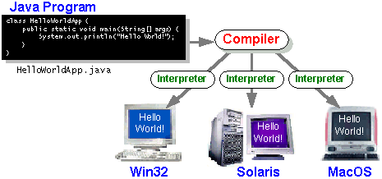
A Picture is Worth…
The output of the compiler is .class file
The Interpreter's are sometimes referred to as the Java Virtual Machines

Slide 88
So What!
The platform independence of Java may be a huge marketing tool, but is actually of little use to people learning Object Oriented Programming and Abstract Data Types
What is of use is the simplicity of the Java syntax and programming concepts
Java is a "pure" Object Oriented Language
encapsulation, inheritance, and polymorphism
all code must be contained in a class
no free functions (functions that do not belong to some class) like C++, although someone who wants to write messy Java code certainly can
Is OO the best programming paradigm?

Slide 89
HelloWorld.java
/*
A simple program
*/
public class HelloWorld
{
public static void main(String[] args)
{
System.out.println("HELLO CS307!");
}
}

Slide 90
Exercises
/*
A simple program
*/
public class Test
{
public static void main(String[] args)
{
int x=55+45/6*3%2-65+75*2/3;
System.out.println(“x=“+x);
}
}

Slide 91
Exercises
class Test {
public static void main(String[] args) {
int a = 12, b = 5;
System.out.println("a + b = " + (a + b));
System.out.println("a - b = " + (a - b));
System.out.println("a * b = " + (a * b));
System.out.println("a / b = " + (a / b));
System.out.println("a % b = " + (a % b));
}
}

Slide 92
Exercises
class Test {
public static void main(String[] args) {
int a = 4;
int var;
var = a;
System.out.println("var using =: " + var);
var += a;
System.out.println("var using +=: " + var);
var *= a;
System.out.println("var using *=: " + var);
}
}

Slide 93
Exercises
class Test {
public static void main(String[] args) {
int a = 7, b = 11;
System.out.println("a is " + a + " and b is " + b);
System.out.println(a == b);
System.out.println(a != b);
System.out.println(a > b);
System.out.println(a < b);
System.out.println(a >= b);
System.out.println(a <= b);
}
}

Slide 94
Exercises
class Test {
public static void main(String[] args) {
System.out.println((5 > 3) && (8 > 5));
System.out.println((5 > 3) && (8 < 5));
System.out.println((5 < 3) || (8 > 5)); System.out.println((5 > 3) || (8 < 5)); System.out.println((5 < 3) || (8 < 5)); System.out.println(!(5 == 3));
System.out.println(!(5 > 3));
}
}

Slide 95
Exercises
class Test {
public static void main(String[] args) {
int a = 12, b = 12;
int result1, result2;
System.out.println("Value of a: " + a);
result1 = ++a;
System.out.println("After increment: " + result1); System.out.println("Value of b: " + b);
result2 = --b;
System.out.println("After decrement: " + result2);
}
}

Slide 96
Exercises
class Test {
public static void main(String[] args) {
int februaryDays = 29;
String result;
result = (februaryDays == 28) ? "Not a leap year" : "Leap year";
System.out.println(result);
}
}

Slide 97
Exercises
public class Test {
public static void main(String[] args) {
int a = 20, b = 10, c = 30, result;
result = ((a > b) ? (a > c)? a: c: (b > c)? b: c);
System.out.println("Max of three numbers = "+ result);
}
}

Slide 98
Exercises
public class Test {
public static void main(String[] args) {
int a = 20, b = 10, c = 0, d = 20, e = 40, f = 30;
System.out.println("a+b/d = " + (a + b / d));
System.out.println("a+b*d-e/f = " + (a + b * d - e / f));
}
}

Slide 99
Exercises
public class Test {
public static void main(String[] args) {
int a = 20, b = 10, c = 0;
a = b++ + c;
System.out.println("Value of a(b+c), " + " b(b+1), c = "+ a + ", " + b + ", " + c);
// a=b+++++c is compiled as
// b++ ++ +c
// which gives error.
// a=b+++++c;
// System.out.println(b+++++c);
}
}

Slide 100
Exercises
public class Test {
public static void main(String[] args) {
int x = 5, y = 8;
System.out.println("Concatenation (x+y)= " + x + y);
System.out.println("Addition (x+y) = " + (x + y));
}
}

Slide 101
Exercises
// Importing required classes
import java.io.*;
class GFG {
public static void main(String[] args) {
int n1 = 20;
System.out.println("Number = " + n1);
n1 = -n1;
System.out.println("Result = " + n1);
}
}

Slide 102
Exercises
class Test {
public static void main(String[] args)
{
boolean cond = true;
int a = 10, b = 1;
System.out.println("Cond is: " + cond);
System.out.println("Var1 = " + a);
System.out.println("Var2 = " + b);
System.out.println("Now cond is: " + !cond);
System.out.println("!(a < b) = " + !(a < b));
System.out.println("!(a > b) = " + !(a > b));
}
}

Slide 103
Exercises
class Test {
public static void main(String[] args) {
int n1 = 6, n2 = -2;
System.out.println("First Number = " + n1);
System.out.println("Second Number = " + n2);
System.out.println( n1 + "'s bitwise complement = " ~n1);
System.out.println(n2 + "'s bitwise complement = " +~n2);
}
}

Slide 104
Exercises
class LogicalOPTest {
public static void main(String[] args){
int a = 10, b = 1;
System.out.println("Var1 = " + a);
System.out.println("Var2 = " + b);
System.out.println("!(a < b) = " + !(a < b));
System.out.println("!(a > b) = " + !(a > b));
}
}

Slide 105
Exercises
class Test {
public static void main(String[] args)
{
int n1 = 5, n2 = 10, res;
System.out.println("First num: " + n1);
System.out.println("Second num: " + n2);
res = (n1 > n2) ? (n1 + n2) : (n1 - n2);
System.out.println("Result = " + res);
}
}

Slide 106
Exercises
public class Test {
public static void main(String[] args) {
int a = 5;
int b = 7;
// bitwise and
// 0101 & 0111=0101 = 5
System.out.println("a&b = " + (a & b));
// bitwise or
// 0101 | 0111=0111 = 7
System.out.println("a|b = " + (a | b));
// bitwise xor
// 0101 ^ 0111=0010 = 2
System.out.println("a^b = " + (a ^ b));
// bitwise not
// ~0101=1010
// will give 2's complement of 1010 = -6
System.out.println("~a = " + ~a);
a &= b;
System.out.println("a= " + a);
}
}

Slide 107

Arithmetic Operators
Unary: + - ++ --
Examples: –5, +5
char ch=‘X’;
ch++; // (ch = ‘Y’)
Binary : + - * / %
Examples: int i= j+5;
int i=-10;
int k=i++;
What will the value of k be?
System.out.println(.4%.2);
What will the code print?
107
Notes:
Example 1:
int k=10;
k++; //value becomes 11
char ch=‘X’;
ch++; // (ch = ‘Y’)
Example 2:
int a = 5;
int b = 2;
int c = a + b;
System.out.println(5%2); // output is 1

Slide 108
Relational Operators
< > >= <= == !=
Returns true or false
Example:
int i=10;
int j=20;
System.out.println( i>j );
// output is false
System.out.println(i==10);
// output is true
108

Slide 109
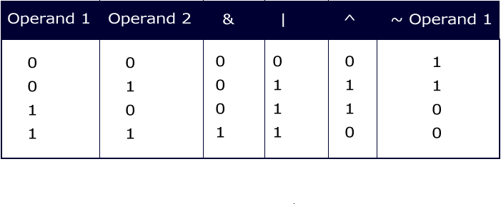
Integer Bitwise Operators
~ & | ^
They convert the integral data types into their binary form and then perform operations according the table.
109

Slide 110

Example : Integer Bitwise Operators
public class AndOrNotEx{
public static void main(String str[]){
byte x=1;
byte y=3;
System.out.println(x&y); // prints 1
System.out.println(x|y); // prints 3
System.out.println(x^y); // prints 2
System.out.println(~x); // prints -2
}}
Can you arrive at all of these without executing the code?
What will happen if you change byte to double?
110

Slide 111
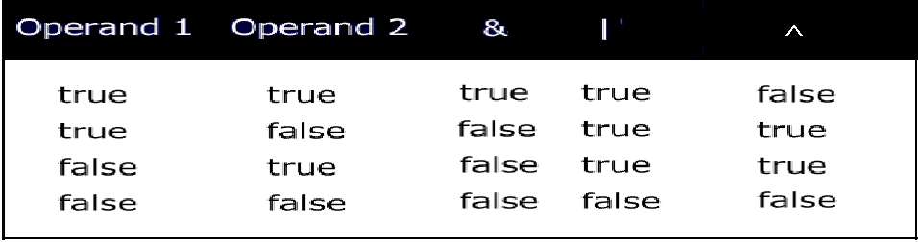
Logical Operators
& | ^
What will happen when you compile the following statement?
if(~(1>2))
System.out.println(“OK");
111

Slide 112
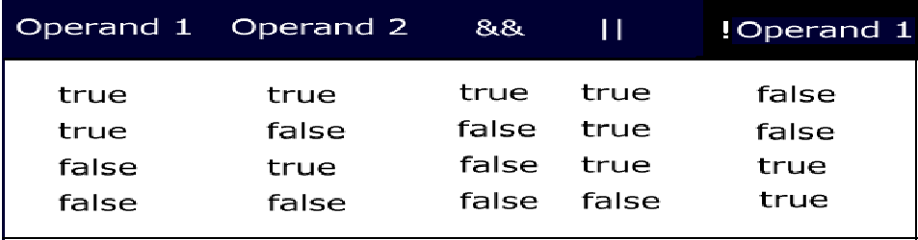
Conditional Logical Operators
&& || ! ?:
Logical operators are binary operators that require boolean values as operands.
&& and || are also called short circuit operators because they are optimized.
112
Notes:
How are the short circuit operators “optimized”?
&& checks if the first condition is false. If it is so, then it doesn't evaluate the second condition.
|| checks if the first condition is true. If it is so, then it doesn't evaluate the second condition.

Slide 113
Activity
Type this code and find out the difference between && and & operators?
public class Example{
public static void main(String args[]){
int i=0;
int j=2;
boolean b= (i>j) && (j++>i);
System.out.println(j);
b= (i>j) & (j++>i);
System.out.println(j);
}
}
113

Slide 114
Ternary operator
Syntax of ?:
<variable> = (boolean expression) ? <value to assign if true> : <value to assign if false>
Example :-
int i=10;
double j=10.1;
int k=(i>j)?10:20;
System.out.println(k); // outputs 20
What is the problem with the code below assuming i, j and k are declared as in the example above?
int k=(j=i)?10:20;
114

Slide 115
Compound Operators
+= -= *= /= %= &= |= ^=
Example:
int a = 10;
int b=2;
a+=b; // means a=(int)(a+b);
double d=45.3;
d/=1.2;
115
Notes:
Note that a=a+b; and a+=b; are not exact equivalents. The later involves a cast operator. We will look into this in greater detail after we have looked at cast.

Slide 116
Shift operators
>> the SHIFT RIGHT operator (Arithmetic Shift)
<< the SHIFT LEFT operator
>>> the UNSIGNED SHIFT RIGHT operator (Logical Shift)
System.out.println(2<<1); // prints 4
System.out.println(-1>>2); // prints -1
System.out.println(-1>>>2); // prints 1073741823
116
Notes:
In case of right shift there is always a debate whether the left bits that get vacant during the shift must retain the sign of the original number or not.Some people believe that the sign must be retained → Arithmetic Shift. Others believe it must not be retained → Logical Shift
That is the reason why Java came up with two shift operators >> for Arithmetic Shift and >>> for Logical Shift. (Recall the non-portability feature of Java)

Slide 117
Precedence
Operators Associativity
-------------------------------------------------------
[] . () methodCall() left to right
! ~ ++ -- - + new (cast) right to left
* / % left to right
+ - left to right
>> >>> << left to right
< > <= >= instanceof left to right
== != left to right
& left to right
^ left to right
| left to right
&& left to right
|| left to right
?: left to right
= += -= *= /= >>= <<= >>>= &= ^= |= left to right
117

Slide 118
Activity
Find out what happens if you try to shift more than the number of bits in an int ?
System.out.println(2<<32);
System.out.println(2>>32);
System.out.println(2>>>32);
System.out.println(2<<33);
System.out.println(2>>33);
System.out.println(2>>>33);
118

Slide 119
Flow control statements
Conditional Statements
if statement
Nested if else statement
switch statement
Loops
for statement
enhanced for statement
while statement
do-while statement
Loops can have break or continue.
All of these statements except (enhanced for statement) are same as that in C (in terms of the syntax and way they work).
But note that for Java conditions must always evaluate to boolean value.
The switch expression should be integer value (not long) or char and case expression must evaluate to a constant/final value
119

Slide 120
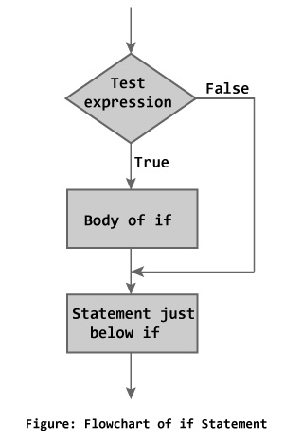
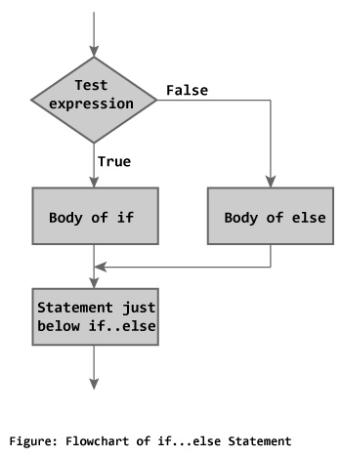
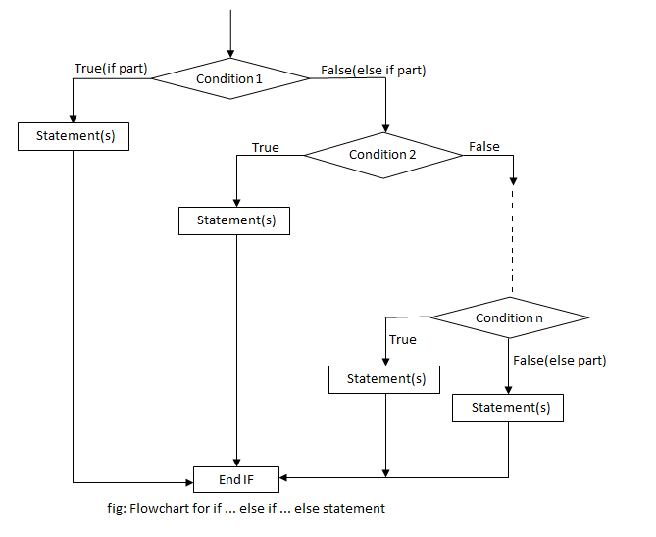
Notes:
if statement syntax:
if (condition) statement(s)
[else statement(s)] ;
if statement is same as that in C except that the condition must always evaluate to a boolean value.
Examples:
if(x==y) x++;
if (x>y) y++;
else x++;
if(true) { y++;
System.out.println(“OK”);
}

Slide 121
Example for nested if else
class Ladder
{
public static void main(String[] args)
{
int number = 0;
if (number > 0) {
System.out.println("Number is positive.");
}
else if (number < 0)
{
System.out.println("Number is negative.");
}
Else
{ System.out.println("Number is 0.");
}
}
}
Output: 0

Slide 122
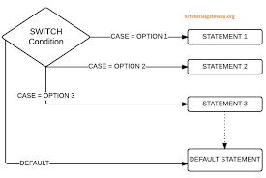
Syntax:
switch (expression){
[case expression: statement(s)]
…
[default: statement(s)]
}
Notes:
Switch statement:
Syntax:
switch (expression){
[case expression: statement(s)]
…
[default: statement(s)]
}
switch statement is also very similar to the one in C
switch expression must be either integer value (not long) or char. In Java SE and later, String can also be used in switch statement's expression
case expression must evaluate to a constant/final value.
break statement after every set of case statements will prevent fall-through.

Slide 123
Example for Switch
public class SwitchExample {
public static void main(String[] args) {
int number=20;
switch(number){
case 10: System.out.println("10");break;
case 20: System.out.println("20");break;
case 30: System.out.println("30");break;
default:System.out.println("Not in 10, 20 or 30");
}
}
}
Output:20

Slide 124
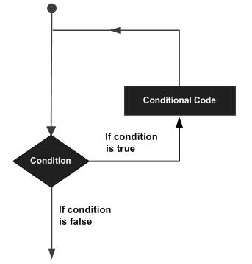
Looping
Notes:
for loop:
Syntax
for(initialization;condition;iteration) statement(s);
for statement (like in C) is used to iterate through a set of statements over a range of values specified and computed by the for loop itself.
The initialization expression is
used to initialize variable(s)
more than one variable initialization is separated by commas)
can also include initialization with declaration
executed only once when the loop begins.
The condition expression
Must evaluate to a boolean value
Loop iterates till the condition is true
Only one condition can be specified; multiple conditions can be combined using logical operators
is evaluated at the beginning of each loop
The iteration expression
is usually an increment or decrement expression of the variable initialized in the initialization expression
is evaluated at the beginning of each loop
while and do-while:
while(condition) statement(s);
do statement(s) while(condition);
Like in C, while and do-while statement are used to iterate through a set of statements till the condition remains true.
while evaluates the condition before at the beginning of each iteration whereas do-while evaluates condition only at the end of each iteration.
Therefore, do-while guarantees that the loop statements are executed at least once.
Condition expression must result in ___________
Can you think of a situation where you would prefer do-while instead of while?

Slide 125
Example for while
class PalindromeExample{
public static void main(String args[]){
int r,sum=0,temp;
int n=454;//It is the number variable to be checked for palindrome
temp=n;
while(n>0){
r=n%10; //getting remainder
sum=(sum*10)+r;
n=n/10;
}
if(temp==sum)
System.out.println("palindrome number ");
else
System.out.println("not palindrome");
}
}
Output:palindrome number

Slide 126
Example do-while Loop
Output: value of x : 10 value of x : 11 value of x : 12 value of x : 13 value of x : 14 value of x : 15 value of x : 16 value of x : 17 value of x : 18 value of x : 19
public class Test { public static void main(String args[]) { int x = 10; Do { System.out.print("value of x : " + x ); x++; System.out.print("\n"); } while( x < 20 ); } }

Slide 127
Example for Loop
public class FibonacciFor
{
public static void main(String[] args)
{
int n=10,first=0,second=1,next,i;
System.out.println("Printing first "+n+" numbers in Fibonacci Series \n");
for(i=0;i<n;i++)
{
if(i<=1)
next=i;
else
{
next = first + second;
first = second;
second = next;
}
System.out.print(next + "\t"); } }}
Output:0 1 1 2 3 5 8 13

Slide 128
Reading Input
Scanner class is provided by Java to read input. (in the package java.util)
To read input from console (keyboard)
System class is provided in the package java.lang (all classes in this are implicitly imported)
import java.util.Scanner;
public class StudentTester {
public static void main (String[] args) {
Scanner inp = new Scanner (System.in);
int myNum = 0;
if ( inp.hasNextInt() ) {
myNum = inp.nextInt();
}
System.out.println(“num = “ + myNum);
}
nextInt() is a method provided in the Scanner class which returns the integer value typed by the user.
Note: if a value which is not an integer is entered “Exception” is raised. method hasNextInt() : check if an integer is available. If so call nextInt()
System.in is an object provided by Java
Notes:
128

Slide 129
Reading Input
// example to read from console input but it throw exception if i/p is not number
import java.util.Scanner;
public class readint2
{
public static void main (String[] args)
{
Scanner inp = new Scanner (System.in);
System.out.print("How old are you") ;
int age = inp.nextInt();
System.out.println("I am " + age +" years old");
}
}
Output
How old are you 25
I am 25 years old
Notes:
129

Slide 130
Reading Input
Output (Input mismatch Exception is thrown)
How old are you abc
Exception in thread "main" java.util.InputMismatchException
at java.util.Scanner.throwFor(Scanner.java:909)
at java.util.Scanner.next(Scanner.java:1530)
at java.util.Scanner.nextInt(Scanner.java:2160)
at java.util.Scanner.nextInt(Scanner.java:2119)
at readint2.main(readint2.java:9)
Notes:
130

Slide 131
Reading Input
(some) Methods provided by Scanner class
a. Check if input is available ( return boolean i.e true/false)
Eg. Scanner inp = new Scanner(System.in)
int age = inp.nextInt();
inp.hasNextLine()
inp.hasNextInt()
inp.hasNextFloat()
inp.hasNextDouble()
b. Reading the next input
String aLine = inp.nextLine();
int age = inp.nextInt();
float length = inp.nextFloat();
double weight = inp.nextDouble();
No function for reading a character.
So read a string and take the first char;
Notes:
131

Slide 132
Reading a String
// example to read name
import java.util.Scanner;
public class readname1
{
public static void main (String[] args)
{
System.out.print("Enter your username: ");
Scanner readname = new Scanner(System.in);
String username = readname.nextLine();
System.out.println("Your username is " + username);
}
}
Output
Enter your username: suresh kumar
Your username is suresh kumar
Notes:
132

Slide 133
Class
A class is a construct created in object-oriented programming languages that enables creation of objects.
Also sometimes called blueprint or template or prototype from which objects are created.
It defines members (variables and methods).
A class is an abstraction.

Slide 134
Class
class is a template for an object, and an object is an instance of a class.
Class is declared by use of the class keyword.
class classname {
type instance-variable1;
type instance-variable2;
// ...
type instance-variableN;
type methodname1(parameter-list)
{
// body of method
}
type methodname2(parameter-list) {
// body of method
}
// ...
type methodnameN(parameter-list) {
// body of method
}
}

Slide 135
Class
Eg.
class Box
{
double width;
double height;
double depth;
}

Slide 136
Sample Program 1
/* A program that uses the Box class.
Call this file BoxDemo.java
*/
class Box
{
double width;
double height;
double depth;
}
// This class declares an object of type Box.
class BoxDemo
{
public static void main(String args[])
{
Box mybox = new Box();
double vol;
// assign values to mybox's instance variables
mybox.width = 10;
mybox.height = 20;
mybox.depth = 15;
// compute volume of box
vol = mybox.width * mybox.height * mybox.depth;
System.out.println("Volume is " + vol);
}
}
Output
Volume is 3000.0

Slide 137
Sample Program 2 (declares two objects)
// This program declares two Box objects.
class Box
{
double width;
double height;
double depth;
}
class BoxDemo2
{
public static void main(String args[])
{
Box mybox1 = new Box();
Box mybox2 = new Box();
double vol;
// assign values to mybox1's instance variables
mybox1.width = 10;
mybox1.height = 20;
mybox1.depth = 15;
/* assign different values to mybox2's
instance variables */
mybox2.width = 3;
mybox2.height = 6;
mybox2.depth = 9;
// compute volume of first box
vol = mybox1.width * mybox1.height * mybox1.depth;
System.out.println("Volume is " + vol);
// compute volume of second box
vol = mybox2.width * mybox2.height * mybox2.depth;
System.out.println("Volume is " + vol);
}
}
Output
Volume is 3000.0
Volume is 162.0

Slide 138
Sample Program 3 (Passing values)
class Box
{
double width;
double height;
double depth;
// compute and return volume
double volume()
{
return width * height * depth;
}
// sets dimensions of box
void setDim(double w, double h, double d)
{
width = w;
height = h;
depth = d;
}
}
class BoxDemo5
{
public static void main(String args[])
{
Box mybox1 = new Box();
Box mybox2 = new Box();
double vol;
// initialize each box
mybox1.setDim(10, 20, 15);
mybox2.setDim(3, 6, 9);
// get volume of first box
vol = mybox1.volume();
System.out.println("Volume is " + vol);
// get volume of second box
vol = mybox2.volume();
System.out.println("Volume is " + vol);
}
}
Ouput
Volume is 3000.0
Volume is 162.0

Slide 139
Access Specifier
public can be accessed from anywhere.
private cannot be seen outside of its class. When a member does not have an explicit access specification, it is visible to subclasses as well as to other classes in the same package. This is the default access.
If you want to allow an element to be seen outside your current package, but only to classes that subclass your class directly, then declare that element protected.
A class has only two possible access levels: default and public. When a class is declared as public, it is accessible by any other code. If a class has default access, then it can only be accessed by other code within its same package.

Slide 140
Class Member Access

Slide 141
Access Specifier
class Test { int a; // default access public int b; // public access private int c; // private access // methods to access c void setc(int i) { // set c's value c = i; } int getc() { // get c's value return c; } } }
class AccessTest { public static void main(String args[]) { Test ob = new Test(); // These are OK, a and b may be accessed directly ob.a = 10; ob.b = 20; // This is not OK and will cause an error // ob.c = 100; // Error! // You must access c through its methods ob.setc(100); // OK System.out.println("a, b, and c: " + ob.a + " " + ob.b + " " + ob.getc()); } }

Slide 142
Abstraction
An essential element of object-oriented programming is abstraction.
Humans manage complexity through abstraction.
For example, people do not think of a car as a set of tens of thousands of individual parts. They think of it as a well-defined object with its own unique behaviour.
This abstraction allows people to use a car to drive to the grocery store without being overwhelmed by the complexity of the parts that form the car. They can ignore the details of how the engine, transmission, and braking systems work. Instead they are free to utilize the object as a whole.

Slide 143
Example
class Customer {
int account_no;
float balance_Amt;
String name;
int age;
String address;
void balance_inquiry()
{ /* to perform balance inquiry only account number is required that means remaining properties are hidden for balance inquiry method */ }
void fund_Transfer()
{ /* To transfer the fund account number and balance is required and remaining properties are hidden for fund transfer method */ }

Slide 144
OOP Principles
Encapsulation
Encapsulation is the mechanism that binds together code and the data it manipulates, and keeps both safe from outside interference and misuse.
One way to think about encapsulation is as a protective wrapper that prevents the code and data from being arbitrarily accessed by other code defined outside the wrapper. Access to the code and data inside the wrapper is tightly controlled through a well-defined interface.

Slide 145
public class EncapTest { private String name; private String idNum; private int age; public int getAge() { return age; } public String getName() { return name; } public String getIdNum() { return idNum; } public void setAge( int newAge) { age = newAge; } public void setName(String newName) { name = newName; } public void setIdNum( String newId) { idNum = newId; } }
public class RunEncap { public static void main(String args[]) { EncapTest encap = new EncapTest(); encap.setName("James"); encap.setAge(20); encap.setIdNum("12343ms"); System.out.print("Name : " + encap.getName() + " Age : " + encap.getAge()); } } Output: Name : James Age : 20

Slide 146
OOP Principles
Inheritance
Inheritance is the process by which one object acquires the properties of another object.
This is important because it supports the concept of hierarchical classification.
Knowledge is made manageable by hierarchical (that is, top-down) classifications.
It can inherit its general attributes from its parent.
Inheritance mechanism that makes it possible for one object to be a specific instance of a more general case.
Eg. Animals , Mammals (they inherit all the attributes of animals)

Slide 147
OOP Principles
Polymorphism
Polymorphism (from the Greek, meaning “many forms”) is a feature that allows one interface to be used for a general class of actions.
Eg. One stack is used for integer values, one for floating-point values, and one for characters. The algorithm that implements each stack is the same

Slide 148
Constructor
Java allows objects to initialize themselves when they are created. This automatic initialization is performed through the use of a constructor.
A constructor initializes an object immediately upon creation. It has the same name as the class in which it resides and is syntactically similar to a method. Once defined, the constructor is automatically called immediately after the object is created, before the new operator completes.
Constructors look a little strange because they have no return type, not even void. This is because the implicit return type of a class constructor is the class type itself.

Slide 149
Sample Program (Constructor )
/* Here, Box uses a constructor to initialize the
dimensions of a box.
*/
class Box
{
double width;
double height;
double depth;
// This is the constructor for Box.
Box() {
System.out.println("Constructing Box");
width = 10;
height = 10;
depth = 10;
}
// compute and return volume
double volume() {
return width * height * depth;
}
}
class constructor
{
public static void main(String args[])
{
// declare, allocate, and initialize Box objects
Box mybox1 = new Box();
Box mybox2 = new Box();
double vol;
// get volume of first box
vol = mybox1.volume();
System.out.println("Volume is " + vol);
// get volume of second box
vol = mybox2.volume();
System.out.println("Volume is " + vol);
}
}

Slide 150
Constructor (Output)
Constructing Box
Constructing Box
Volume is 1000.0
Volume is 1000.0

Slide 151
Constructors Overloading
Multiple constructors in the same class with different parameters is called as constructor overloading.
class rectangle
{
private int l,b;
public rectangle()
{
l=b=10;
}
public rectangle(int x)
{
l=b=x;
}
public void area()
{
System.out.println(“Area =“+l*b);
}}
class main
{
public static void main(String args[])
{
rectangle r1 = new rectangle();
rectangle r2 = new rectangle(5);
r1.area();
r2.area(); Output
Area = 100
Area = 25

Slide 152
Parameterized Constructors
While the Box( ) constructor in the preceding example does initialize a Box object, it is not very useful—all boxes have the same dimensions. What is needed is a way to construct Box objects of various dimensions. The easy solution is to add parameters to the constructor

Slide 153
Parameterized Constructors
/* Here, Box uses a parameterized constructor to
initialize the dimensions of a box.
*/
class Box {
double width;
double height;
double depth;
// This is the constructor for Box.
Box(double w, double h, double d) {
width = w;
height = h;
depth = d;
}
// compute and return volume
double volume() {
return width * height * depth;
}
}
class BoxDemo7
{
public static void main(String args[])
{
// declare, allocate, and initialize Box objects
Box mybox1 = new Box(10, 20, 15);
Box mybox2 = new Box(3, 6, 9);
double vol;
// get volume of first box
vol = mybox1.volume();
System.out.println("Volume is " + vol);
// get volume of second box
vol = mybox2.volume();
System.out.println("Volume is " + vol);
}
}
Output
Volume is 3000.0
Volume is 162.0

Slide 154
Copy Constructors
There is no copy constructor in java. But, we can copy the values of one object to another like copy constructor in C++.
Parameterized constructor to which the parameter passed in an object is called as copy constructor.
The parameters of the object passed to the constructor are used to initialize the parameters of the newly created object, hence the name “copy”

Slide 155
Copy Constructors
There are many ways to copy the values of one object into another in java
By constructor
By assigning the values of one object into another
By clone() method of Object class

Slide 156
Copy Constructors Eg.
import java.util.*;
class circle
{
private float r,area;
circle()
{
Scanner sc = new Scanner(System.in);
System.out.print("Enter Radius :");
r=sc.nextInt();
}
circle(circle x)
{
r=x.r;
}
void calculate()
{
area=3.14f*r*r;
}
void display()
{
System.out.println("Area ="+area);
}
}

Slide 157
Copy Constructors Eg...
class copycons
{
public static void main(String args[])
{
circle c = new circle();
c.calculate();
c.display();
circle c1 = new circle(c);
c1.calculate();
c1.display();
}
}
Output
Enter Radius :10
Area =314.0
Area =314.0

Slide 158
Copy Constructors Eg.
class studentcpy
{
int id;
String name;
studentcpy(int i, String n)
{
id = i;
name = n;
}
studentcpy(studentcpy s)
{
id=s.id;
name=s.name;
}
void display()
{
System.out.println(id+" " +name);
}
public static void main(String args[])
{
studentcpy s1 = new studentcpy(101,"Suresh");
studentcpy s2 = new studentcpy(s1);
s1.display();
s2.display();
}
}
Output
101 Suresh
101 Suresh

Slide 159
Passing Objects to a Method
In copy constructor we can pass an object of the same class to the constructor.
Objects can be passed to methods also
When a object passed to a method in java the values contained in that object can be changed. These values will remain changed even when the method execution ends and the control returns to the caller method.

Slide 160
Passing Objects to a Method Ex. 1
public class passobj1
{
private int value;
public static void main(String args[])
{
passobj1 p = new passobj1();
p.value=5;
System.out.println("Before calling " +p.value);
increment(p);
System.out.println("After calling " +p.value);
}

Slide 161
Passing Objects to a Method Ex. 1…
public static void increment(passobj1 a)
{
a.value++;
}
}
Output
Before calling 5
After calling 6

Slide 162
Passing Objects to a Method Ex.
class Rectangle
{
int length, width;
Rectangle(int l, int b) {
length = l;
width = b; }
void area(Rectangle r1)
{
int areaOfRectangle = r1.length * r1.width;
System.out.println("Area of Rectangle : " + areaOfRectangle);
}
}

Slide 163
Passing Objects to a Method Ex…
class passobj
{
public static void main(String args[])
{
Rectangle r1 = new Rectangle(10, 20);
r1.area(r1);
}
}
Output
Area of Rectangle : 200

Slide 164
Returning Objects from a Method
The return type of method indicates what type of data will a method return
If the method return an integer type data
Then the return type is written as int
Similarly for float
If an object of a class is to be returned the return type of that method will be the name of the class, whose object is to be returned.

Slide 165
Returning Objects from a Method…
class Rectangle {
int length;
int breadth;
Rectangle(int l,int b)
{
length = l;
breadth = b;
}
Rectangle getRectangleObject()
{
Rectangle rect = new Rectangle(10,20);
return rect;
}
}

Slide 166
Returning Objects from a Method…
class Retobj {
public static void main(String args[]) {
Rectangle ob1 = new Rectangle(40,50);
Rectangle ob2;
ob2 = ob1.getRectangleObject();
System.out.println("ob1.length : " + ob1.length);
System.out.println("ob1.breadth: " + ob1.breadth);
System.out.println("ob2.length : " + ob2.length);
System.out.println("ob2.breadth: " + ob2.breadth);
}
}

Slide 167
Returning Objects from a Method…
Output
ob1.length : 40
ob1.breadth: 50
ob2.length : 10
ob2.breadth: 20

Slide 168
Overloading Methods
In Java it is possible to define two or more methods within the same class that share the same name, as long as their parameter declarations are different. When this is the case, the methods are said to be overloaded, and the process is referred to as method overloading.
Method overloading is one of the ways that Java implements polymorphism.

Slide 169
Overloading Methods Ex.
// Example for method overloading.
class OverloadDemo {
void add1() {
System.out.println("No parameters");
}
// Overload test for one integer parameter.
void add1(int a) {
System.out.println("a: " + a);
}
// Overload test for two integer parameters.
void add1(int a, int b) {
System.out.println("SUM of a and b: " + (a+b));
}
// overload test for a double parameter
double add1(double a) {
System.out.println("double a: " + a);
return a*a;
}
}

Slide 170
Abstract class and methods
Declaring a class as an abstract class prevents you from creating instances of that class.
Abstract methods are the methods that don’t have the method body. They are just declarations
While an abstract class can have abstract methods, it could also NOT have any abstract methods.
The whole class must be declared abstract, even if a single method is abstract.
An abstract method must not be static.
A class can inherit from abstract class either by complete or partial Implementation. In the case of partial implementation, the class should be marked abstract.

Slide 171
Abstract class - Ex
// A Simple demonstration of abstract.
abstract class A {
abstract void callme();
// concrete methods are still allowed in abstract classes
void callmetoo()
{
System.out.println("This is a concrete method.");
}
}
class B extends A {
void callme() {
System.out.println("B's implementation of callme.");
}
}
class AbstractDemo
{
public static void main(String args[])
{
B b = new B();
b.callme();
b.callmetoo();
}
}
Ouput
B's implementation of callme.
This is a concrete method.

Slide 172
Superclass
super acts somewhat like this, except that it always refers to the superclass of the subclass in which it is used. This usage has the following
general form: super.member
member can be either a method or an instance variable.
This second form of super is most applicable to situations in which member names of a subclass hide members by the same name in the superclass.

Slide 173
Superclass Ex.
// Using super to overcome name hiding.
class A
{
int i;
}
// Create a subclass by extending class A.
class B extends A
{
int i; // this i hides the i in A
B(int a, int b)
{
super.i = a; // i in A
i = b; // i in B
}
void show() {
System.out.println("i in superclass: " + super.i);
System.out.println("i in subclass: " + i);
}
}
class UseSuper {
public static void main(String args[]) {
B subOb = new B(1, 2);
subOb.show();
}
}
Output
i in superclass: 1
i in subclass: 2

Slide 174
Static Keyword
You can declare both methods and variables to be static.
example of a static member is main( ). main( ) is declared as static because it must be called before any objects exist.
Instance variables declared as static are, essentially, global variables. When objects of its class are declared, no copy of a static variable is made. Instead, all instances of the class share the same static variable.

Slide 175
Static Keyword…
When you will want to define a class member that will be used independently of any object of that class. Normally a class member must be accessed only in conjunction with an object of its class. However, it is possible to create a member that can be used by itself, without reference to a specific instance. To create such a member, precede its declaration with the keyword static.
When a member is declared static, it can be accessed before any objects of its class are created, and without reference to any object.

Slide 176
static block
If you need to do computation in order to initialize your static variables, you can declare a static block which gets executed exactly once, when the class is first loaded

Slide 177
static restrictions
Methods declared as static have several restrictions
They can only call other static methods.
They must only access static data.
They cannot refer to this or super in any way.

Slide 178
Static – Eg.
// Demonstrate static variables, methods, and blocks.
class UseStatic {
static int a = 3;
static int b;
static void meth(int x) {
System.out.println("x = " + x);
System.out.println("a = " + a);
System.out.println("b = " + b);
}
static {
System.out.println("Static block initialized.");
b = a * 4;
}
public static void main(String args[]) {
meth(42);
}
}

Slide 179
Static – Eg…
Output
Static block initialized.
x = 42
a = 3
b = 12
As soon as the UseStatic class is loaded, all of the static statements are run. First, a is set to 3, then the static block executes (printing a message), and finally, b is initialized to a * 4 or 12. Then main( ) is called, which calls meth( ), passing 42 to x. The three println( ) statements refer to the two static variables a and b, as well as to the local variable x.

Slide 180
Nested Class : Special Case(Inner Class)
two types of nested classes:
Non-static nested class (inner class) i. Member Inner Class ii. Anonymous Inner Class iii. Local Inner Class
Static nested class
Questions to Students
Java inner class or nested class is a class which is declared inside the class or interface.
We use inner classes to logically group classes and interfaces in one place so that it can be more readable and maintainable.
Additionally, it can access all the members of outer class including private data members and methods.
Advantage of java inner classes
Code Optimization: It requires less code to write.

Slide 181
Inner Class
class InnerClassDemo() { Public static void main(String args[]){ Outer outter=new Outer(); outer.test(); } } Output: outer_x=100
class outer { Int outer_x=100; Void test() { Inner inner=new Inner(); Inner.display(); //this is an inner class class Inner { Void display() { System.out.println(“display: outter_x”+outer_x); } } }
Notes:
A inner class is a class that is defined inside other class. There are two main advantages to inner classes:
1.They can make the outer class more self-contained since they are defined inside a class
2.Both of their methods have access to each other's private methods and instance variables.

Slide 182
Static Inner Classes
Copyright © 2008 Pearson Addison-Wesley.
All rights reserved
A normal inner class has a connection between its objects and the outer class object that created the inner class object
This allows an inner class definition to reference an instance variable, or invoke a method of the outer class
There are certain situations, however, when an inner class must be static
If an object of the inner class is created within a static method of the outer class
If the inner class must have static members
Notes:
182

Slide 183
Static Inner Classes
Copyright © 2008 Pearson Addison-Wesley.
All rights reserved
Since a static inner class has no connection to an object of the outer class, within an inner class method
Instance variables of the outer class cannot be referenced
Nonstatic methods of the outer class cannot be invoked
To invoke a static method or to name a static variable of a static inner class within the outer class, preface each with the name of the inner class and a dot
Notes:
183

Slide 184
Local Inner Class
public class localInner1{ private int data=30;//instance variable void display(){ class Local{ void msg(){System.out.println(data);} } Local l=new Local(); l.msg(); } public static void main(String args[]){ localInner1 obj=new localInner1(); obj.display(); } } Output: 30

Slide 185
Anonymous Inner Class
Doesn’t name the class
inner class defined at the place where you create an instance of it (in the middle of a method)
Useful if the only thing you want to do with an inner class is create instances of it in one location
In addition to referring to fields/methods of the outer class, can refer to final local variables

Slide 186
Syntax for anonymous inner classes
use new Foo() { public int one() { return 1; } public int add(int x, int y) { return x+y; } };
to define an anonymous inner class that:
extends class Foo
defines methods one and add

Slide 187
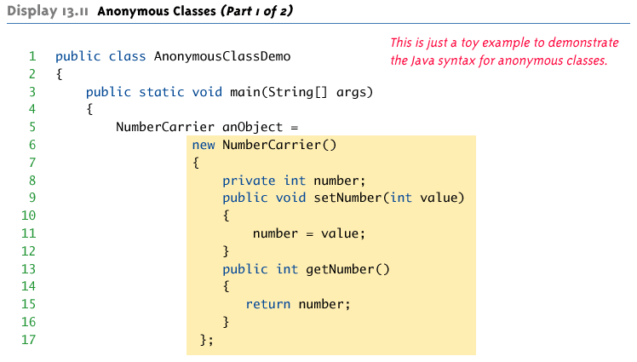
Anonymous Classes
Copyright © 2008 Pearson Addison-Wesley.
All rights reserved
Notes:
187

Slide 188
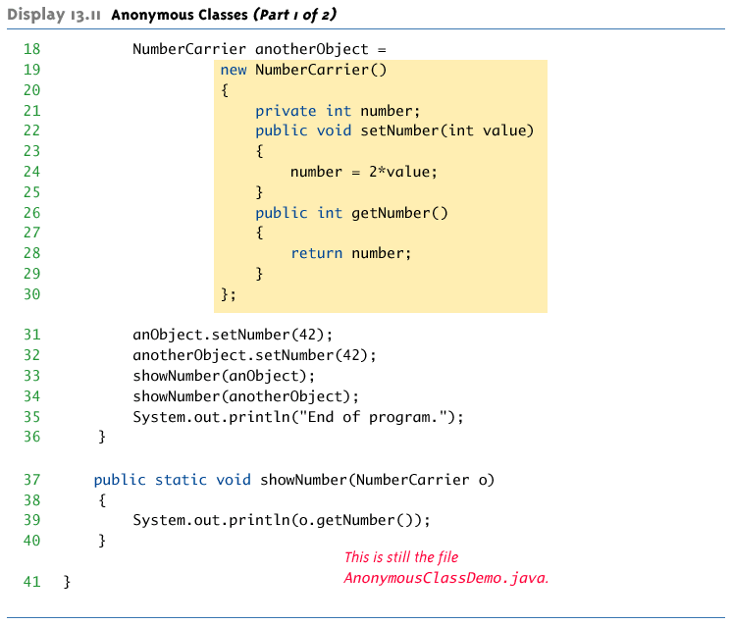
Anonymous Classes
Copyright © 2008 Pearson Addison-Wesley.
All rights reserved
Notes:
188

Slide 189
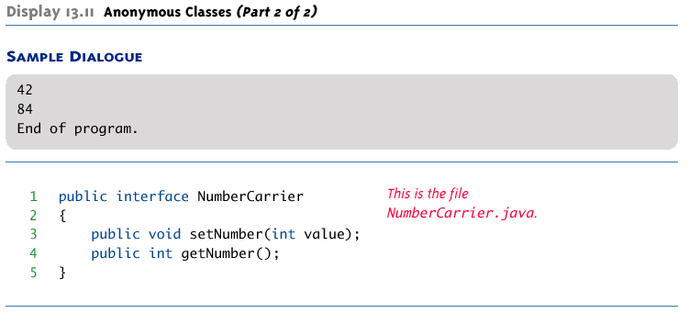
Anonymous Classes
Copyright © 2008 Pearson Addison-Wesley.
All rights reserved
Notes:
189

Slide 190
Anonymous Classes
Java8 Lamda Notation
Leads to most popular Lambda Notation.
If an interface has one method , then this can lead to create an anonymous inner class with one method to override.
Example ActionListener
Leads to @FunctionalInterface also

Slide 191
Java anonymous class that implements ActionListener
……
button.addActionListener(new ActionListener() {
public void actionPerformed(ActionEvent arg0) {
counter --; setText(counter + "");
}
}
);
Using Lamda Notation
button.addActionListener(e -> { System.out.println("Handled Lambda listener"); System.out.println("Have fun!"); });

Slide 192
Abstract Class
abstract class Shape{
abstract void draw();
}
class Rectangle extends Shape{
void draw(){
System.out.println("drawing rectangle");}
}
class Circle1 extends Shape{
void draw(){System.out.println("drawing circle");}
}
class TestAbstraction1{
public static void main(String args[]){
Shape s=new Circle1();
s.draw();
}
}
Questions to Students
An abstract class is a class that is declared abstract —it may or may not include abstract methods.
Abstract classes cannot be instantiated, but they can be subclassed.
When an abstract class is subclassed, the subclass usually provides implementations for all of the abstract methods in its parent class.
//In real scenario, implementation is provided by others i.e. unknown by end user
//In real scenario, method is called by programmer or user
//In a real scenario, object is provided through method, e.g., getShape() method

Slide 193
Interface
interface printable{
void print();
}
class A implements printable{
public void print(){
System.out.println("Hello");
}
public static void main(String args[]){
A obj = new A6();
obj.print();
}
}
Questions to Students
The interface in Java is a mechanism to achieve abstraction. There can be only abstract methods in the Java interface, not method body. It is used to achieve abstraction and multiple inheritance in Java.
interfaces can have abstract methods and variables. It cannot have a method body.

