Slide 1
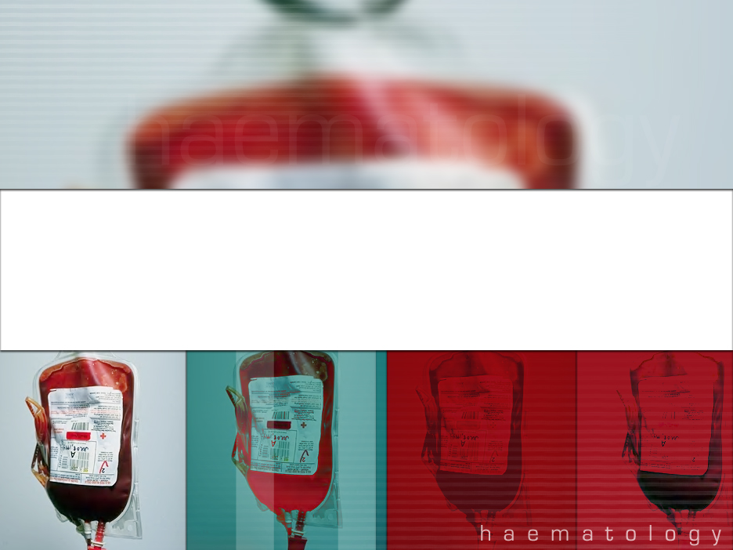
Blood Bank QEH- An era of bankruptcy??
Department of Haematology
Dr. Renée Boyce
Dr. Theresa Laurent (consultant/advisor)

Slide 2

The rational use of blood and blood products

Slide 3
Presentation Aims
To discuss the following:
    The various components available from blood
    The rational use of blood and its components
    Problems faced by QEH
    Proposals for improved blood product usage in QEH

Slide 4
Blood is an amazing fluid!
Keeps us warm
Provides nutrients for cells, tissues and organs
Removes waste products from various sites

Slide 5
What is blood?
A highly specialised circulating tissue which has several types of cells suspended in a liquid medium called plasma.
Origins from Greek ‘haima’
Blood is a life sustaining fluid

Slide 6


Slide 7
Blood components
Packed red cells
Platelets
Fresh Frozen Plasma
Frozen plasma
Cryoprecipitate
Albumin
Immunoglobulins

Slide 8
Local study
Looked at the donations over period January 1, 2006 to December 31, 2006
Examined the various products collected during that period
Study limitations

Slide 9
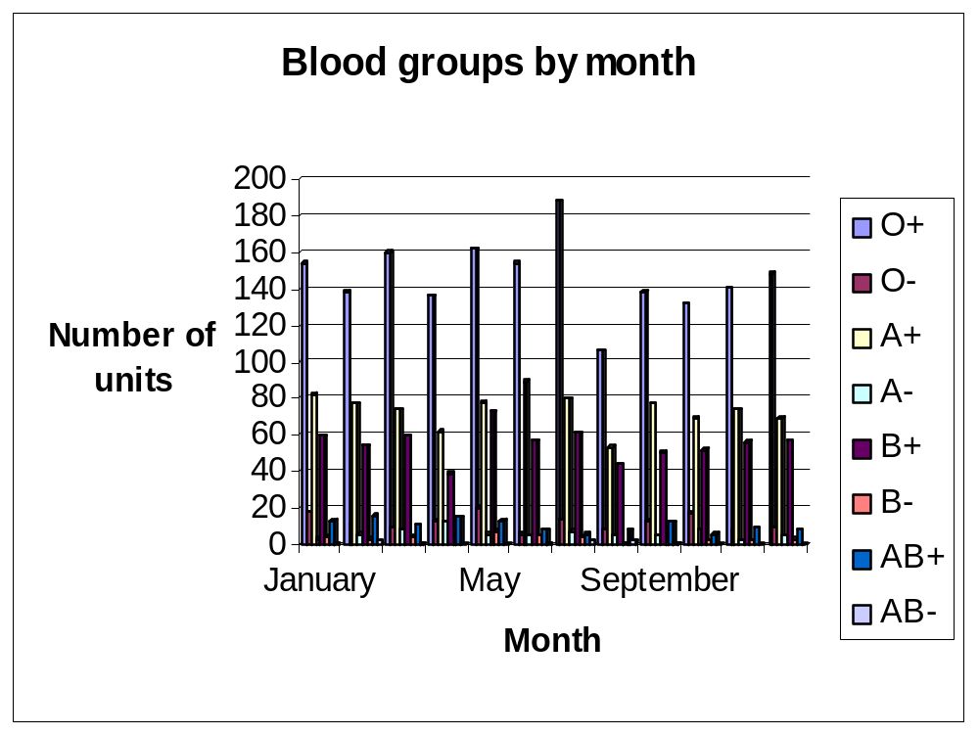

Slide 10
Table of ABO and Rh distribution by nation
ABO and Rh blood type distribution by nation (averages for each population)
Population | O+ | A+ | B+ | AB+ | O− | A− | B− | AB−
Australia^{[11]} | 40% | 31% | 8% | 2% | 9% | 7% | 2% | 1%
Canada^{[12]} | 39% | 36% | 7.6% | 2.5% | 7% | 6% | 1.4% | 0.5%
Denmark^{[13]} | 35% | 37% | 8% | 4% | 6% | 7% | 2% | 1%
Finland^{[14]} | 27% | 38% | 15% | 7% | 4% | 6% | 2% | 1%
France^{[15]} | 36% | 37% | 9% | 3% | 6% | 7% | 1% | 1%
Hong Kong, China^{[16]} | 40% | 26% | 27% | 7% | <0.3% | <0.3% | <0.3% | <0.3%
Korea, South^{[17]} | 27.4% | 34.4% | 26.8% | 11.2% | 0.1% | 0.1% | 0.1% | 0.05%
Poland^{[18]} | 31% | 32% | 15% | 7% | 6% | 6% | 2% | 1%
Sweden^{[19]} | 32% | 37% | 10% | 5% | 6% | 7% | 2% | 1%
UK^{[20]} | 37% | 35% | 8% | 3% | 7% | 7% | 2% | 1%
USA^{[21]} | 38% | 34% | 9% | 3% | 7% | 6% | 2% | 1%

Slide 11
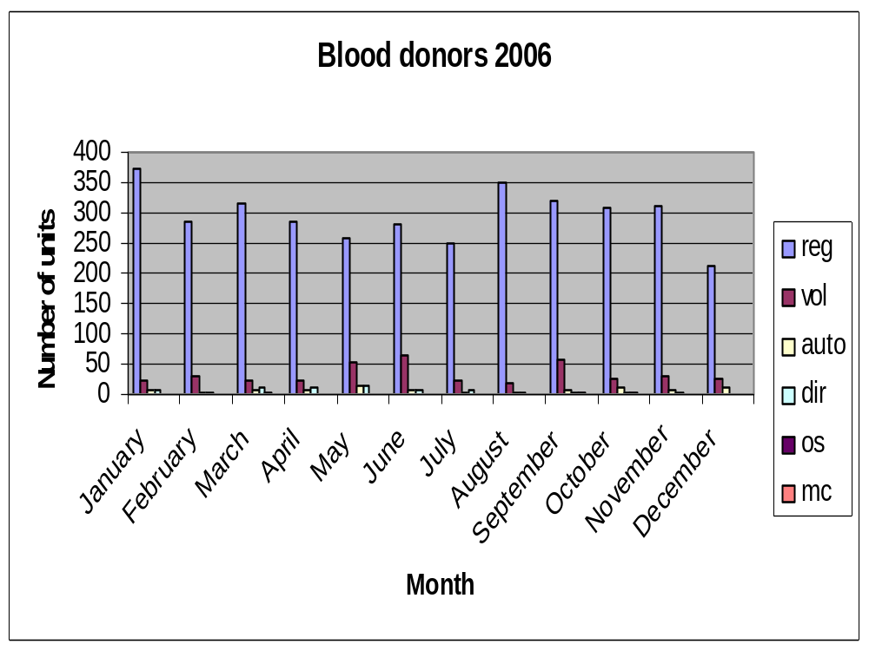

Slide 12
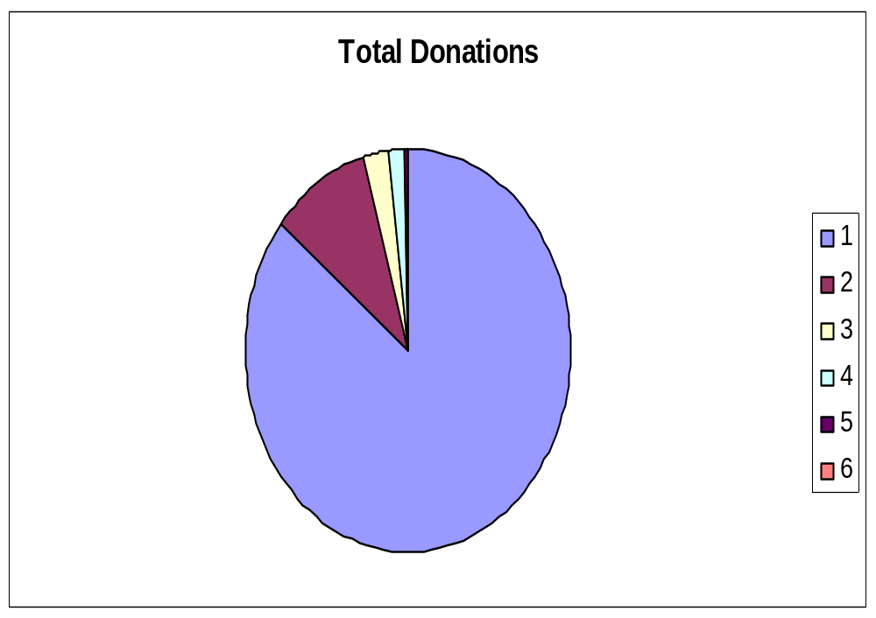

Slide 13
Theoretical Yield of components
1 unit of blood theoretically gives
  1 unit FFP
  1 unit PRBC’s
  1 single donor unit cryoprecipitate, single donor unit platelets
    Plasma for Ig and albumin
In theory
  4138 U of FFP, 4138 U PRBC’s, 4138 U cryo 4138 single donor units platelets
In reality
  334 U FFP, 2405 U PRBC’s, 46U cryo*
  216 U plasma, 409 U platelets*

Slide 14
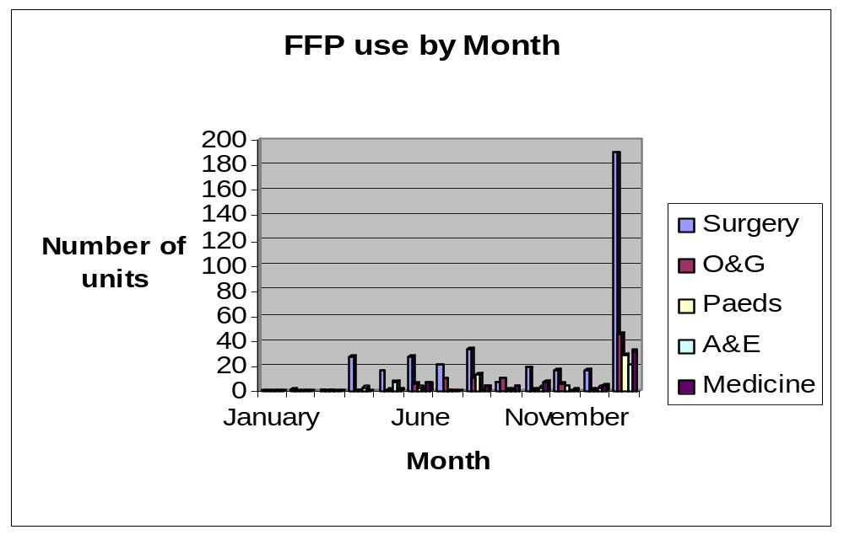
Component use by month

Slide 15
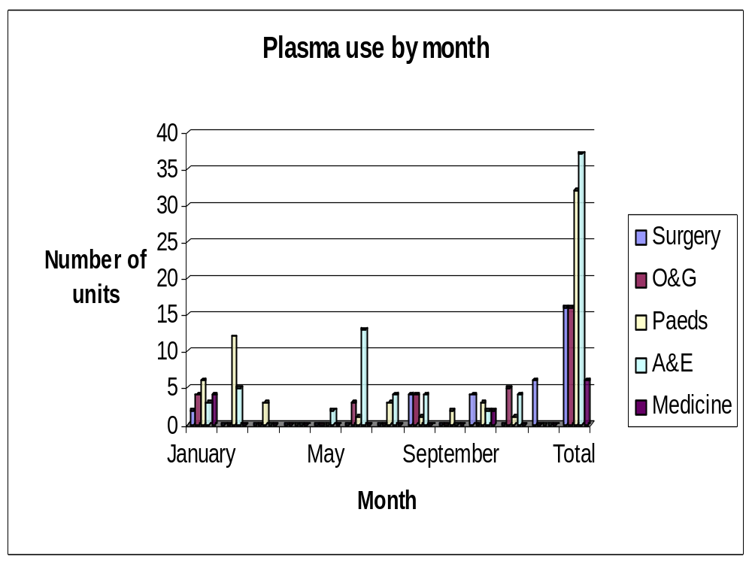

Slide 16
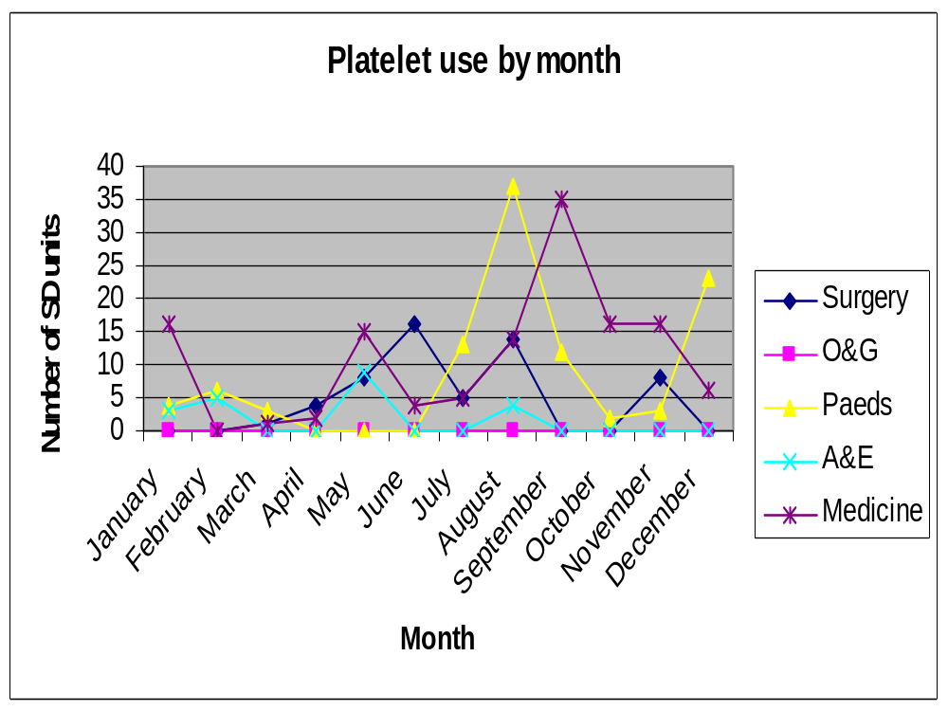

Slide 17
Discarded Units
Whole blood 504 (39%)
Packed cells 13 (5%)
FFP 29 (9%)
Platelets 169 (41%)

Slide 18
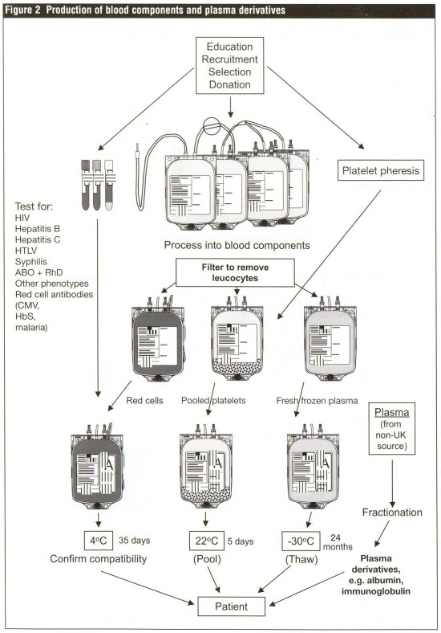

Slide 19
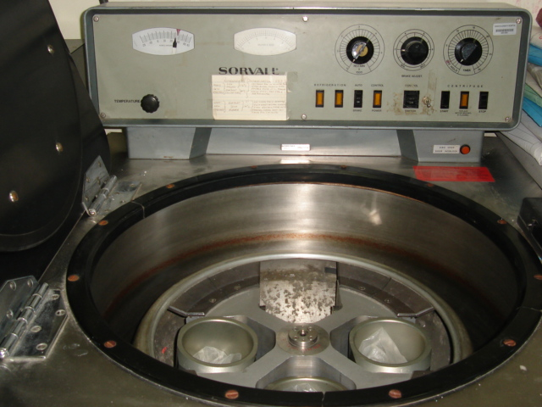
Blood separation

Slide 20
The Donation Process
Education
Recruitment
Selection
Donation

Slide 21
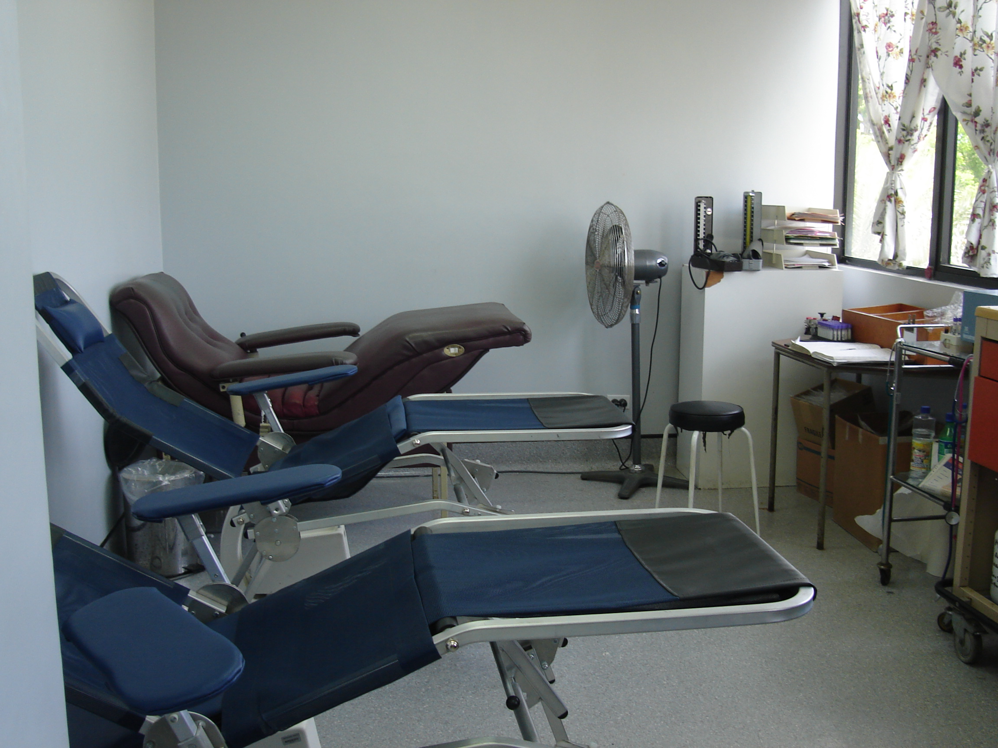
Blood Collecting

Slide 22
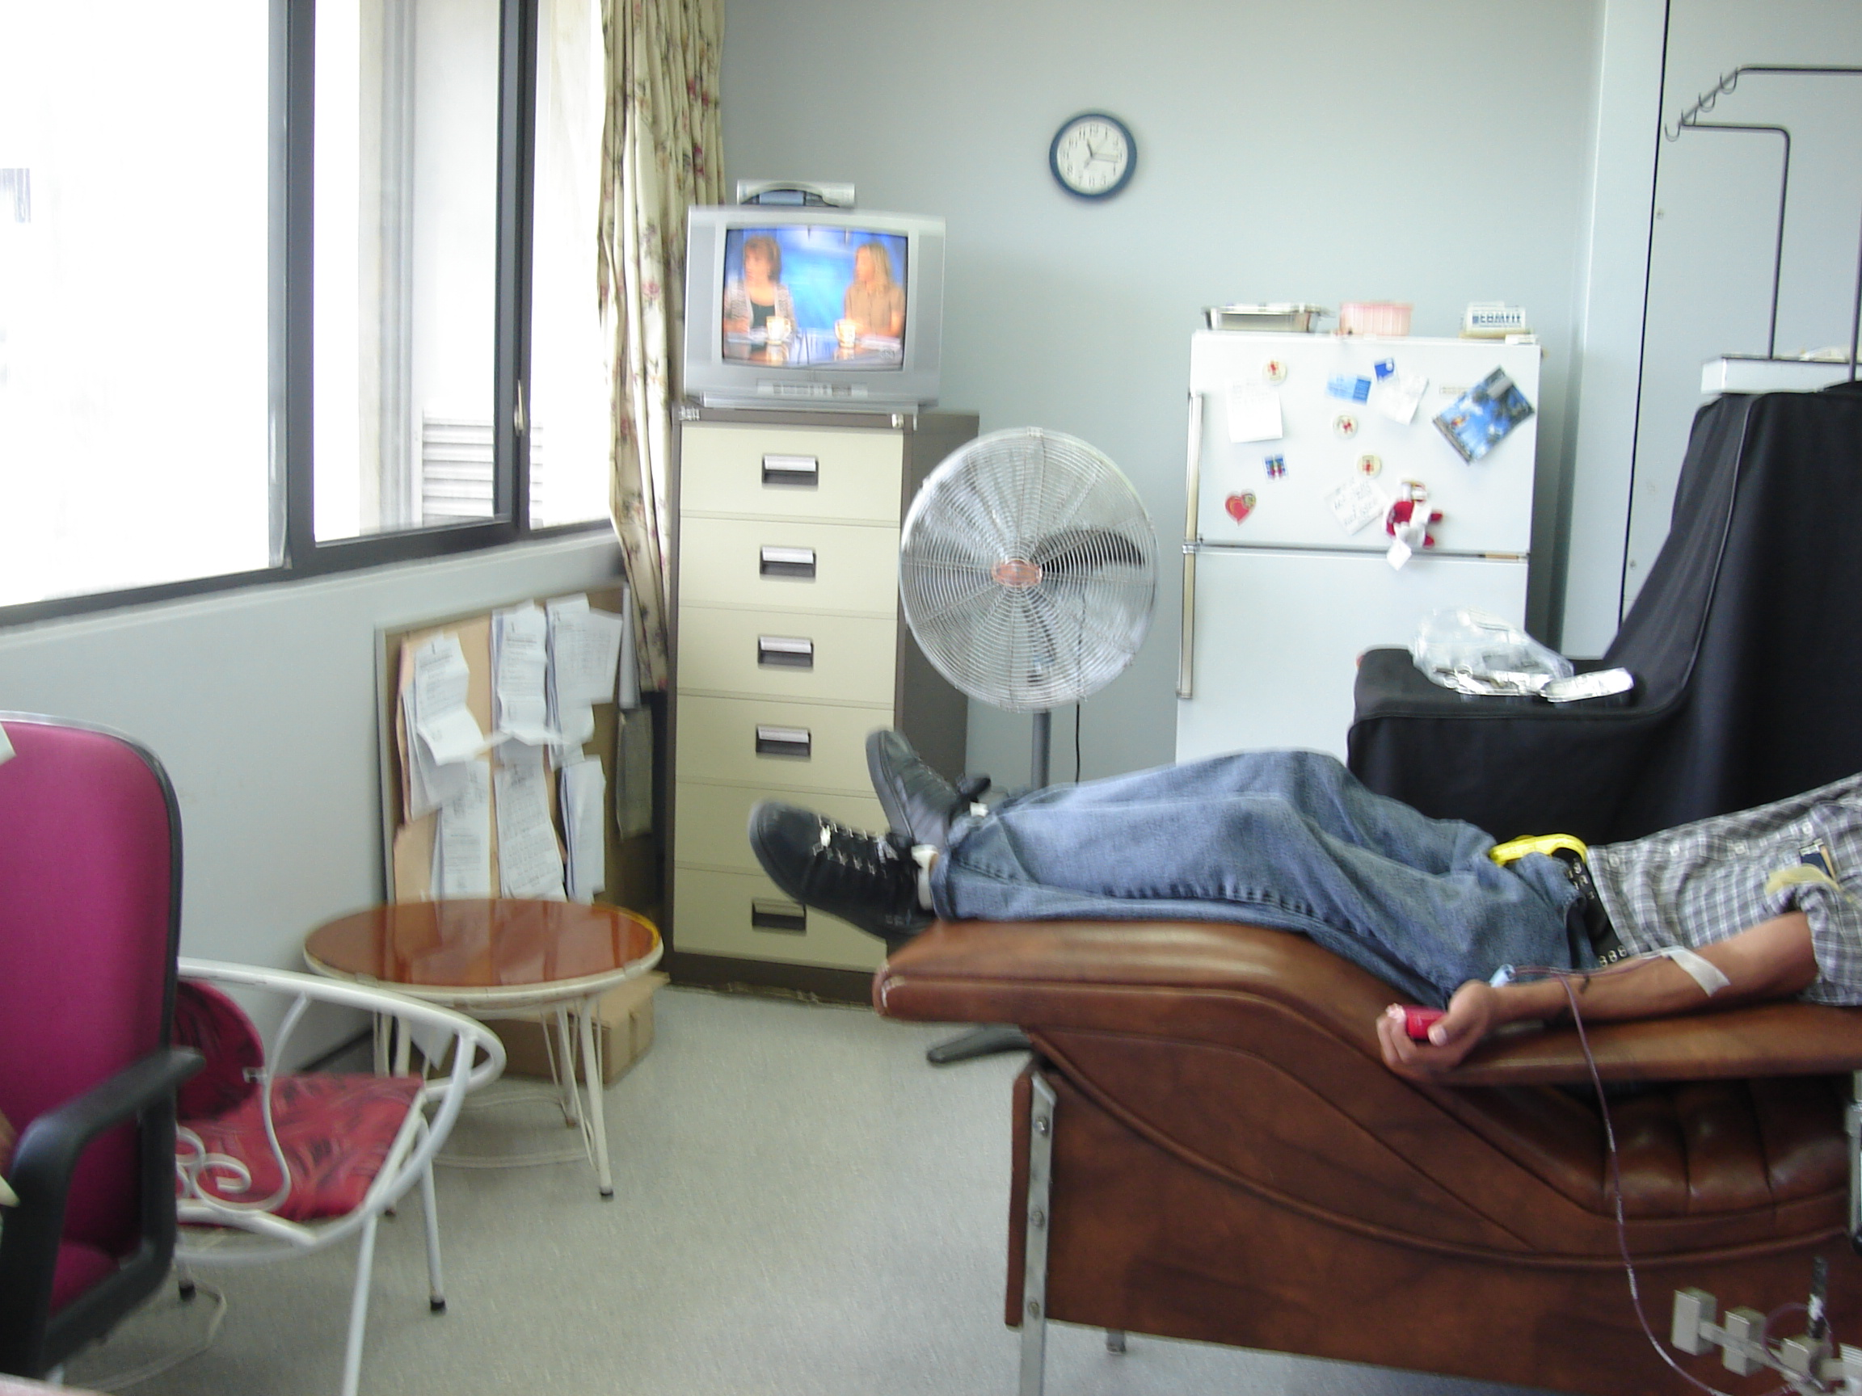
Blood Donation

Slide 23
Infectious Disease Testing
HIV
Hepatitis B
Hepatitis C
HTLV-I and II
CMV
Malaria
Syphilis*

Slide 24
Whole Blood
It is now used rarely in current practice in the UK or U.S.A, although in many countries it accounts for most transfusions.
Almost all whole blood donations are processed to separate red cells, platelets and plasma.

Slide 25
Whole Blood
Currently whole blood should only be considered in the following scenario:
  An adult has bled acutely and massively
  The adult has already received 5 to 7 units of RBC plus crystalloids

Slide 26
Packed red cells
150-200 mls. of red cells with plasma removed
Haemoglobin 20g/ 100 ml, PCV 55-75
Expected rise in Hb with 1 unit of red cells is approximately 1g/dL

Slide 27
Indications for Packed Cells
Massive blood loss
Anaemia of chronic disease
Haemoglobinopathies
Perioperative period to maintain Hb> 7g/dL
No need for transfusion with Hb >10

Slide 28
Platelets
150-400 x10⁹ /L
Platelet units can be either
    Single donor units
    Apheresis units
1 single donor unit contains 55 x10⁹
1 apheresis unit contains 240x10⁹

Slide 29
Platelets
Stored at room temperature
Constantly agitated
Only last for 5 days
1 dose of platelets should raise patient’s counts by 30 x10⁹ after 1 hour
Infused in 15 mins

Slide 30
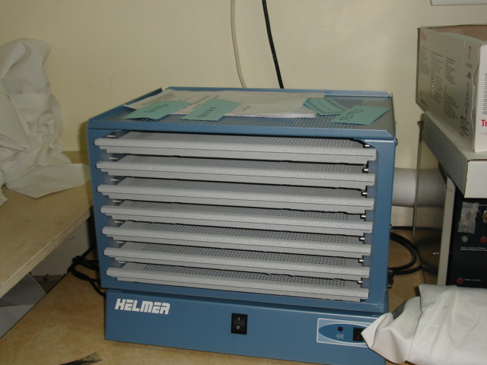

Slide 31
Indications for platelet transfusion
BLEEDING due to thrombocytopaenia
Due to platelet dysfunction
Prevention of spontaneous bleeding with counts < 20

Slide 32
Recommended counts to avoid bleeding
Platelet count /ul | Clinical Condition
> 100 000 | Major abdominal, chest or neurosurgery
> 50 000 | Trauma, major surgery
> 30 000 | Minor surgical procedures
> 20 000 | Prevention/treatment of bleeding in pts with sepsis, leukemia, malignancy
> 10 000 | Uncomplicated malignancy, leukemia
> 5 000 | ITP patients at low risk

Slide 33
FFP
Fresh Frozen Plasma
Plasma collected from single donor units or by apheresis
Frozen within 8 hours of collection
-18º to -30º C
Can last for a year

Slide 34
FFP
1 unit is 250 ml
Contains all plasma proteins
Indications:
  Correction of bleeding due to excess warfarin, Vitamin K deficiency, liver disease
  DIC, dilutional coagulopathy
  Inherited factor XI deficiency
  TTP
Notes:
Controlled temperature water bath
ABO compatibility

Slide 35
FFP
Dose: 15 mls/kg about 3-5 units
FFP and INR <2
Give at 1ml/kg per hour in likely fluid overload patients
Given within 24 hours of thawing
Requesting FFP

Slide 36
Frozen Plasma
Plasma frozen within 24 hours of collection
Maintains level of plasma proteins except factor VIII
Same indications as FFP

Slide 37
Cryoprecipitate
FFP thawed at 4ºC and centrifuged
Cryoprecipitate is the by-product
Contains Fibrinogen, Factor VIII, Factor XIII, von Willebrand’s Factor

Slide 38
Cryoprecipitate
No longer indicated for Hemophilia*
Source of Fibrinogen in acquired coagulopathies as in DIC; platelet dysfunction in uremia
Indicated for bleeding in vWD, Factor XIII deficiency

Slide 39
Cryoprecipitate
Infused as quickly as possible
Give within 6 hours of thawing
10-15 mls; usually 10 units pooled
10 bags contain approx. 2gm of fibrinogen and should raise fibrinogen level to 70mg/dL

Slide 40

Almost there!!!!!!!

Slide 41
Appropriateness of transfusion
May be life-saving
May have acute or delayed complications
Puts patient at risk unnecessarily
‘ The transfusion of safe blood products to treat any condition leading to significant morbidity or mortality, that cannot be managed by any other means’.

Slide 42
Inappropriateness of transfusion
Giving blood products for conditions that can otherwise be treated e.g. anaemia
Using blood products when other fluids work just as well
Blood is often unnecessarily given to raise a patient’s haemoglobin level before surgery or to allow earlier discharge from hospital. These are rarely valid reasons for transfusion.

Slide 43
Inappropriateness of Transfusion
Patients’ transfusion requirements can often be minimized by good anaesthetic and surgical management.
Blood not needed exposes patient unnecessarily
Blood is an expensive, scarce resource. Unnecessary transfusions may cause a shortage of blood products for patients in real need.

Slide 44


Slide 45
Problems faced by QEH
Too few donors
Lack of equipment
Insufficient products
Insufficient reagent
Infectious disease testing

Slide 46
Recommendations
Increase public awareness about need for blood and hence the number of voluntary donors
Continue to encourage relatives to donate for patients*
Increase the number of mobile clinics
Extend the opening hours for blood collecting
Notes:
Value of mobile clinics, were supposed to have 4 this year only 2 happened.
Problems with preparation of rooms, informing personnel at locations by the facilitators

Slide 47
Recommendations
Management of stocks of blood and blood products
Maintenance and replacement of equipment
On-going training of Haematology Lab Staff
Better management of reagents for- infectious disease testing, antigens etc.
Improved record keeping
Move to electronic record keeping
Notes:
Addition of new antigens in chronically transfused patients.

Slide 48
Recommendations
View to reduce the need for allogeneic transfusions
Autologous transfusions
Blood saving devices in OR
Acute normovolemic haemodilution
Oxygen carrying compounds

Slide 49
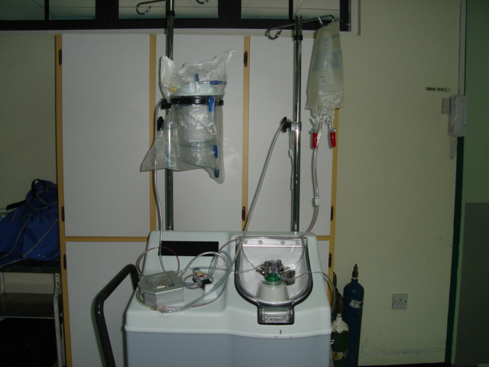

Slide 50
Conclusion
‘Primum-non-nocere’
Weigh risks and benefits
Haemoglobin level is not the sole indicator for transfusion
Use of appropriate products for the various conditions
Personal ethics

Slide 51
Credits
Blood bank staff
Blood collecting staff
Dr. T. Laurent
Prof. P. Prussia
Ms. Kay Bryan

Slide 52
Bibliography
Uptodate.com
British Transfusion guidelines 2007
Clinical use of blood, WHO
MJA: Tuckfield et al.,Reduction of inappropriate use of blood products by prospective monitoring of blood forms
Transfusion practice: Palo et al., Population based audit of fresh frozen plasma transfusion practices
Vox Sanguinis: Titlestead et al., Monitoring transfusion practices at two university hospitals
Transfusion: Schramm et al., Influencing blood usage in Germany
Transfusion: Healy et al., Effect of Fresh Frozen Plasma on Prothrombin Time in patients with mild coagulation abnormalities
Transfusion: Sullivan et al., Blood collection and transfusion in the USA in 2001
Transfusion: Triulzi, The art of plasma transfusion therapy

Slide 53


