Slide 1
DATABASE FUNDAMENTALS
By: Sadaquat Ali Ruk

Slide 2
INTRODUCTION
Good Decisions require Good Information derived from the raw facts.
Data is managed more accurately when stored in a database.
Databases are incredibly prevalent -- they underlie technology used by most people every day if not every hour.

Slide 3
Why Databases?
Databases solves many of the problems occurring in data management & daily life.
Used in almost all modern settings involving data management.
Business
Research
Management
Redundancy can be reduced
Inconsistency can be avoided
The data can be shared

Slide 4
Data vs. Information
Data is raw, unorganized facts that need to be processed. Data can be something simple and seemingly random and useless until it is organized.
When data is processed, organized, structured or presented in a given context so as to make it useful, it is called information.
Each student's test score is one piece of data.
The average score of a class or of the entire school is information that can be derived from the given data.

Slide 5
CAN ANY ONE
GUESS
WHAT KNOWLEDGE IS????

Slide 6
Database Management Systems
A database management system (DBMS), or simply a database system (DBS), consists of
A set of application programs used to access, update and manage that data (which form the data management system (MS)).
The goal of a DBMS is to provide an environment that is both convenient and efficient to use in
Retrieving information from the database.
Storing information into the database.

Slide 7
Types of Database Management Systems.
Relational DataBase Management Systems(RDBMS):
It is a software system, which can be used to represents data in the form of tables. RDBMS will use SQL2 as a Queries language.
Object Oriented DataBase Management Systems(OODBMS):
It is a software system, which can be used to represent the data in the form of objects. This DBMS will use OQL as a Query language.
Object Relational DataBase Management Systems(ORDBMS):
It is a DBMS which will represents some part of the data in the form of tables and some other part of the data in the form of objects. This management system will use SQL3 as a Query Language, it is a combination of SQL2 and OQL.

Slide 8
Database Instances and Schemas
Similar to types and variables in programming languages
Schema- the logical structure of the database
Example: The database consists of information about a set of customers and accounts and the relationship between them)
Instance
The actual content of the database at a particular point in time

Slide 9
CAN YOU GUESS WHAT IS NORMALIZATION OF THE DATABASE ??

Slide 10
Database normalization is the process of removing redundant data from your tables in to improve storage efficiency, data integrity, and scalability.
In the relational model, methods exist for quantifying how efficient a database is. These classifications are called normal forms (or NF), and there are algorithms for converting a given database between them.
Normalization generally involves splitting existing tables into multiple ones, which must be re-joined or linked each time a query is issued.

Slide 11
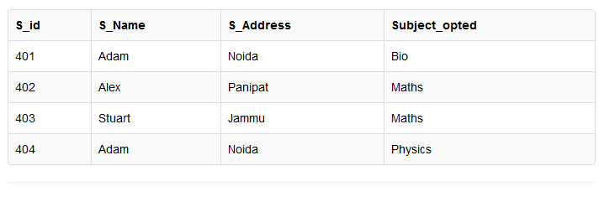
Problems With Normalization
Can you guess what is the problem here?

Slide 12
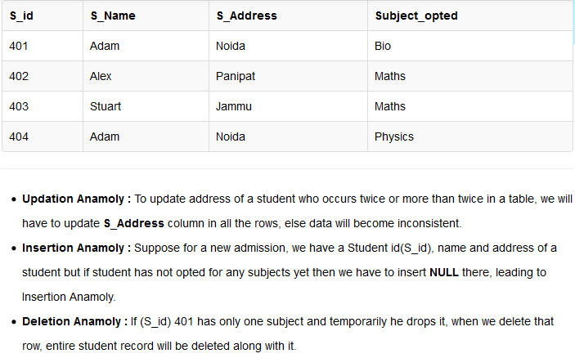

Slide 13
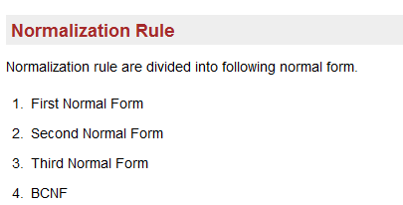
NORMALIZATION

Slide 14
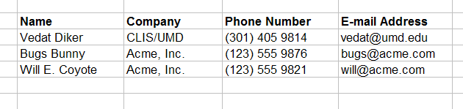
Field (Column)
Customers
a field

Slide 15
Record (Row)
Customers
a record

Slide 16
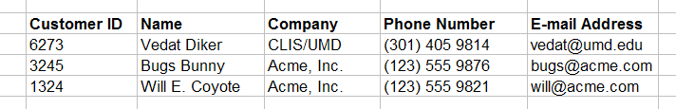
Primary Key
Customers
primary key field
Primary key.
A primary key is a one or more fields that uniquely identifies a row in a table.
The primary key cannot be null (blank).

Slide 17
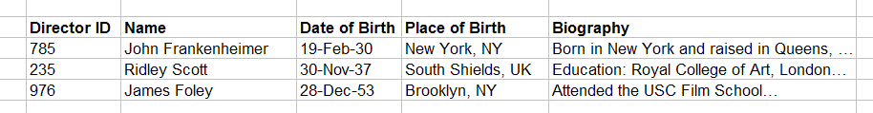
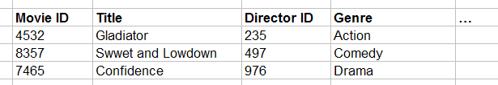
Foreign Key
primary key field
parent table
Directors
relationship
child table
Movies
foreign key field
A foreign key is a column (or columns) that references a column (most often the primary key) of another table. .

Slide 18
KEYS
_{Composite} _{Key:}
In the context of relational databases, is a combination of two or more columns in a table that can be used to uniquely identify each row in the table
_{Candidate Key}
A Candidate Key can be any column or a combination of columns that can qualify as unique key in database.

Slide 19
Relationship Types
One-to-one
Occur when each entry in the first table has one, and only one, counterpart in the second table.
President
Country

Slide 20
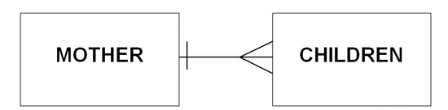
One To Many
Are the most common type of database relationship.
They occur when each record in the first table corresponds to one or more records in the second table but each record in the second table corresponds to only one record in the first table

Slide 21

Many To Many
Occur when each record in the first table corresponds to one or more records in the second table and each record in the second table corresponds to one or more records in the first table.

Slide 22
Self-Referencing Relationships: A Special Case
Self-referencing relationships are a special case of a normal table relationship.
The only difference is that in this case, there is only one table involved and it is on both sides of the relationship.
One common example is an Employees table that contains information about the supervisor of each employee. Each supervisor is also an employee and has his or her own supervisor.
In this case, there is a one-to-many self-referencing relationship, as each employee has one supervisor but each supervisor may have more than one employee.

Slide 23
WHAT IS SQL
?????

Slide 24
MY SQL
MySQL is the most popular Open Source Relational SQL database management system.
MySQL is one of the best RDBMS being used for developing web-based software applications.
MySQL represents an excellent introduction to modern database technology, as well as being a reliable mainstream database resource for high-volume applications.
MySQL is released under an open-source license. So you have nothing to pay to use it.
MySQL works on many operating systems and with many languages including PHP, PERL, C, C++, JAVA, etc.
MySQL is customizable. The open-source GPL license allows programmers to modify the MySQL software to fit their own specific environments.

Slide 25
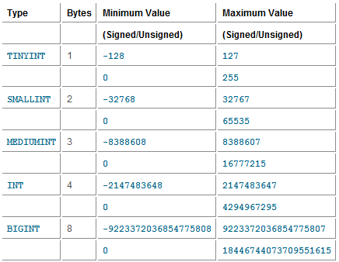
Data Types Used In MYSQL
Numeric Data Types:

Slide 26
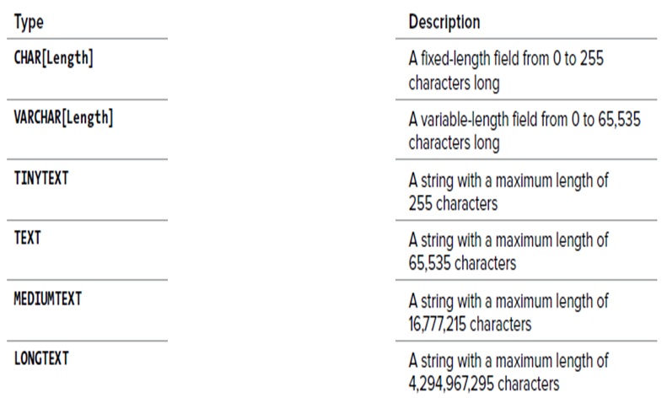
String Data Types
Do you know about BLOB DATA TYPE????

Slide 27
Data Definition Language (DDL)
(DDL) statements are used to define the database structure or schema.
Data Manipulation Language (DML)
(DML) statements are used for managing data within schema objects.

Slide 28
DDL(Data Defination Language) Create, Drop, Alter, Truncate, Rename, Update
USE DB_Name;
CREATE TABLE table1(id INT, NAME CHAR(10));
RENAME TABLE table1 to employee;
Truncate employees;
DESC employees;
CREATE TABLE table2(id INT UNSIGNED PRIMARY KEY AUTO_INCREMENT , NAME CHAR(10) NOT NULL);
ALTER TABLE table2 RENAME TO abc;
ALTER TABLE table2 ADD std_id INT , ADD std_name CHAR(10);
ALTER TABLE table5 DROP std_id ;
ALTER TABLE table5 MODIFY std_name INT;
DROP TABLE table2;
DROP TABLE IF EXISTS table2;

Slide 29
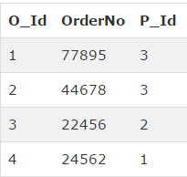
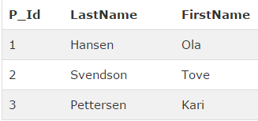
TASK
Create a table Persons(P_Id,FNAME,LNAME)
Create table Orders(O_Id,OrderNo,P_Id)

Slide 30
SOLUTION
CREATE TABLE Persons ( P_Id int NOT NULL, LastName varchar(255) NOT NULL, FirstName varchar(255), PRIMARY KEY (P_Id) )
CREATE TABLE Orders ( O_Id int NOT NULL, OrderNo int NOT NULL, P_Id int, PRIMARY KEY (O_Id), FOREIGN KEY (P_Id) REFERENCES Persons(P_Id) )

Slide 31
SQL AND & OR Operators
The AND & OR operators are used to filter records based on more than one condition.
SELECT * FROM EMPLOYE WHERE EmpName=‘ABC' AND City=‘XYZ';
SELECT * FROM EMPLOYE WHERE EmpName=‘ABC' OR City=‘XYZ';

Slide 32
SQL ORDER BY
The ORDER BY keyword is used to sort the result-set.
The ORDER BY keyword is used to sort the result-set by one or more columns.
The ORDER BY keyword sorts the records in ascending order by default. To sort the records in a descending order, you can use the DESC keyword.
SELECT column_name, column_name FROM table_name ORDER BY column_name ASC|DESC;

Slide 33
SQL LIKE Operator
The LIKE operator is used in a WHERE clause to search for a specified pattern in a column.
SELECT column_name(s) FROM table_name WHERE column_name LIKE pattern;
SELECT column_name(s) FROM table_name WHERE column_name NOT LIKE pattern;

Slide 34
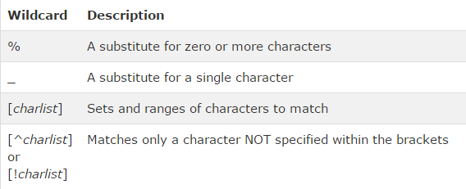
WILD CARDS
SELECT ALL THE EMPLOYEES THAT HAVE EMPNAME STARTING WITH A,B or C.
SELECT ALL THE EMPLOYEES THAT HAVE EMPNAME starting with "L",
followed by any character, followed by "n",
followed by any character, followed by anything.
SELECT ALL THE EMPLOYEES THAT HAVE EMPNAME STARTING WITH Small a only

Slide 35
SQL BETWEEN
The BETWEEN operator selects values within a range. The values can be numbers, text, or dates.
SELECT column_name(s) FROM table_name WHERE column_name BETWEEN value1 AND value2;

Slide 36
DML(Insert, Update, Delete)
Add new row use the insert statement
Change / Edit the row which is already save use the update statement
Remove the row use the delete statement

Slide 37
Insert
INSERT INTO TABLE_NAME (COLUMN_NAME) VALUES(COLUMN_VALUE);
INSERT INTO TABLE_NAME(COLUMN_NAME1, COLUMN_NAME2) VALUES(VALUE1, VALUE);

Slide 38
Update
UPDATE table_name
SET column_name = column_vlaue;
OR you write condition
UPDATE table_name
SET column_name = column_vlaue
WHERE column_name = column_vlaue;

Slide 39
Delete
DELETE FROM TABLE_NAME
OR you write condition
DELETE FROM TABLE_NAME WHERE COLUMN_NAME = COLUMN_VALUE;

Slide 40
MySQL Joins Overview
MySQL Join is used to join the records from two table using join clause.
The Join Clause return you the set of records from both table on the basis of common column.
The Join return you only match able records from both table on the basis of where clause .

Slide 41
MySQL Join Types
MySQL Inner Join
MySQL Equi Join
MySQL Natural Join
MySQL Cross Join
MySQL Outer Join
Left Outer Join
Right Outer Join
Self Join

Slide 42


